Slide 1

Should T-Mobile Invest In Home-based Internet Service?
Presented By:
  Ankita Chouhan
  Ravi Patel
Instructor: Eleni Rokou
BQOM 2521 Decision Making in Complex Environment

Slide 2
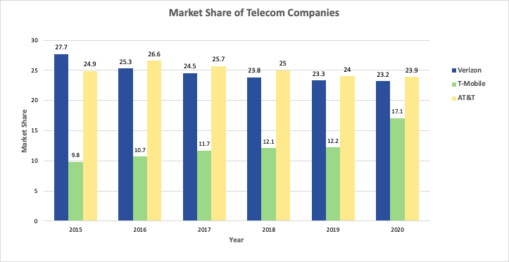
MARKET SHARE
Source: https://www.ibisworld.com/industry-statistics/market-size/internet-service-providers-united-states/

Slide 3

Technological Innovation
Competitive Advantage
Customer Satisfaction
Growth
STRATEGIC CRITERIA
Brand Recognition

Slide 4
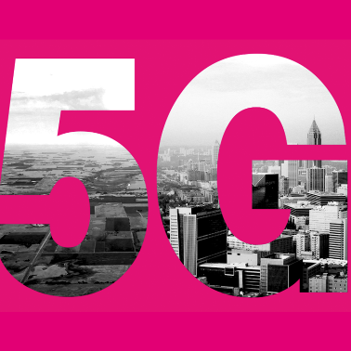
GOAL
By Mike Sievert, T-Mobile CEO:
“Our new goal is to build the world’s best 5G network, delivering innovation, speed, and value. With the New T-Mobile, you will never be forced to choose between low prices or a great network again, because with the new T-Mobile network, we’ll give you BOTH”

Slide 5
ALTERNATIVES
A1: Do not enter in a new market
A2: Enter a new market with existing technology
A3: Partnership with existing company
A4: Enter a new market with 5G-based technology

Slide 6
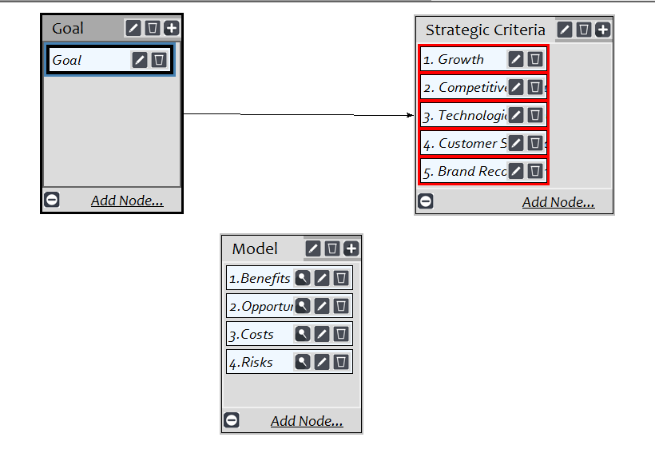
BOCR Model

Slide 7
Strategic Criteria: Priorities
Strategic Criteria | Weight | Rank
Growth | 0.174 | 3
Competitive Advantage | 0.306 | 1
Technological Innovation | 0.140 | 4
Customer Satisfaction | 0.273 | 2
Brand Recognition | 0.106 | 5

Slide 8
BENEFITS
Economical
Organizational
Operational
Impact on Market Share
Impact on Existing Market
Impact on Revenue
Impact on Investment
Number of Customers
Customers Reaction
Pricing
Technology Requirements
Coverage

Slide 9
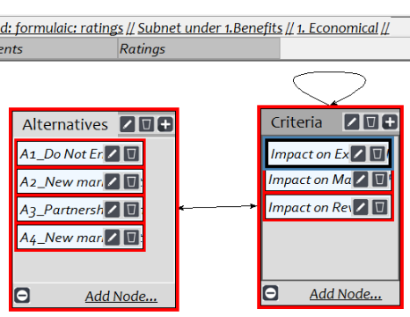
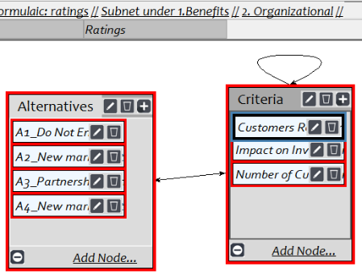
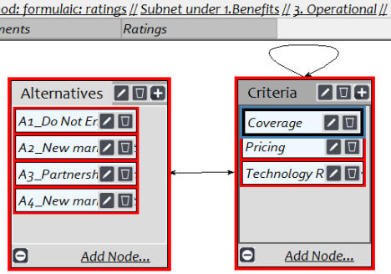
Subnet Under Benefits

Slide 10
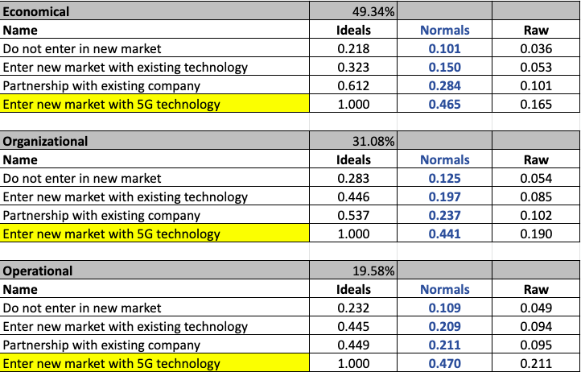
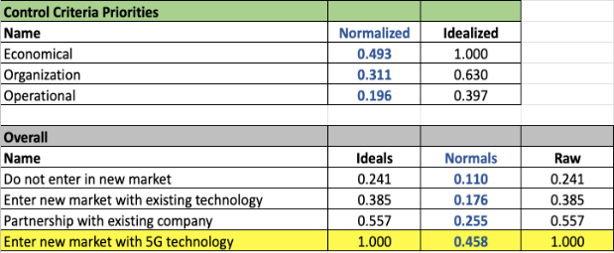
Results of Priority Benefits

Slide 11
OPPORTUNITIES
Economical
Organizational
Impact on Existing Market
Impact on Market Share
Impact on Revenue
Brand Recognition
Number of Customers
Number of Investors

Slide 12
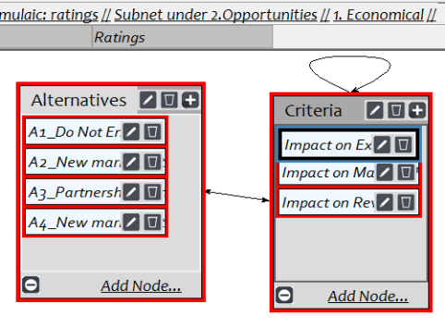
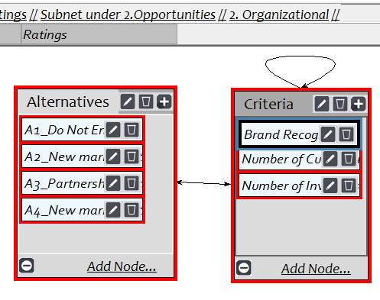
Subnet Under Opportunities

Slide 13
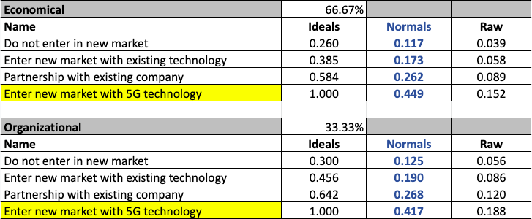
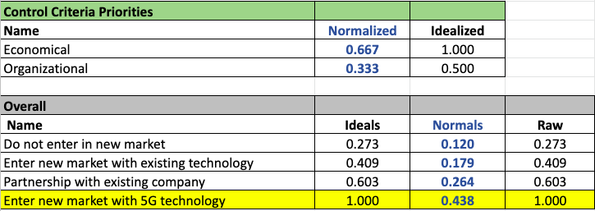
Results of Priority Opportunities

Slide 14
COSTS
Financial
Organizational
Partnership Cost
Marketing Cost
Opportunity Cost
Employees Requirement
Technological Investment
Infrastructure Requirement

Slide 15
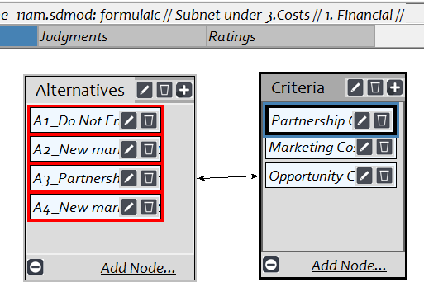
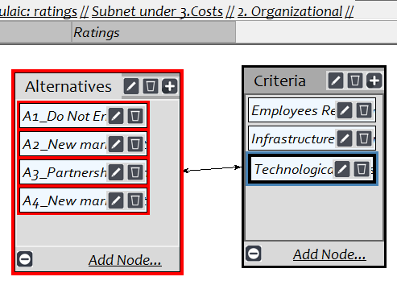
Subnet Under Costs

Slide 16
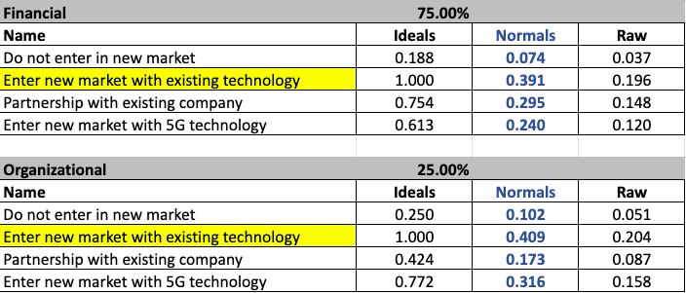
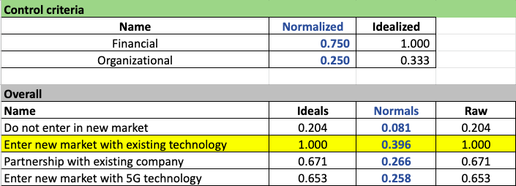
Results of Priority Costs

Slide 17
RISKS
Economical
Organizational
Market Competition
Customers Reaction
Marketing Requirement
Impact of Network Traffic
Infrastructure Requirements
Focus
Business Relationship
Internal-Org
Customers Perception
General Public Perception
Sustainability
External-Org

Slide 18
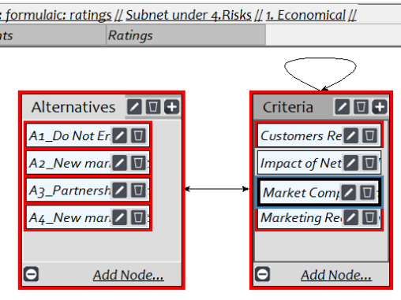
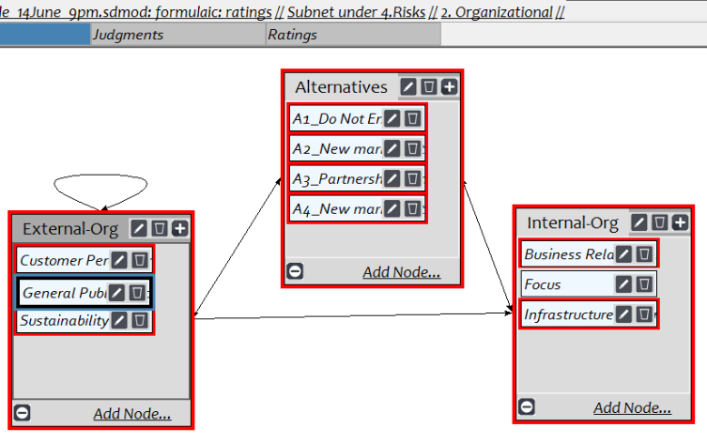
Subnet Under Risks

Slide 19
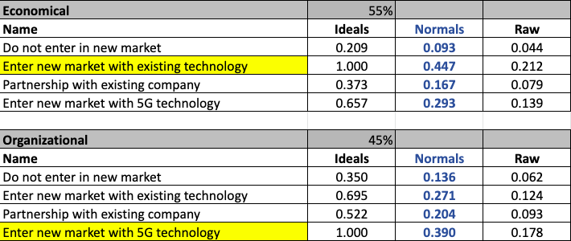
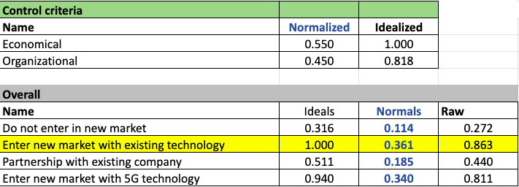
Results of Priority Risks

Slide 20
Scales For Ratings Model
Growth | Competitive Advantage | Technological Innovation | Customer Satisfaction | Brand Recognition
Excellent | Maximum | Not Required | Less than 3 | Very High Impact
Very Good | More than Average | Little Requirement | Between 3 to 5 | High Impact
Good | Average | More than Little | Between 5 to 7 | Medium Impact
Fair | Less than Average | Significant | Greater than 7 | Low Impact
Poor | Minimum |  |  | Very Low Impact
Very Poor |  |  |  | Neutral

Slide 21
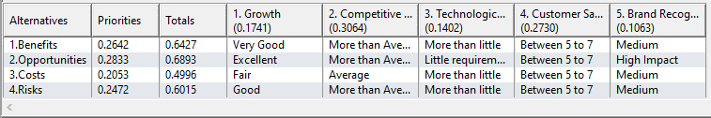
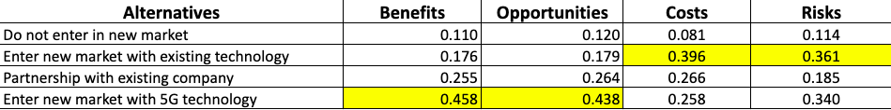
Ratings of Strategic Criteria
Overall Result Under Every Perspective

Slide 22
Multiplicative: Short Term Solution
Multiplicative - Short Term
Name | Ideals | Normals | Raw
Do not enter in new market | 0.627 | 27% | 1.185
Enter new market with existing technology | 0.097 | 4% | 0.182
Partnership with existing company | 0.602 | 26% | 1.137
Enter new market with 5G technology | 1.000 | 43% | 1.889

Slide 23
Additive: Long Term Solution
Additive - Long Term
Name | Ideals | Normals | Raw
Do not enter in new market | 0.161 | 7% | 0.036
Enter new market with existing technology | -0.942 | -39% | -0.210
Partnership with existing company | 0.340 | 14% | 0.076
Enter new market with 5G technology | 1.000 | 41% | 0.223

Slide 24
RESULTS
OF
AHP SENSITIVITY ANALYSIS

Slide 25
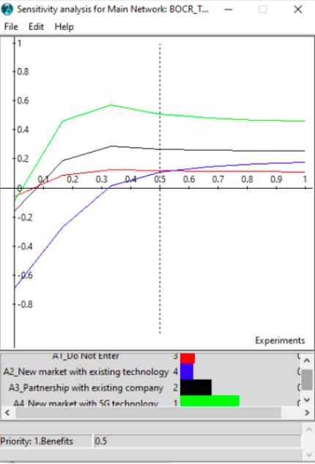
Priority: Benefits
Interpretation:
In the screenshot, we can see the result is very stable. For the short-term benefits, Alternative-4 remains the top preference even after changing the priority. However, there are two cross-over points, that change the priority of the bottom two alternatives. If priority becomes more than 55%, the third-best option changes from A2 to A1 and, if the priority of Benefits becomes less than7%, the second-best option changes from A1 to A3.

Slide 26
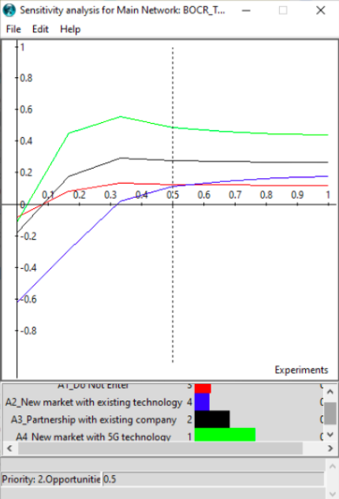
Priority: Opportunities
Interpretation:
The result of the Opportunity is very similar to the Benefit perspective. As we can see, we have a very stable result with just two cross-over points. If the priority of Opportunities becomes more than 57%, then the third-best option will change from A1 to A2 and, if priority becomes lower than 8%, the second-best option changes from A1 to A3. However, in the long-term, Alternative-4, i.e., Entering a new market with 5G technology is always beneficial even if the priority changes.

Slide 27
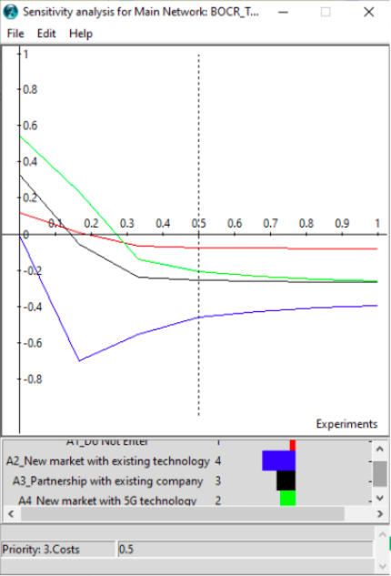
Priority: Costs
Interpretation:
Sensitivity Analysis shows that our most costly option is A2 - Entering a new market with existing technology (even after changing the priority). Now, if the priority of Cost goes down, the option to enter a new market with 5G technology (Alternative 4) becomes the best option at a point of less than 30 over the best-presented option to Not Enter the Market (Alternative-1). The option to Partner with an existing company (Alternative-3) becomes the second-best option at less than 12%. The cost in the long-term could potentially benefit most by the option of investment in the new technology.

Slide 28
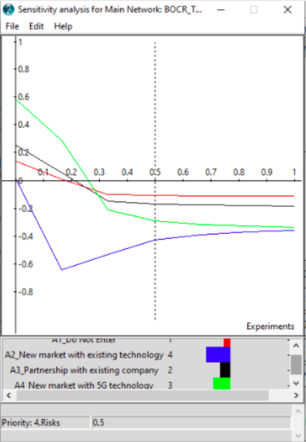
Priority: Risks
Interpretation:
As we can see in the screenshot, Alternative 2 remains the riskiest option. Alternatives 2 and 4 are very close in terms of risks at around 98% (however, there is no crossover point). Also, if the priority of the Risks goes down, the option to enter the new market with 5G technology (Alternative 4) becomes the second-best option at 29% then the best option at 27%. The option to Partner with an existing company becomes the second-best option at a point less than 23%. In the long term, the risks of partnerships may be most significant given the number of variables that could be introduced or controlled by the company.

Slide 29
SUMMARY
The decision to enter a new market with various technology is complex for a large company. The mission of T-Mobile helps identify the key factors related to the decision.
Competitive Advantage was the highest weight of the strategic criteria
Priority of Benefits and Opportunities – Enter New Market with 5G
Priority of Risks and Costs – Mix
  Enter New Market with Existing Technology
  Enter New Market with 5G
Short-Term and Long-Term – Enter New Market with 5G

Slide 30

Thank You!
Questions?

