Slide 1


Post-Pandemic Work Scheduling
In a Pittsburgh-Based Engineering Office
University of Pittsburgh Decision Making – Final Project Author - Alexa Bohn

Slide 2

Remote Work in the U.S.
10-25%
3X
50-70%
as many Americans working remotely post-COVID
[1] Change in Remote Work Trends after COVID in USA. Statista, Apr. 2020, www-statista-com.pitt.idm.oclc.org/statistics/1122987/change-in-remote-work-trends-after-covid-in-usa/.
[2] Parker, Kim, et al. “How Coronavirus Has Changed the Way Americans Work.” Pew Research Center's Social & Demographic Trends Project, Pew Research Center, 25 May 2021, www.pewresearch.org/social-trends/2020/12/09/how-the-coronavirus-outbreak-has-and-hasnt-changed-the-way-americans-work/?=1.

Slide 3
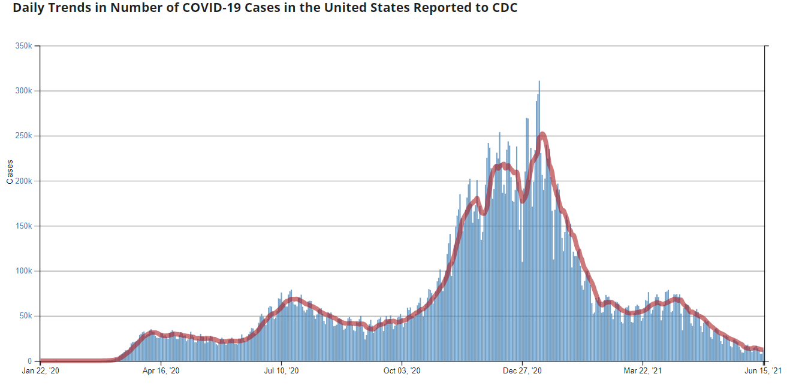


Defining the “new normal”
Requires confronting the divide between employers, employees
Employees: majority want to continue with flexible schedule and working-from-home post-pandemic
Employers: 70% planning a partial or full return-to-office by fall 2021
65%
of Americans have at least first vaccine dose
Many states removing mask mandates at 70% vaccinated adults
[3] “CDC COVID Data Tracker.” Centers for Disease Control and Prevention, Centers for Disease Control and Prevention, covid.cdc.gov/covid-data-tracker/#trends_dailytrendscases.
[4] Jdickler. “Tensions Rise as Return-to-Work Plans Gain Steam.” CNBC, CNBC, 27 Apr. 2021, www.cnbc.com/2021/04/27/tensions-rise-as-return-to-work-plans-gain-steam.html.

Slide 4

Decision:
What work schedule should be implemented post-pandemic in R&D engineering at MSA?
Decision: What work schedule should be implemented post-pandemic in R&D engineering at MSA?
Full return
50/50 hybrid - scheduled
Strategic Criteria
Productivity & Efficiency
BOCR Subnets
Benefits
Opportunities
50/50 hybrid - selected
Fully flexible
Talent Management (Attraction, Retention)
Cost
Risk
Collaboration/ Innovation
Executive Director
Director
Managers
R&D engineers

Slide 5

Benefits Subnet

Slide 6
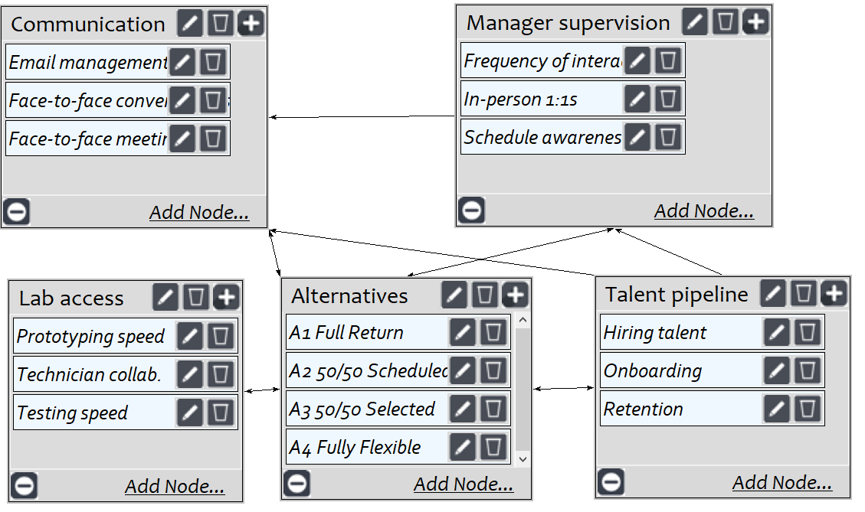
Benefits Subnet – R&D Business (P=0.55)
A1 Full Return (0.41): best bolsters face-to-face communication, increases manager supervision and effectiveness, most efficient laboratories

Slide 7
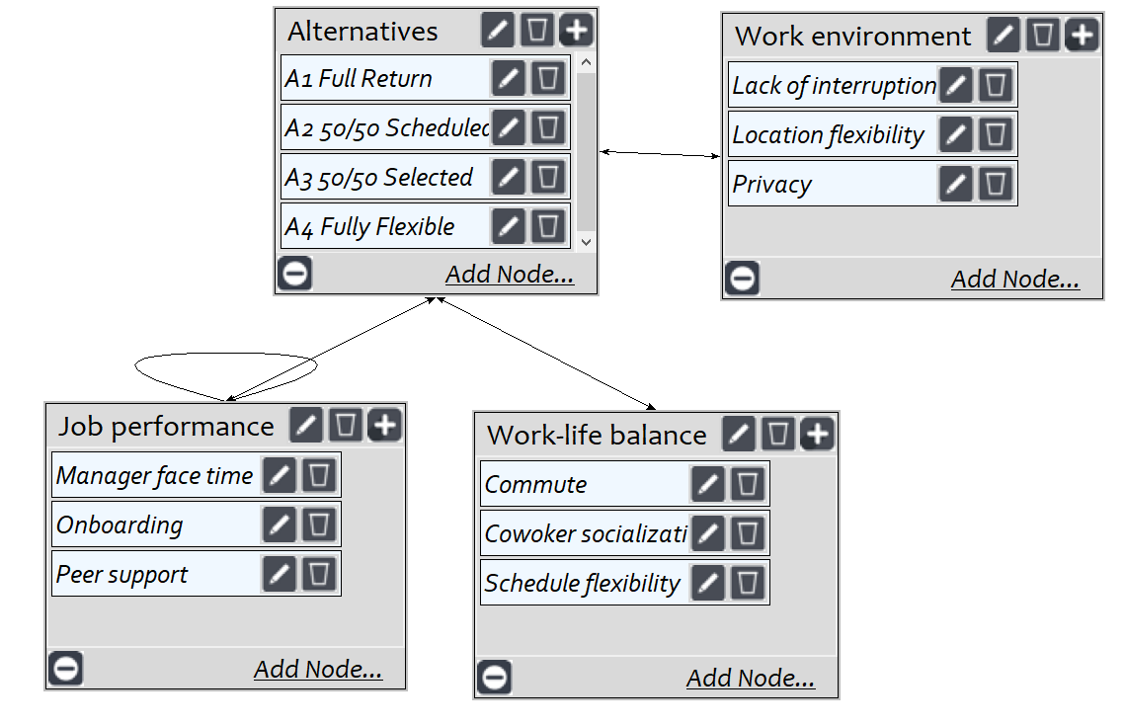
Benefits Subnet – Employees (P=0.45)
A4 Fully Flexible (0.33): aligns with research that employees highly value schedule flexibility, private work environments, and reduced commutes

Slide 8

Benefits Subnet – Overall Synthesis
Most Beneficial Alternative: A1 Full Return

Slide 9

Opportunities Subnet

Slide 10
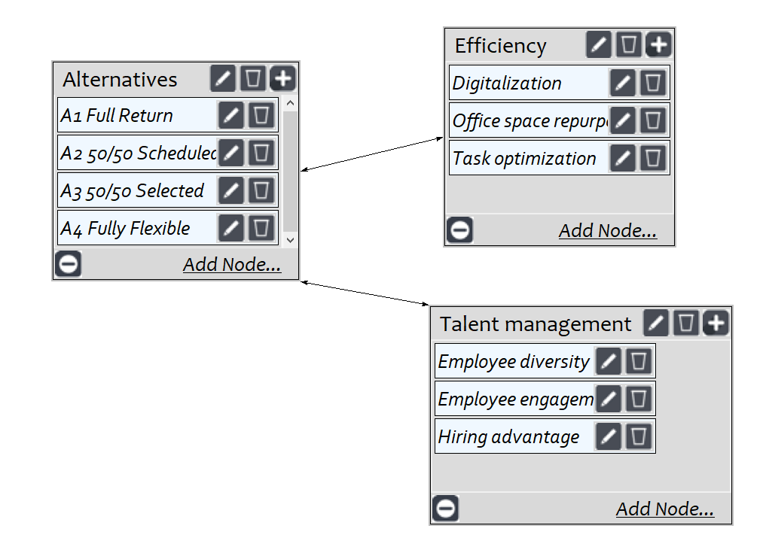
Opportunities Subnet – R&D Business (P=0.55)
A4 Fully Flexible: opportunities particularly in offering high-talent employees competitive job offers and efficiency gains through space & task optimization

Slide 11
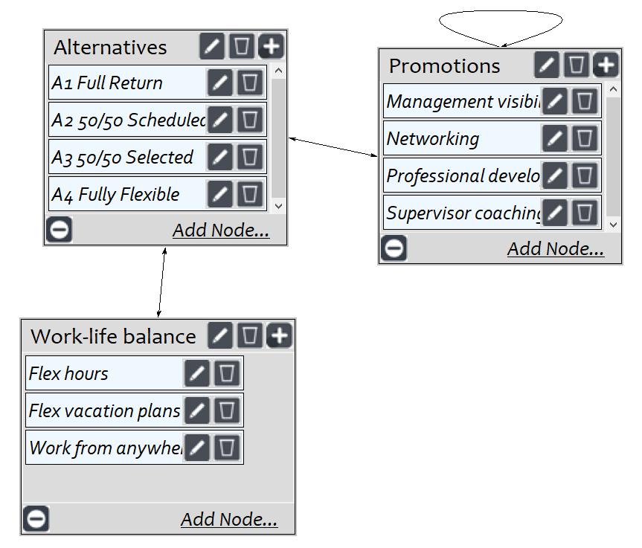
Opportunities Subnet – Employees (P=0.45)
A4 Fully Flexible: most opportunity regarding employee engagement & work-life balance

Slide 12
Opportunities Subnet – Overall Synthesis
Most Opportunity Alternative: A4 Fully Flexible

Slide 13

Cost Subnet

Slide 14
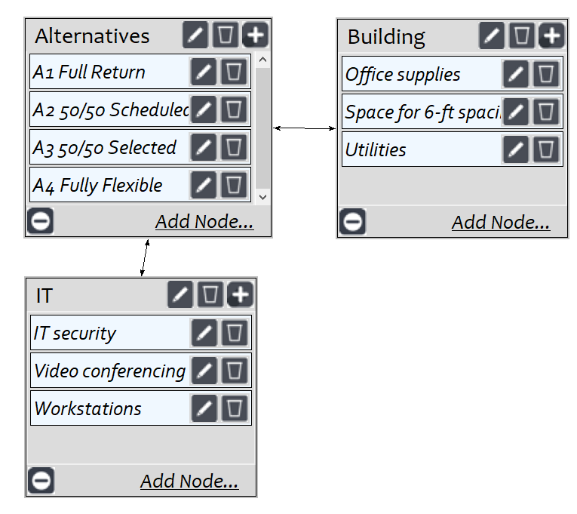
Cost Subnet – Infrastructure (P=0.33)
A1 Full Return: high utilities cost and office-supply consumption relative to other alternatives

Slide 15
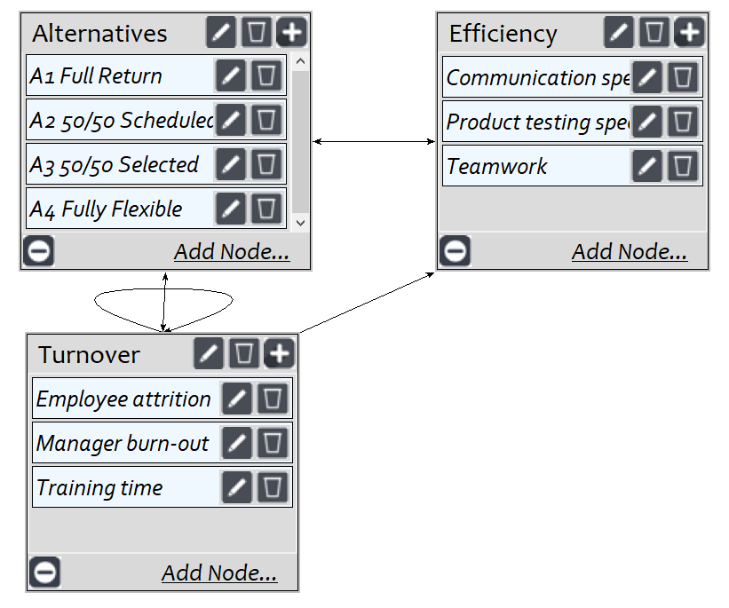
Cost Subnet – Productivity (P=0.66)
for Executive Director of R&D – much more important than infrastructure
A4 Fully Flexible: supported by manager community of practice discussions regarding R&D communication speed, product testing speed, employee onboarding and upskilling, manager burn-out

Slide 16
Cost Subnet – Overall Synthesis
Most Costly Alternative: A4 Fully Flexible

Slide 17

Risk Subnet

Slide 18
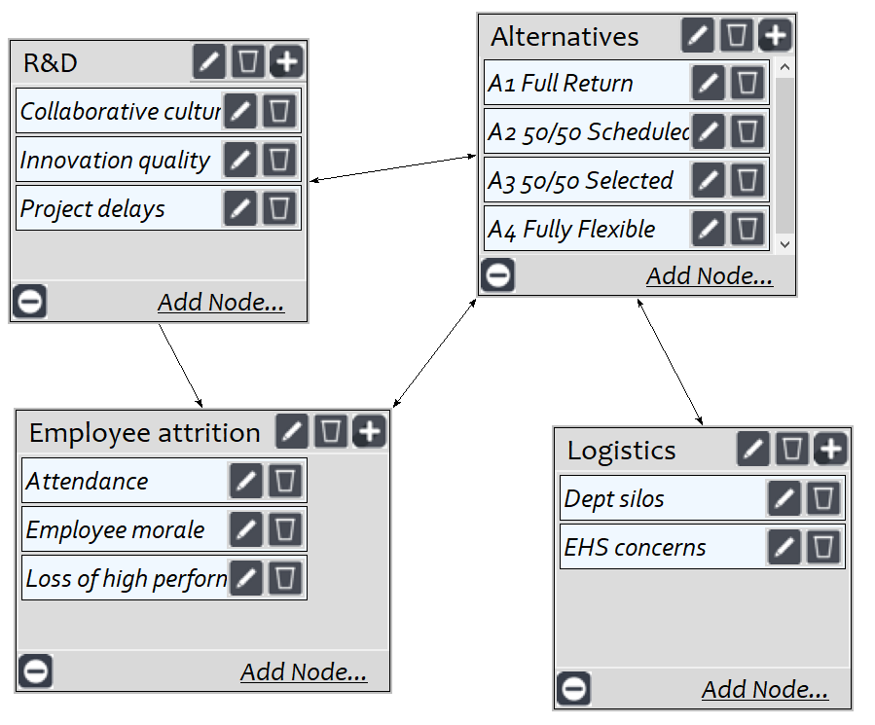
Risk Subnet – Business (P=0.50)
A1 Full Return: risk related to employee attrition and degradation of workforce that affects R&D culture and new product development results

Slide 19
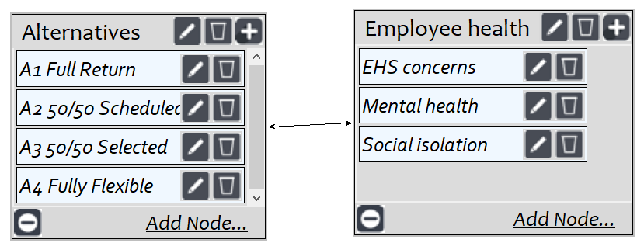
Risk Subnet – Employees (P=0.50)
Based on company culture – strives to do right by its people
A1 Full Return: risk related to lingering health/safety concerns and mental health from a severe shift in work-life balance

Slide 20
Risk Subnet – Overall Synthesis
Most Risky Alternative: A1 Full Return

Slide 21

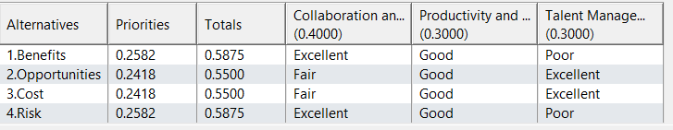
Overall Ratings Model
A1 Full Return
A4 Fully Flexible
A4 Fully Flexible
A1 Full Return
Multiplicative
Marginal/Short-term
Additive-negative
Sum/Long-term

Slide 22
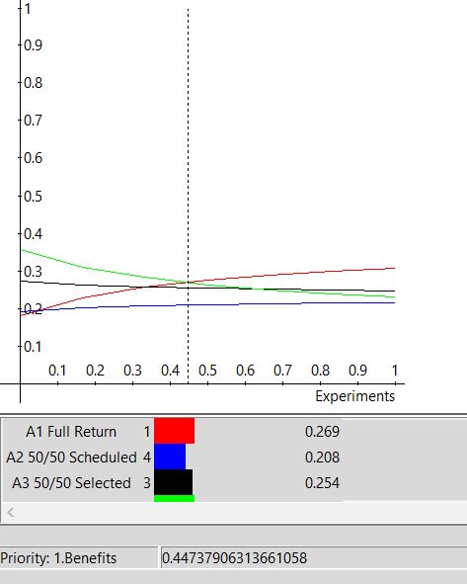
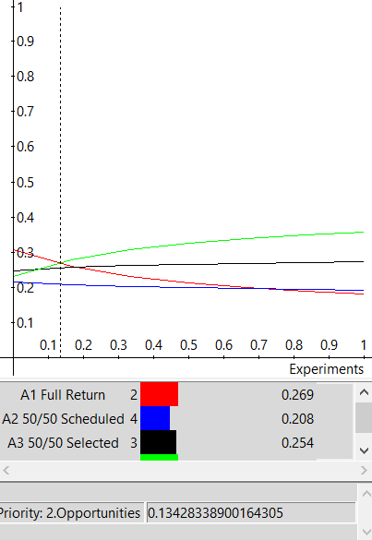
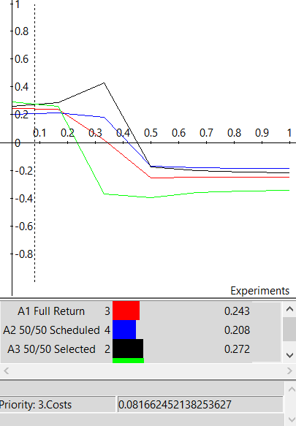
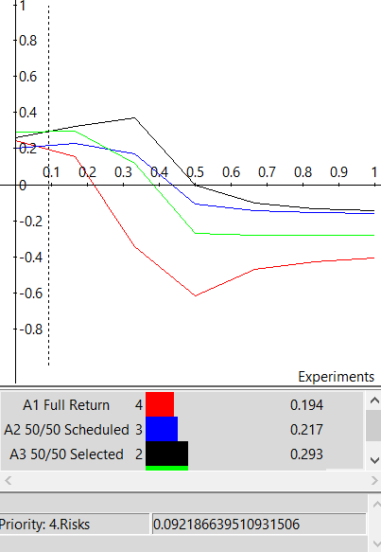
Sensitivity Analysis digging deeper into results
Benefits
Opportunities
Cost
Risk
Larger weighting (>45-50%): A1 Full Return more heavily favored. Getting results, but at a high cost and likely with degrading talent pool.
Fairly stable; only at very low weighting does option with most opportunity (A4) lose out to other alternatives
Instability suggesting inconsistency in subnet – 2 changes in first place ranking
50/50 selected days becomes preferred when risks weighted around 10% or higher

Slide 23
Discussion
Model predicts that a 50/50 hybrid schedule will be tempting for executives to put in place as COVID-related restrictions are lifted
However, in long-term, a fully flexible schedule will offer opportunities to become more efficient, attract higher talent employees, and potentially increase R&D performance
No matter the work schedule – will only succeed with
Strong organizational culture
Hiring self-motivated and passionate employees
Building manager & direct report trust
Setting clear performance expectations
High probability of retaining current employees
Regain collaborative face-to-face interactions
Mitigate risk of not meeting R&D output goals
Regain direct manager supervision

Slide 24
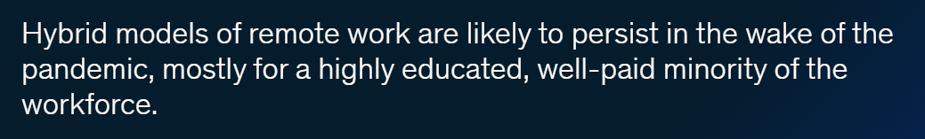


Discussion
Consistent with McKinsey report findings: The Future of Work after COVID-19

Slide 25
Thank you!
University of Pittsburgh Decision Making – Final Project Author - Alexa Bohn

