Slide 1
Determining the best remote access solution for new sales reporting software
Brad Vukich & Nathan Cybak

Slide 2
Alternatives
Remote Desktop Access
VPN
Mobile Device Management Solution

Slide 3
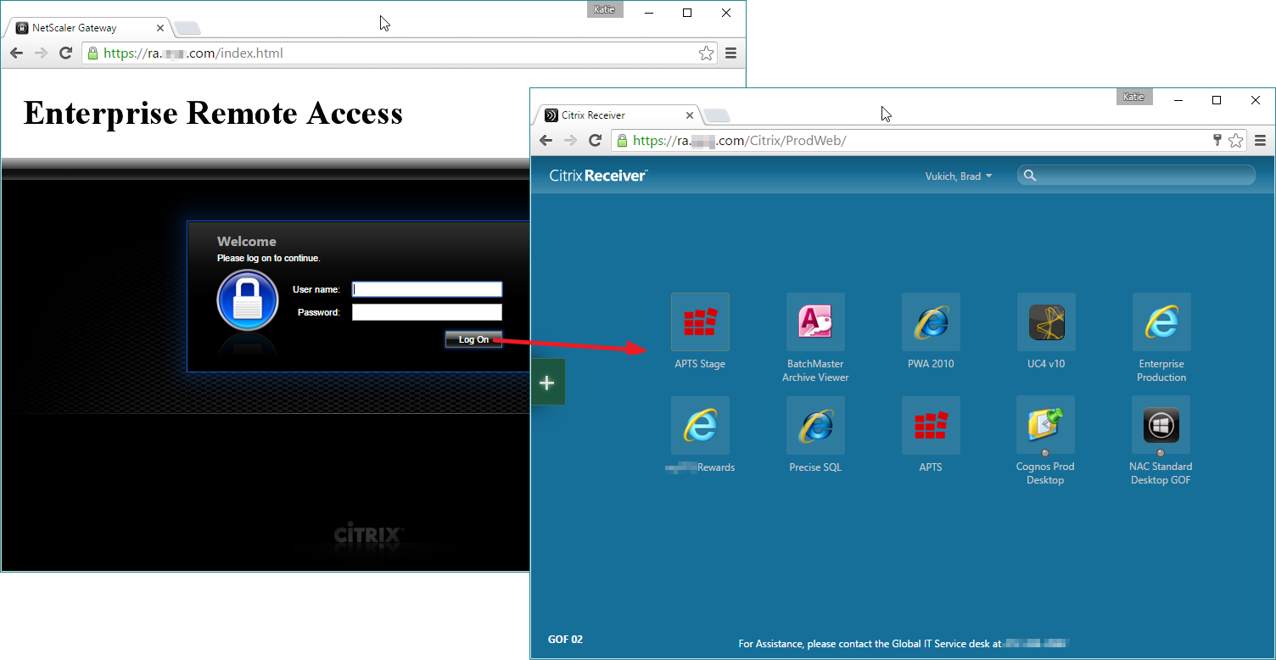
Remote Desktop Access
RDP requires network access for any productivity, but can be accessed from any device, even public workstations

Slide 4
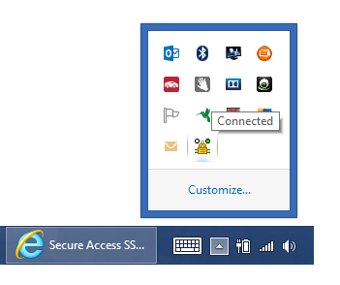
VPN
A Virtual Peer Network allows a user to connect a device to a physically separate network, i.e. a business network from home using a proxy
This allows them to retrieve company data assets remotely while still using the same computer environment with the same software they always use.

Slide 5
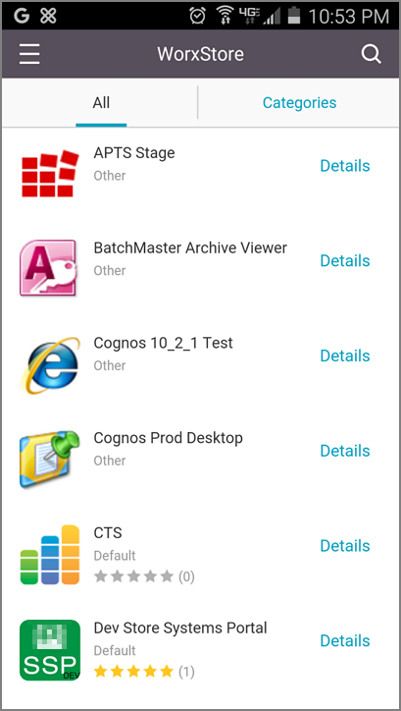
Mobile Device Management Solution
An MDM solution involves identifying existing mobile apps and developing a suite of custom apps to fulfill business productivity requirements on mobile devices
The company can either provide mobile devices or implement a “BYOD” (Bring Your Own Device) policy

Slide 6
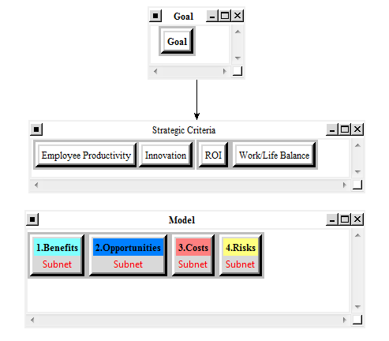
Model

Slide 7
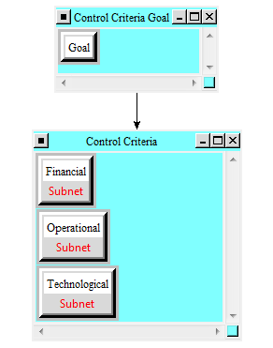
Benefits subnet

Slide 8
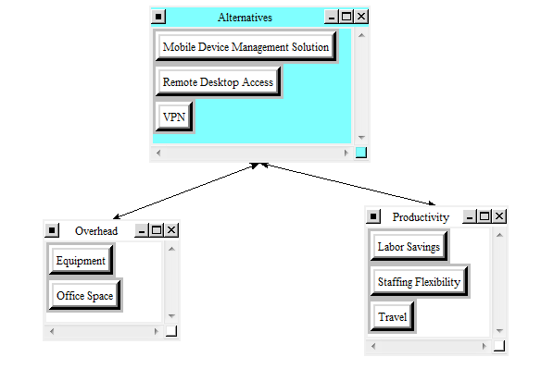
Benefits - Financial

Slide 9
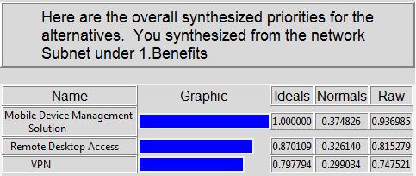
Synthesis of Benefits

Slide 10
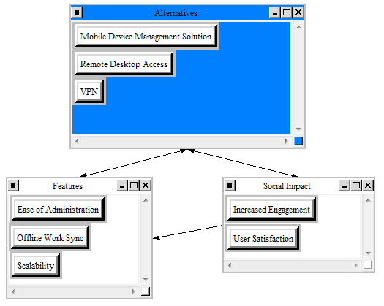
Opportunities - Operational

Slide 11
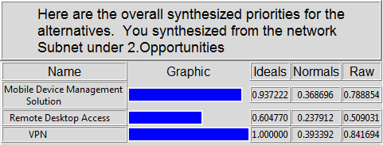
Synthesis of Opportunities

Slide 12
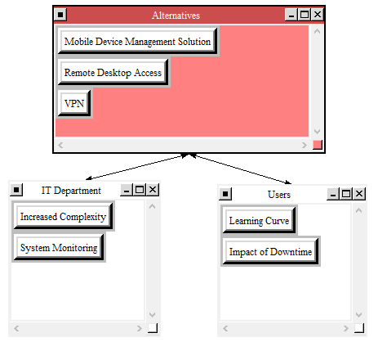
Costs - Operational

Slide 13
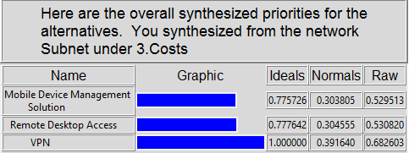
Synthesis of Costs

Slide 14
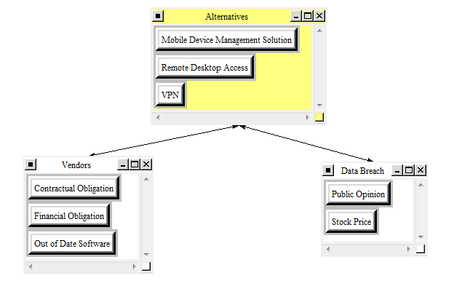
Risks - Financial

Slide 15
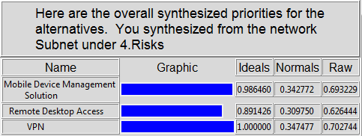
Synthesis of RISKS

Slide 16
Strategic Criteria
Return on Investment
Employee Productivity
Employee Work-Life Balance
Innovation

Slide 17
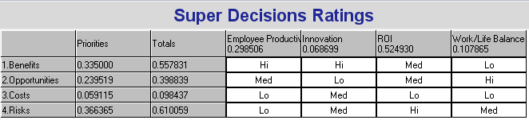
Ratings model

Slide 18
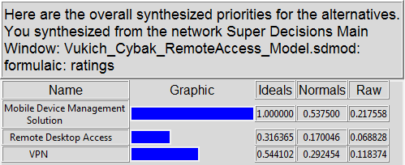
Results - Additive Negative

Slide 19
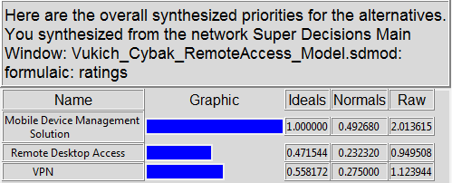
Results - Multiplicative

Slide 20
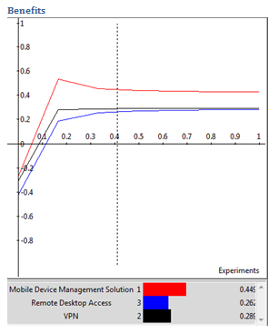
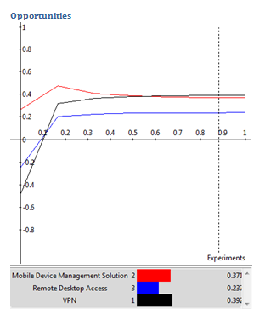
Sensitivity Analysis

Slide 21
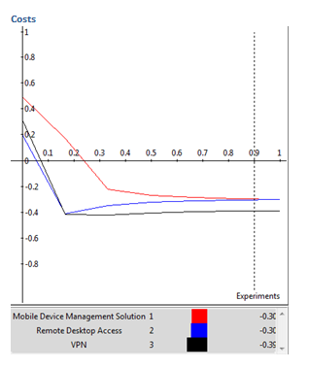
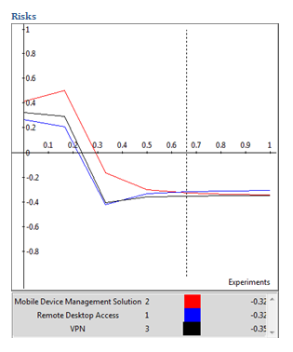
Sensitivity Analysis

