Slide 1

Should AMAZon expand its delivery service in the us?
Michael Lemon

Slide 2
Company Background
Formed in 1994
Mission: “Be Earth’s most customer-centric company, where shoppers everywhere can discover anything they might want to buy online
Primary Services:
E-commerce (online retail)
Cloud Computing
eBooks
Media
Offer free shipping with Amazon Prime membership
2015 Shipping costs reached an all-time high (>$5 million)

Slide 3

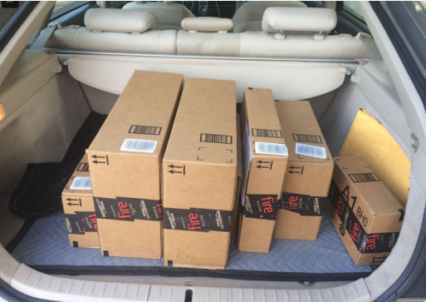

Recently in the News
Engineering and lobbying for drone delivery service
Beta testing Uber-esque delivery service
Acquired French shipping company Colís Privé, and have invested in British delivery company Yodel

Slide 4
Alternatives
Continue slowly investing internally to create their own delivery service.
Maintain course in projects that are catered toward revolutionizing the industry
Purchase small courier company and build out their infrastructure.
Become a small player in the parcel delivery market immediately, while maintaining business with UPS & FedEx
Purchase a large courier company
Become a large player in the parcel delivery market immediately
End ventures into creating a delivery service.

Slide 5
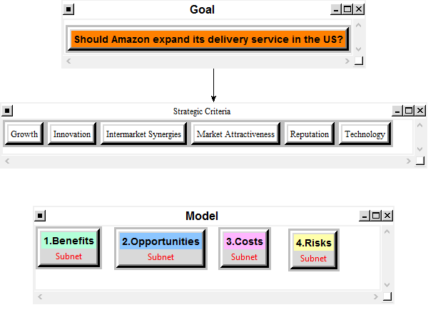
The model

Slide 6
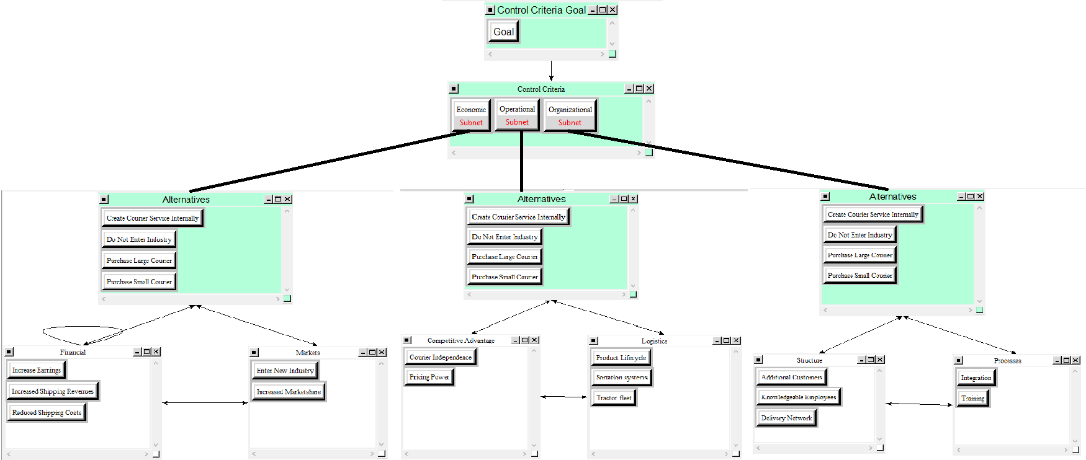
Benefits

Slide 7
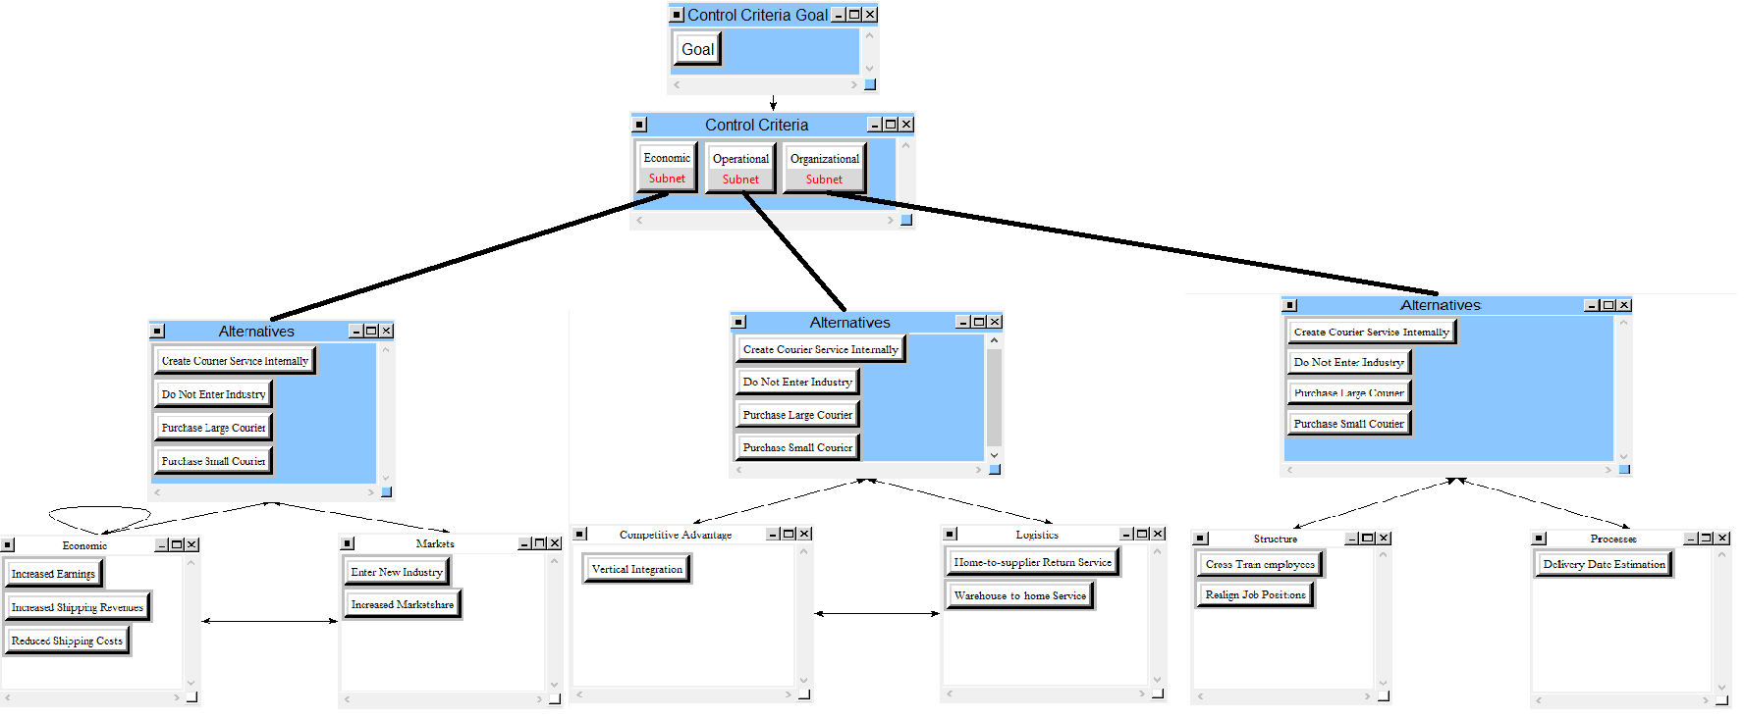
Opportunities

Slide 8
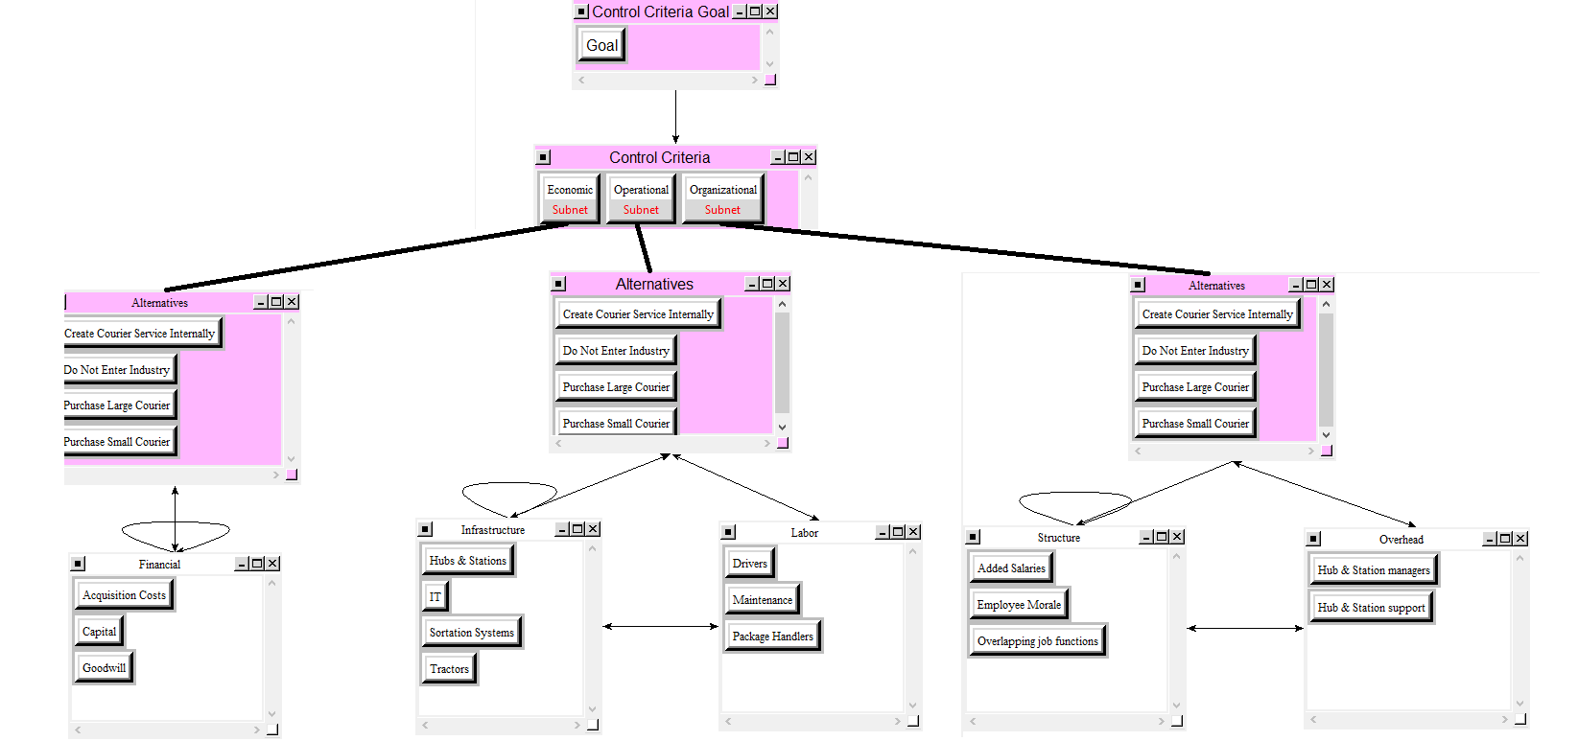
Costs

Slide 9
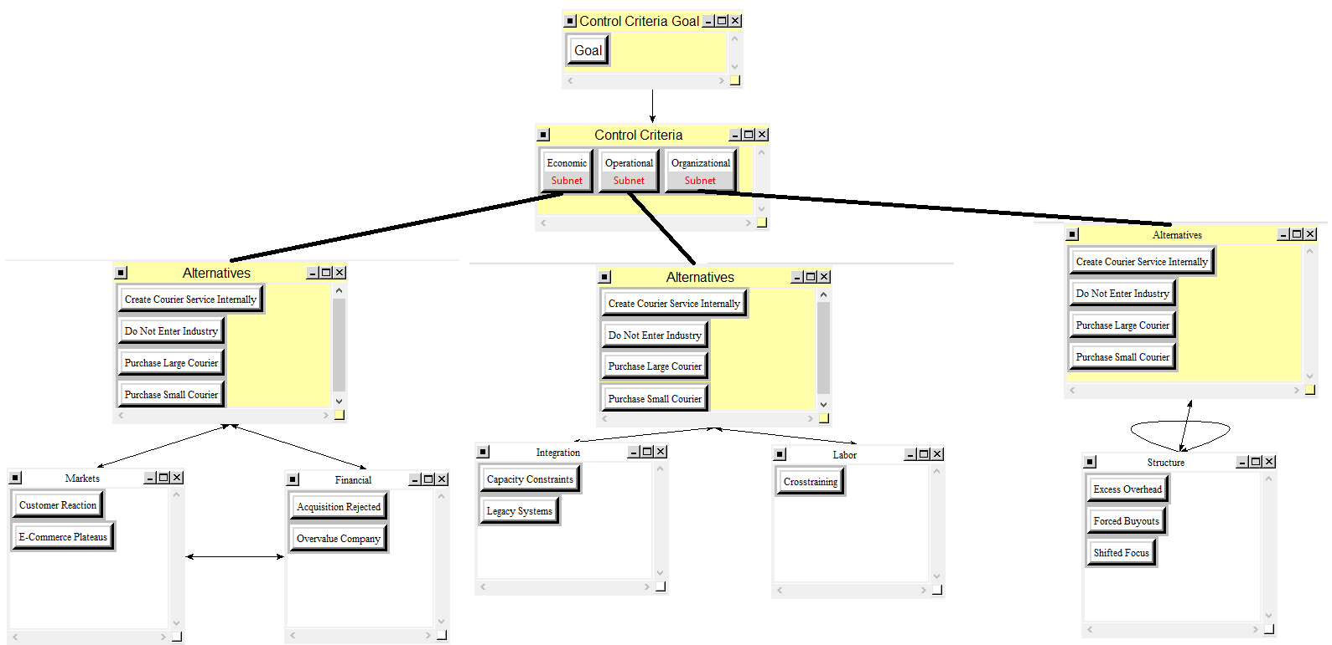
Risks

Slide 10
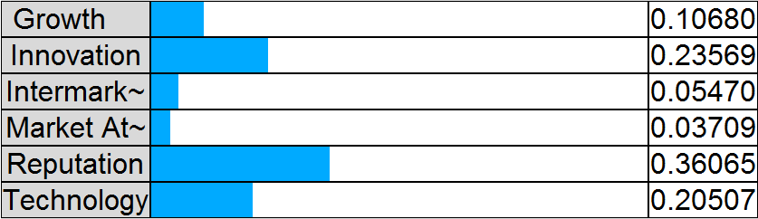
Strategic Criteria Priorities

Slide 11
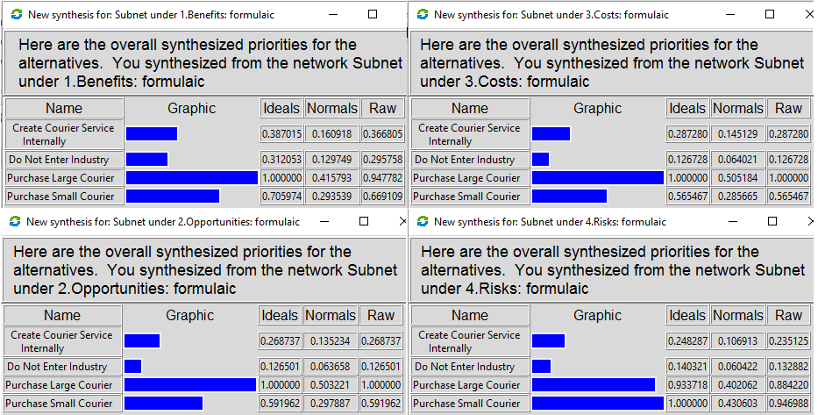
BOCR Priorities

Slide 12
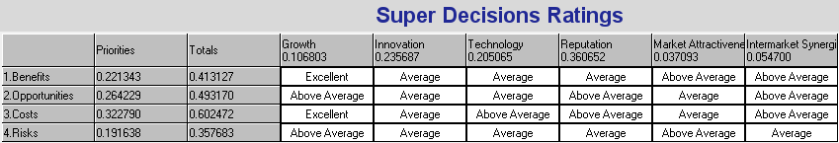
Super Decisions Ratings Matrix

Slide 13
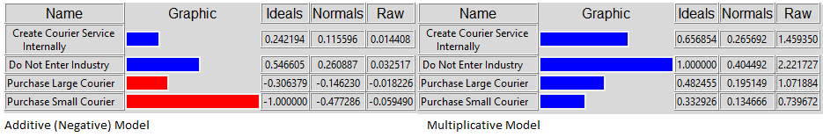
The Results

Slide 14
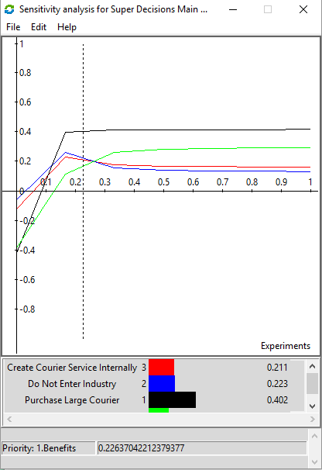
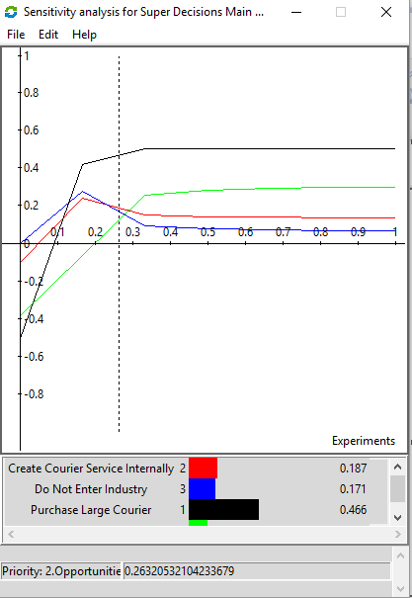
Sensitivity Analysis Benefits Opportunities

Slide 15
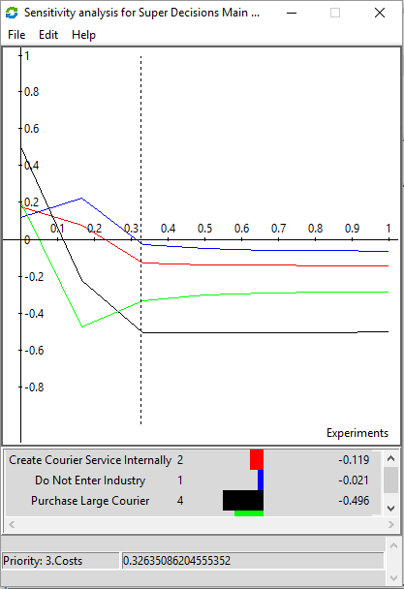
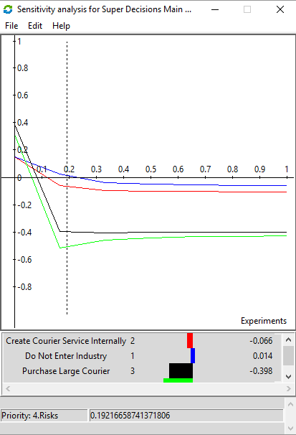
Sensitivity Analysis Costs Risks

Slide 16
Conclusions
Not entering the US delivery industry is the best alternative in both the long and short term.
High costs and risks negated the positive gains associated to entering the industry.
As Amazon gains knowledge (having purchased a French courier), I would suggest they continue to monitor the BOCR, as the priorities could shift.

Slide 17
Ways to Improve the Model
Select specific options for companies to purchase
FedEx may react differently than UPS and vice versa
Gather financials to determine the attractiveness of a company to purchase (company may be undervalued)
Perform more extensive research to determine economic benefits

