Slide 1
To Walmartize or Not to Walmartize? (2012)

Slide 2
Alternatives
The alternatives in the Spirits market are listed below.
Build Wal-Mart
Do Not Build Wal-Mart

Slide 3
Criteria
Whether D.C. should allow Wal-Mart to open stores within the city limits?
Effect on Small Business
Profitability
Public Opinion

Slide 4
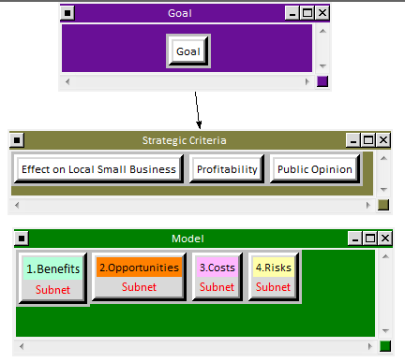
BOCR model

Slide 5
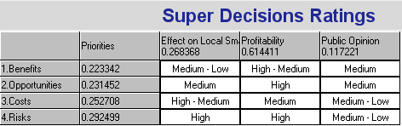
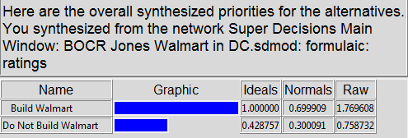
Rating model

Slide 6
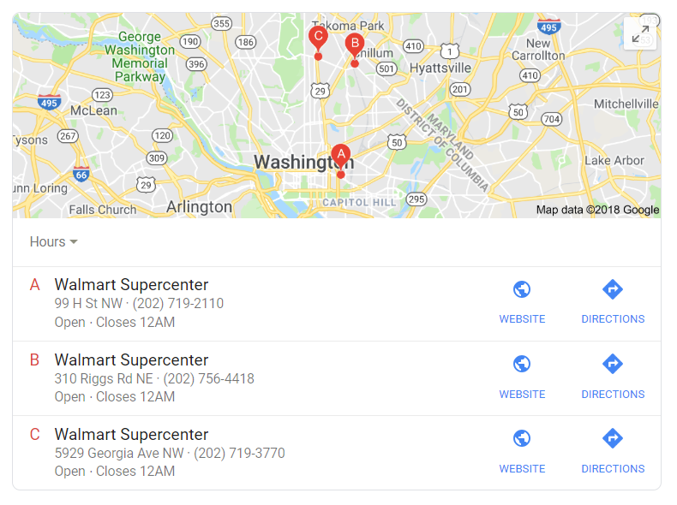
Conclusion
The results of the Ratings model indicate that the Wal-Mart should be built in Washington, D.C. Moreover, the results of ratings with respect to the strategic criteria yield Profitability to be more highly rated amongst the other criteria.
The study was done in 2012.
In 2018, there are three Walmart in Washington D.C.

