Slide 1
Should R&D and Manufacturing Operations be Centralized or Decentralized in Multinational Corporations?
Gobinda Saha
BQOM 2521
April 19, 2016
Decision Making in Complex Environment

Slide 2
Origin of Dilemma
Manufacturing MNCs typically grow through acquisitions rather than organic growth.
Acquisitions are aligned with long term strategy of the corporation.
However, operating multiple locations is NOT always cost effective, especially R&D laboratories (think ROI).
The complexity is unavoidable. Decision making is critical.

Slide 3
Multiple Locations
Advantages
Disadvantages
Close to customers
Faster services
Brand recognition
…….
Operating cost
Duplication
Bureaucracy
…….
Data driven bias-free analysis is critical for long term success

Slide 4
Centralized vs. Decentralized
Alternatives
One central
location
Four regional
locations
Locations near
major customers
Scattered (acquired)
locations
Strategic Criteria
Market share
Time to market
Efficiency (cost reduction)
Customer intimacy
Benefits
Opportunities
Costs
Risks
Control Criteria
Financial
Social
Capacity
Capability

Slide 5
Benefits
Control Criteria
Financial
Social
Capacity
Capability
Revenue
Growth
Infrastructure
Expertise
Sales volume
Local market
Competition
Brand value
Org. bureaucracy
Corp. neighborhood
Land
Building
Energy
Knowledge
Instruments
IP
Profitability
Community
Communications
Attractiveness
Maintenance
COGS
Transportation
Currency
Tax
Welfare
Political
Cultural
Language
In-person
IT
Airport/shipyard proximity
Talents for scope
Economic hub
Salary for scope

Slide 6
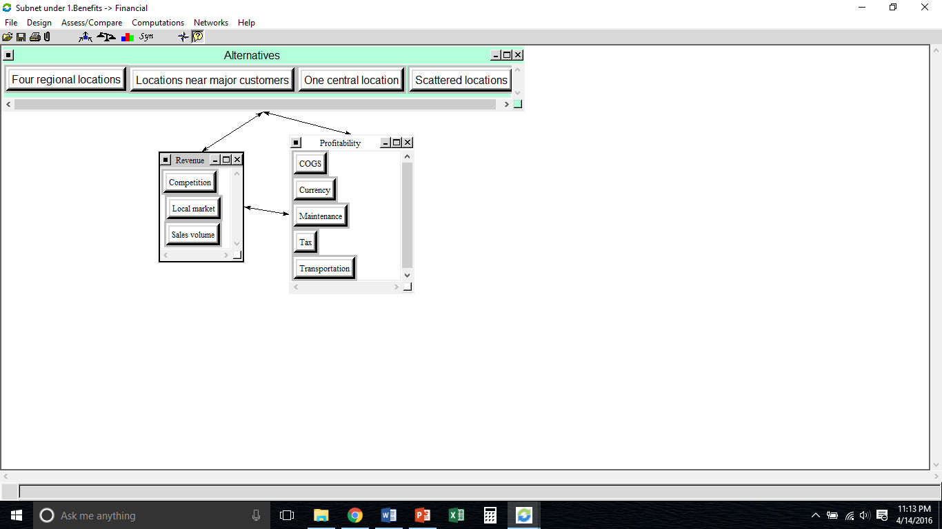
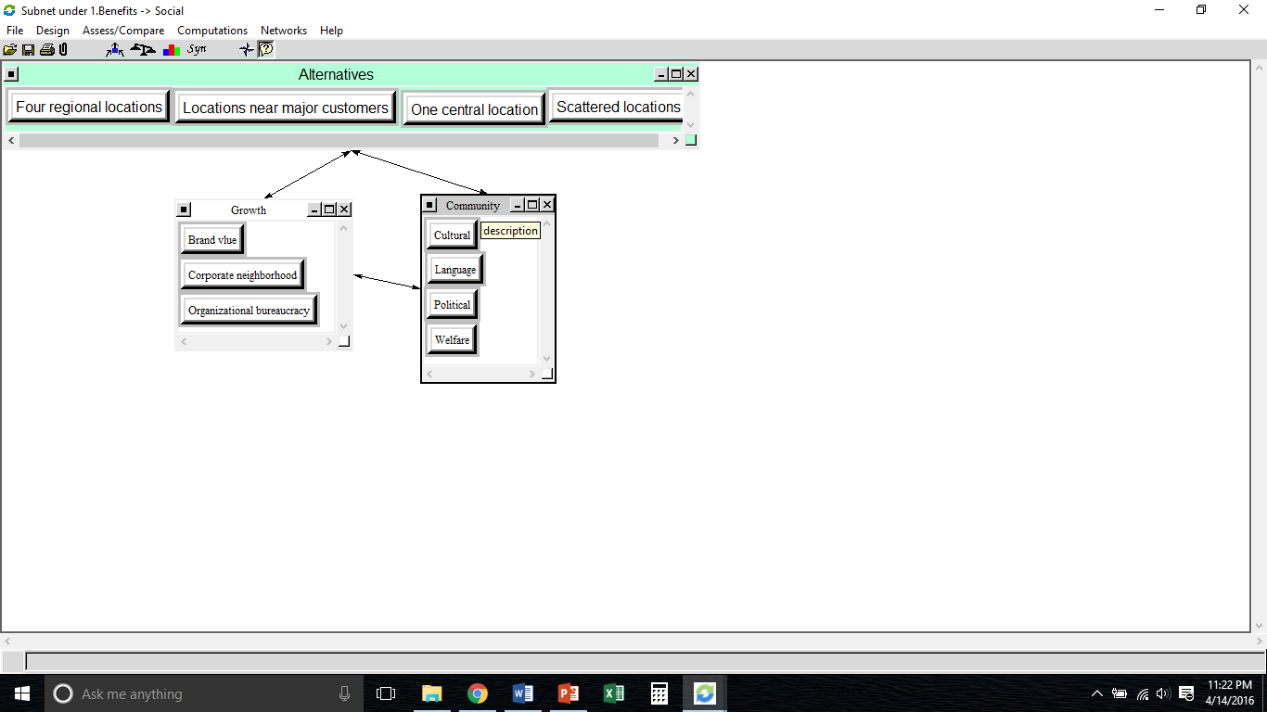
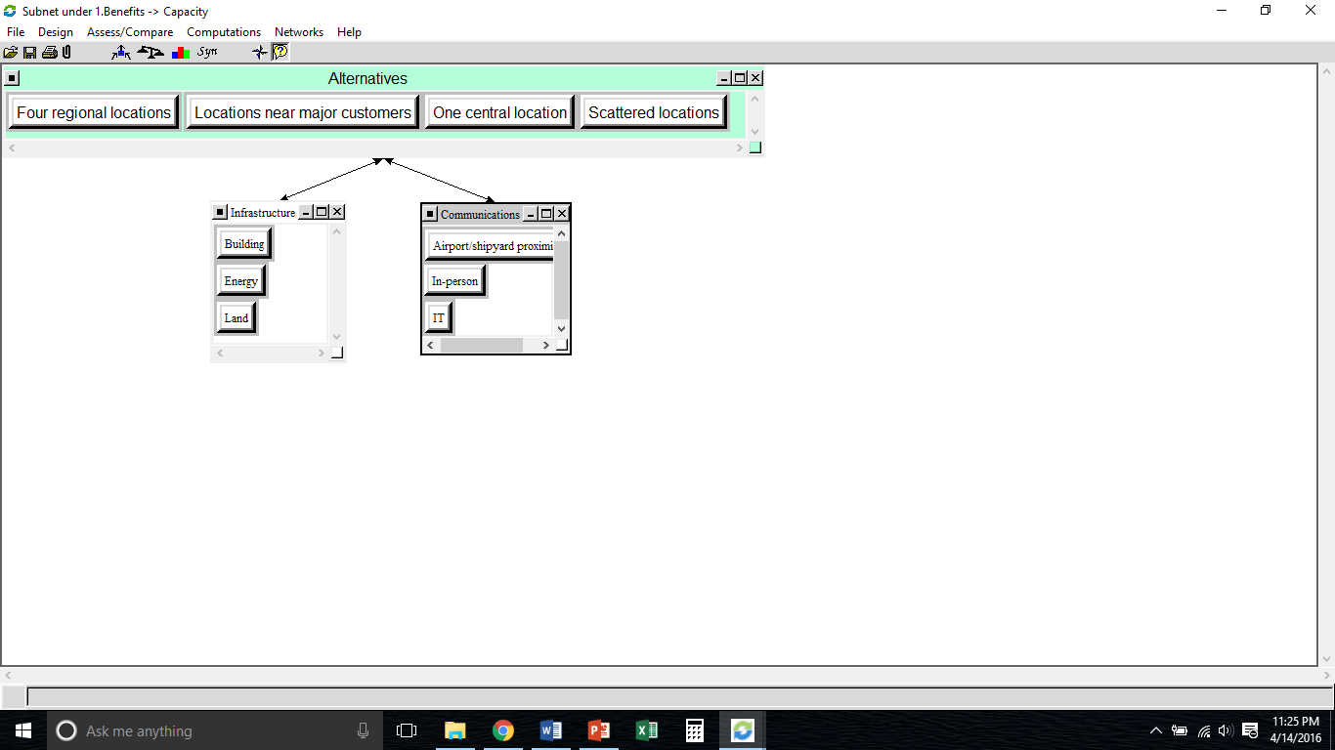
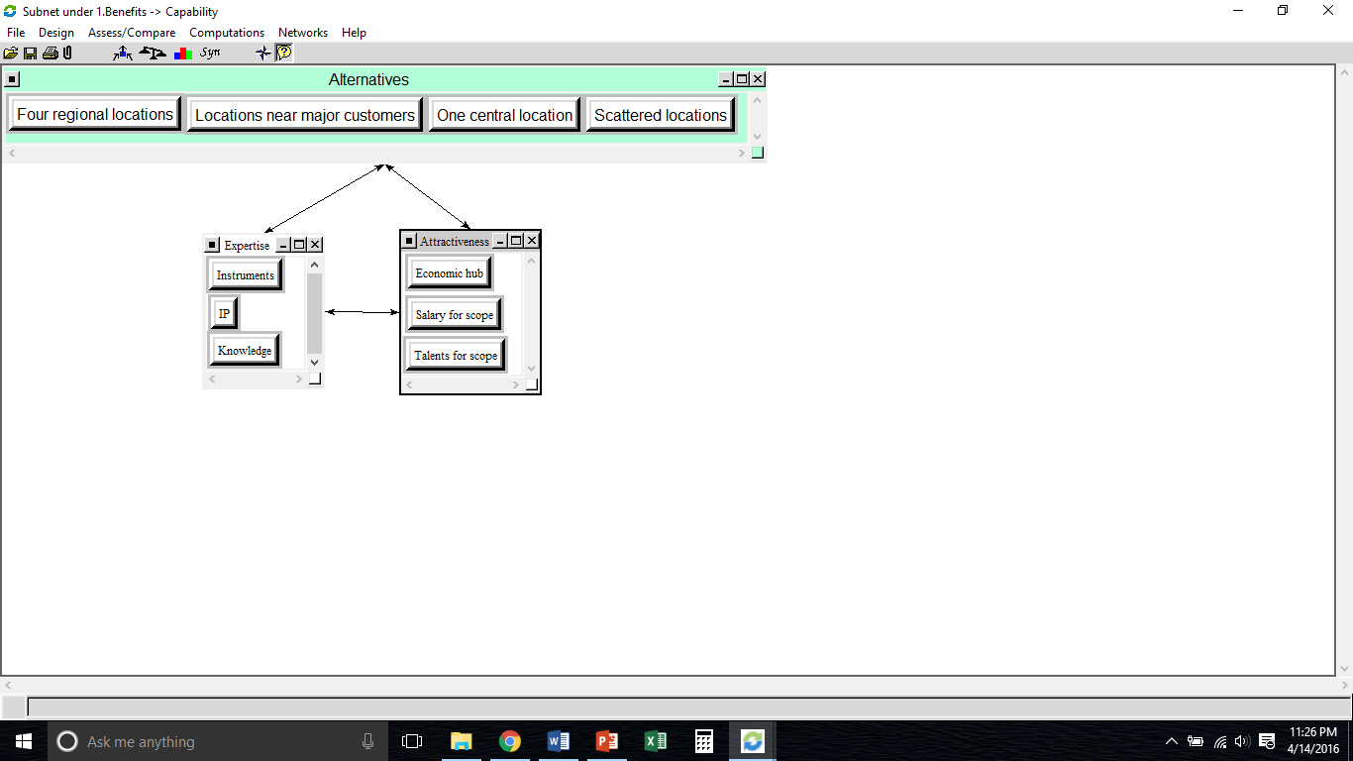
Financial
Social
Benefits
Capacity
Capability

Slide 7
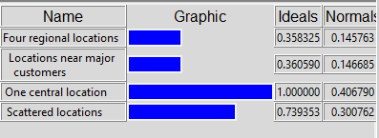
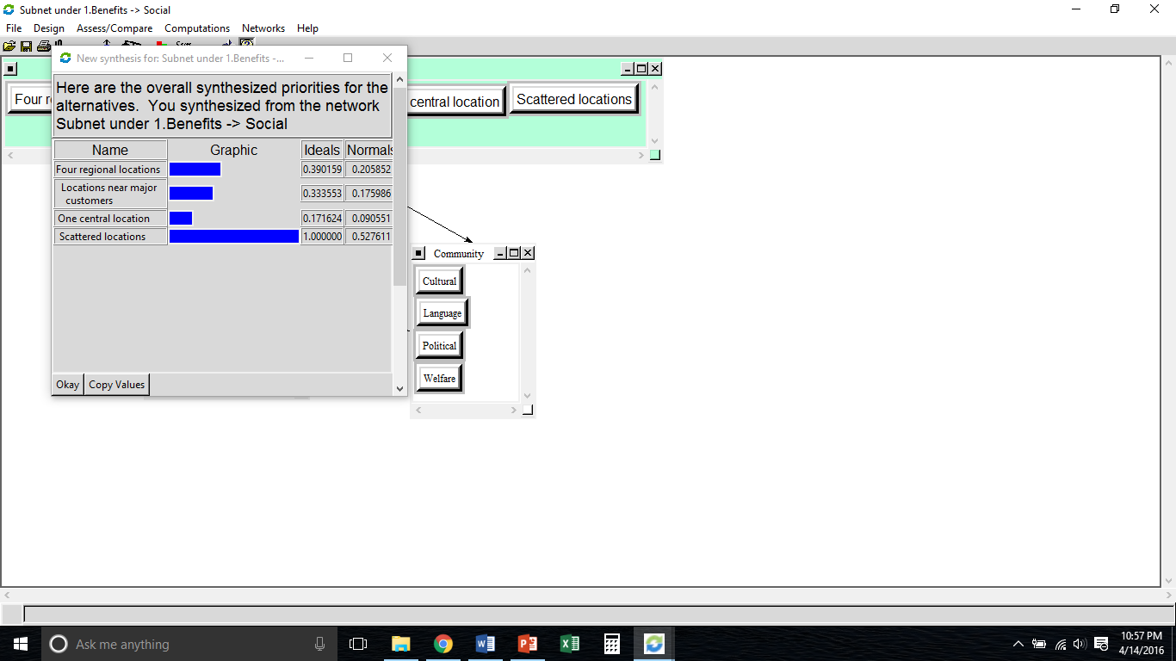
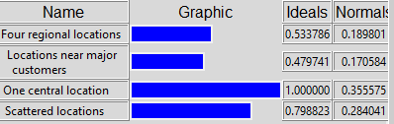
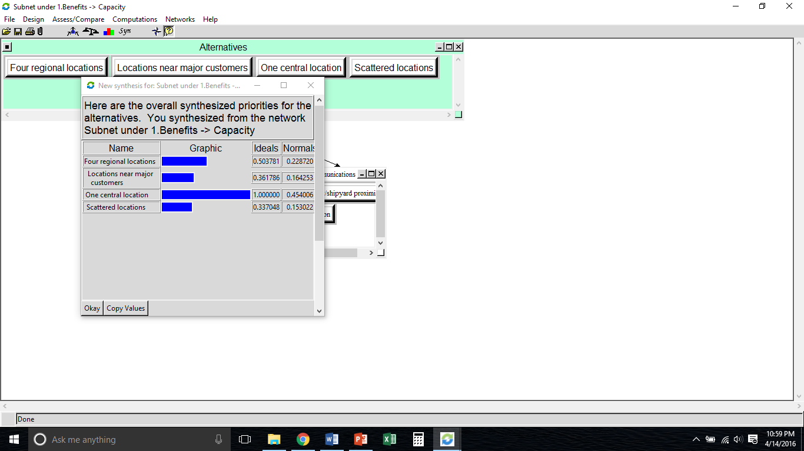
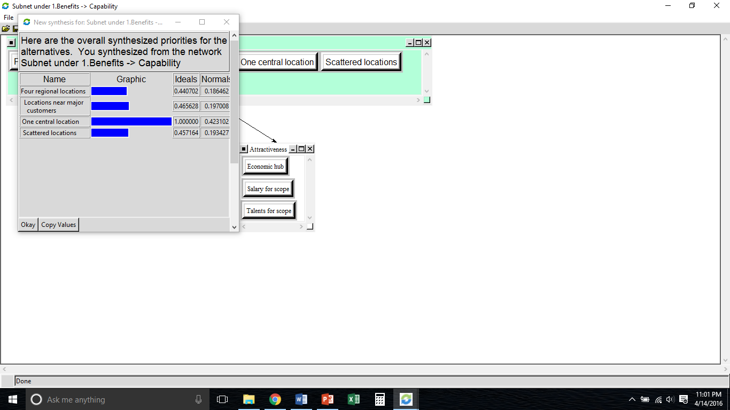
Benefits
Financial
Social
Capacity
Capability

Slide 8
Opportunities
Control Criteria
Financial
Social
Capacity
Capability
Revenue
Growth
Infrastructure
Expertise
Sales volume
Local Market
Competition
Population
Brand value
Corp. neighborhood
Land
Building
Expansion
IP
Knowledge
Profitability
Community
Growth
Attractiveness
Plant proximity
Fixed cost
Tax credit
Welfare
Political
Customer intimacy
New business
Adjacent market
Retention
Talents for scope
Economic hub

Slide 9
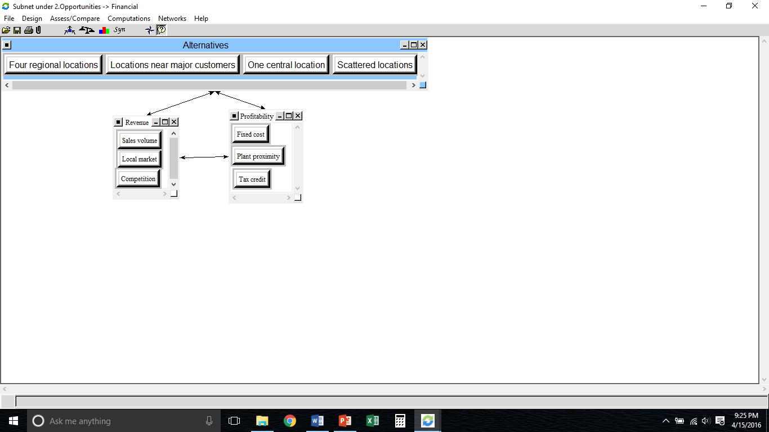
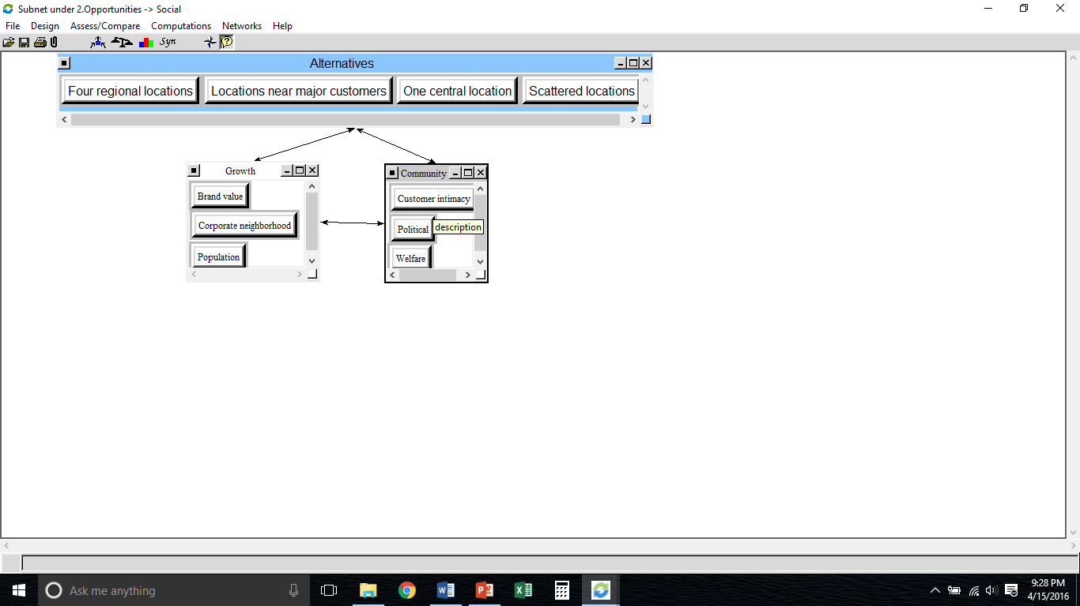
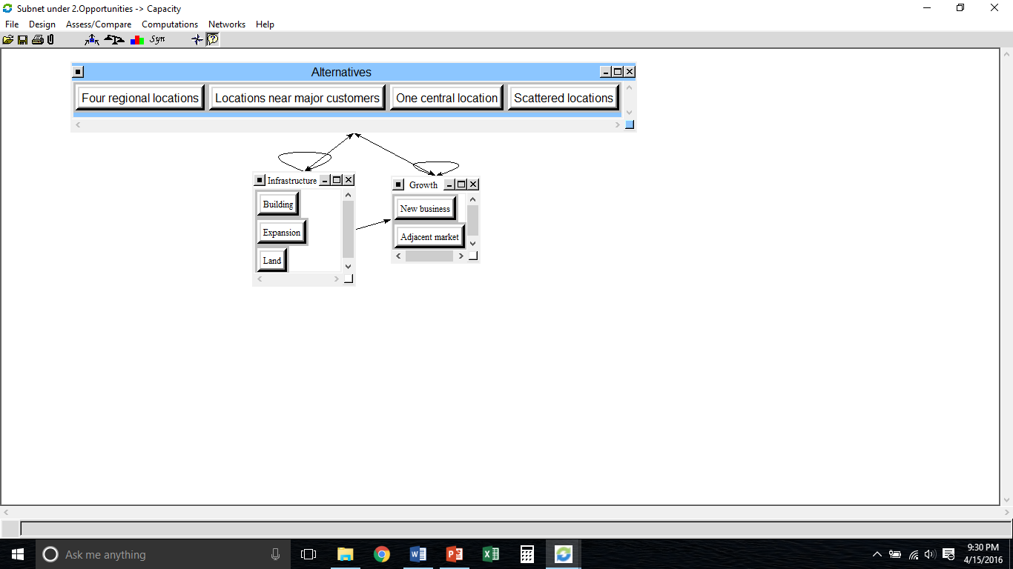
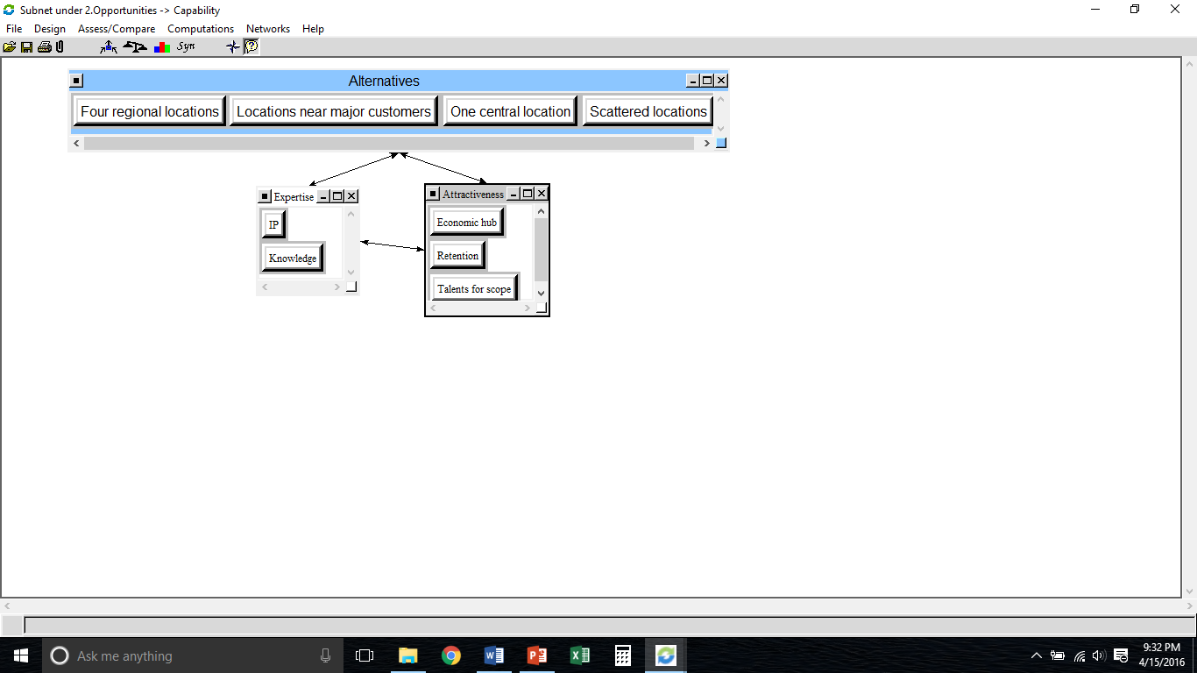
Financial
Social
Opportunities
Capacity
Capability

Slide 10
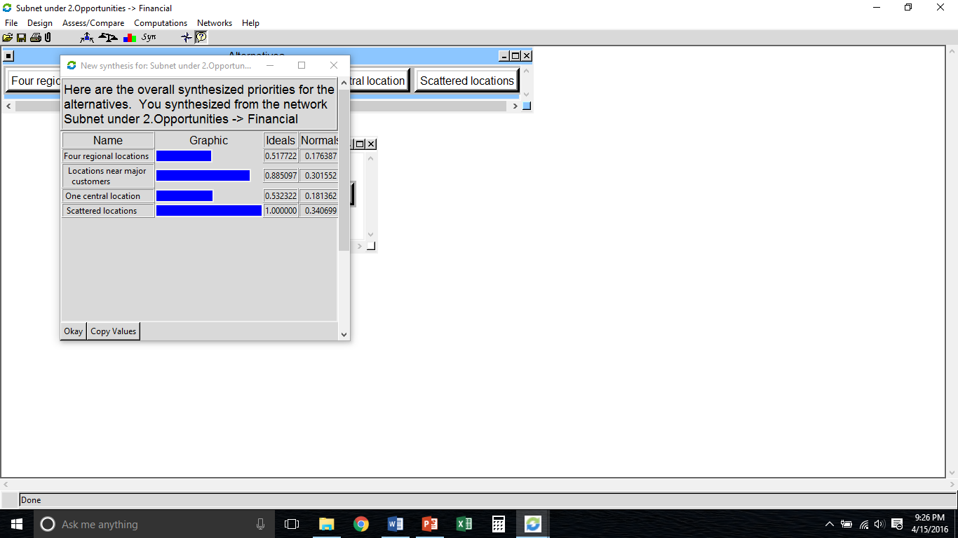
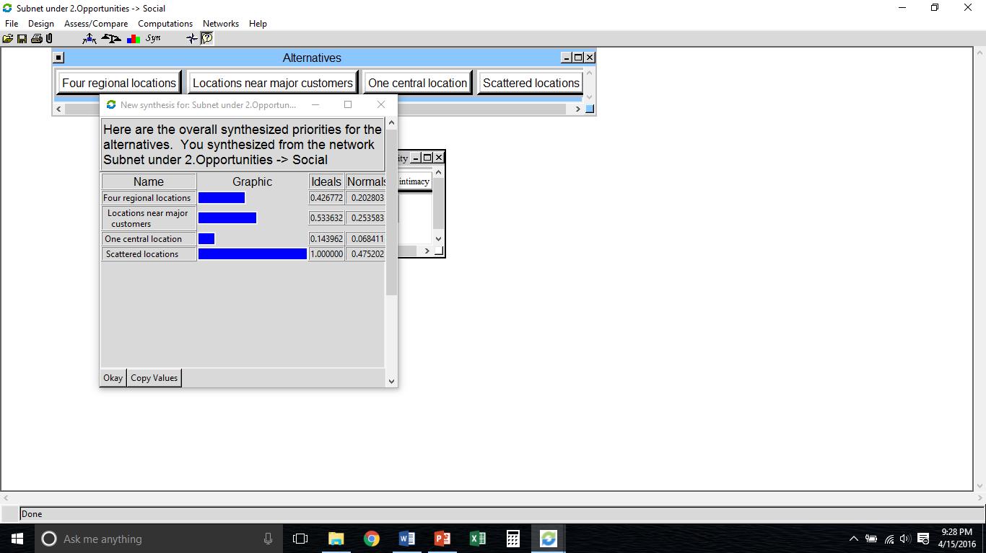
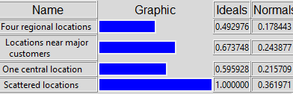
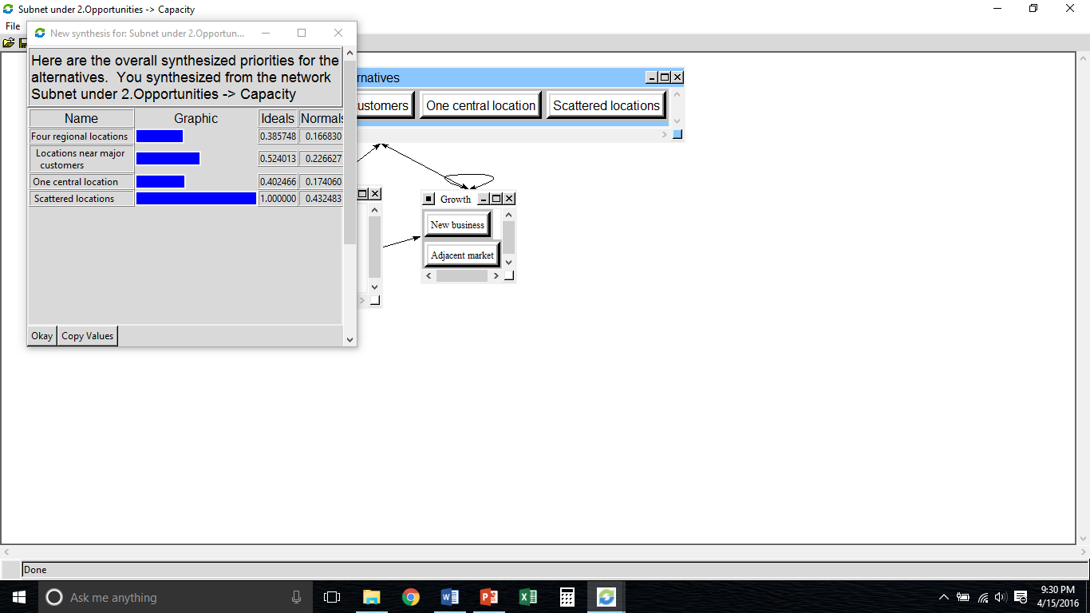
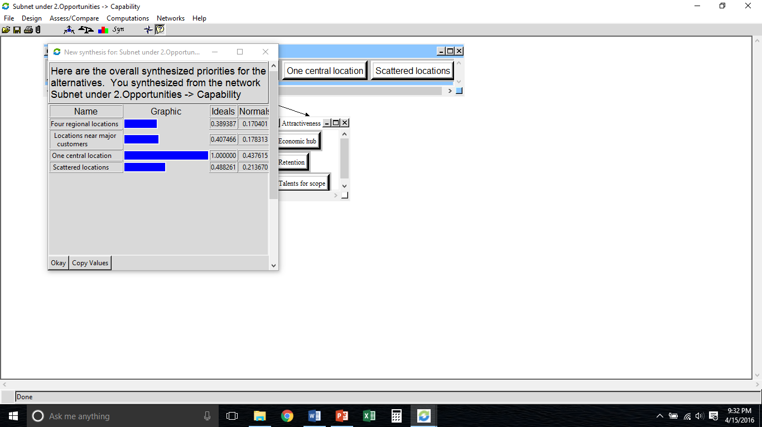
Financial
Opportunities
Social
Capacity
Capability

Slide 11
Costs
Control Criteria
Financial
Social
Capacity
Capability
Revenue
Growth
Infrastructure
Expertise
Sales volume
Time to service
Discont. operations
Brand value
Ancillary market
Land
Building
Lease
IP
Knowledge
Instruments
Profitability
Community
Communications
Attractiveness
Duplication
COGS
Depreciation
Retirements
Local labor laws
Relocation cost
Transportation
Retention
Talents for scope
Economic hub

Slide 12
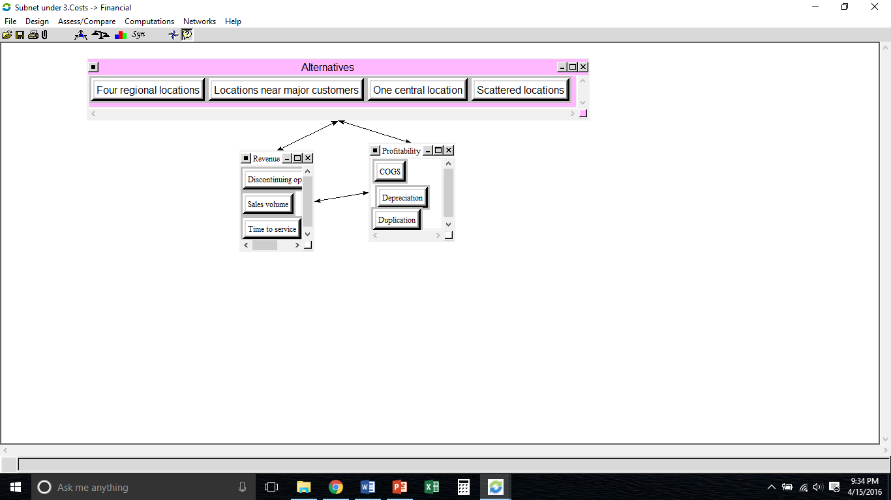
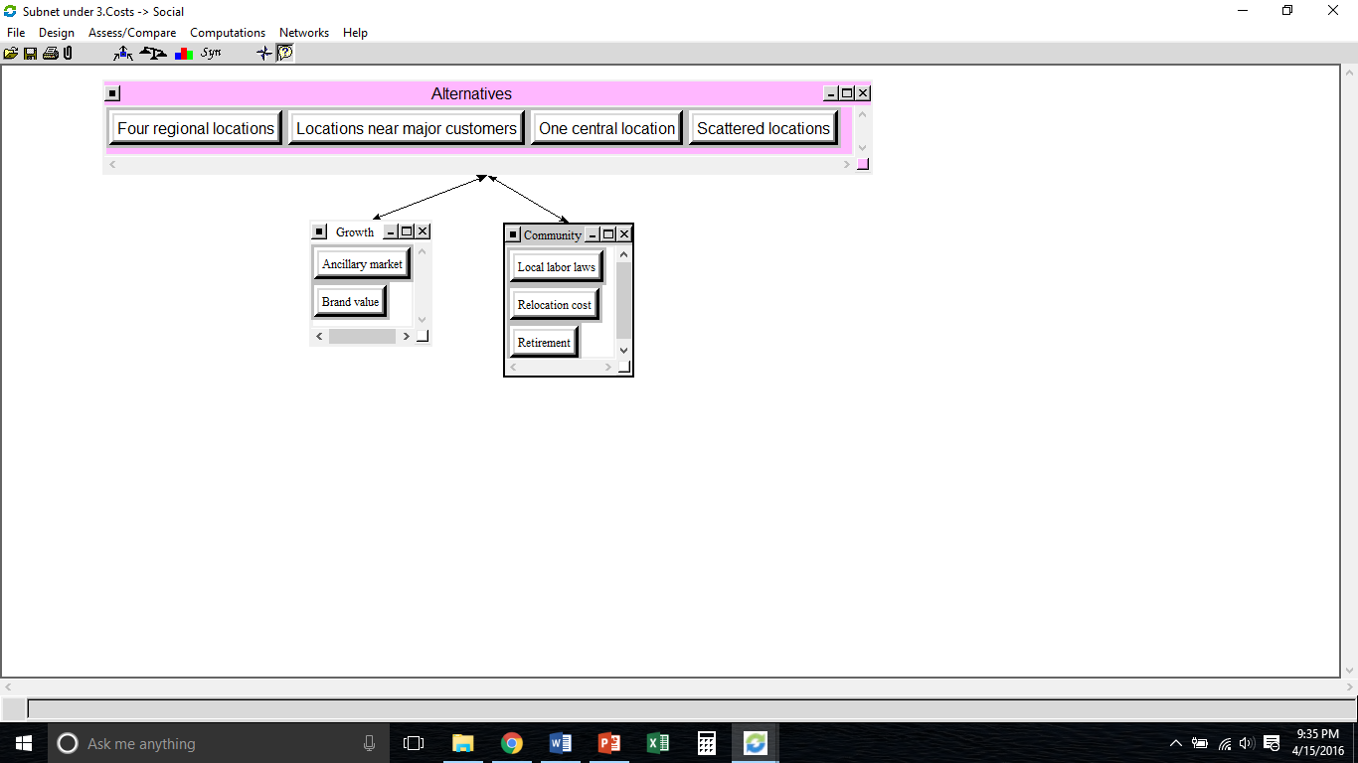
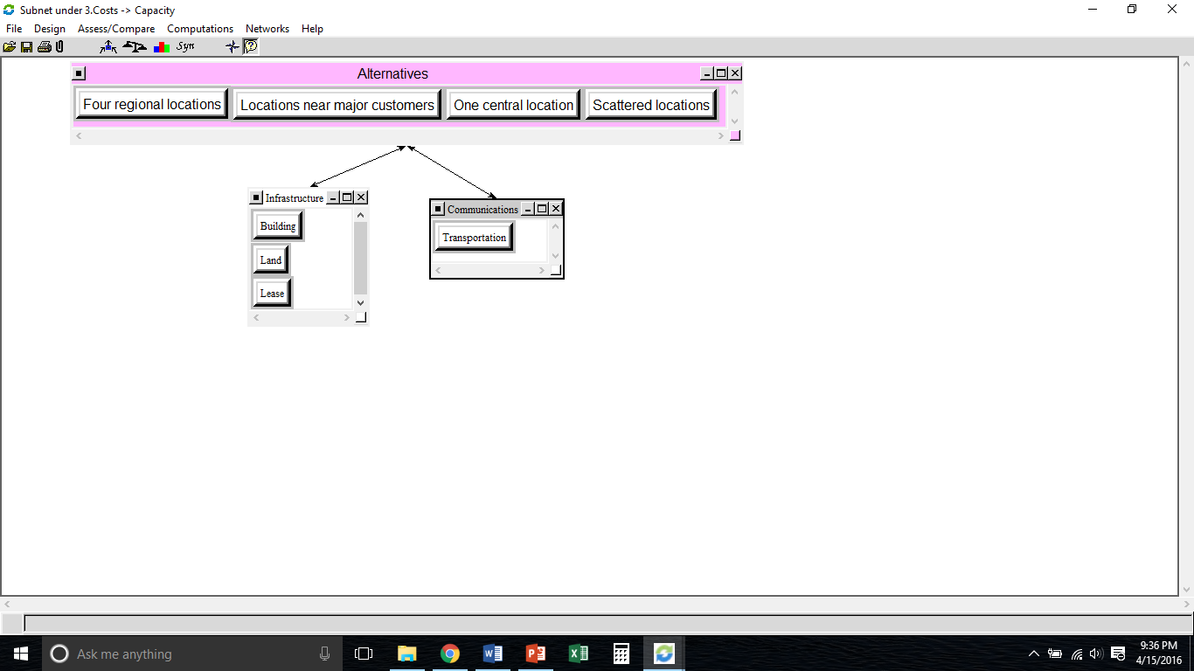
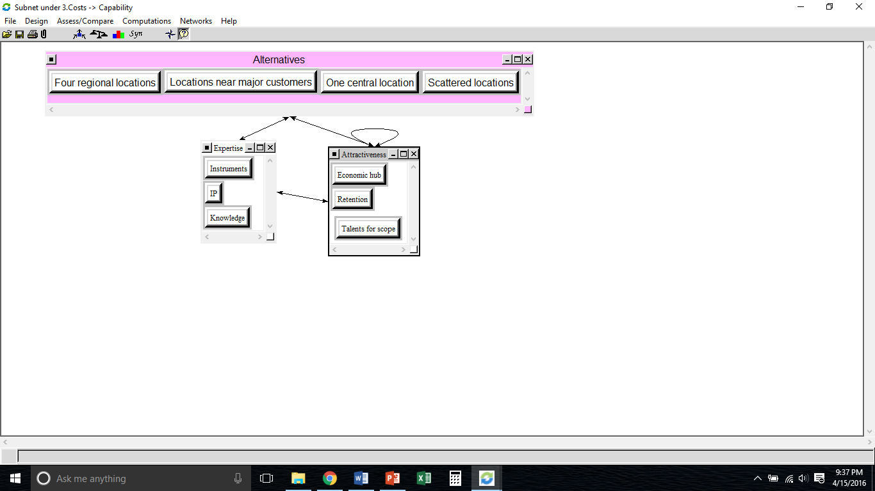
Financial
Social
Costs
Capacity
Capability

Slide 13
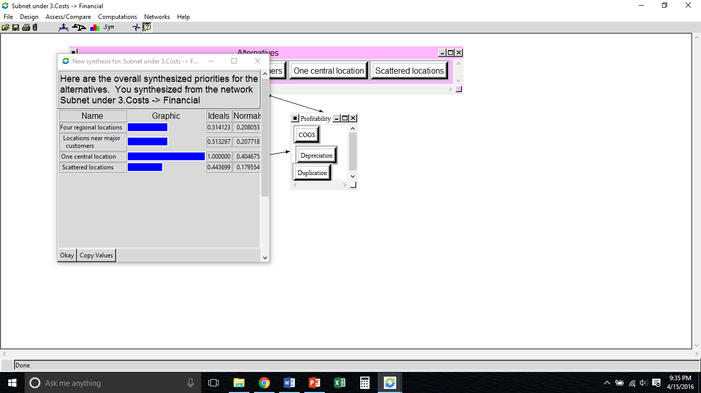
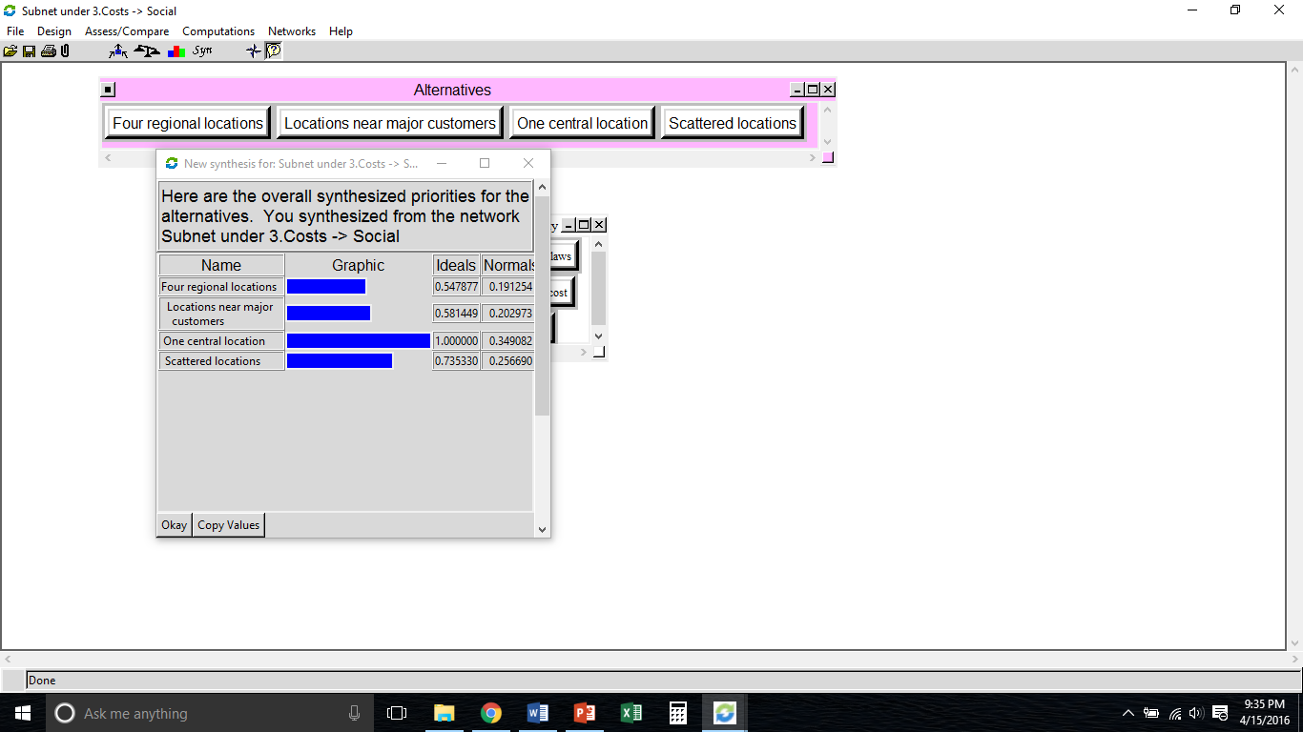
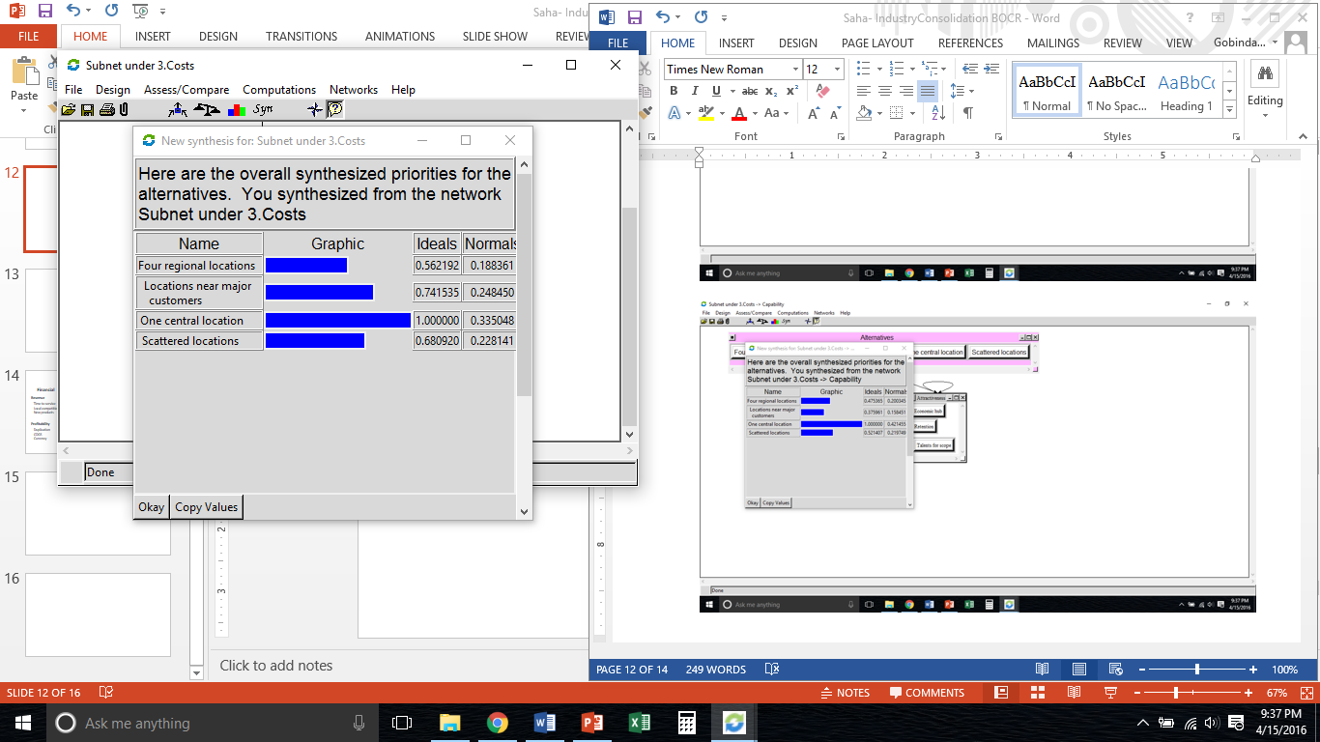
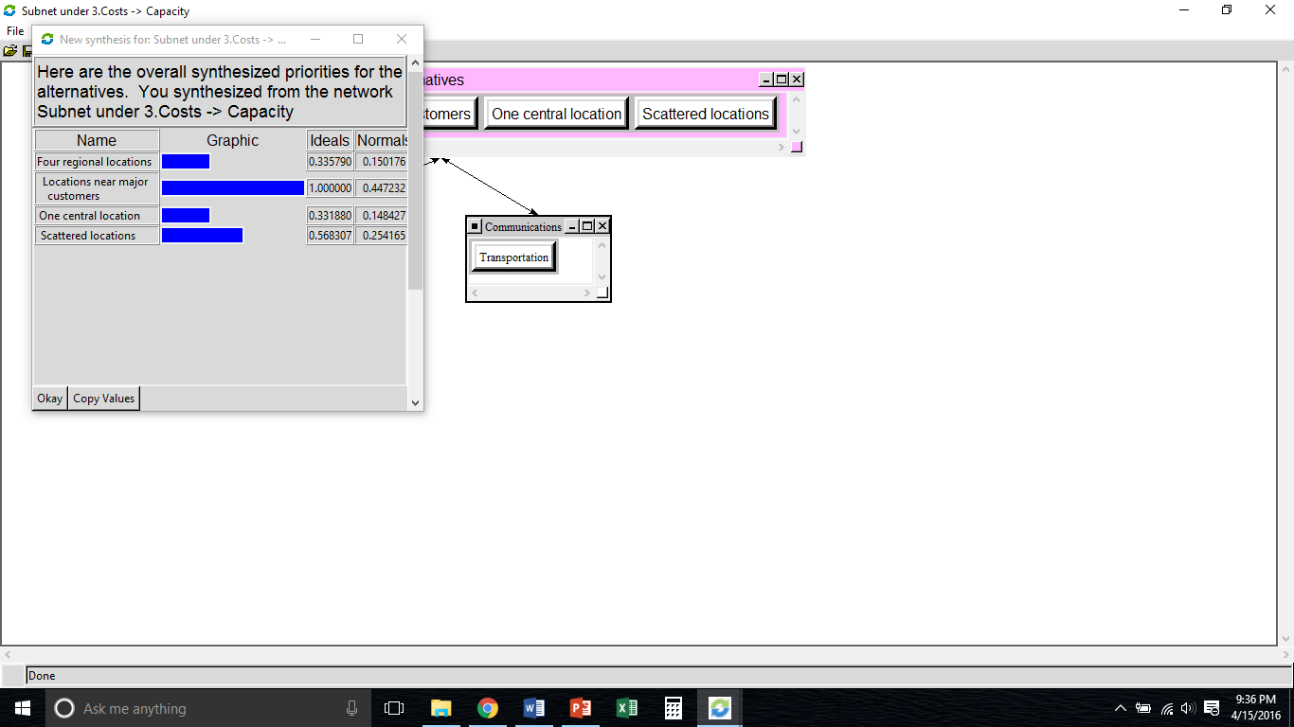
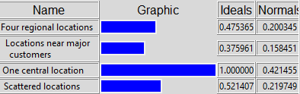
Financial
Costs
Social
Capacity
Capability

Slide 14
Risks
Control Criteria
Financial
Social
Capacity
Capability
Revenue
Growth
Infrastructure
Expertise
Time to service
Local competition
New products
CSR
Brand value
Ancillary market
Zoning
Lease
Permits
Retirement
Demography
IP
Profitability
Community
Communications
Attractiveness
Duplication
COGS
Currency
Local support
Political
Energy/tax credit
Info. share
Shipment time
Talents for scope
Economic hub

Slide 15
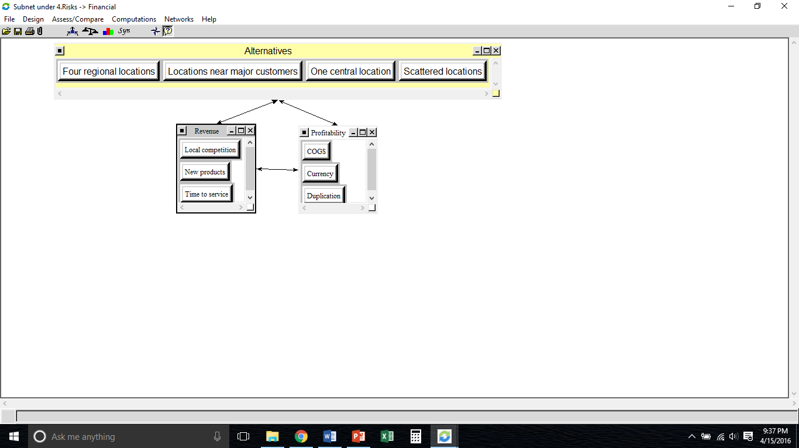
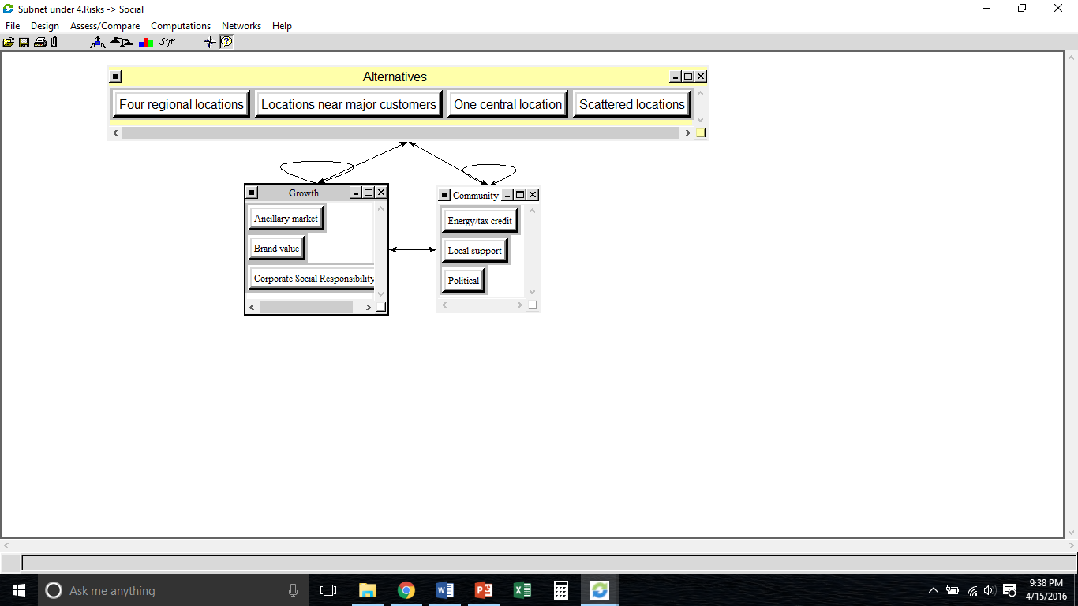
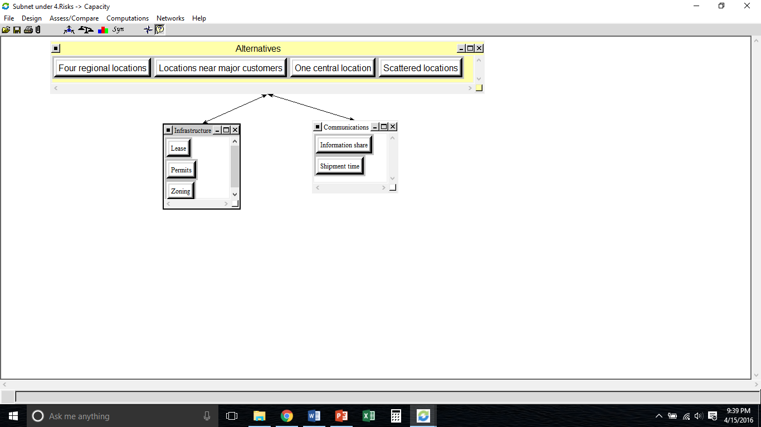
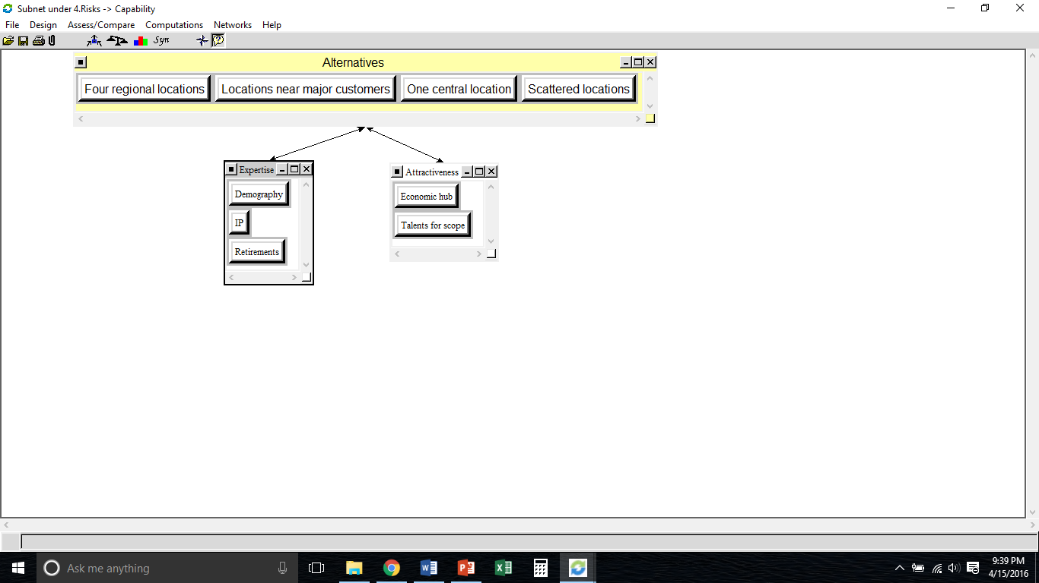
Financial
Social
Risks
Capacity
Capability

Slide 16
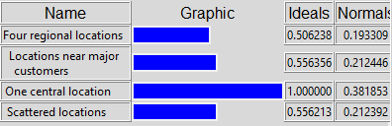
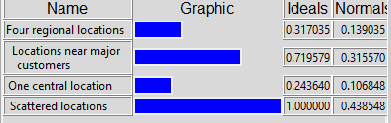
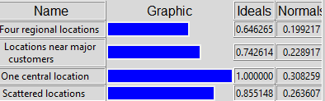
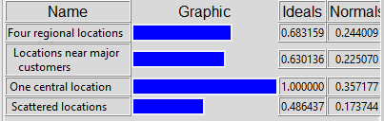

Financial
Risks
Social
Capacity
Capability

Slide 17
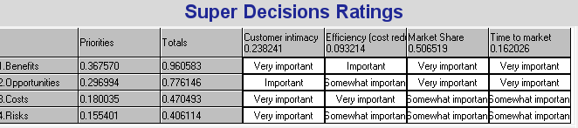
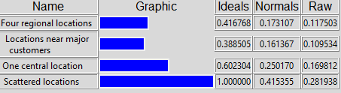
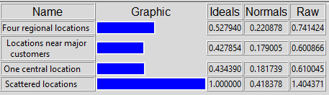
Benefits
Opportunities
Additive
Multiplicative
Costs
Risks

Slide 18
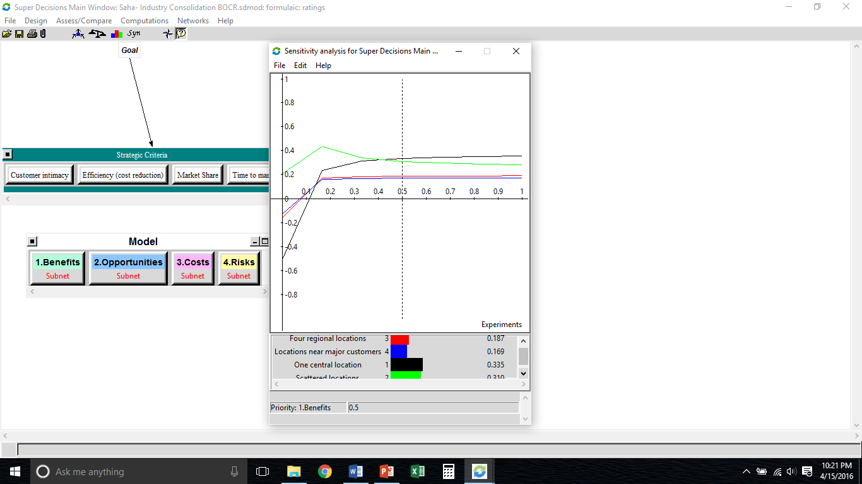
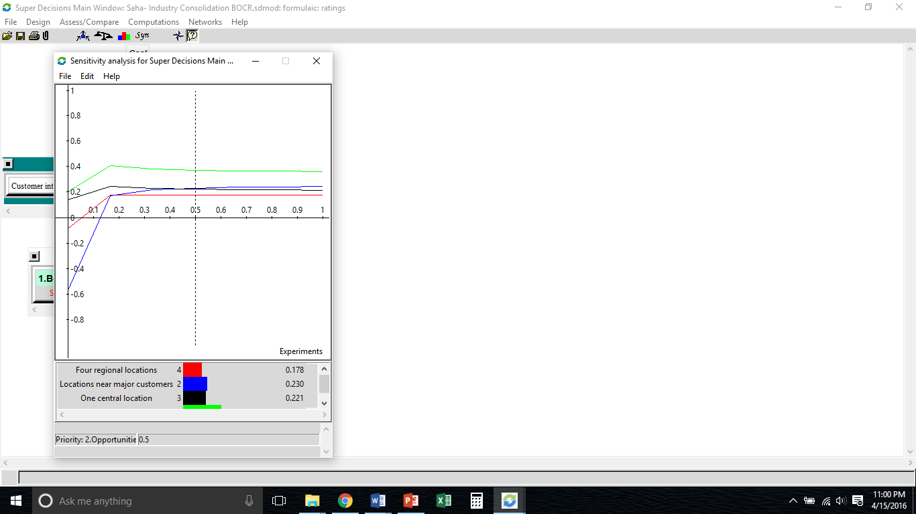
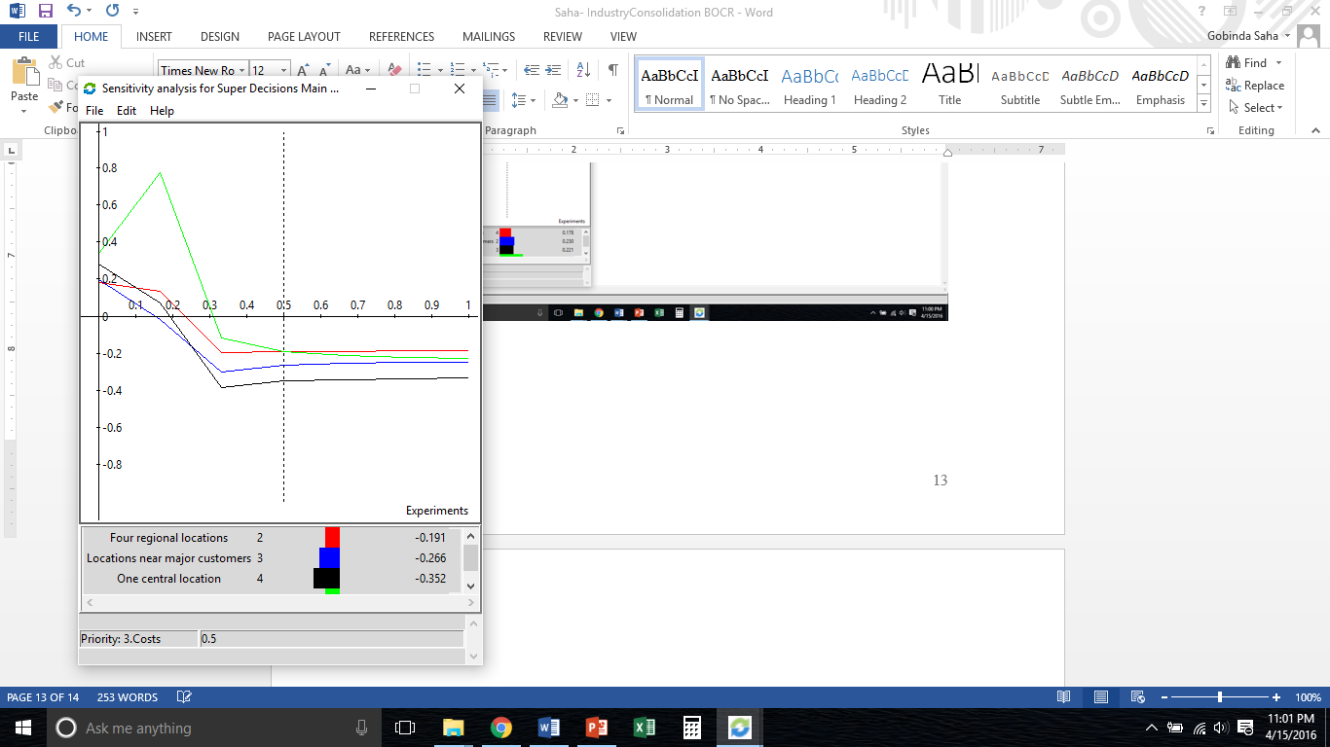
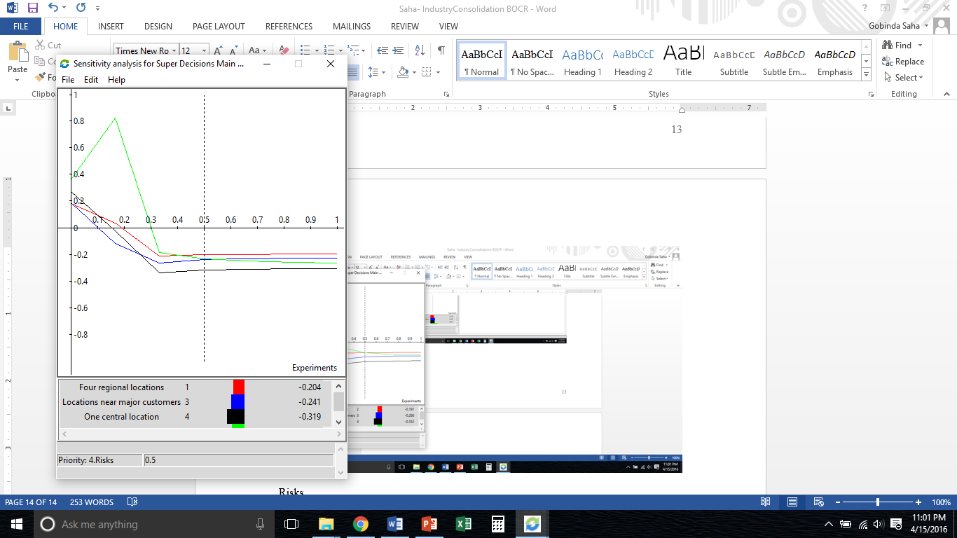
Benefits
Opportunities
Sensitivity Analysis
Costs
Risks

