Slide 1
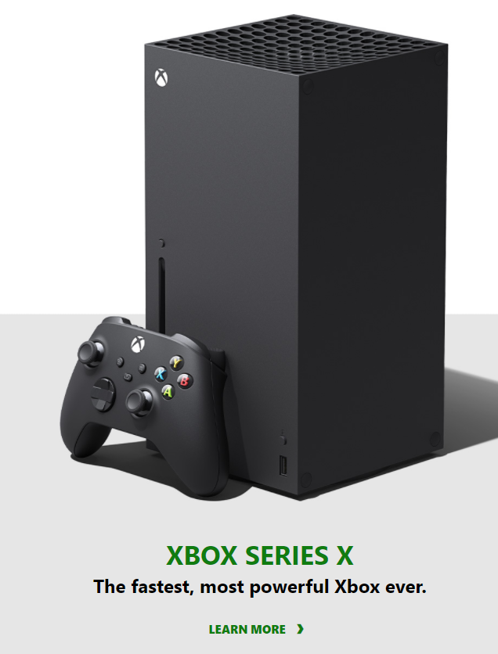
What action Microsoft should take to promote the new Xbox

Slide 2
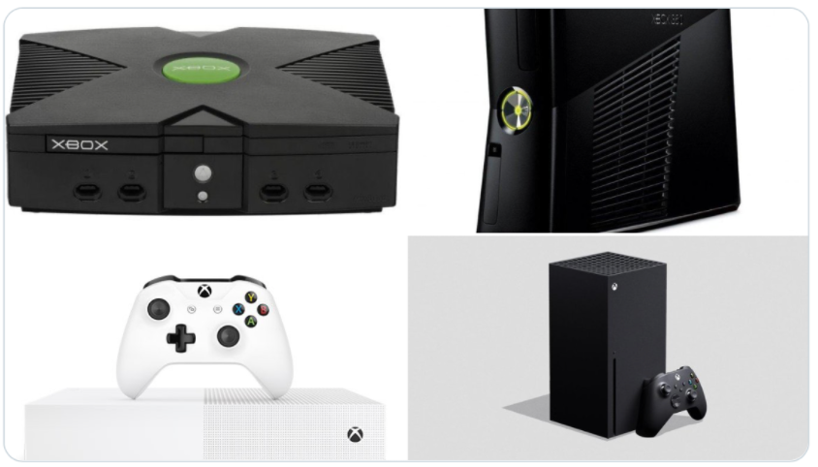
Introduction
Xbox is a series of video game consoles that Microsoft has created since 2001
Microsoft is going to release the 4th generation Xbox in Nov 2020

Slide 3
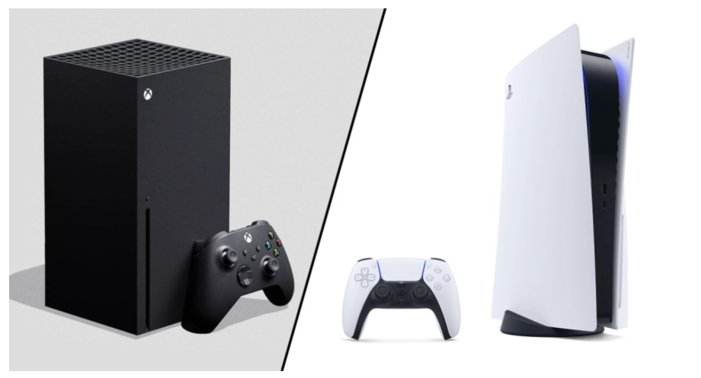
Major Competitor
PlayStation
Similar tech specs
Similar target users

Slide 4
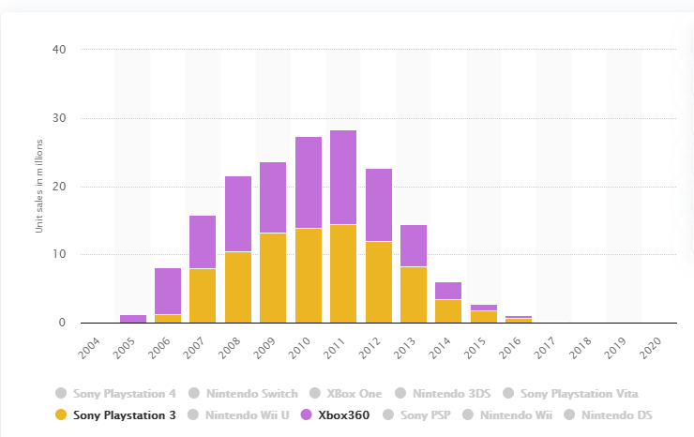
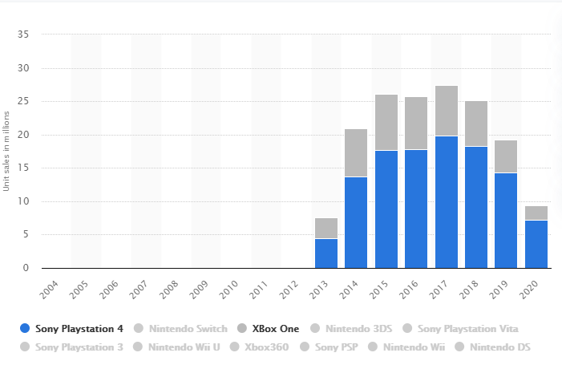
Data of market share for the previous generation of the two platform
Has almost the same market share in the Xbox360 generation
Has far less market share in the Xbox one generation

Slide 5


List of best-selling video games
No. | Game | Copies sold
1 | Grand Theft Auto V | 8.72 million
2 | PlayerUnknown's Battlegrounds | 8 million
3 | Call of Duty: Black Ops III | 7.37 million
4 | Call of Duty: WWII | 6.23 million
5 | Red Dead Redemption 2 | 5.77 million
6 | Minecraft: Xbox One Edition | 5.43 million
7 | Call of Duty: Advanced Warfare | 5.22 million
8 | Battlefield 1 | 5.13 million
9 | Fallout 4 | 5.03 million
10 | Halo 5: Guardians | 5 million
No. | Game | Copies sold
1 | Grand Theft Auto V | 20 million
2 | Uncharted 4: A Thief's End | 16 million
3 | Red Dead Redemption 2 | 14 million
4 | Marvel's Spider-Man | 13.2 million
5 | God of War | 12 million
6 | The Witcher 3: Wild Hunt | 10.8 million
7 | Horizon Zero Dawn | 10 million
 | The Last of Us Remastered | 10 million
9 | Gran Turismo Sport | 8 million
10 | Infamous Second Son | 6 million
Exclusive Video games

Slide 6




Alternatives
Expand current video game studio
    Microsoft has its own video game studio and can expand that studio to create more games.
Schedule more 3rd party exclusive games
    Microsoft can contract with more video game companies to produce more exclusive games on the new Xbox series X
Acquire video game studios
    Microsoft can acquire a small team game studio that can increase the game variety of the Xbox game environment
Acquire a video game publisher
    A video game publisher usually has a mature and large development team and standard process that can publish games by itself.

Slide 7

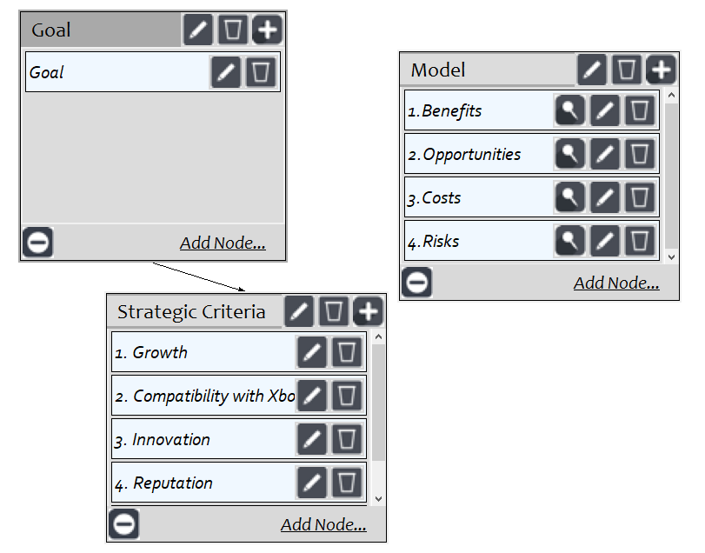
Strategic criteria

Slide 8
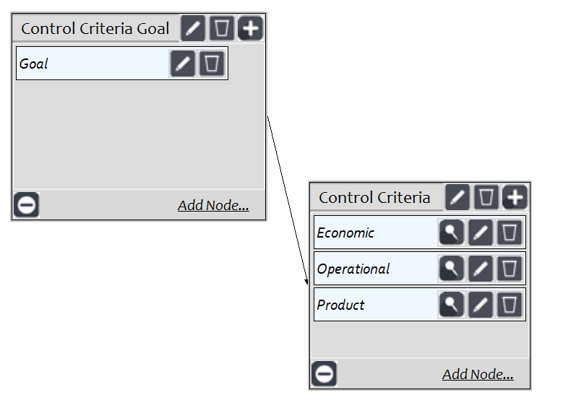
Benefits: Control Criteria

Slide 9
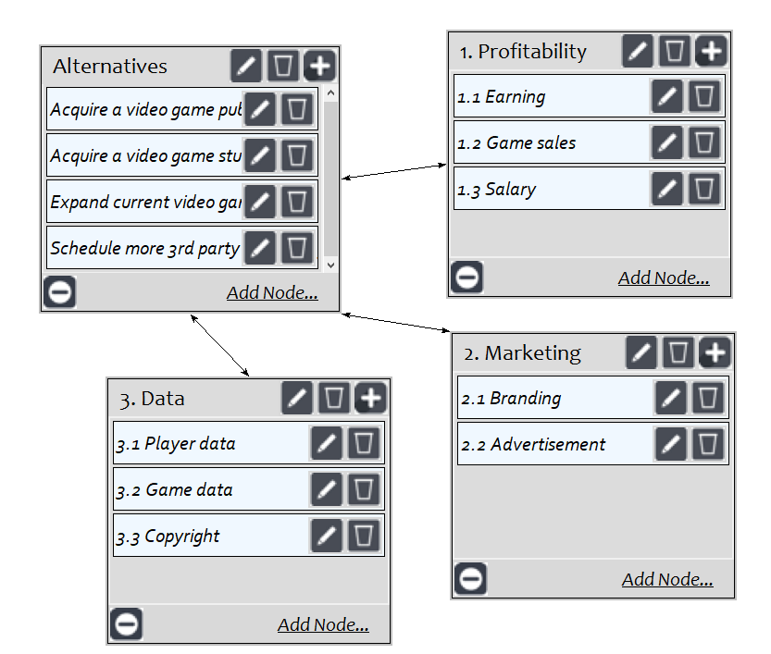
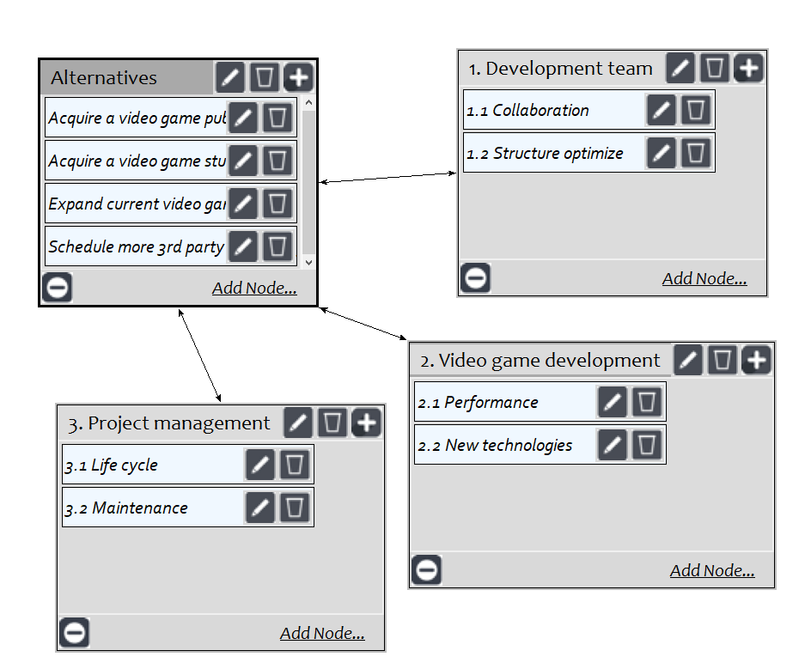
Benefits: Economic, Operational

Slide 10
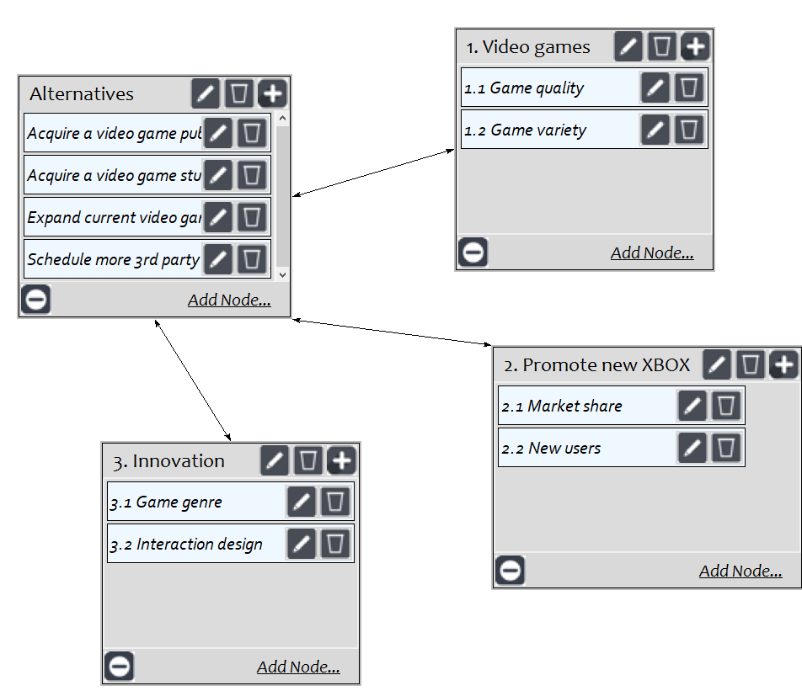
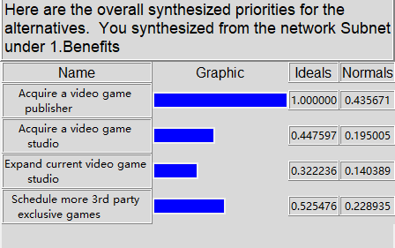
Benefits: product results

Slide 11
Opportunities: Control Criteria

Slide 12
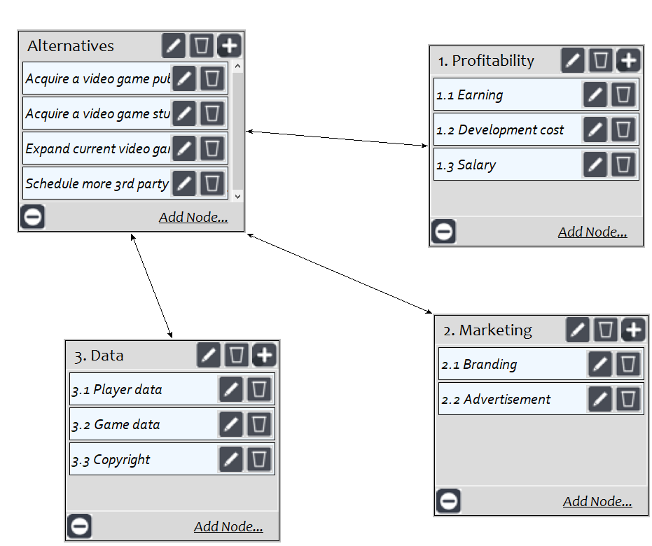
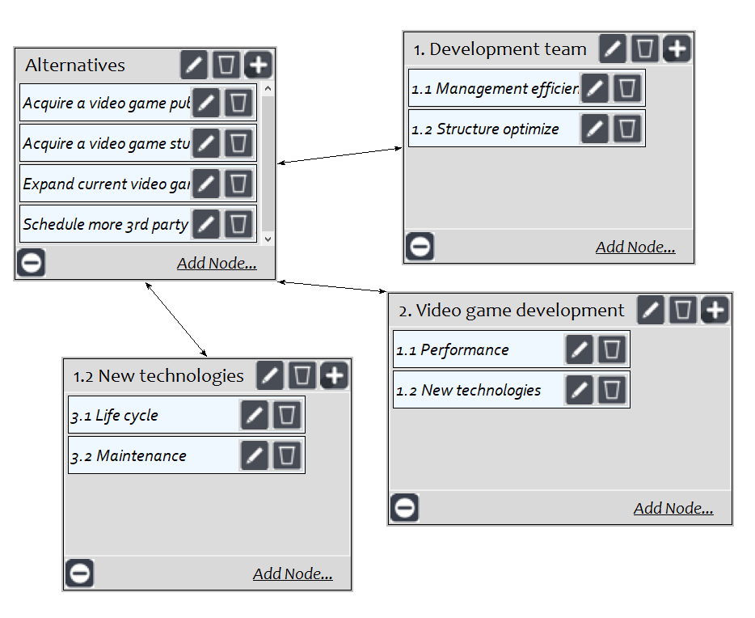
Opportunities: Economic, Operational

Slide 13
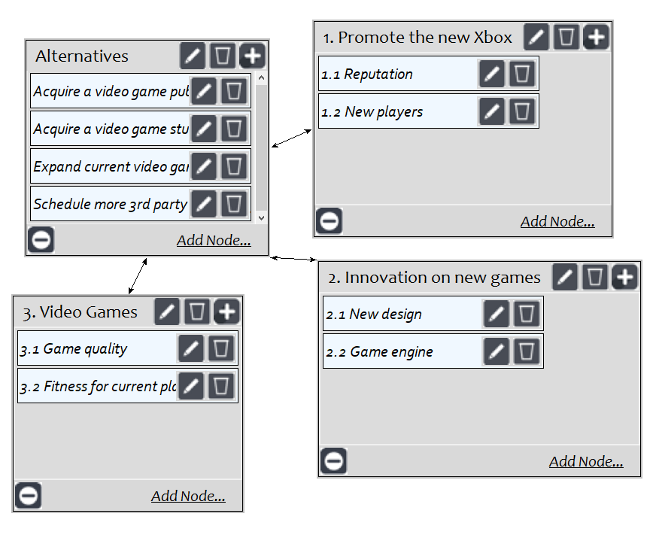
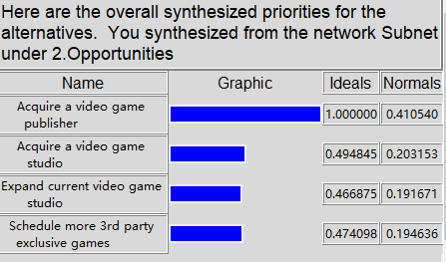
Opportunities: Product, result

Slide 14
Costs: Control Criteria

Slide 15
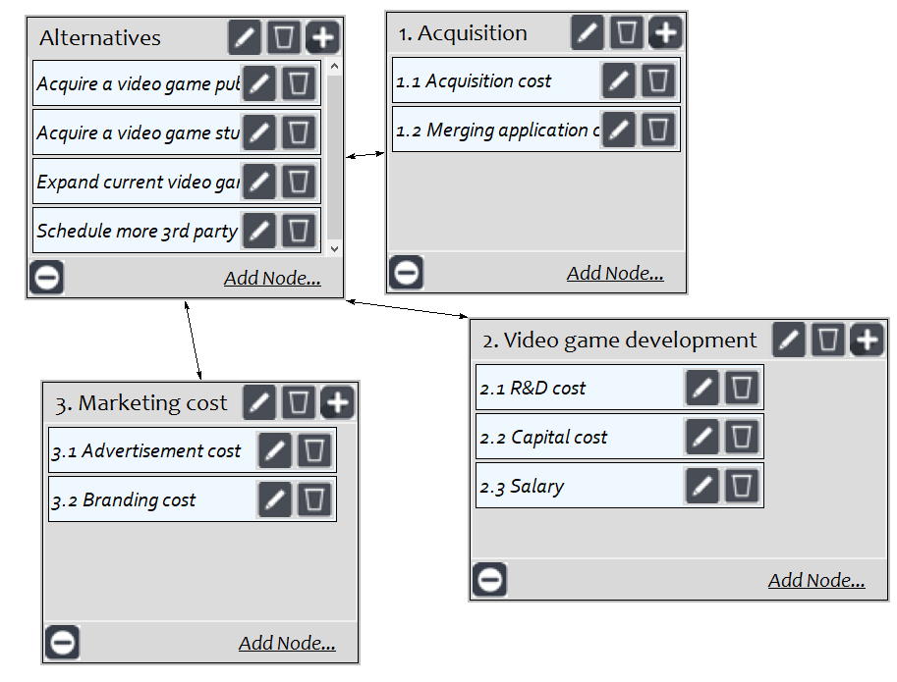
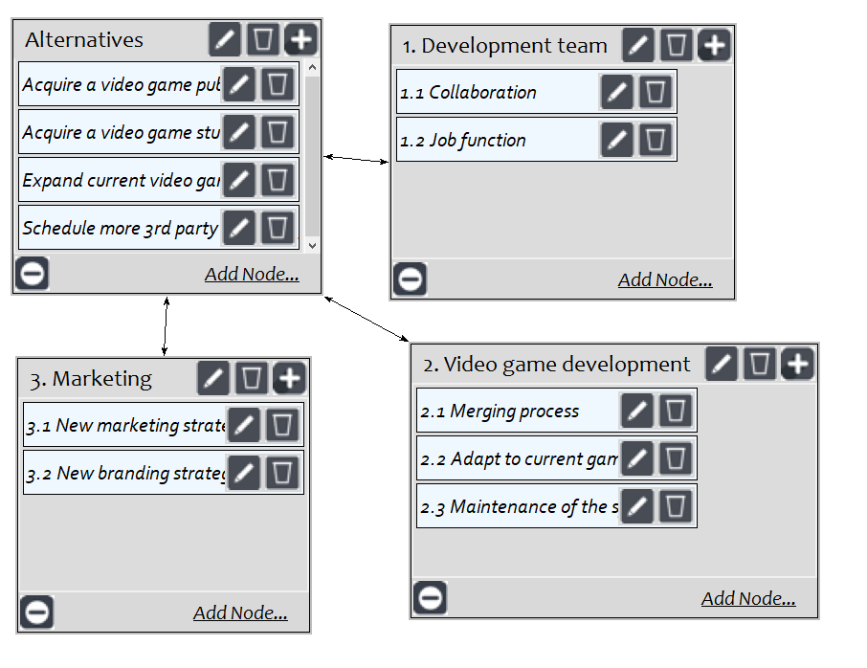
Costs: Economic, Operational

Slide 16
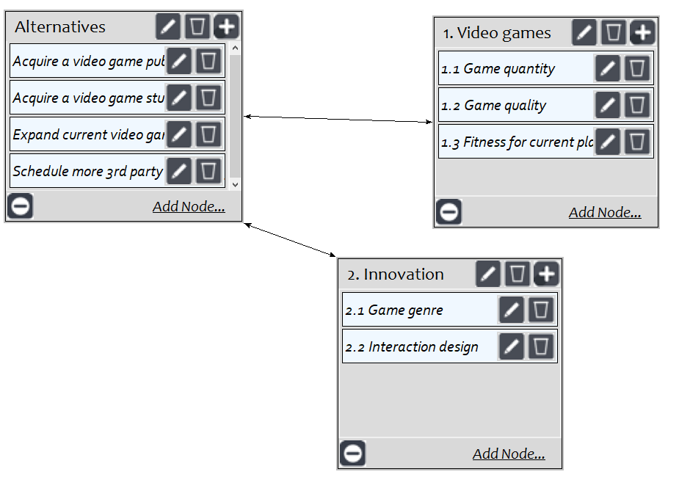
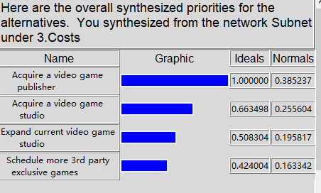
Costs: Product, result

Slide 17
Risks: Control Criteria

Slide 18
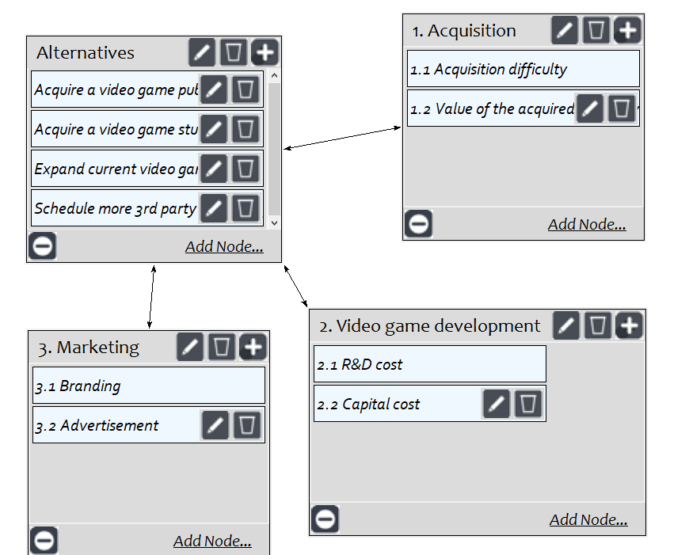
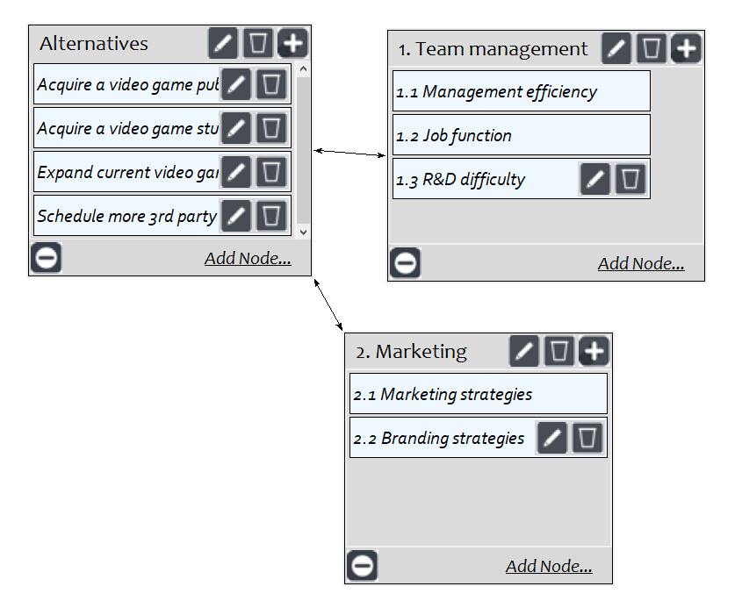
Risks: Economic, Operational

Slide 19
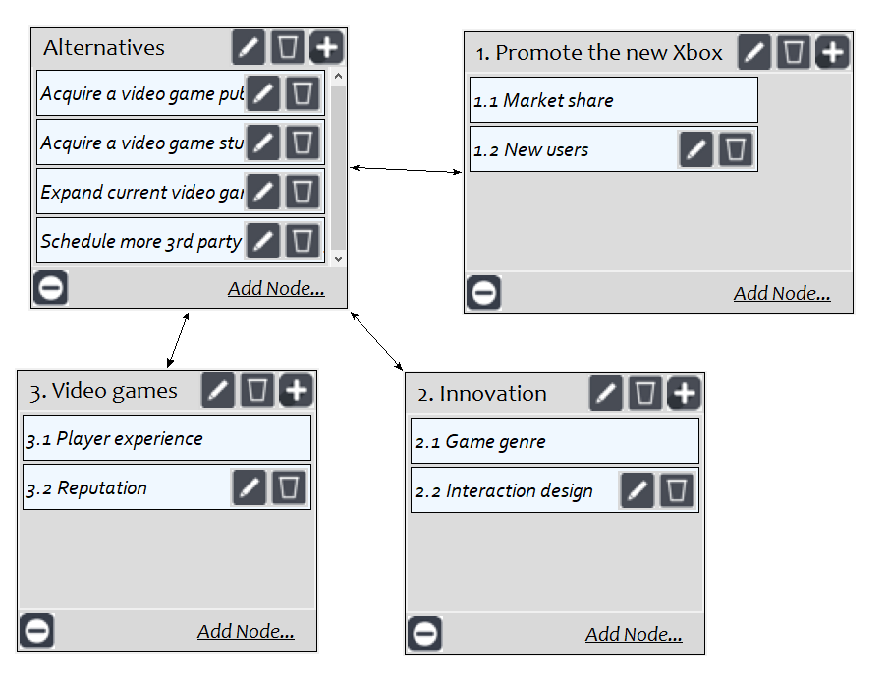
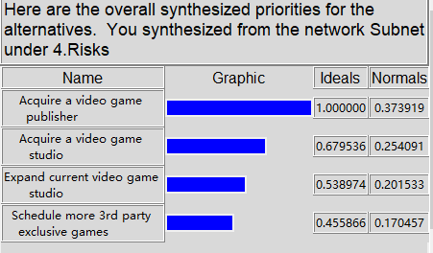
Risks: Product, result

Slide 20
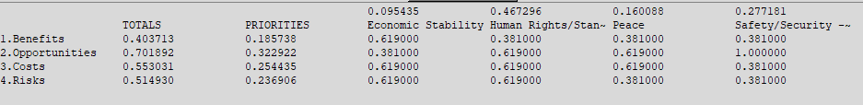
Rating result

Slide 21
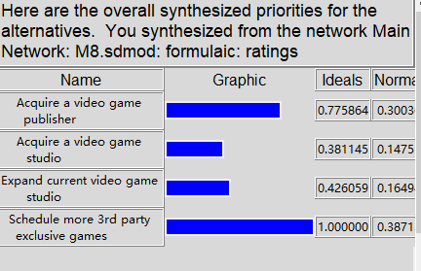
Overall Synthesis – Multiplicative – Short Term Solution

Slide 22
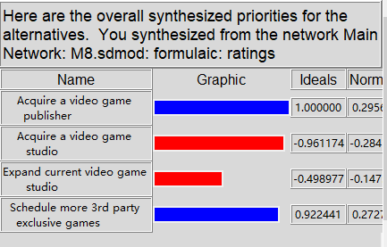
Overall Synthesis- Additive (negative)- Long Term Solution

Slide 23
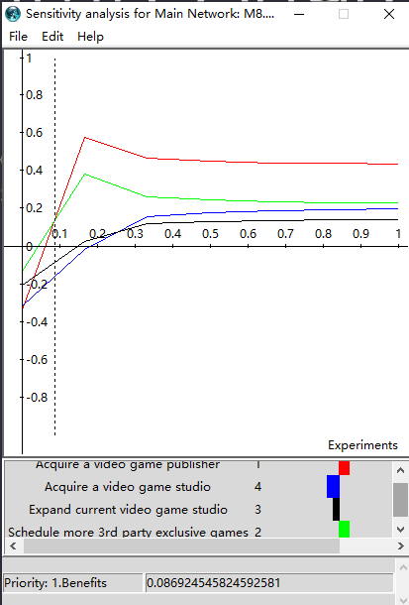
Sensitivity Analysis
Benefits
The Schedule more 3rd party exclusive games alternative will have the highest value if the priority of benefits changes to below 0.09

Slide 24
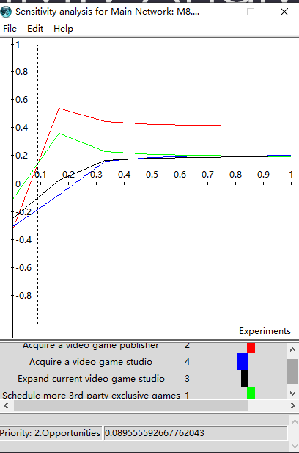
Sensitivity Analysis
Opportunities
The Schedule more 3rd party exclusive games alternative will have the highest value if the priority of opportunities changes to below 0.09

Slide 25
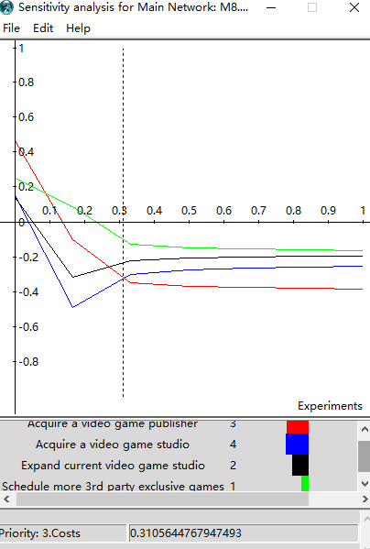
Sensitivity Analysis
Costs
The Acquire video game studios alternative will have the lowest value if the priority of costs changes to below 0.31

Slide 26
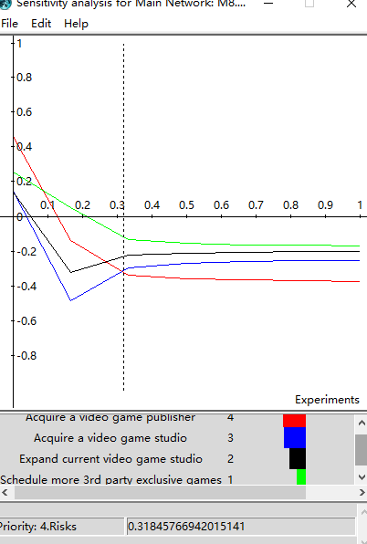
Sensitivity Analysis
Risks
The Acquire video game studios alternative will have the lowest value if the priority of risks changes to below 0.31

Slide 27
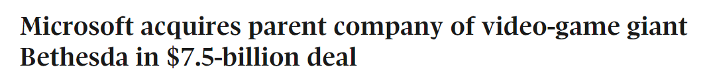
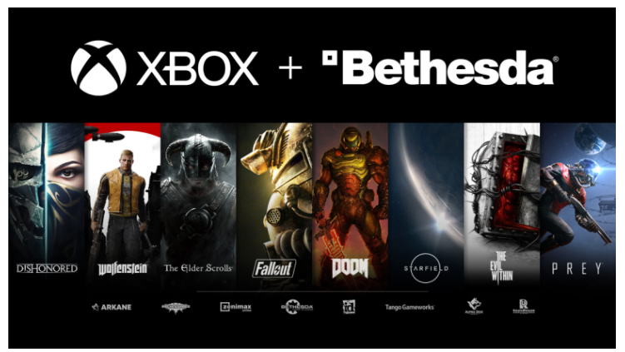
Conclusion

