Slide 1
Axel Springer Sustainability in Danger
Daniel Goldstein

Slide 2
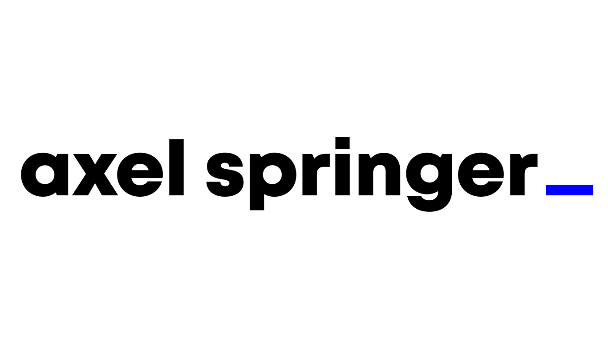
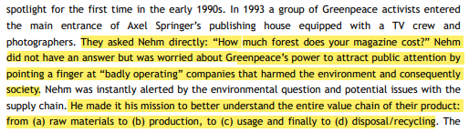
Background
European digital publishing company founded in Germany in 1946
Committed to sustainable practices
Florian Nehm – Head of Corporate Sustainability and EU Affairs

Slide 3

Decision at Stake
In 2011 Nehm “read a few interesting new details about working conditions, environmental aspects and about the devastating circumstances under which some minerals were excavated in Eastern Congo”
Sold to perpetuate the fighting the DRC
Dependent on these devices made by Apple
Usage of these devices internally
Created apps for sales and revenue numbers, forecasts, etc.
What to do?
Notes:
In 1993, Nehm made a commitment to better understanding his value chain of all their products
Even though they aren’t creating these devices, Nehm is worries about how Axel Springer can be roped into this situation.
Additionally, Axel Springer is just starting to digitally expand abroad, and they heavily rely on these devices
How do you go about dealing with a situation that isn’t directly your problem?
Could this reflect poorly on Axel Springer somehow?

Slide 4
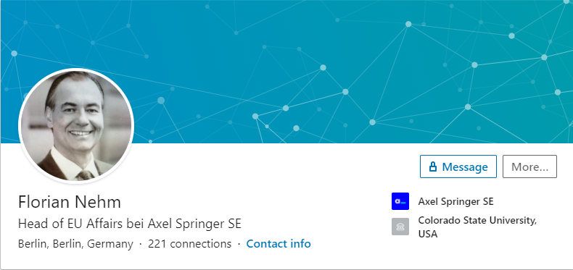
Alternatives
Do Nothing/Inform CEO – Mathias Döpfner
Use their publishing platform to shed light on this issue to companies and consumers and KEEP using the Apple devices they have
Use their publishing platform to shed light on this issue to companies and consumers and STOP using the Apple devices they have and switch to a more environmentally friendly device
Notes:
I fully understand that No Nothing is probably not the solution that should happen. HOWEVER, I believe it should be here because the BO – CR should roughly = 0 (maybe a little negative).
BUT
If the CR outweigh the other two alternatives by a lot, there’s a chance the doing nothing could be a better idea than I thought.
In the latter two alternatives, I kept in mind that “use platform” meant publishing articles and working with companies to help consumers and companies improve their sustainability habits.
The main different with continuing to use Apple devices is the negative stigma Axel Springer could potentially receive if they talk about the malpractice Apple is using but don’t actually do anything themselves about it.

Slide 5
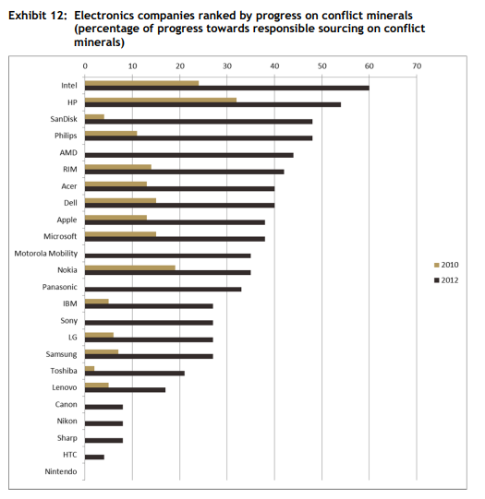
Where to get devices from?

Slide 6
Criteria for Axel Springer From the perspective of Florian Nehm
Strategic Criteria
Control Criteria
Consumer Responsibility
Corporate Sustainability
Profit
Reputation/Brand
Environmental
Operational
Organizational

Slide 7
Key Factors
Environmental
Funding the conflict in the DRC - Cost
Usage of conflict minerals in general – Cost/Risk
Operational
Innovative Thinking - Risk
Usage of conflict minerals within Axel Springer – Cost/Risk
Training - Cost
Organizational
Reputation - BOCR
Subscriptions to magazines – B/O
Sustainability commitment - BOCR
Notes:
Time consuming to go over all the factors within subnetworks, but I wanted to give you an idea of what I think Florian Nehm would have kept in mind

Slide 8
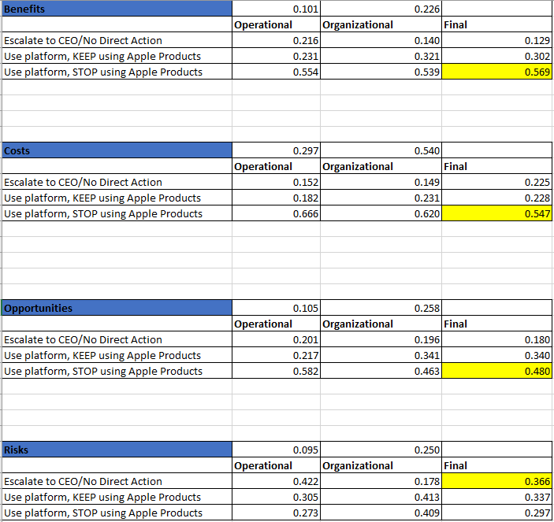
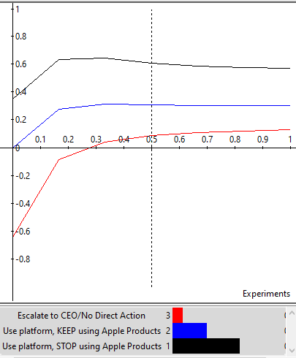
The Net-Net

Slide 9
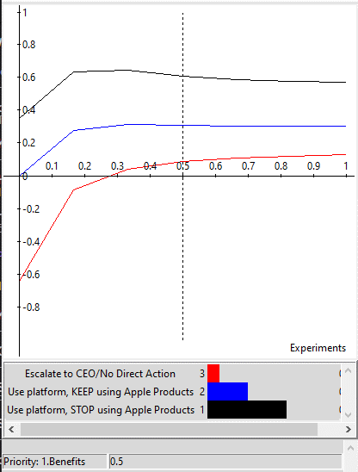
Benefits

Slide 10
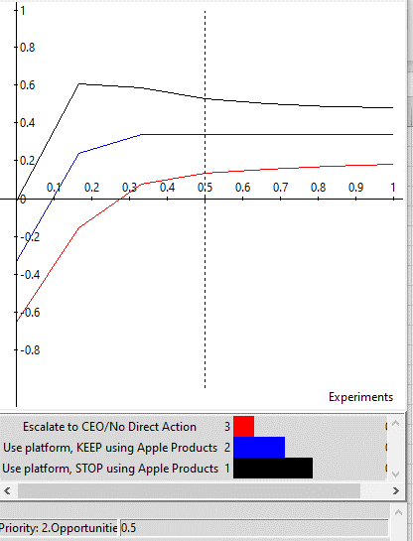
Opportunities

Slide 11
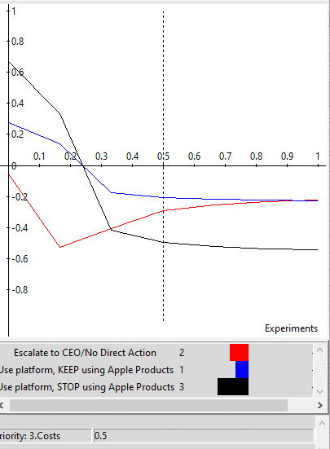
Costs
.106 actual prio.

Slide 12
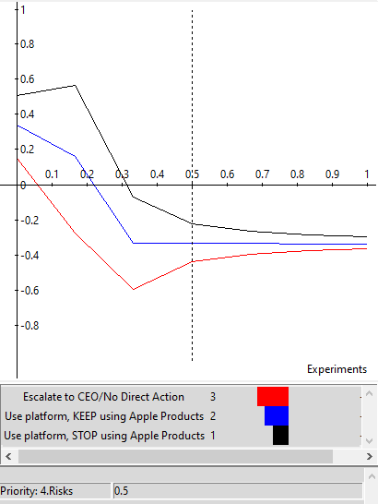
Risks

Slide 13
Results
0.220 | 0.460 | 0.119 | 0.201
Consumer Responsi~ | Corporate Sustain~ | Profit | Reputation
Benefits
Use platform, stop using Apple products
Costs
Use platform, stop using Apple products
Opportunities
Use platform, stop using Apple products
Risks
Do Nothing/Bring up to the CEO
 | PRIORITIES
1.Benefits | 0.274
2.Opportunities | 0.352
3.Costs | 0.106
4.Risks | 0.267

Slide 14
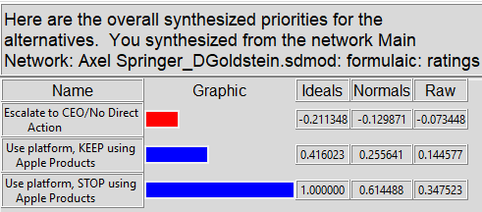
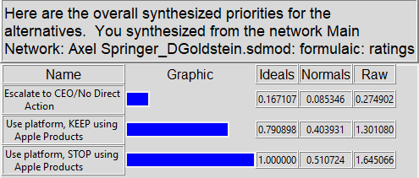
Results
Additive
Multiplicative
Notes:
I am happy and not shocked by the results. The fact that Axel Springer would stop using Apples products would send a message to companies utilizing conflict minerals that other companies will stop using their products as well unless they change. To me and according to the model, these effects are seen over time.
In the multiplicative short-term solution, the solution is still the same, but the second alternative is closer behind. To me, I think this is because the Opportunities and Risks have not come into play yet.

Slide 15
How well Did the BOCR Model Work? What would I do Differently?
While I think the BOCR model worked, I wish I could have gone back and created more alternatives
I mainly stuck to the alternatives presented in the case study
I didn’t have any rank reversals, which might have happened if I added more alternatives

Slide 16
Thank you

