Slide 1
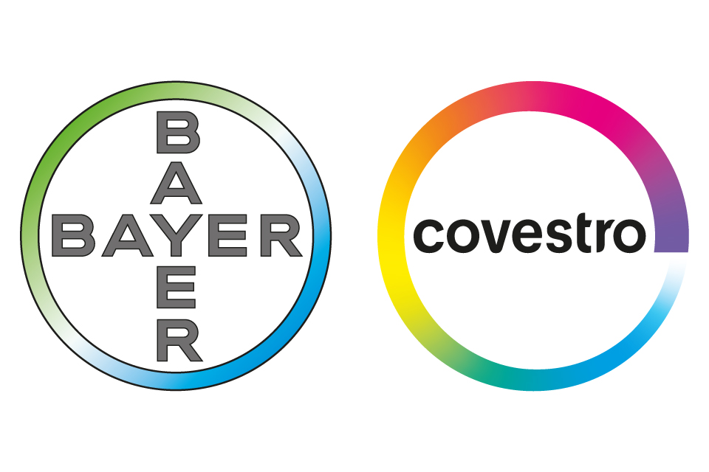
What is the next step Covestro should undertake being independent from bayer?
Friederike sand

Slide 2

Company Background

Slide 3
Carve-out timeline
Sept 2014:
Announcement of carve-out
Sept/Oct 2015:
IPO of Covestro
Sept 2016:
Bayer’s stake in Covestro 69%
Sept 2017: Bayer's stake in Covestro 24.6%

Slide 4
Alternatives
Organizational Restructuring
Speed up business decision making
Acquire New Segment
Diversification
Acquire Same Segment
Increase market share
Do Nothing
Low cost
Assimilate to a fast-changing market
Reduce cost
Acquire segment knowledge
Synergies
Reduce competition
Enlarge customer base
Stability
No impact on employees

Slide 5
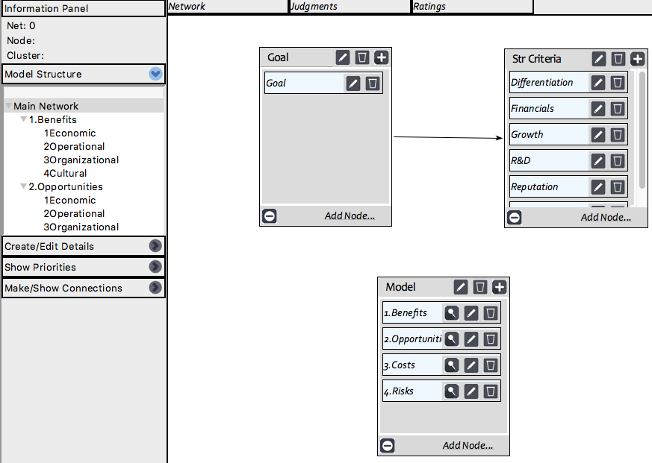
The Model
Differentiation
Reputation
Growth
Next Step for Covestro
Financials
Synergies
R&D

Slide 6
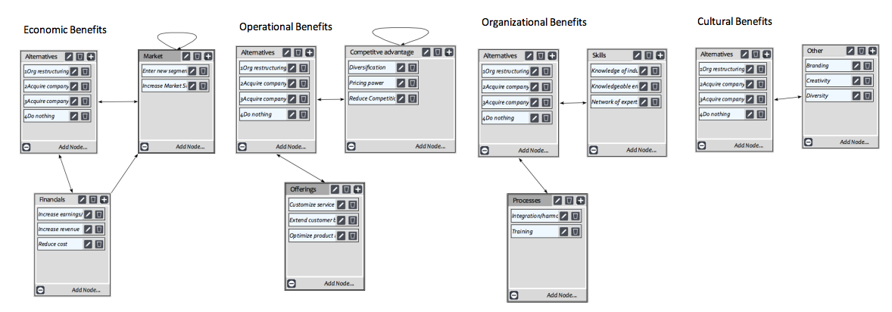
Benefits

Slide 7
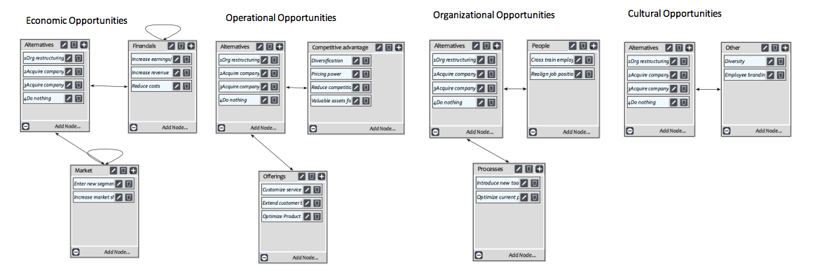
Opportunities

Slide 8
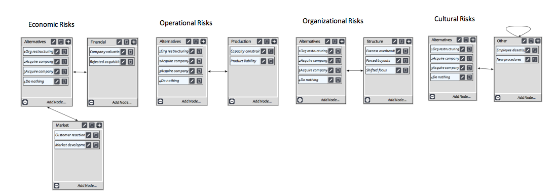
Risks

Slide 9
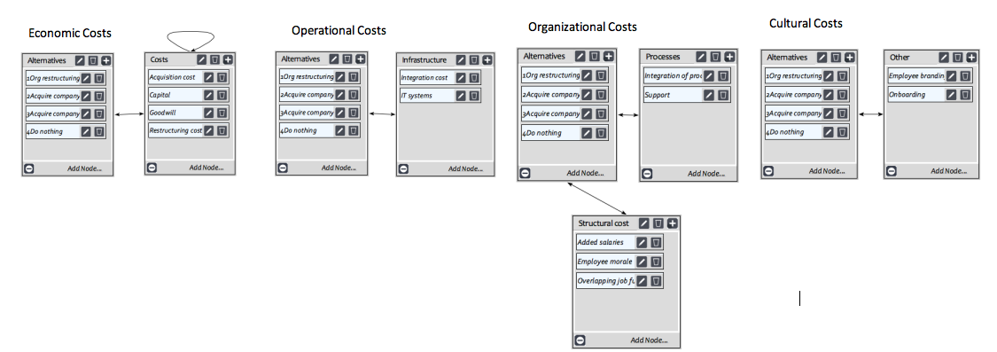
Costs

Slide 10
Steps
Pair-wise comparison of the six strategic criteria
Judgement for each subnet to create BCOR priorities
Comparison of BCOR priorities against strategic criteria priorities
Model synthetization

Slide 11
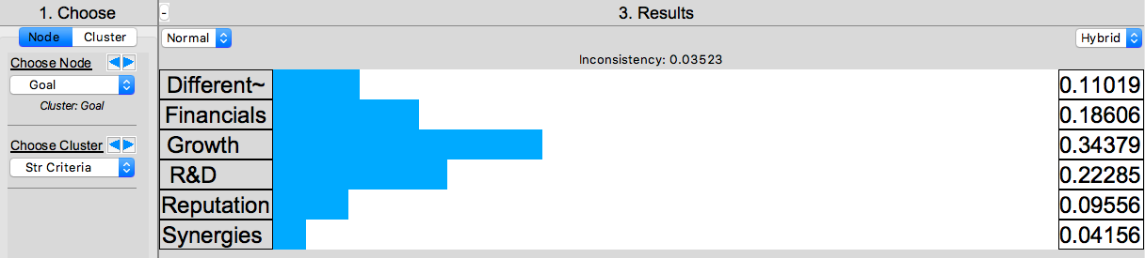
Growth is most important for Covestro
Pair-wise comparison of the six strategic criteria
Judgement for each subnet to create BCOR priorities
Comparison of BCOR priorities against strategic criteria priorities
Model synthetization

Slide 12
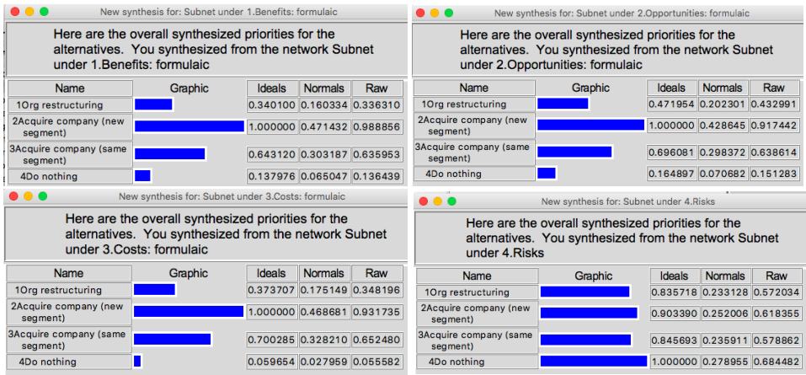
New Segment provides most benefits & opportunities but shows highest cost
Pair-wise comparison of the six strategic criteria
Judgement for each subnet to create BCOR priorities
Comparison of BCOR priorities against strategic criteria priorities
Model synthetization

Slide 13
Rating Scale
Pair-wise comparison of the six strategic criteria
Judgement for each subnet to create BCOR priorities
Comparison of BCOR priorities against strategic criteria priorities
Model synthetization

Slide 14
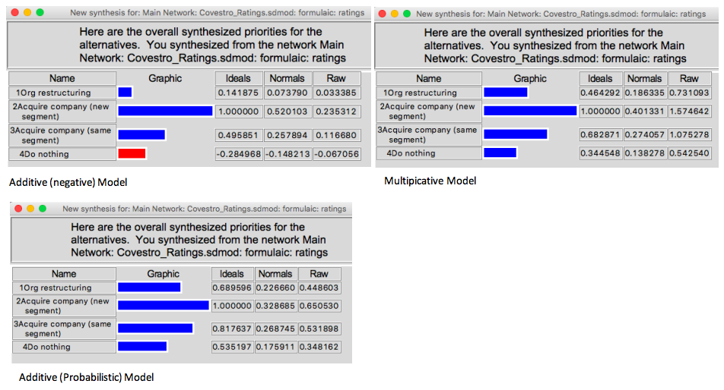
Acquiring a company that operates in a new segment is the best alternative
Pair-wise comparison of the six strategic criteria
Judgement for each subnet to create BCOR priorities
Comparison of BCOR priorities against strategic criteria priorities
Model synthetization

Slide 15

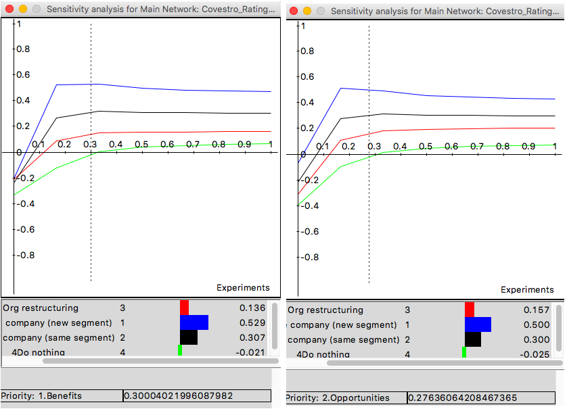
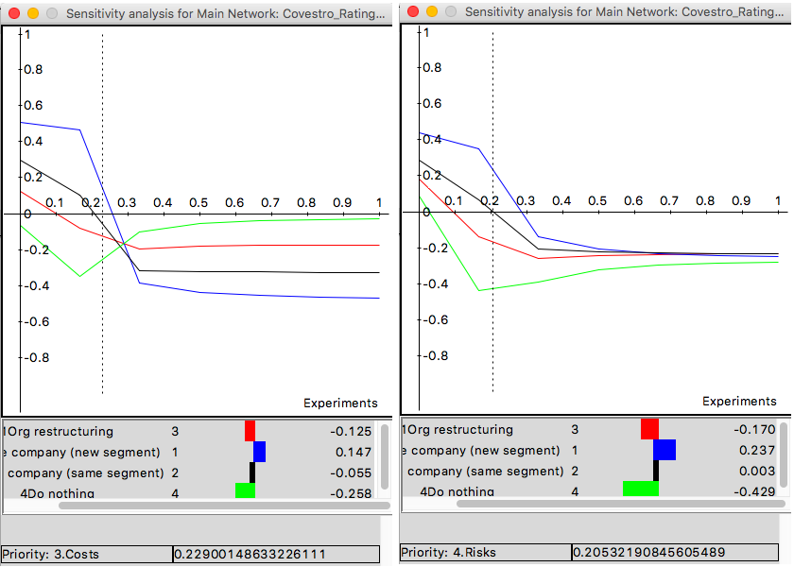
Sensitivity Analysis

Slide 16
Conclusion
Acquire a new company that is operating in a segment, where Covestro is not operating yet
… sustain its competitive advantage
…foster growth and innovation
… generate great result for investors

Slide 17
Ways to Improve the Model
Select specific options for companies to purchase to get a better insight in the BOCR associated with it
Perform more extensive research to determine economic benefits

Slide 18
Thank you for your attention!
Questions?

