Slide 1
Company x’s allocation of funds during covid-19 AHP/Ratings Model
Lexie DeWaine

Slide 2
Project profiles
Personal Assistance WFH (total cost $35,956,360)
• Laptops $1,011,560
• Monthly Wi-Fi Stipend $ 16,552,800
• Home Office Allowance $ 18,392,000
In Office Costs WFH (total cost $12,517,700)
• Extended I.T. Department $ 6,795,750
• Software for Laptops $ 2,000,000
• Monitoring Devices on Laptops $ 3,721,950
Side Effects of Covid WFH (total cost $955,900)
• Paid additional sick days for employees $0
• Masks/gloves $ 629,200
• Routine in-office testing $ 326,700
Extra-Curricular WFH (total cost $270,000)
• Online Training $ 135,000
• Virtual Happy Hours $0
• Virtual Gifts $ 135,000
*bold indicates monthly cost that has been multiplied by 9

Slide 3
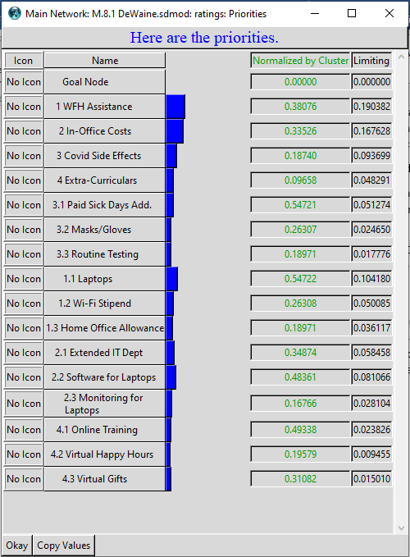
Decision making tool
WFH Assistance
In-Office Costs
Covid Side Effects
Extra-Curriculars
Laptops are highest individualized priority
Ratings scale by most effective, beneficial, no change, harmful

Slide 4
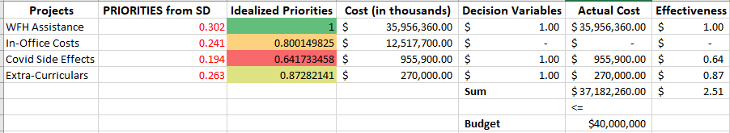
Ratings model
WFH assistance, Covid side effects, and extra curriculars as the projects that fit into the budget with $2,817,740 remaining
Software for laptops cost $2,000,000 with idealized priority of .778
Effectiveness originally 2.51
Effectiveness after software, 3.29
Only without extended I.T. department and monitoring for laptops

Slide 5
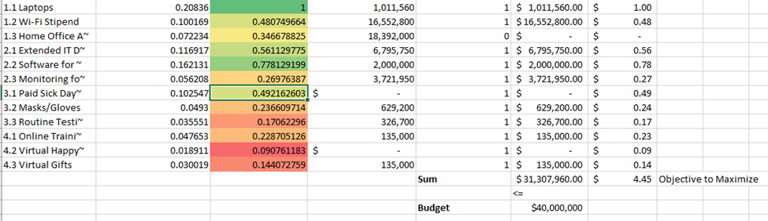
Additional ratings model
Each project broken farther down
Fully funds all projects, except for the home office payment, $8,692,040 remaining, using only 88.3% of the budget
Effectiveness at 4.45
6 taken over home office allowance have priorities totaling 1.1405 rather than .3466
Most beneficial for company and employees

