Slide 1
ANP BOCR - WHAT FORM OF GLOBALIZATION IS THE BEST FIT FOR COMPANY X?
ALTERNATIVES:
  Globalization
  Globalization via acquisition
  Joint globalization
  No globalization

Slide 2
Model-BOCR subnets

Slide 3
Model – BOCR subnets

Slide 4
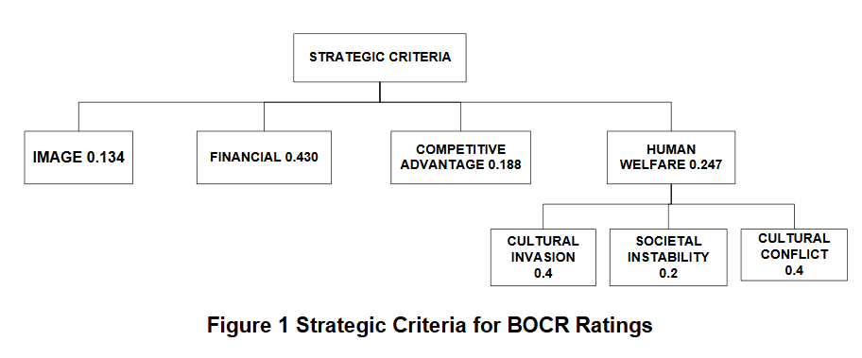
Strategic Criteria

Slide 5
Results

