Slide 1
ANP BOCR - THE MARTHA STEWART DECISION
ALTERNATIVES:
Resign as Chief Executive Officer (CEO)
Continue as CEO
Plea bargain
Spend time in jail.

Slide 2
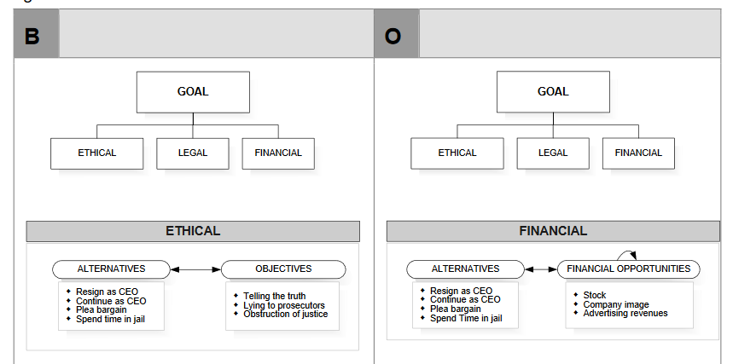
Model-BOCR subnets

Slide 3
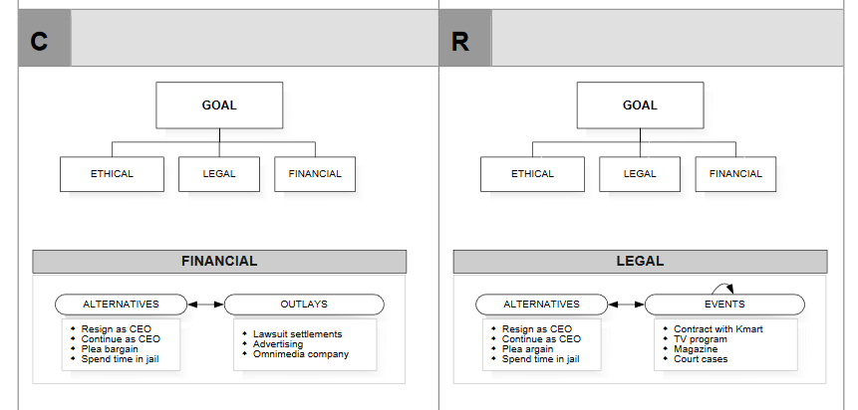
Model – BOCR subnets

Slide 4
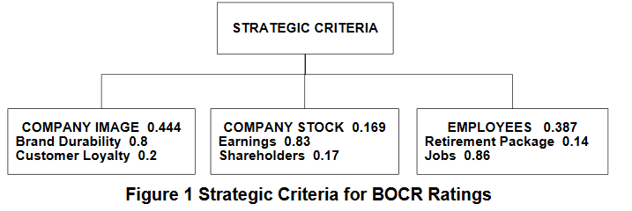
Strategic Criteria

Slide 5
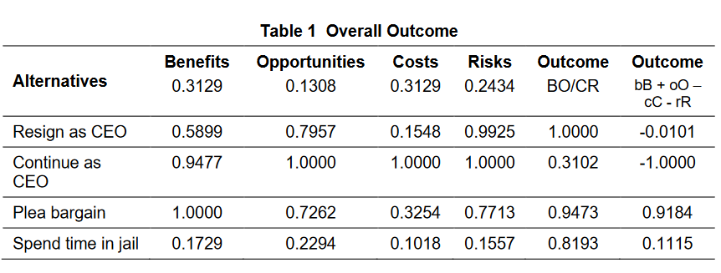
Results

