Slide 1
ANP BOCR - THE FUTURE OF THE CLASSIC PRODUCT LINES
ALTERNATIVES:
Discontinue classic product
Continue production without investment
Invest in the classic lines.

Slide 2
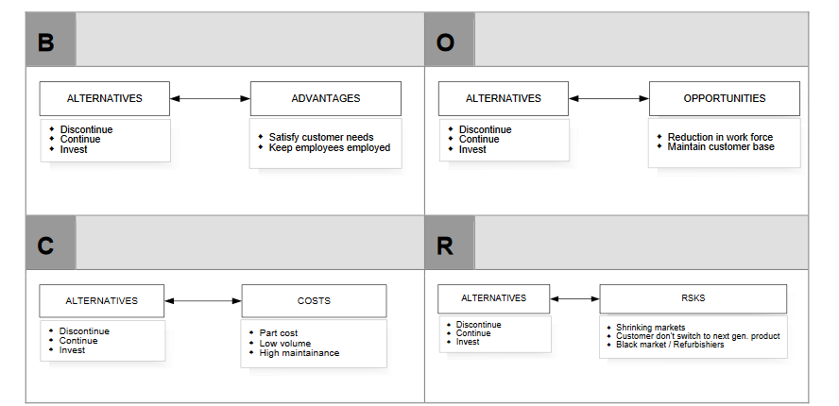
Model-BOCR subnets

Slide 3
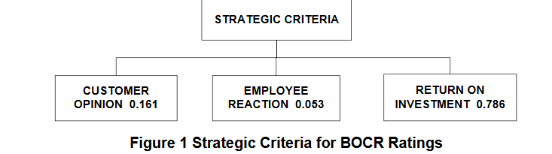
Strategic Criteria

Slide 4
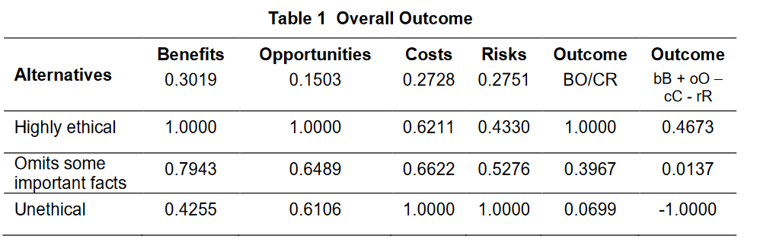
Results

