Slide 1
Employee evaluation with ratings
Goal: Employee selection
Alternatives:
Jim Kendall
Sally Brown
John Carter
Mi Sung
Arturo Chavez

Slide 2
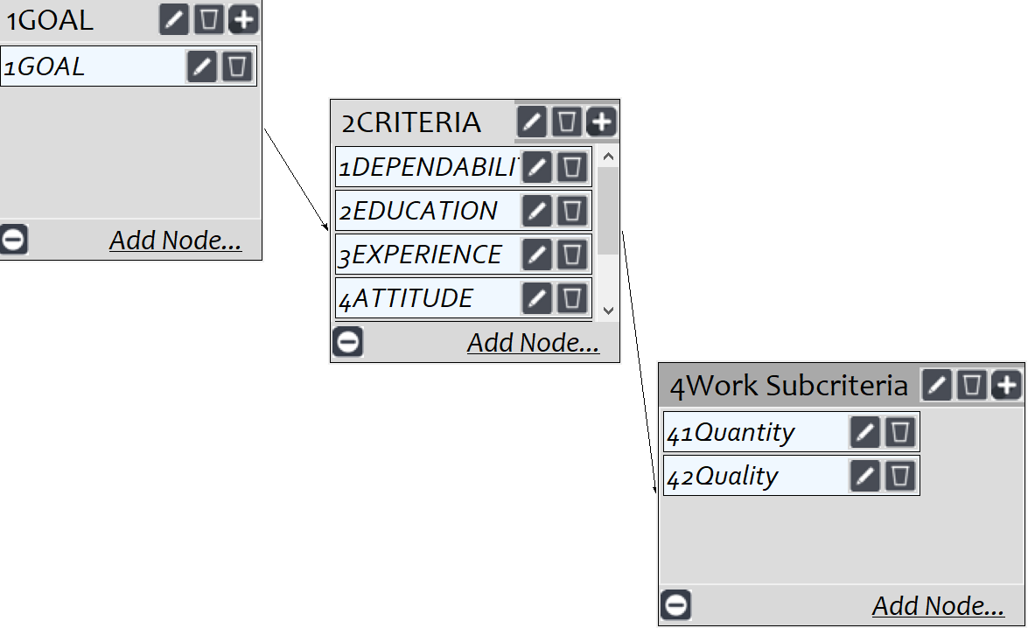
Model
Screenshot of SuperDecisions software Version 3.x

Slide 3
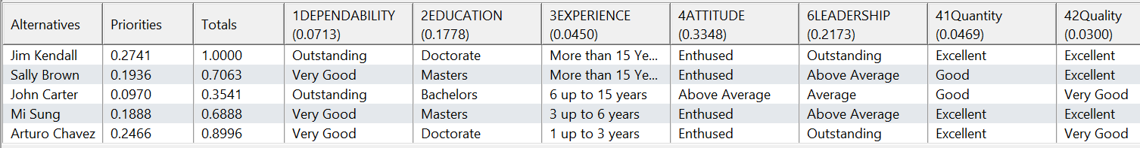
Ratings
Screenshot of SuperDecisions software Version 3.x

Slide 4
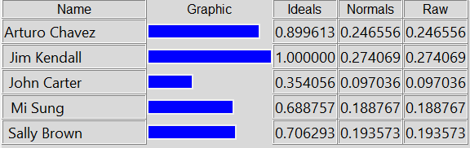
Results

