Slide 1
ANP BOCR - OFFICE SPACE SELECTION
ALTERNATIVES:
Stay at current location and remodel
Lease office space
Build a new building to house the offices.

Slide 2
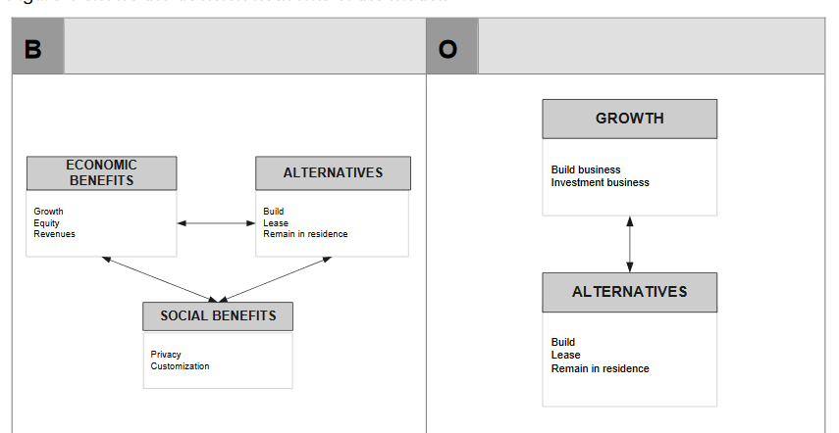
Model-Benefits and Opportunities subnets

Slide 3
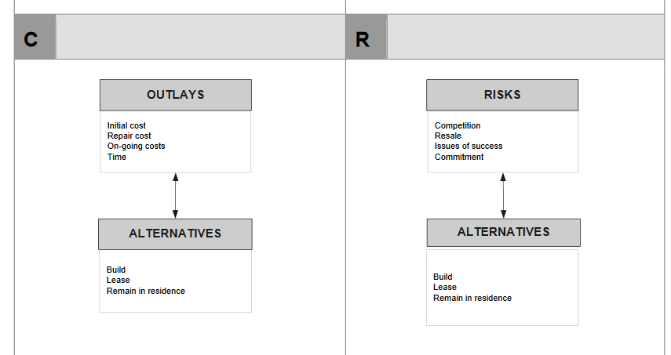
Model-Costs and Risks subnets

Slide 4
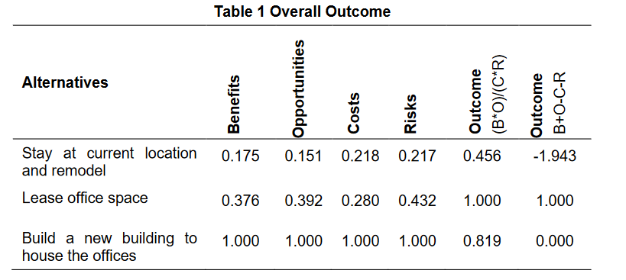
Results

