Slide 1
ANP - GOURMET PRETZEL SHOP
ALTERNATIVES:
Franchise operation
Private ownership

Slide 2
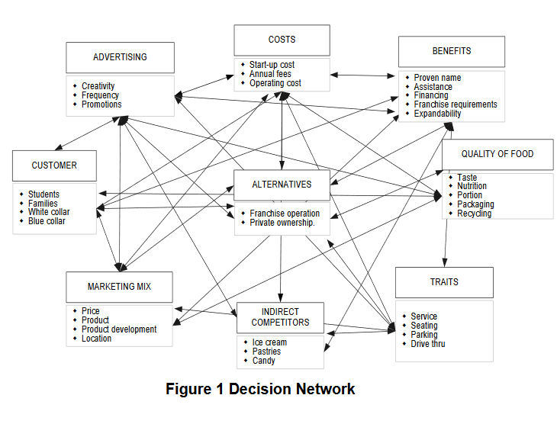
ANP Model

Slide 3
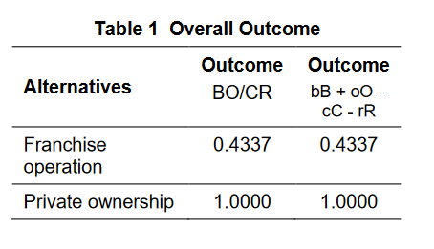
Results

