Slide 1
ANP BOCR - DETERMINING THE BEST IMPLEMENTATION PROGRAM AMONG BALANCED SCORECARD,LEAN,AND COMBINATIONS OF THEM
ALTERNATIVES:
  BSC
  Lean
  Major lean &BSC
  Some lean & BSC

Slide 2
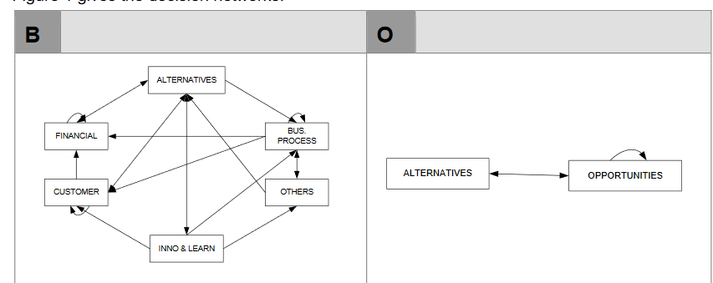
Model-Benefits and Opportunities subnets

Slide 3
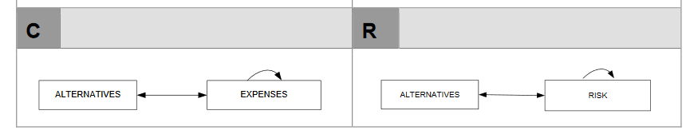
Model-Costs and Risks subnets

Slide 4
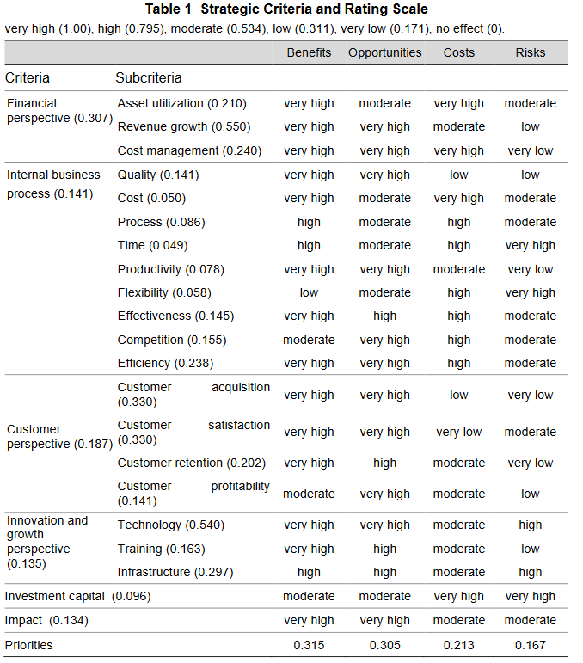
Strategic Criteria

Slide 5
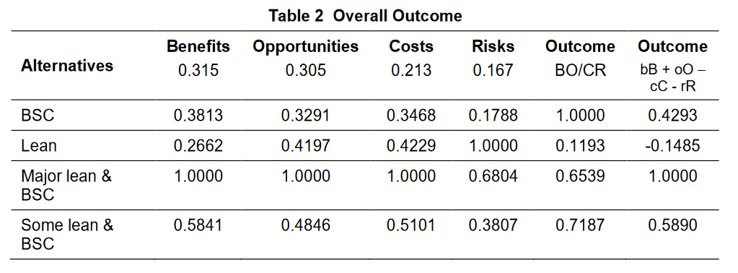
Results

