Slide 1
ANP BOCR - BUSINESS ETHICS:FACED WITH A CHALLENGING DECISION
ALTERNATIVES:
Highly ethical
Omits some important facts
Unethical

Slide 2
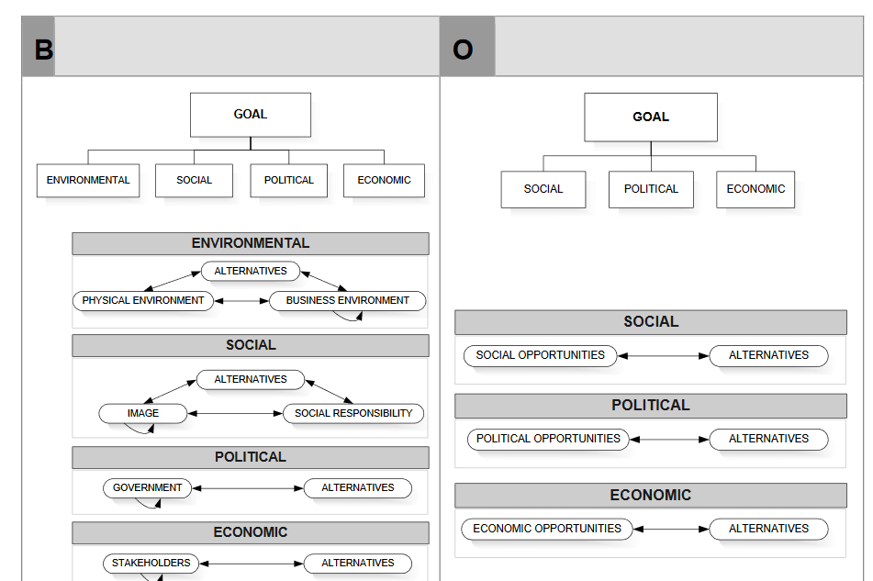
Model-Benefits and Opportunities subnets

Slide 3
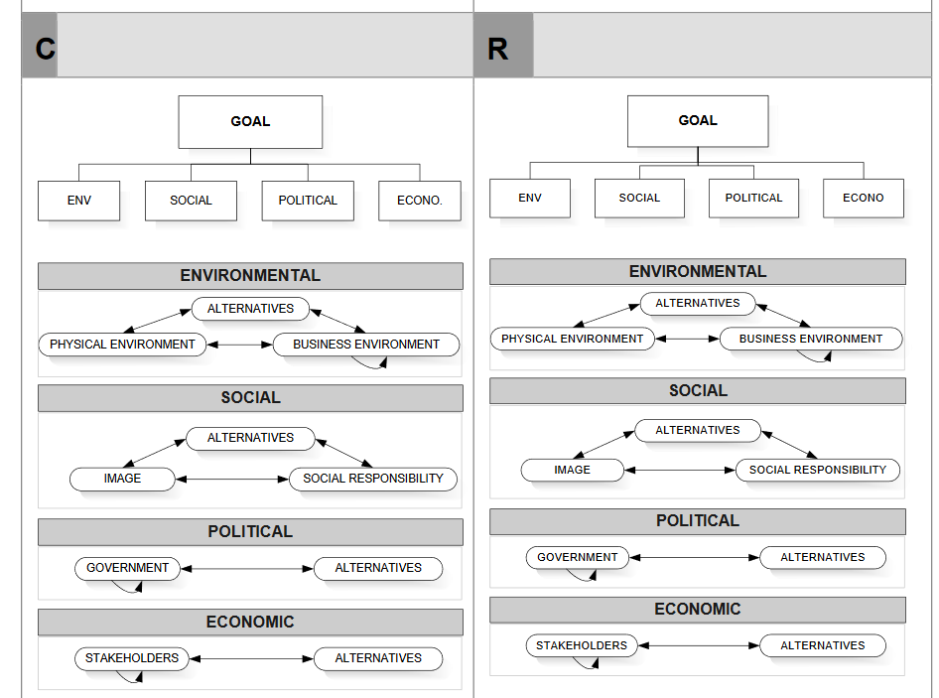
Model-Costs and Risks subnets

Slide 4
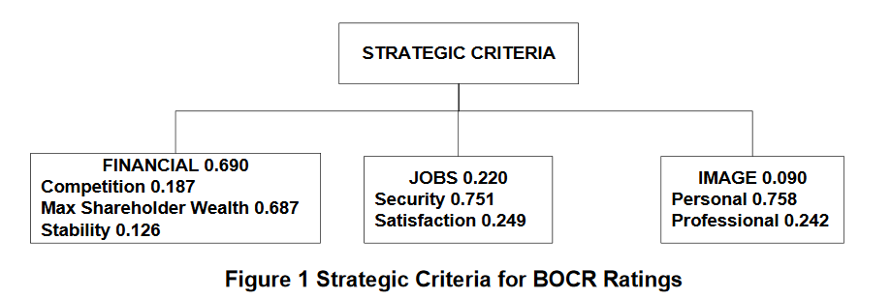
Strategic Criteria

Slide 5
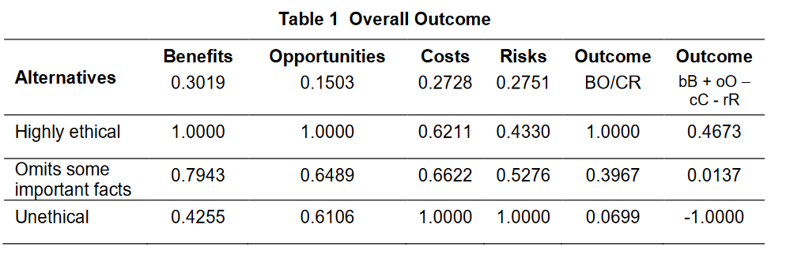
Results

