Slide 1
ANP BOCR - BEST COMPETITIVE STRATEGY FOR RITE AID
ALTERNATIVES:
  Continue expansion efforts
  File for financial restructuring
  Focus on debt reduction

Slide 2
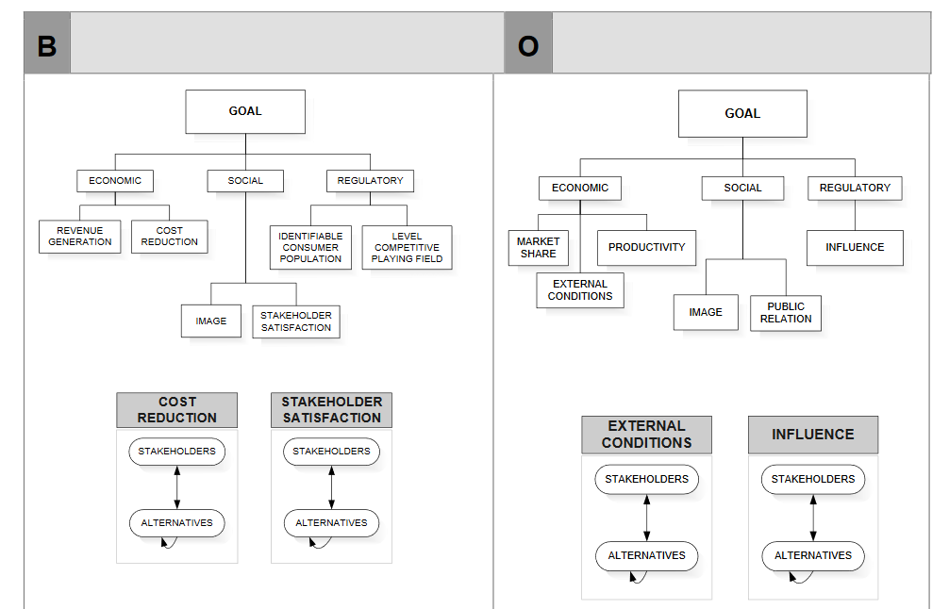
Model-Benefits and Opportunities subnets

Slide 3
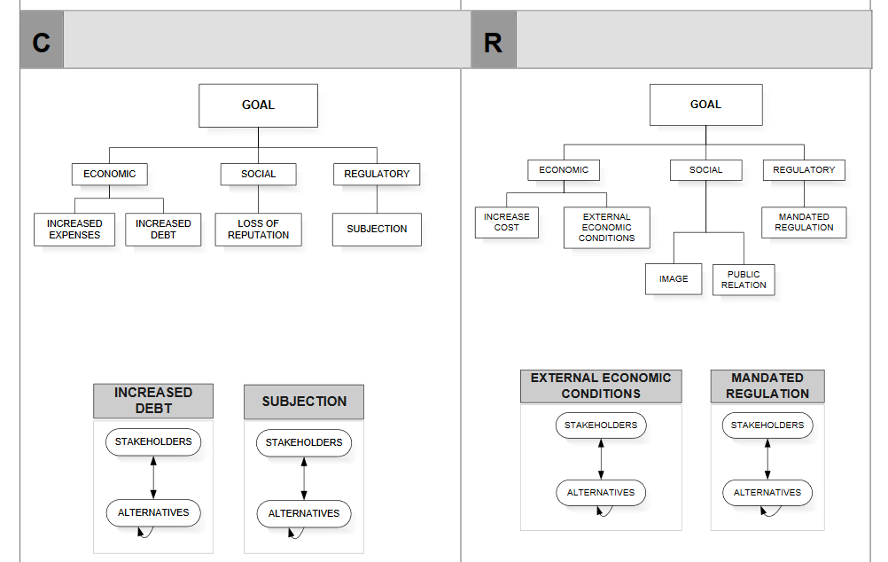
Model-Costs and Risks subnets

Slide 4
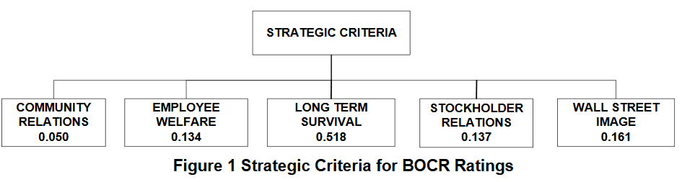
Strategic Criteria

Slide 5
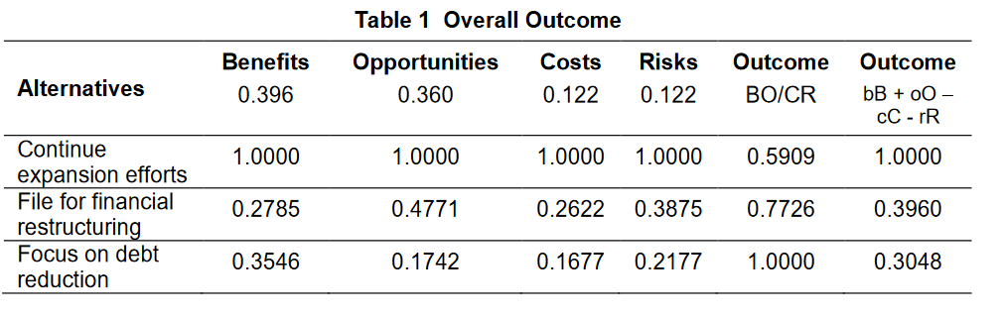
Results

