Slide 1
ANP BOCR - ALLOCATING RESOURCES TO A DEPARTMENT
ALTERNATIVES:
Organic concept
Bluenotes in US market
Acquisitio

Slide 2
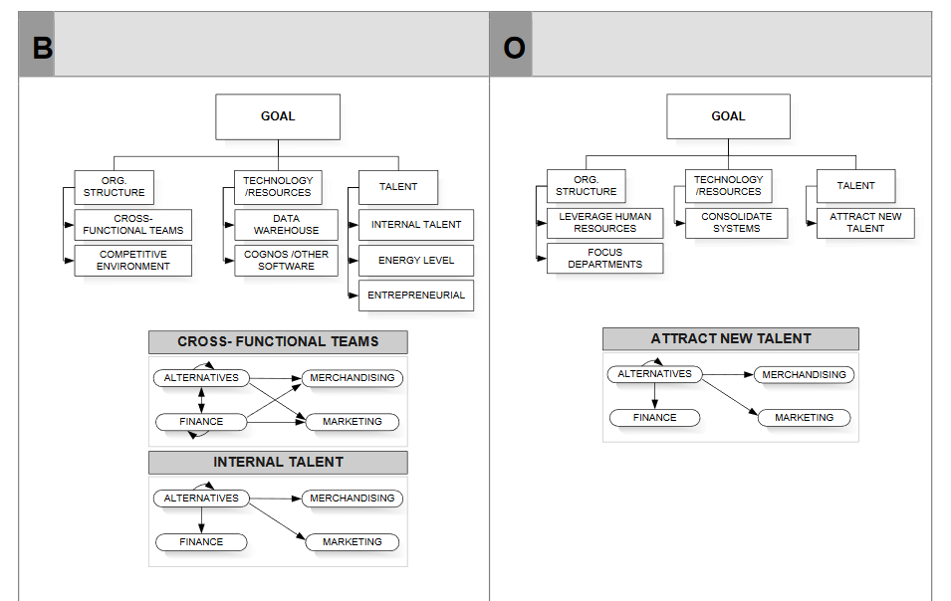
Model-Benefits and Opportunities subnets

Slide 3
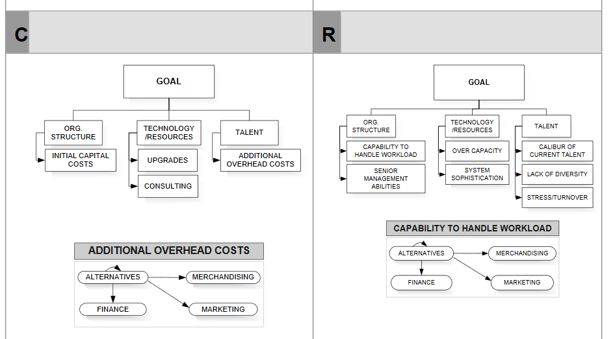
Model-Costs and Risks subnets

Slide 4
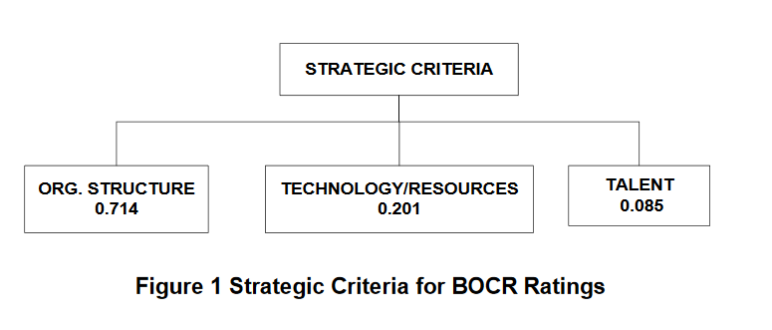
Strategic Criteria

Slide 5
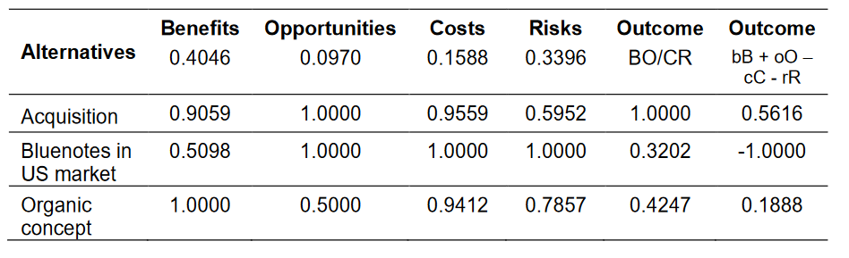
Results

