Slide 1
ANP BOCR - ACTION ON ARTHUR ANDERSEN
ALTERNATIVES:
Indictment
Drop the charges
Settle and drop the charges

Slide 2
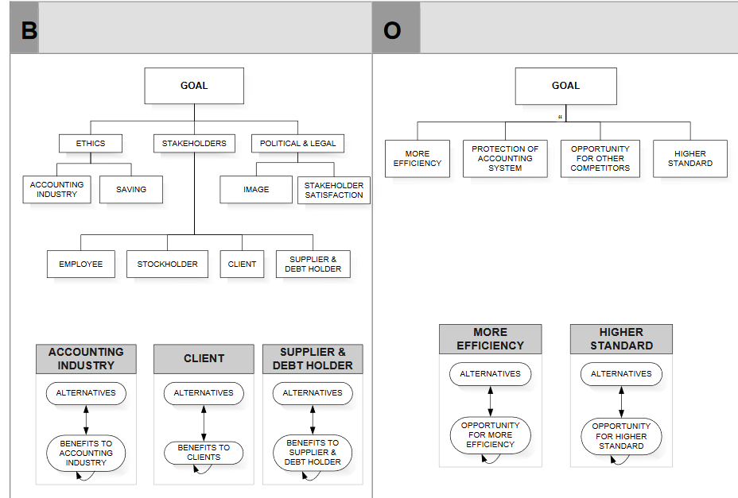
Model-Benefits and Opportunities subnets

Slide 3
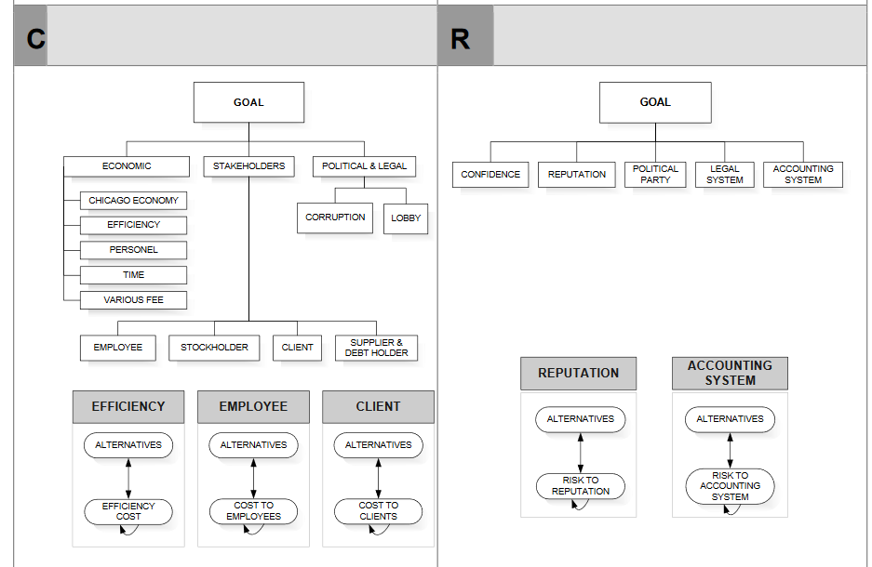
Model-Costs and Risks subnets

Slide 4
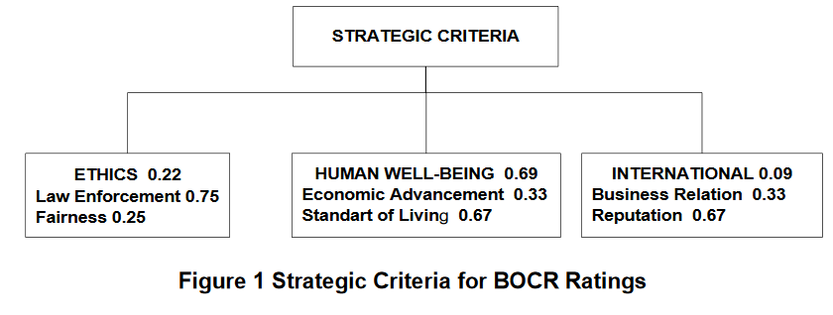
Strategic Criteria

Slide 5
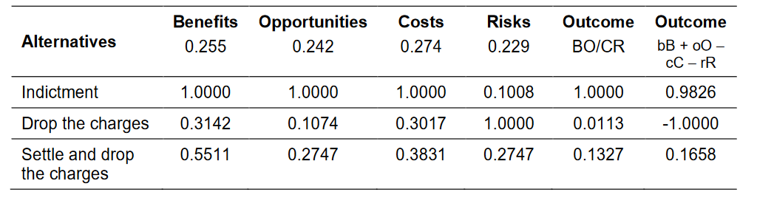
Results

