Slide 1


Konica Minolta’s Automated Workflow Decision
Gary Valkavitch
Prasad Pashte
Ed Gleeson

Slide 2
Industry Background
Main customers General Commercial Printers
  Advertising Printing (Direct Mail, Circulars, Brochures, Displays, Inserts, and Pamphlets)
  Business Cards, Stationery, Catalogs, Directories, Newspapers, Magazines, Books, and Financial/Legal Documents.
Digital printing sales increasing by 5% per year.
General Commercial Printers reported two of the most needed investments in the next two years are digital presses and workflow automation.

Slide 3
Company Background
Manufactures both Commercial Digital Presses and Multifunction Printers (MFPs).
70% of revenue is from sales of Commercial Digital Presses
Main customer base is General Commercial Printers.

Slide 4
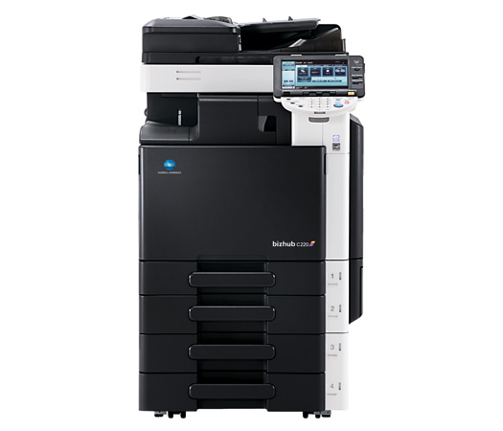
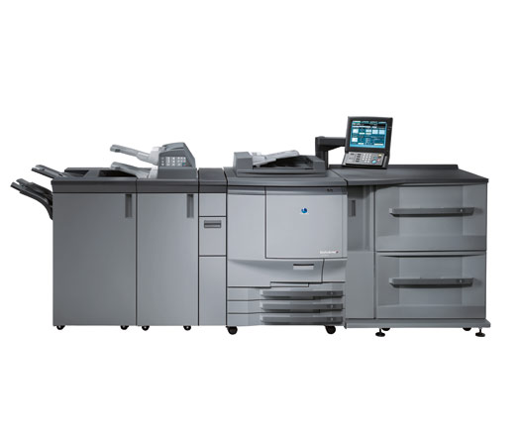
Production Digital Press Multifunction Printer

Slide 5
Alternatives
What strategy should Konica Minolta pursue to achieve long term competitive advantage?
  Develop Proprietary Automated Workflow Solution
  Acquire Electronics for Imaging (EFI)
    Major supplier of varying software offerings to the printing industry that they already have a partnership with.
  Continue Partnership with EFI

Slide 6
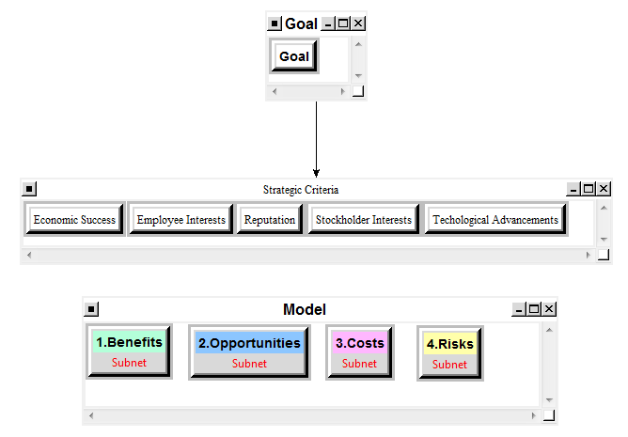
The Model

Slide 7
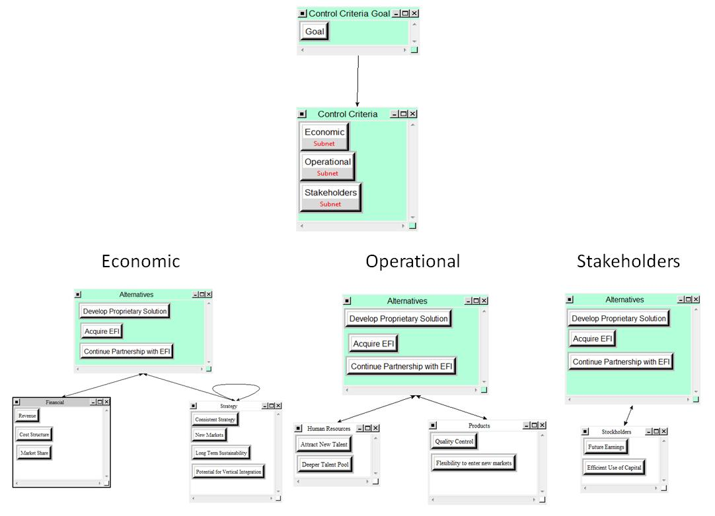
Benefits

Slide 8
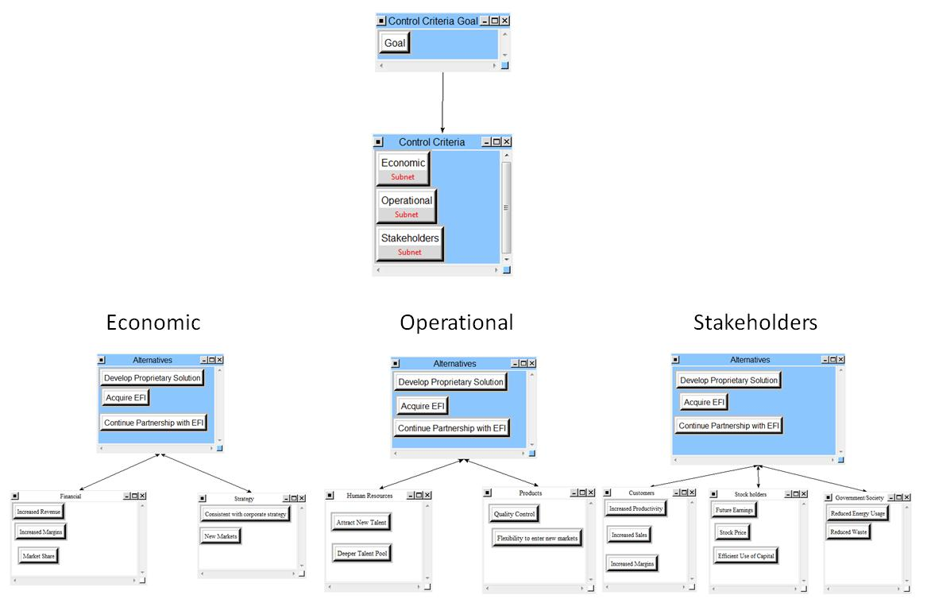
Opportunities

Slide 9
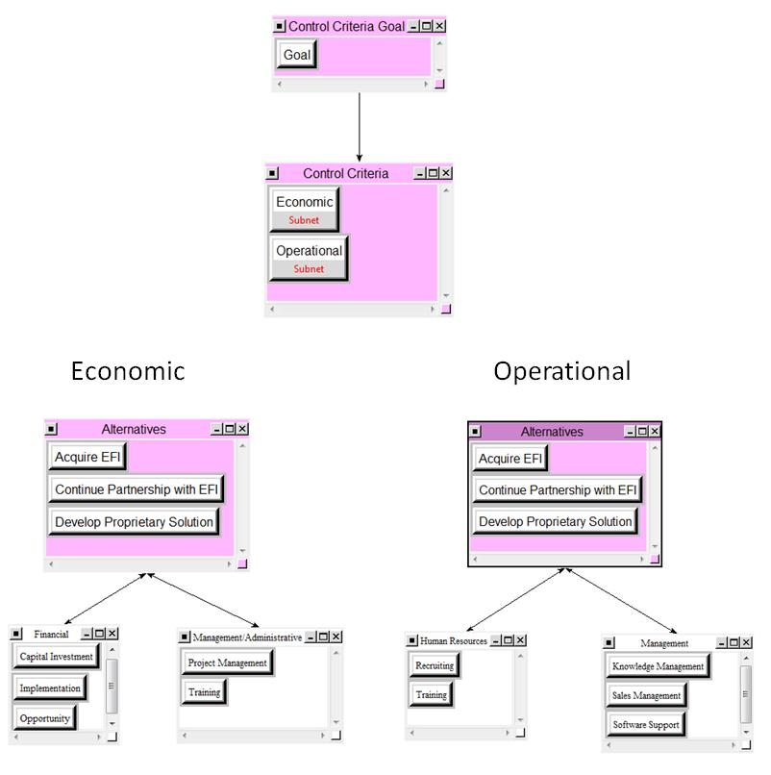
Costs

Slide 10
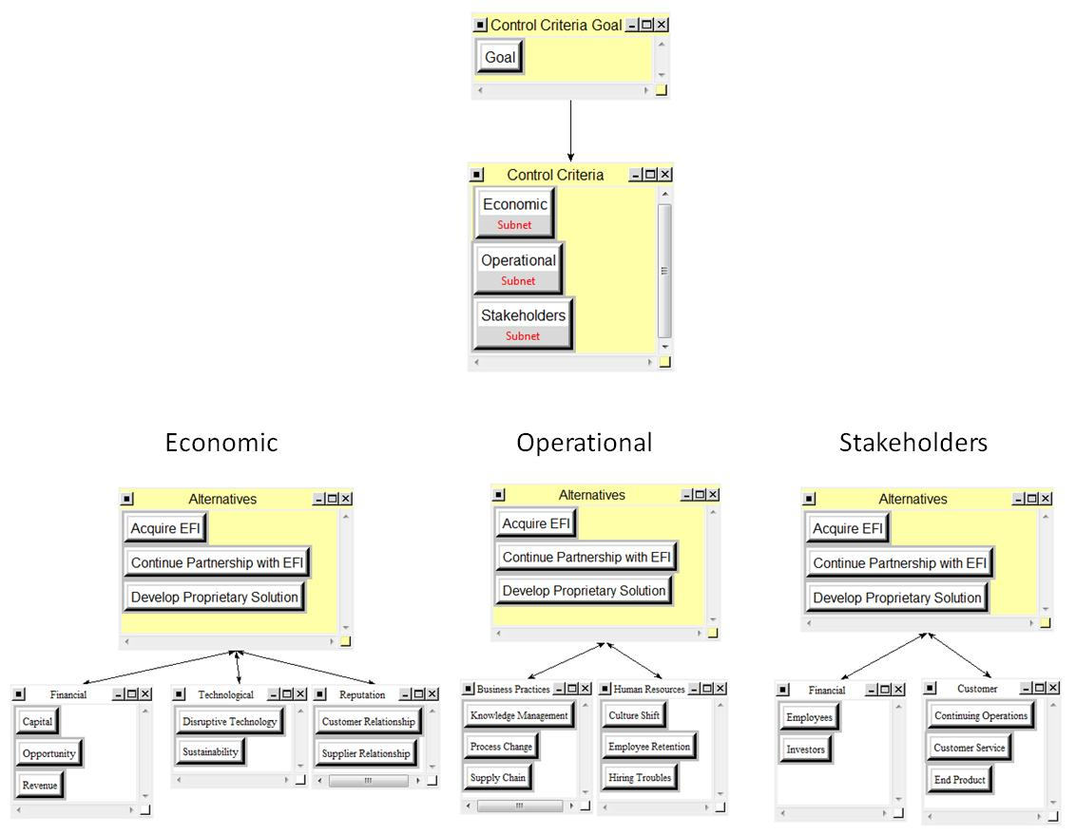
Risks

Slide 11
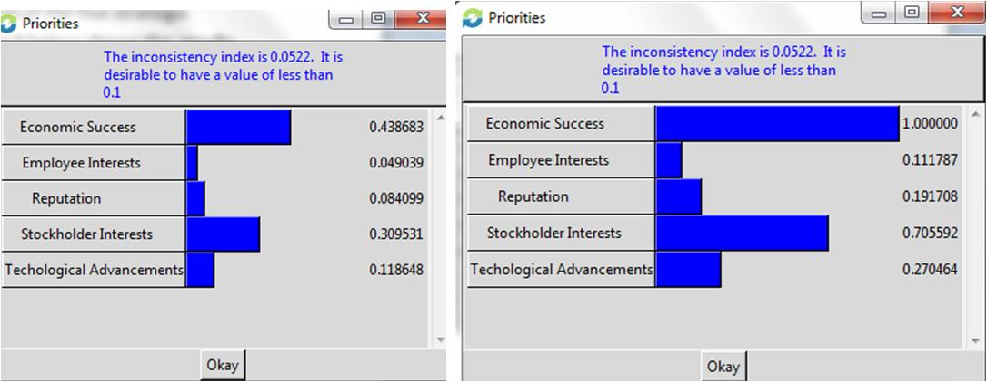
The Result—Strategic Criteria Priorities

Slide 12
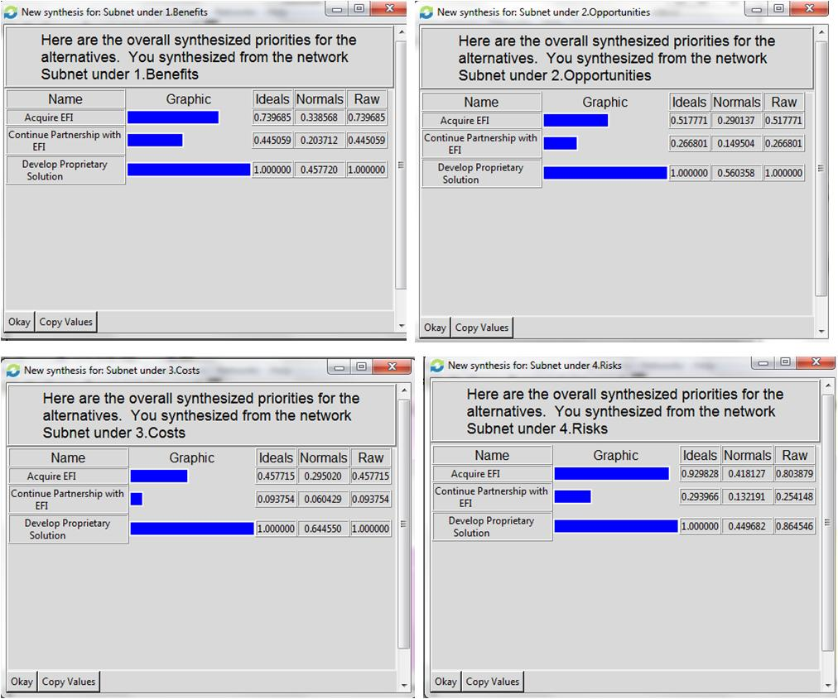
The Result—BOCR Priorities

Slide 13
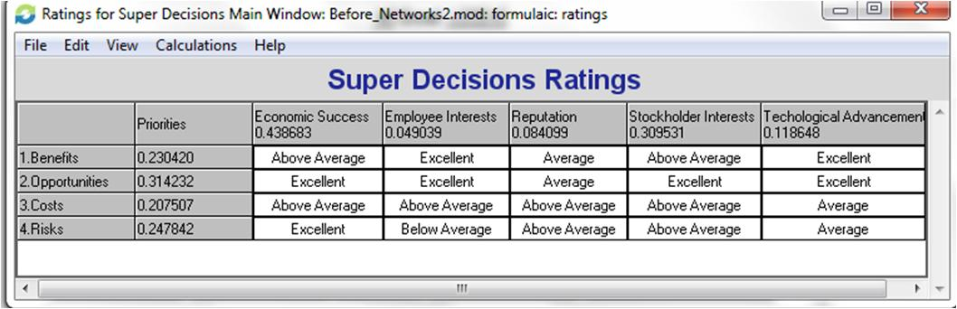
The Result
Super Decisions Ratings

Slide 14
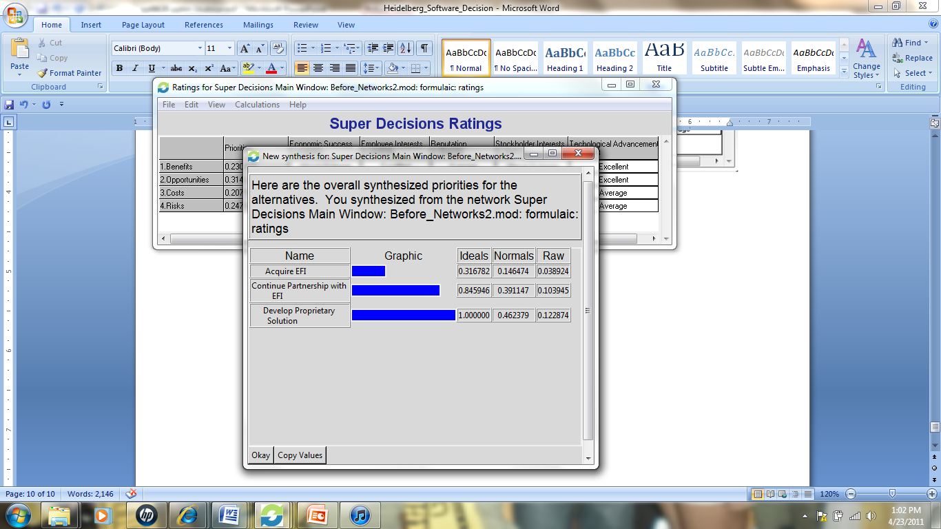
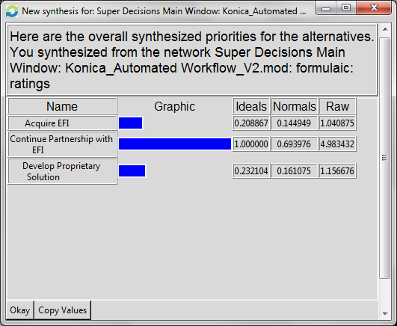
The Result
Synthesized Additive Negative and Multiplicative Models

Slide 15
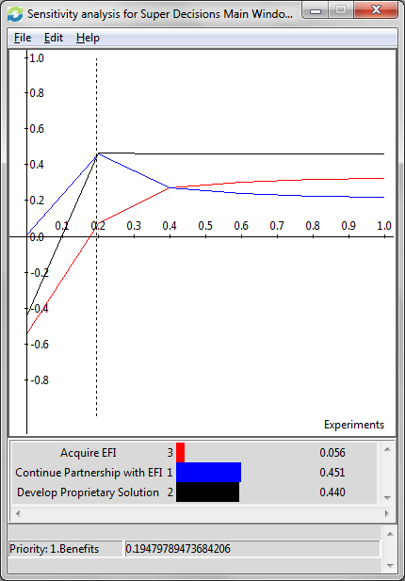
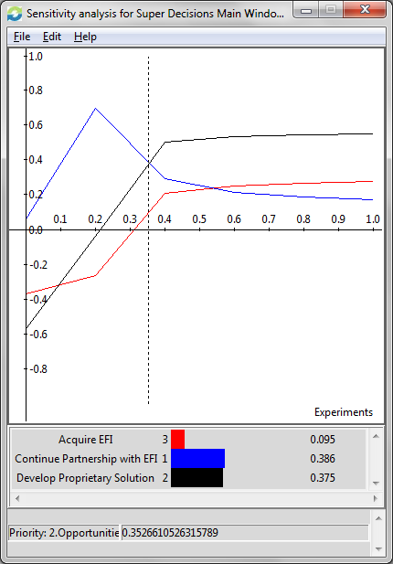
Sensitivity Analysis
Benefits Opportunities

Slide 16
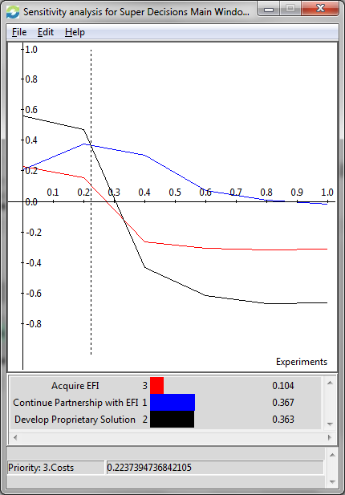
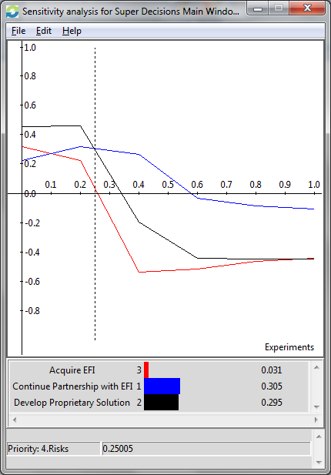
Sensitivity Analysis
Costs Risks

Slide 17
Conclusions
Developing a proprietary automated workflow solution is the best alternative for long term
On short term, the best alternative is to continue partnership with EFI
If the company is cost conscious or risk averse, they’ll continue to pursue partnership with EFI

Slide 18
Ways to Improve the Model
Add more criteria
Consider acquiring other firms
Gather information on EFI financials

