Slide 1
Decision to Launch a New Duct Heater
Rob Coburn
April 26th, 2011

Slide 2
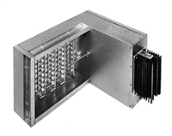

Background
Chromalox is a manufacturer of commercial and industrial electric heating products
Loosing large HVAC bids because of competitor bundling
In order to bid on bundled projects they must offer a new type of duct heater

Slide 3
Alternatives
Chromalox developed three major alternatives. The alternatives were chosen based on their viability and previous strategies used on similar products.
Develop and Manufacture the New Duct Heater In-House
Chromalox would develop the duct heater design in-house using its current R&D capabilities. It would also manufacture the new duct heater in its Nuevo Laredo, MX facility to achieve the best cost point. The duct heaters would be made to order and sold through existing sales channels.
Buy Out New Duct Heaters from Existing Strategic Partner
Chromalox would partner with an existing customer (who also happens to be a competitor) and resell their duct heaters under the Chromalox name. The duct heaters would be made to order by the strategic partner and sold through Chromalox’s existing sales channels.
Do not Launch New Duct Heater
Chromalox would not launch the new duct heater and would continue to focus on existing products and other more profitable ventures.

Slide 4
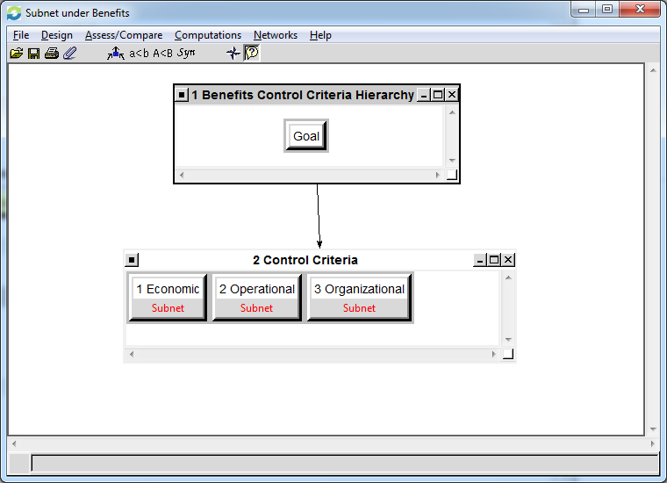
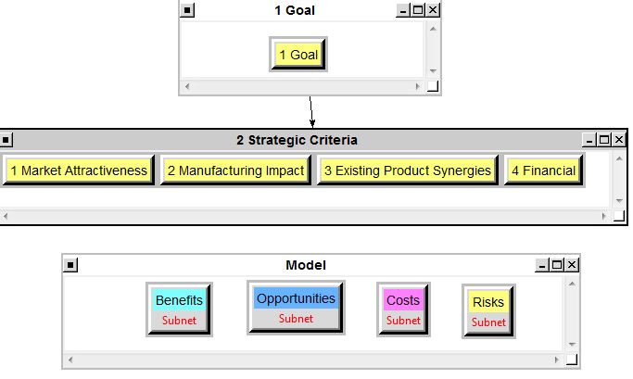
BOCR Model & Subnets

Slide 5
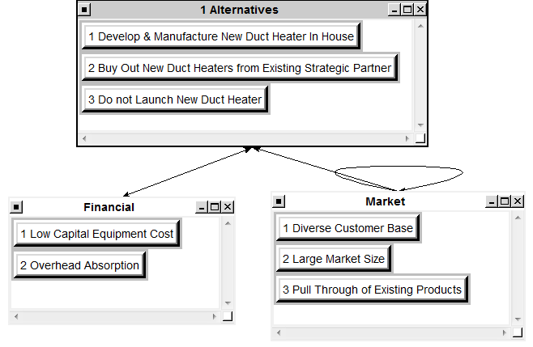
Benefits Control Criteria Under Economic

Slide 6
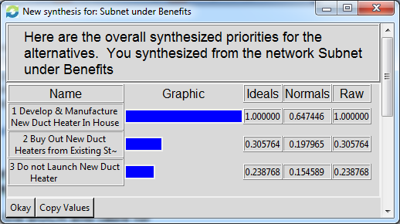
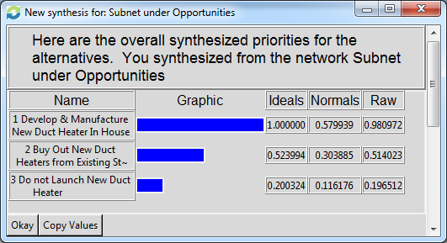
Synthesized Results of Benefits & Opportunities
Benefits
Opportunities

Slide 7
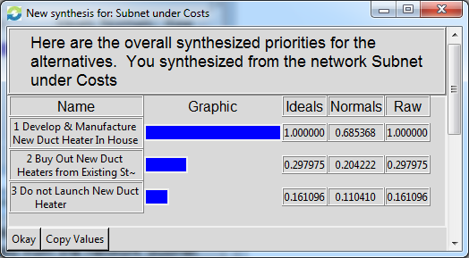
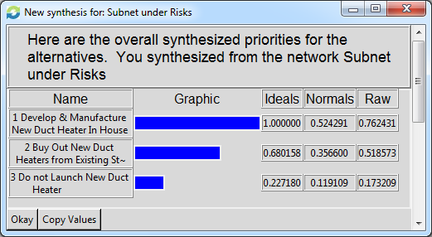
Synthesized Results of Costs & Risks
Costs
Risks

Slide 8
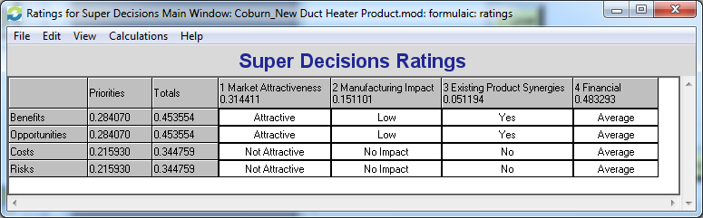
BOCR Strategic Criteria Ratings

Slide 9
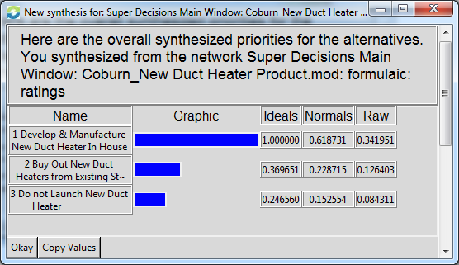
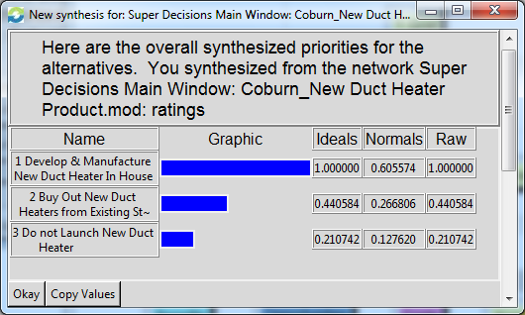
Overall Results
Multiplicative
Additive (Negative)

Slide 10
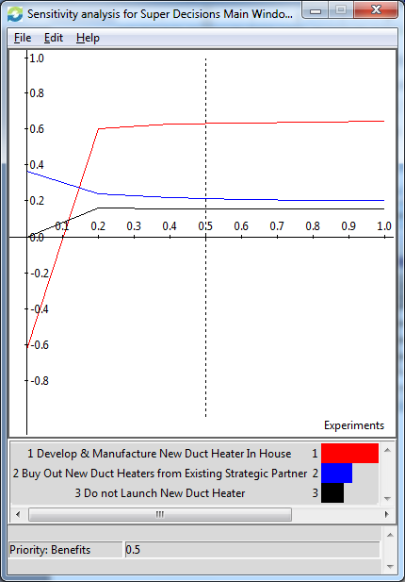
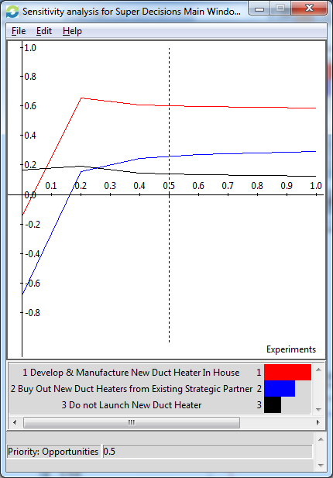
Sensitivity Analysis of Benefits & Opportunities
Benefits
Opportunities

Slide 11
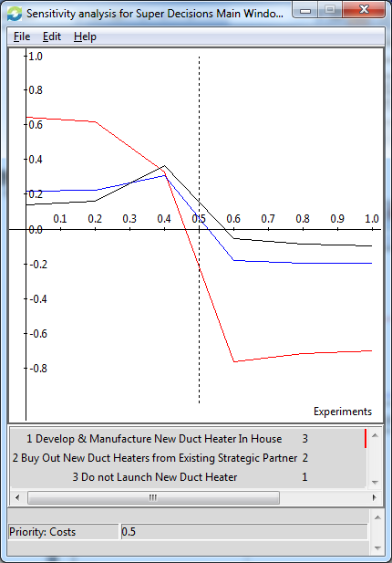
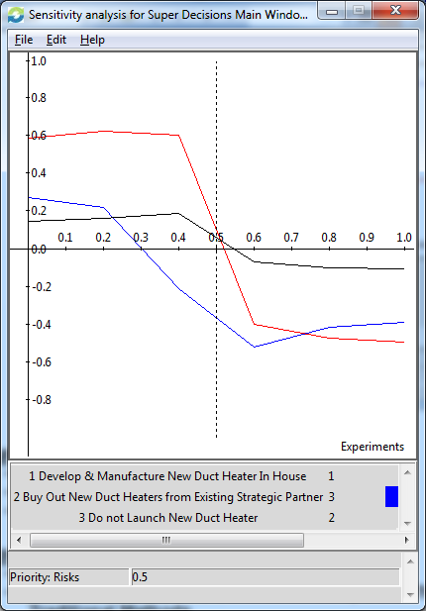
Sensitivity Analysis of Costs & Risks
Costs
Risks

Slide 12
Conclusions
What Did the Model Conclude?
The model concluded that the best decision was to design and manufacture the new duct heater in house.

Slide 13
Questions?

