Slide 1
Gene Patents and the Societal Impact
Rajiv Dhir
Jay Kolb
Benjamin R. Winfield
Cagatay Yanar
Decision Making in Complex Environments
BQOM 2521 – Spring 2010

Slide 2
Introduction
Genes basis of life
Human Genome Project and growth of knowledge
Gene tests/ molecular tests
Screening and diagnosis
Personalized/ targeted therapy
EGFR in lung CA
CT/RT and End stage clinical trials
Future use in drug design and prevention

Slide 3
Patent Issues
Supreme Court judgment in 1980 allowed patents covering genetically engineered bacteria
Slew of patents on DNA now (as much as 20% of human genome covered)
Like drug patents, valid for 20 years. However longer time for profiting since no time consuming clinical trials
Patents allow profiting from work
Monopoly creation

Slide 4
Case against patents
Genes part of nature; are not an invention but discovery of an association
Health care costs increase because of monopoly
Impede free research because of restrictions from the patents in place
New knowledge is first patented and then published

Slide 5
The case that is creating waves
Myriad Genetics: Based in Salt Lake city
Monopoly for testing BRCA 1 and 2 ($3500 vs. $250)
Genes with high association: breast/ ovarian CA
ACLU and multiple medical associations filed lawsuit in NY Southern District Court
Judgment March 29, 2010 striking down Myriad patents
directed to a law of nature and were therefore improperly granted

Slide 6
Model Overview: Alternatives
Allow Gene Patenting: status quo, where gene patents can be obtained and rights reserved to the corporation that identified the gene.
Allow Limited Gene Patenting: add tighter stipulations on the conditions of gene patents right (length of time, limit rights, etc…).
Eliminate Gene Patenting: prevent any patenting related to genetics

Slide 7
Model Overview: Model Structure
 | Benefits
Economic | Social | Government
Corporations | Health of General Public | Legal
Consumer Affordability
Insurance Companies
Government
R&D Expansion
 | Opportunities
Economic |  | Social
Corporate Impact |  | Health of General Public
Consumer Impact
R&D Expansion
 | Costs
Economic | Social | Government
Consumer | Health of General Public | Legal
Insurance Companies | Psycho-Social | Regulations
Government
R&D Expansion
 | Risks
Economic |  | Social
Corporations |  | Consumer Safety
Consumer Affordability |  | Psycho-Social
Insurance Companies
Government
R&D Expansion

Slide 8
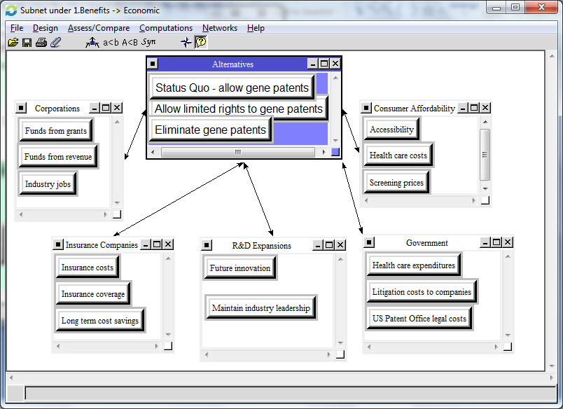
Model Overview: Model Structure (continued)

Slide 9
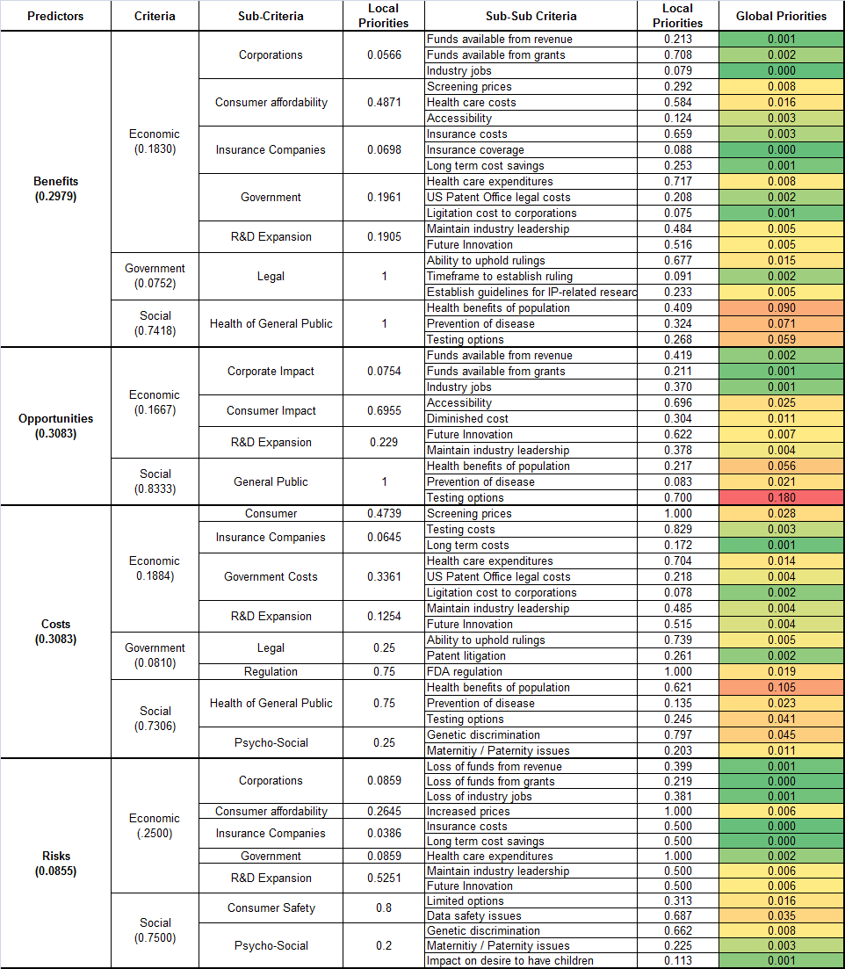
Priorities

Slide 10
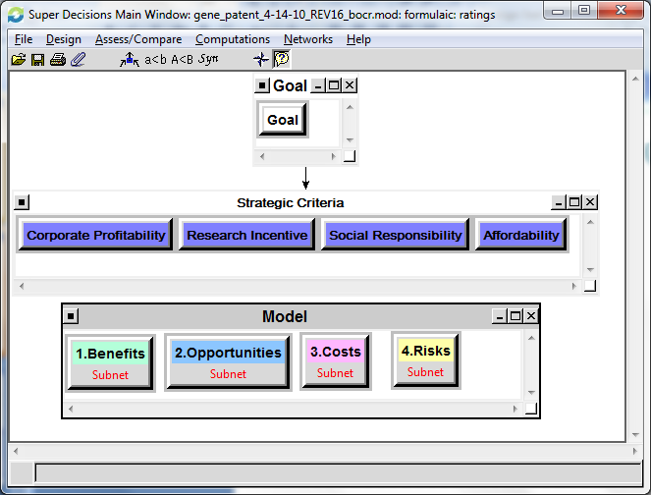
Model Overview: Strategic Criteria
Corporate Profitability
Research Incentive
Social Responsibility
Affordability

Slide 11
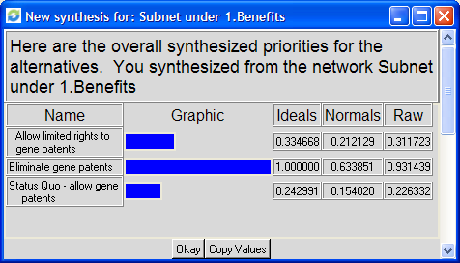
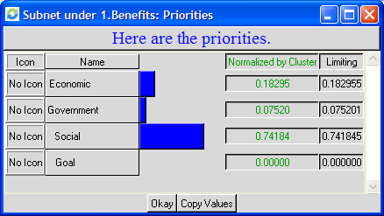
Results: BOCR Subnets
Benefits
Eliminate Gene Patents
Social

Slide 12
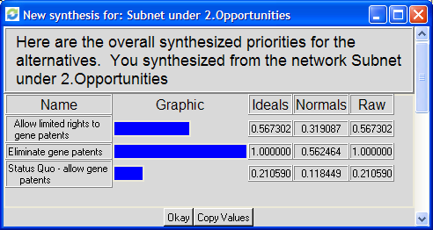
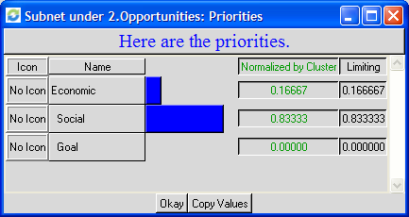
Results: BOCR Subnets (continued)
Opportunities
Eliminate Gene Patents
Social

Slide 13
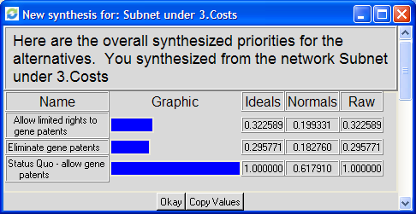
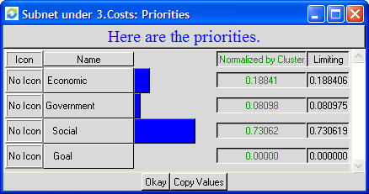
Results: BOCR Subnets (continued)
Costs
Allow Gene Patents
Social

Slide 14
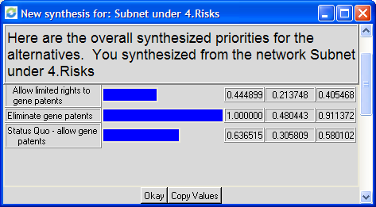
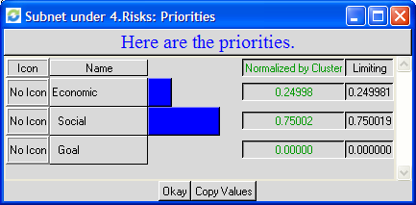
Results: BOCR Subnets (continued)
Risks
Eliminate Gene Patents
Social

Slide 15
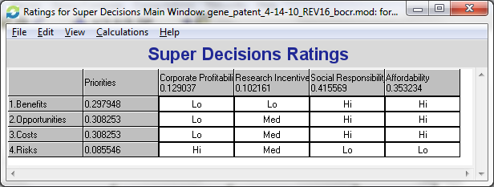
Super Decisions Rating
Priorities for Strategic Criteria
Corporate Profitability | Research Incentive | Social Responsibility | Affordability
13% | 10% | 42% | 35%

Slide 16
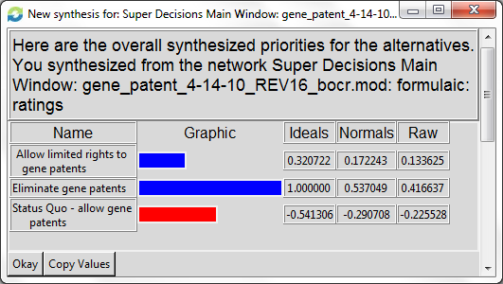
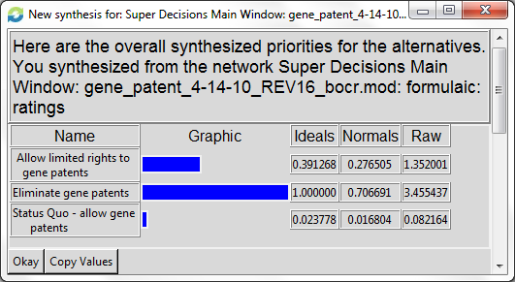
Overall Outcomes
Additive: Short-term
Multiplicative: Long-term

Slide 17
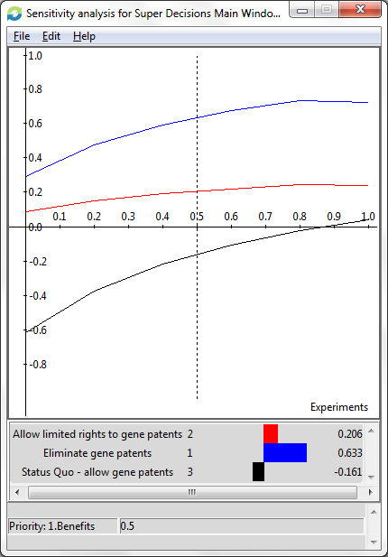
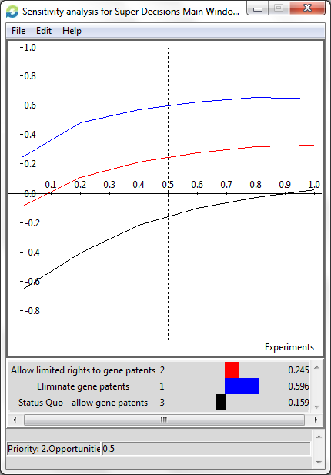
Sensitivity Analysis
Benefits
Opportunities

Slide 18
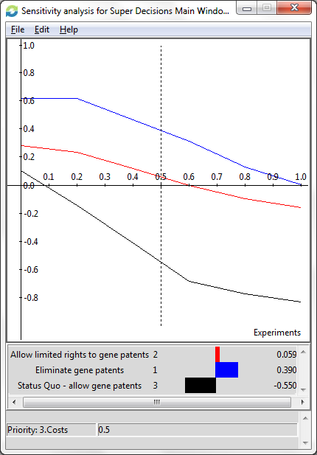
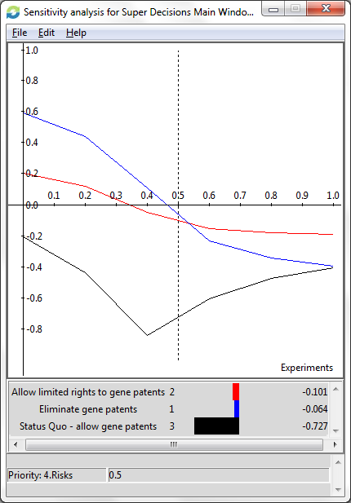
Sensitivity Analysis
Costs
Risks

