Slide 1
Entrepreneurial Decision
Rohan Adwalpalker
Karma Edwards
Travis Wagner
Decision Making in Complex Environments
Final Project - April 20, 2010

Slide 2
Background Information
Less than half of all small business start-ups survive for more than four years
U.S. Small Business Association
To increase the odds of success you need:
Attitude
Sacrifice
Risk Tolerance
Planning
http://www.gaebler.com/Small-Business-Failure-Rates.htm

Slide 3
Possible Entrepreneurial Alternatives
Consulting Firm
Knowledge intensive
Network and credibility based
Computer Service
Labor intensive
Self-directed
Nike Retail Store
Capital intensive
Personnel management

Slide 4
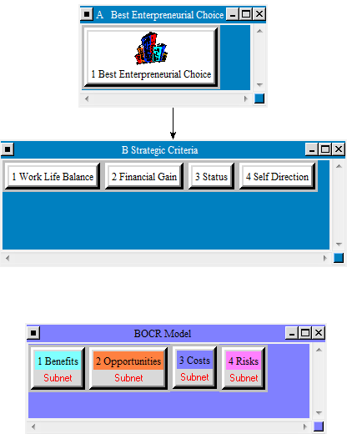
Super Decision Model Structure

Slide 5
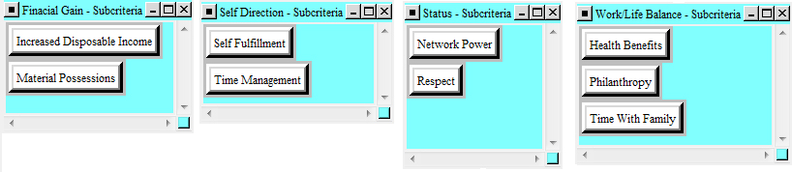
Basic Criteria
Work Life Balance
Health Benefits, Time with family
Financial Gain
Increased Disposable Income, Material Possessions
Status
Network Power, Respect
Self Direction
Time Management, Self Fulfillment

Slide 6
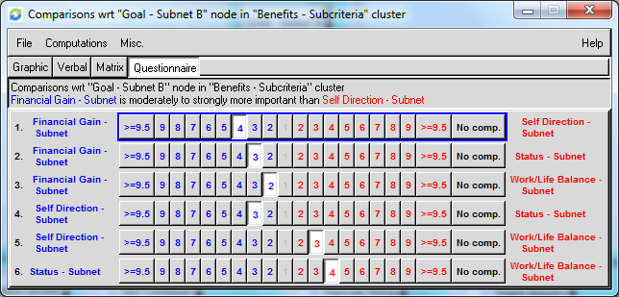
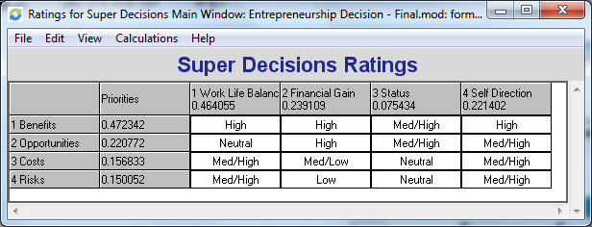
BOCR Model
Benefits
Opportunities
Costs
Risks

Slide 7
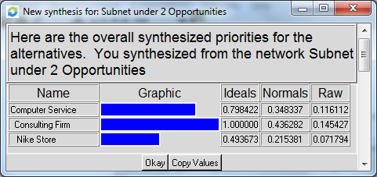
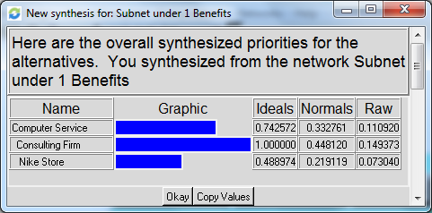
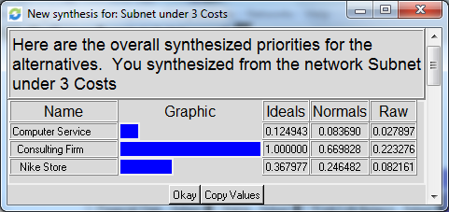
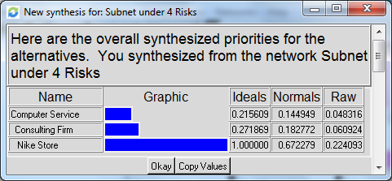
Subnet Results

Slide 8
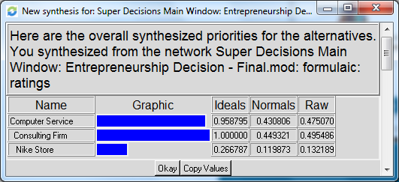
Whole Model Results

Slide 9
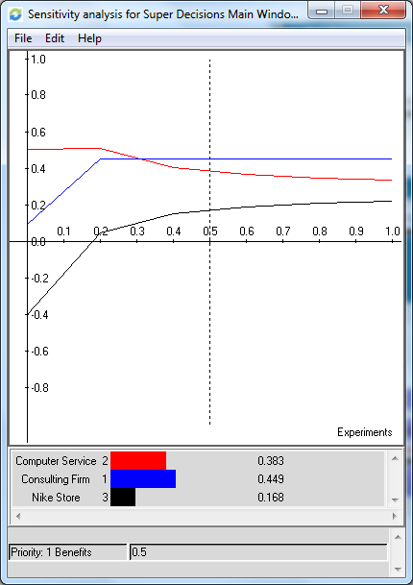
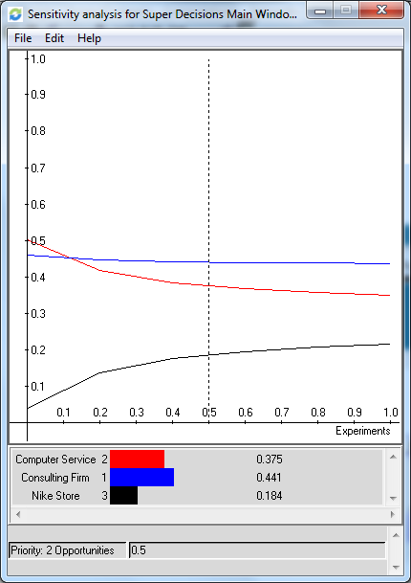
Sensitivity Analysis Benefits and Opportunities

Slide 10
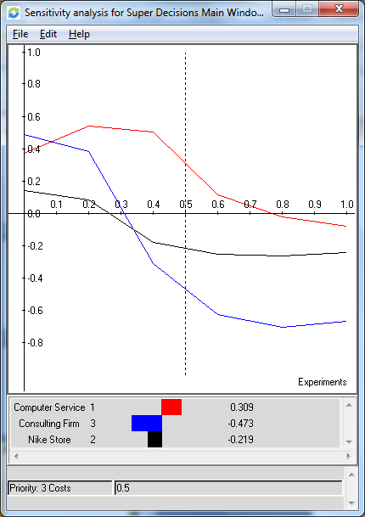
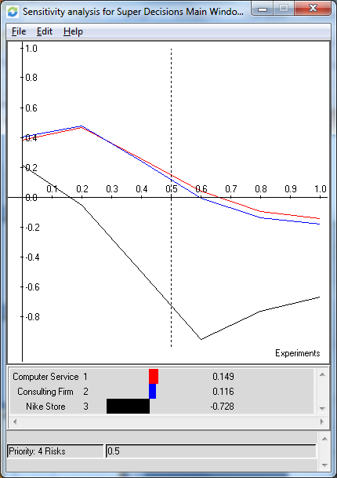
Sensitivity Analysis Costs and Risks

Slide 11
Conclusion
Best Choice – Consulting Firm
0.449321
Close Second Choice – Computer Service
0.430806
Least Desirable Choice – Nike Retail Store
0.119873

