Slide 1
Ismail C. Turan Masahiro Yamauchi
Best Performing Geographic
Emerging Stock Market Cluster

Slide 2
4 Alternatives
Latin America
SE Asia
Eastern Europe
Northern Africa/ Middle East

Slide 3
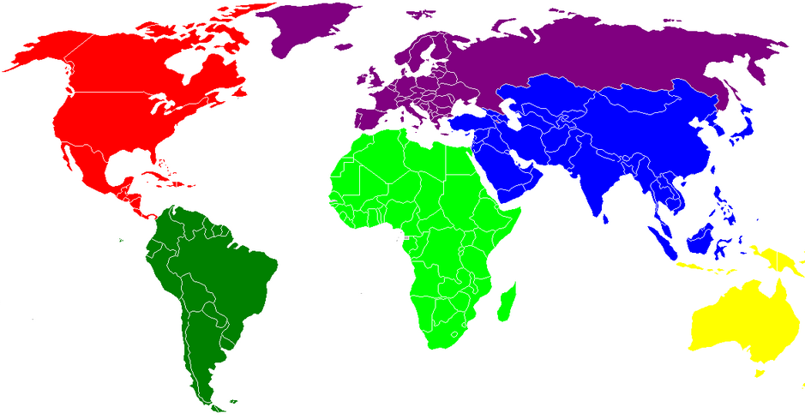
Geographic
Russia
Czech
Hungary
Turkey
Mexico
Morocco
China
Brazil
Egypt
Taiwan
Argentina
Israel
Philippines
Chile
Jordan
Indonesia

Slide 4
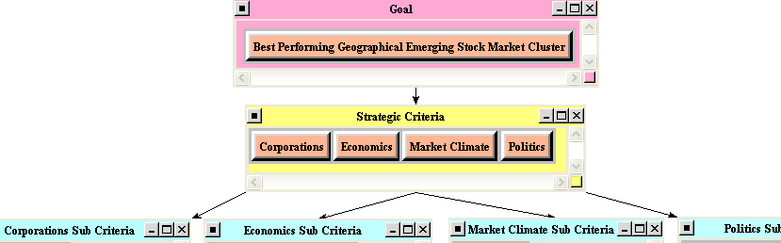
Strategic Criteria
Corporations
Economics
Market Climate
Politics

Slide 5

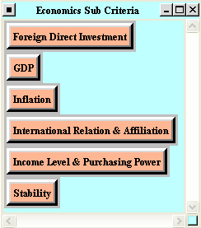
Sub Criteria (1)
Corporations Economics

Slide 6
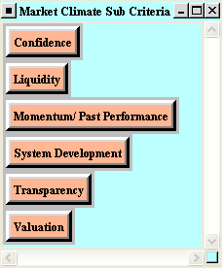
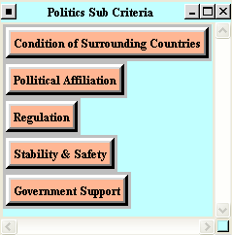
Sub Criteria (2)
Market Climate Politics

Slide 7
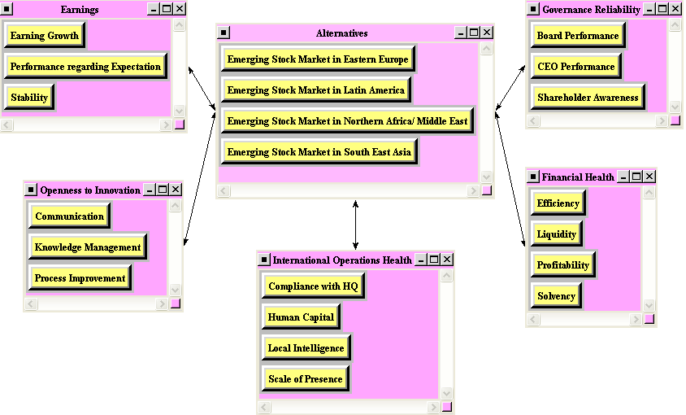
Inner Subnet Example
Benefits - Corporation

Slide 8
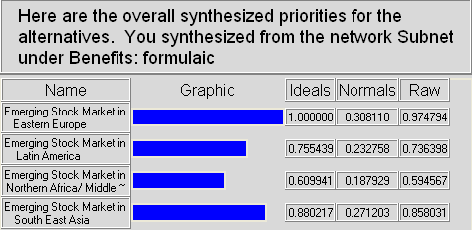
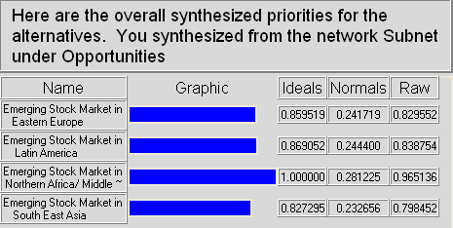
Benefits & Opportunities
Benefits
1st
Eastern Europe
Opportunities
1st
Northern Africa
/ME

Slide 9
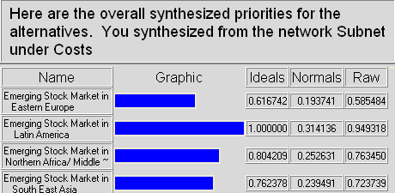
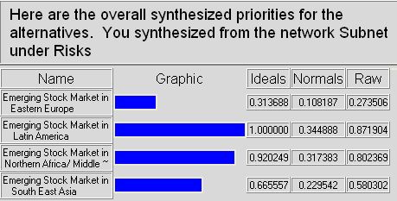
Costs & Risks
Costs
1st
Latin America
Risks
1st
Latin America

Slide 10
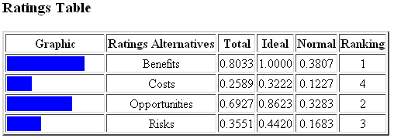
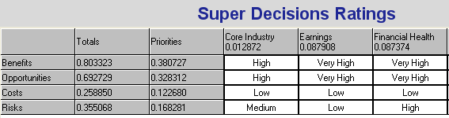
BOCR Ratings & Priorities

Slide 11
Criteria Priorities
Corporations [28.2 %]
sub) Earnings : 8.8% , Financial Health : 8.7% , etc.
Economics [15.0 %]
sub) Stability : 5.1% , GDP: 3.8% , etc.
Market Climate [49.3 %]
sub) Liquidity : 14.8% , Transparency: 11.8%
Valuation : 11.8% , Confidence : 5.4% , etc.
Politics [7.5 %]
sub) Government Support : 2.5% , etc.

Slide 12
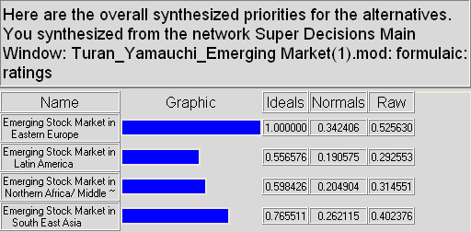

Result (1)
Additive
1st : Eastern Europe , 2nd : SE Asia
3rd : Northern Africa/ ME , 4th : Latin America

Slide 13
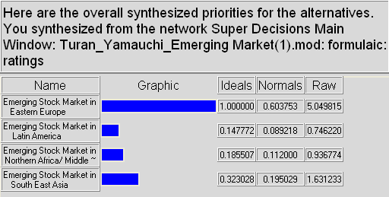
Result (2)
Multiplicative
1st : Eastern Europe , 2nd : SE Asia
3rd : Northern Africa/ ME , 4th : Latin America

Slide 14
Actual Performance

Slide 15
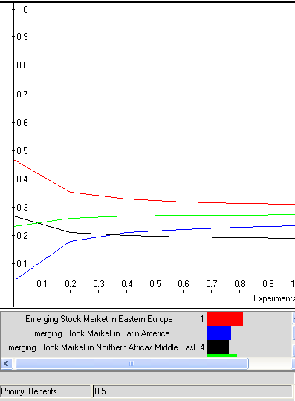
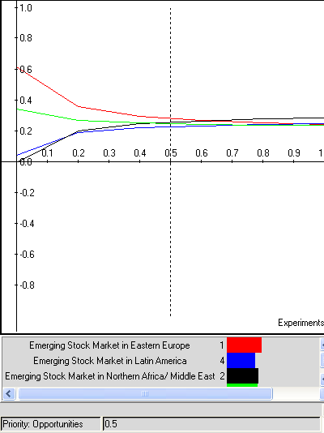
Sensitivity Analysis (1)
Benefits & Opportunities
Benefits Opportunities

Slide 16
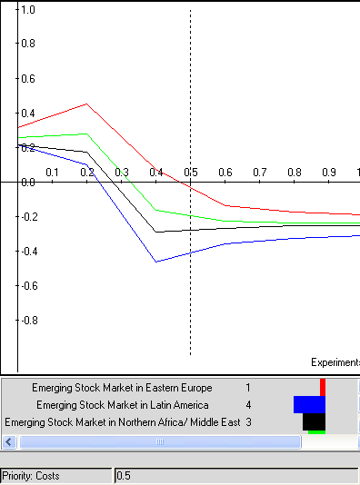
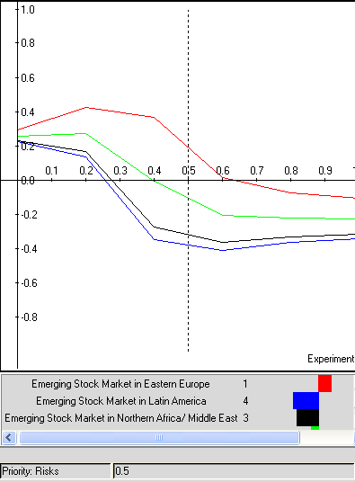
Sensitivity Analysis (2)
Costs & Risks
Costs Risks

Slide 17
Conclusion
Based on our analysis, Eastern Europe has the
highest benefits and the lowest risks.
Although Latin America shows high risks, actual
performance is best. It seems that investors might
seek for profits with understanding “higher risk
generates greater return.”
Recommendation is a diversified investment into
stock markets with higher risk and lower risk.

