Slide 1
The best investment portfolio to investors and the society
Decision Making in a Complex
Environment
Wan-Yi Lee

Slide 2
Goal & Alternatives:
The Best Investment Portfolio for investors and the Society
Stocks
Mutual Fund + Stocks
Bond + Stocks
Savings

Slide 3
Strategic Criteria & Sub Criteria
Global View – International Trend
Eliminating Lag
Regulation on foreign investors
Long-Term Consideration-
Possible factors change
Self Condition change
Time Effect
Strategic Plan –
Acceptable Minimum/Maximum return
Cost/Benefit Analysis

Slide 4
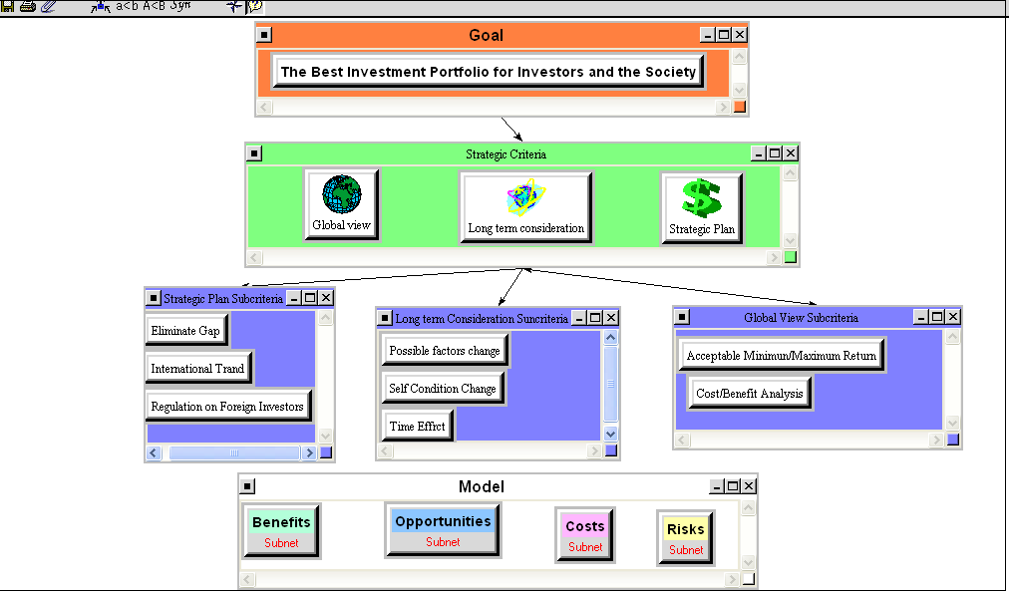
Model

Slide 5
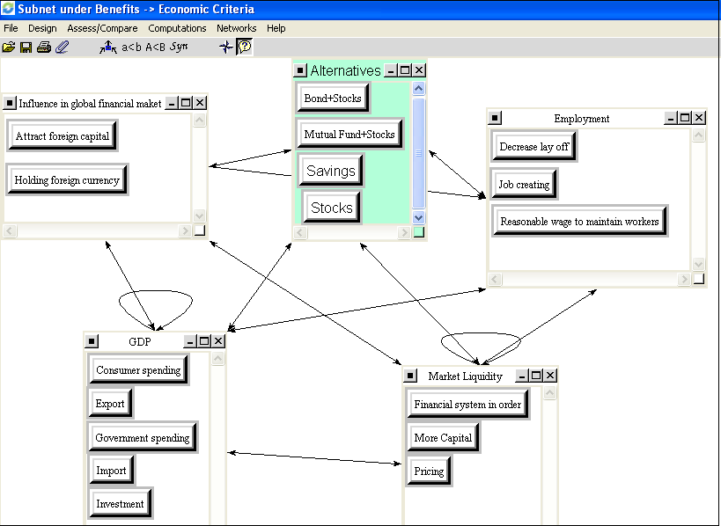
Main Model

Slide 6
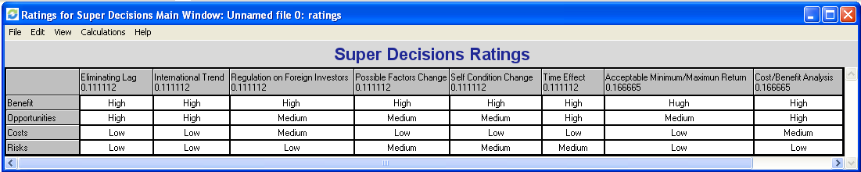
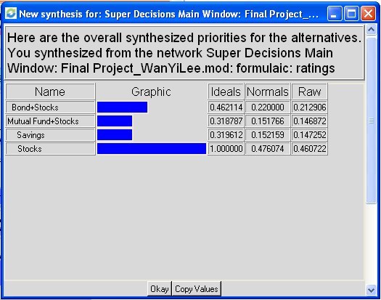
Rating & Result
Priority:
Stocks
Bonds + Stocks
Savings
Mutual Funds + Stocks

Slide 7
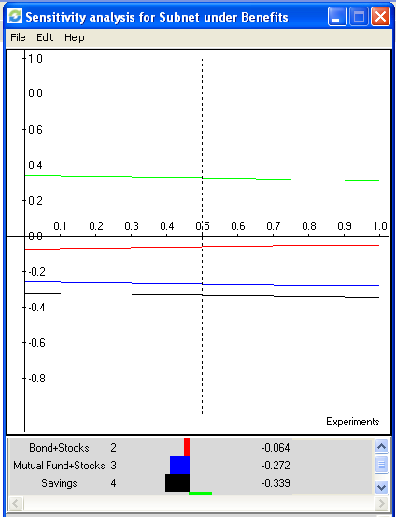
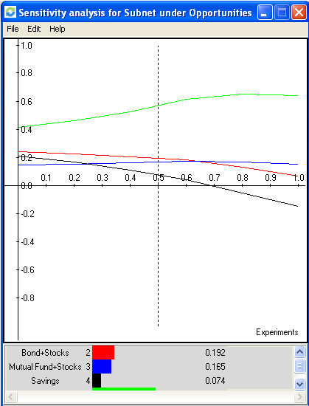
Sensitive Analysis

Slide 8
Critics
limited alternatives
Comparisons may not be objective enough
Criteria missed

