Slide 1
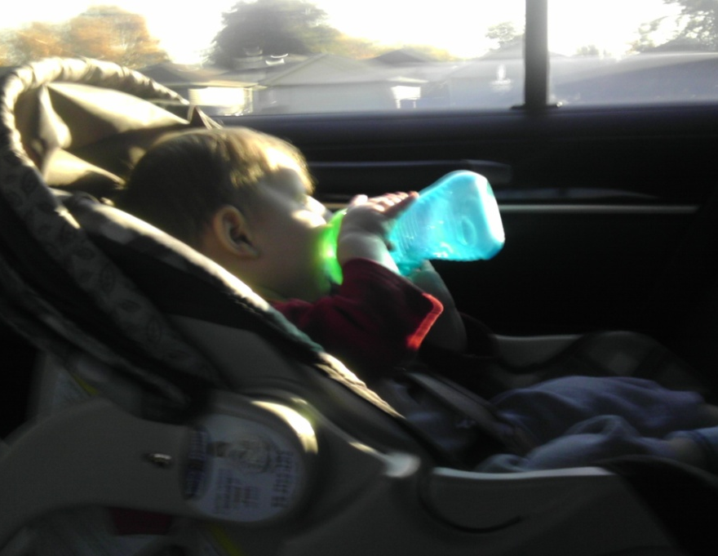
ANP & AHP Analysis of Car Seats: As Applicable to Projects in the Juvenile Industry
A Presentation by Chris Schock and Christy Kaminski-Strum

Slide 2

Project Summary
From the perspective of a juvenile products manufacturing company
Need to make a decision on which brand for an accessory that will be compatible with that brand of car seat
Has implications for future projects (make multiple products that are compatible with a brand/model of car seats

Slide 3
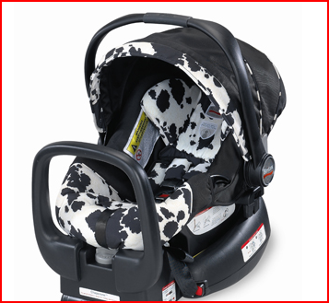
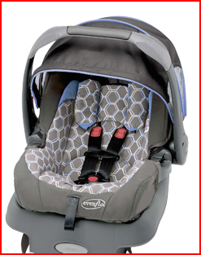
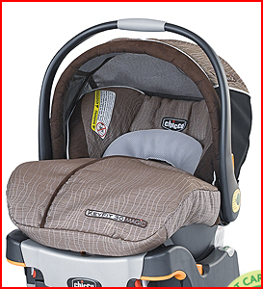
Discussion of Alternatives
Based on Parents.com analysis of best car seats
Evenflo: Serenade
MaxiCosi: Mico
Britax: Chaperone
Safety 1st: onBoard 35 Air
Graco: SnugRide 35
Chicco: KeyFit 30

Slide 4
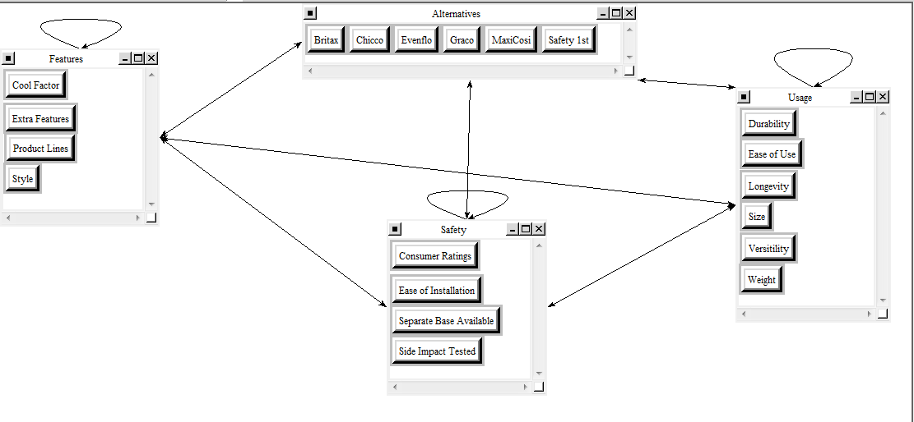
Market Share Analysis (AHP)

Slide 5
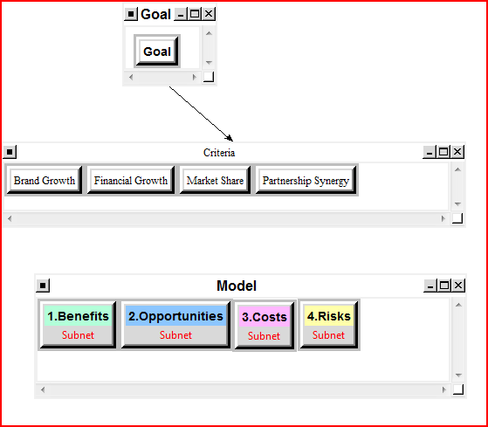
ANP Car Seat Model

Slide 6
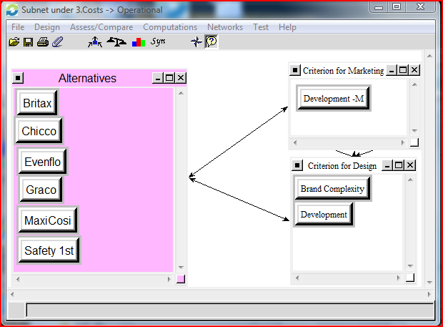
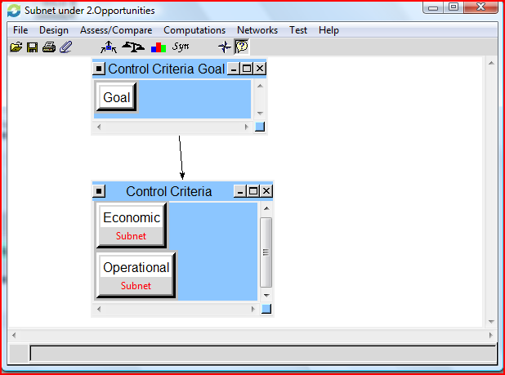
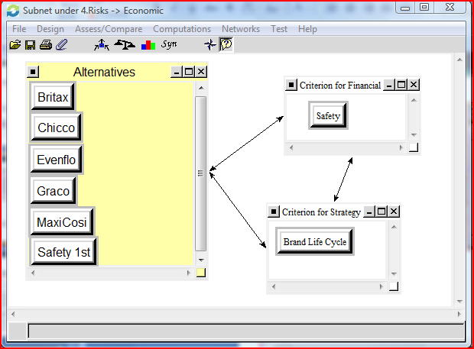
BOCR

Slide 7
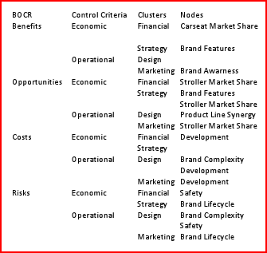
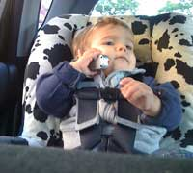
Clusters in the Decision Network

Slide 8

Strategic Criteria
Brand Growth – strategy to expand the juvenile product brand over the next several years
Financial Growth – with the expansion, goal to improve profits
Market Share – of individual product(s)
Partnership Synergy – possibility of partnership with other brand

Slide 9
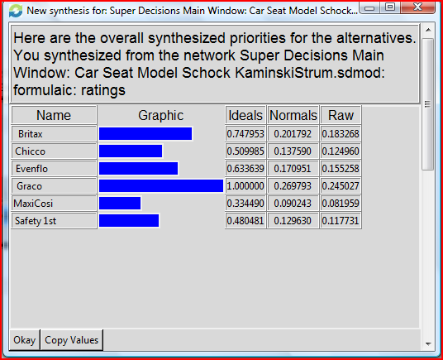
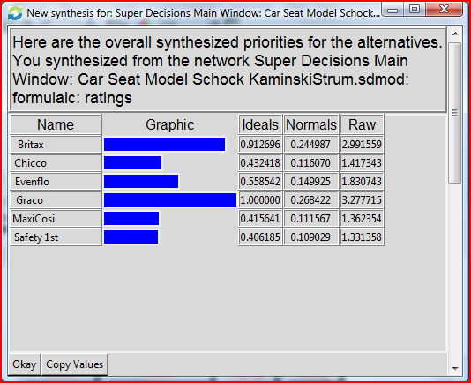
Overall Results
Additive (Negative)
Multiplicative

Slide 10
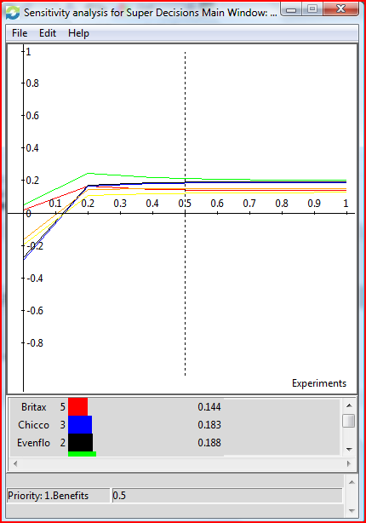
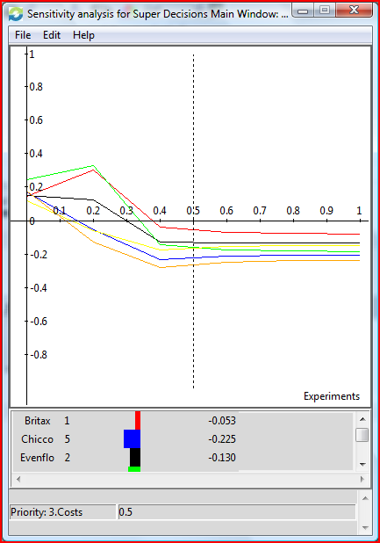
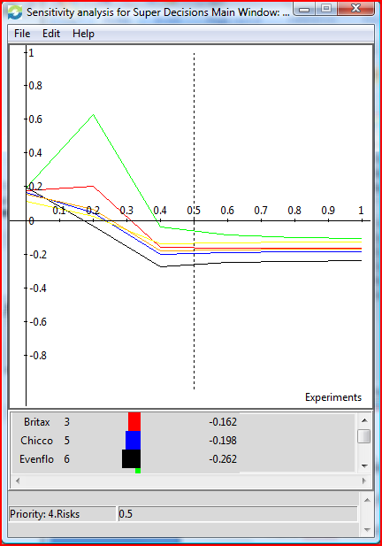
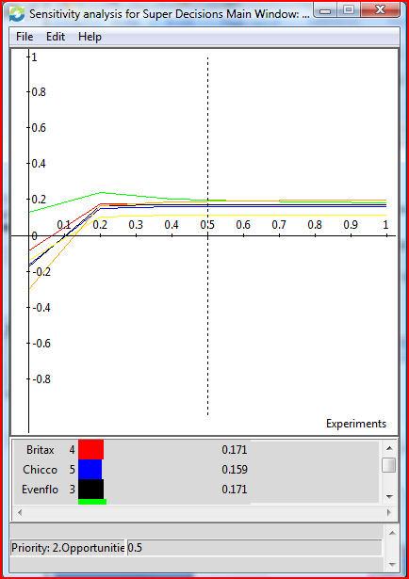
Sensitivity Analysis
Risks
Opportunities
Benefits
Costs

Slide 11

Ethical Implications
Generally, ethics may not directly apply
However, safety of brand should be taken into consideration when considering producing one or more products designed to work with other products – those products will reflect on the products associated with them (for example, those produced by the juvenile products manufacturer in question).
Decisions made by the other company will directly affect the juvenile product manufacturer (recalls, etc.)

Slide 12
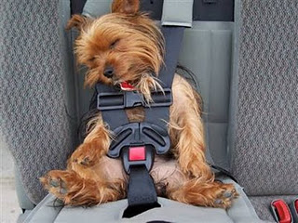
The End

