Slide 1
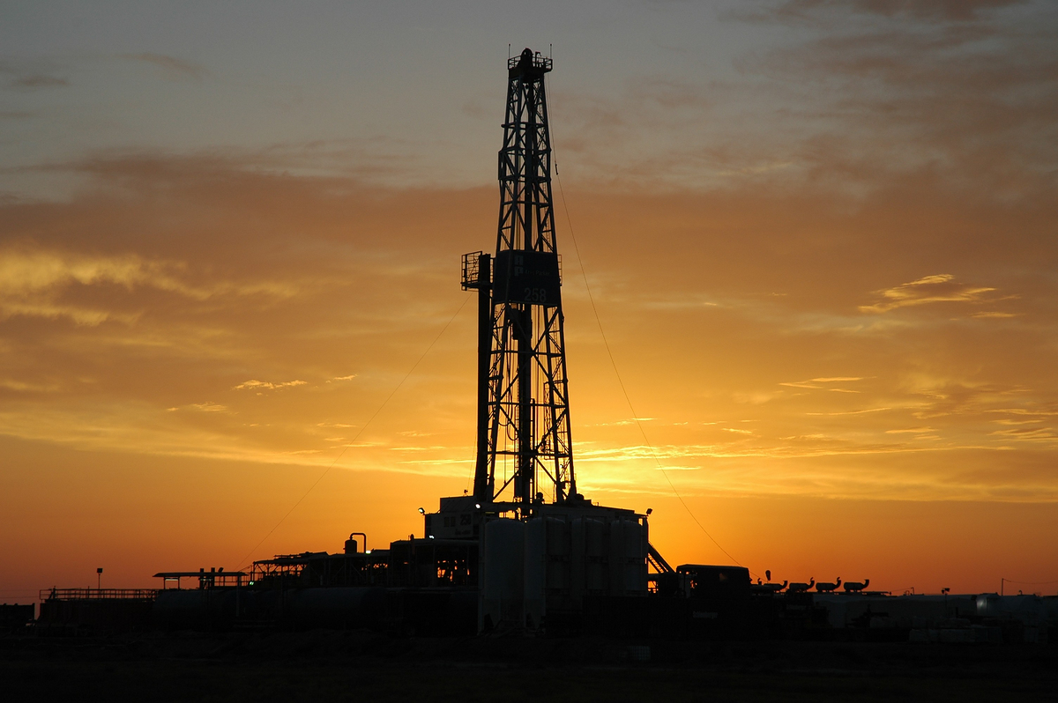
Oil and Gas Service Company:
Move to Ohio?
Jeffrey Luttner

Slide 2
Reasons
Reduced travel time
Reduced man hours
Faster response time
Presence in Utica

Slide 3
Options
Build camp in SE Ohio
Use combined services of SW Pennsylvania camp and Central Pennsylvania camp

Slide 4
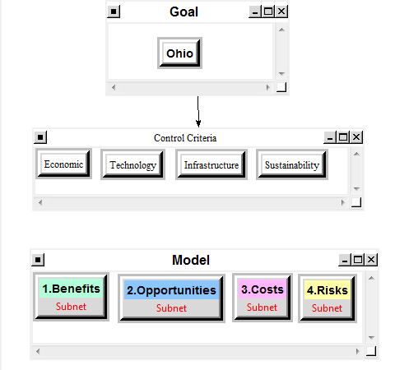

Slide 5
Model
Benefits
Opportunities
Costs
Risks
Customer Proximity
Economic
Business Development
Technology
Fleet
Infrastructure
Competitors
Demand

Slide 6
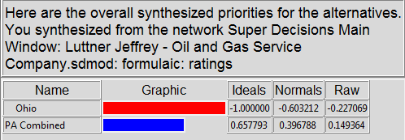
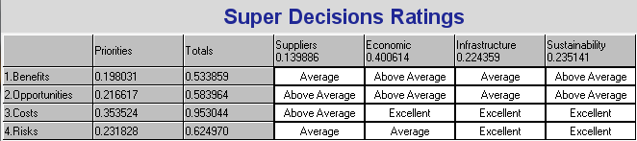
Overall Synthesis
Ratings

Slide 7
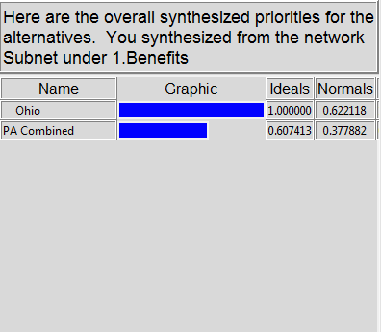
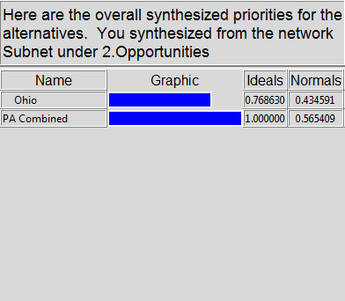
Synthesis Profile – 1.Benefits & 2. Opportunities

Slide 8
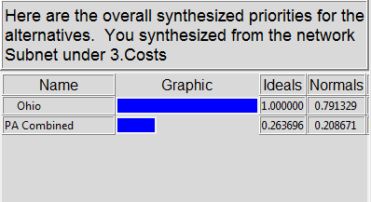
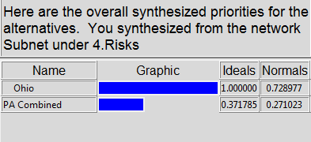
Synthesis Profile – 3. Costs & 4. Risks

Slide 9
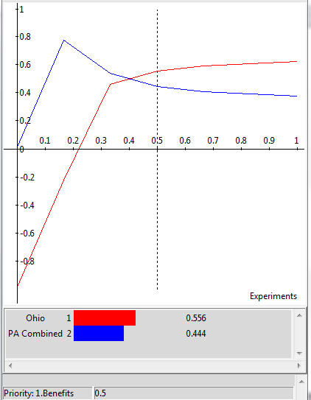
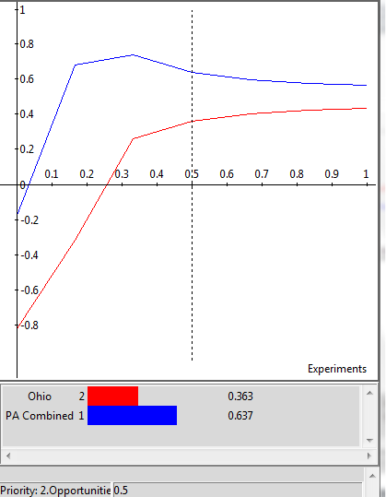
Sensitivity Analysis

Slide 10
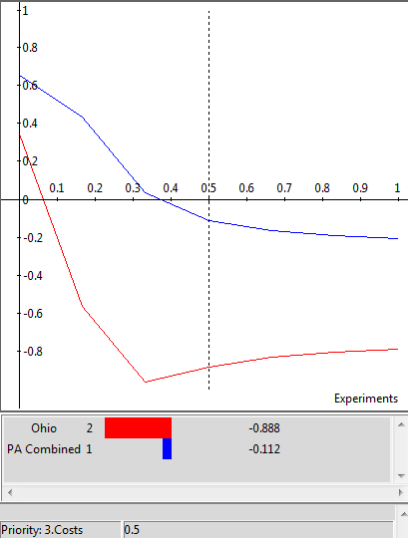
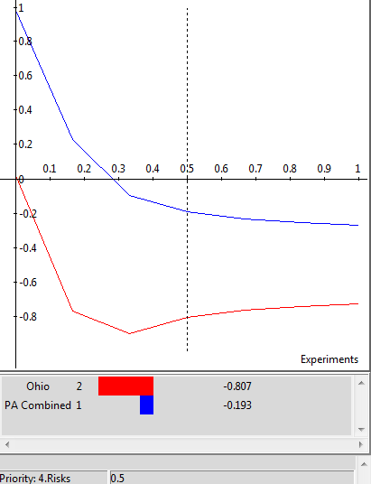
Sensitivity Analysis (cont.)

Slide 11
Conclusion:
Do not build camp in Ohio

