Slide 1


Increasing Retail Banking Revenue for
Fuad Ashwash Decision Making Final Project
Jennifer Stotter April 23, 2013
Patrick Sullivan

Slide 2
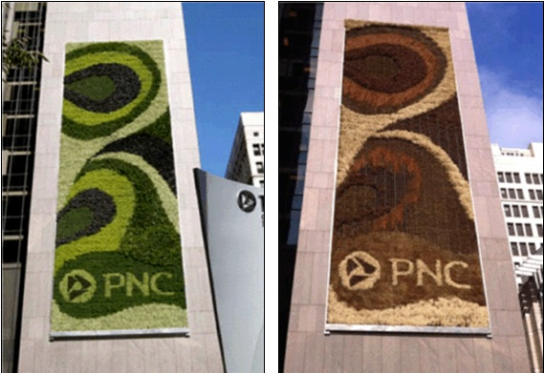
With Increasing Challenges Facing the Banking Industry, How Does PNC Increase Revenues?

Slide 3


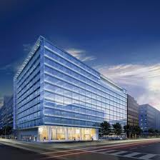
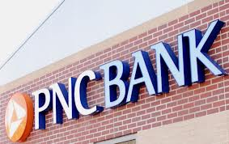
The Alternatives
Improving customer service experience
More mobile banking services
Green Buildings
Revamping public image

Slide 4
The Model Benefits | Opportunities | Costs | Risks Control Criteria Political | Social | Economic Strategic Criteria CFO | Shareholders | Customers

Slide 5
Benefits
Opportunities
Costs
Risks
Economic
Revenue Streams
Green Benefits
Non-profit Partnerships
Social
Public Image
Investor Relations
Political
Regulatory Compliance
Political Image
Economic
Improved Efficiency
First Mover
Social
Markets
Public Relations
Political
Federal Regulations
Political Action Committees
Economic
Cost of Implementation
Staffing
Marketing Expenses
Social
Public Perception
Media Outlets
Political
Regulatory
Political Relationships
Memberships
Economic
Technology
Cyber Crime
Real Estate
Social
Jobs
Image
Demographics
Political
Healthcare
Relations with Politicians
Future Political Action

Slide 6
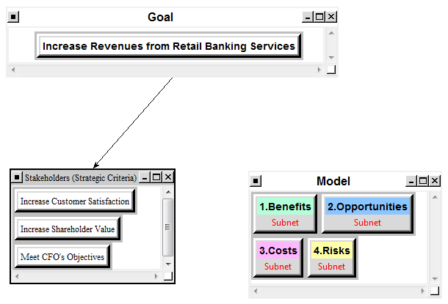

Slide 7
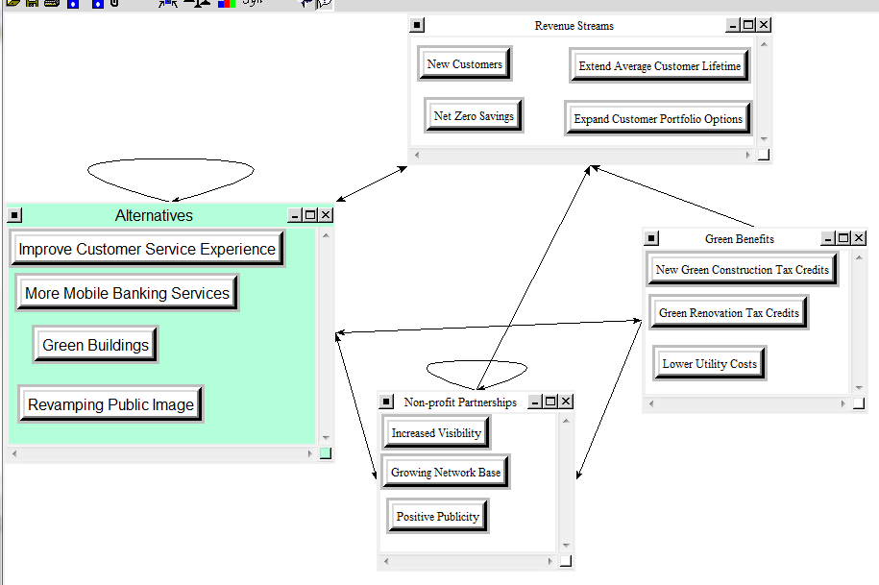

Slide 8
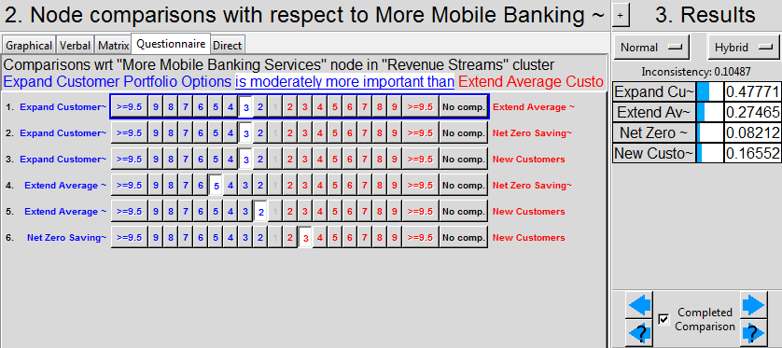
Snapshot of Pairwise Comparisons

Slide 9
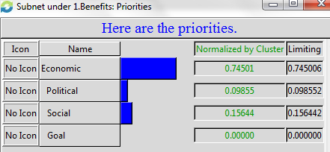
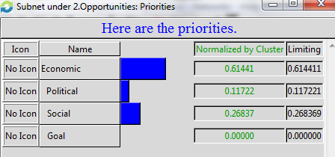
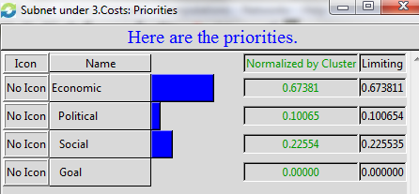
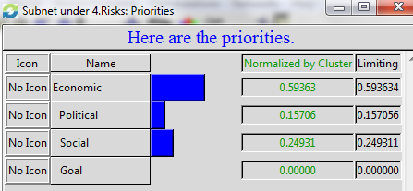
Priorities for Subsets

Slide 10
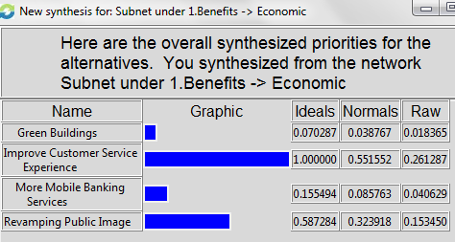
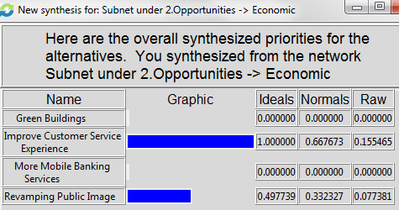
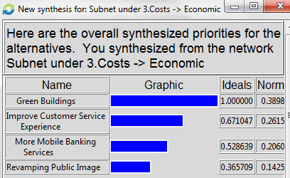
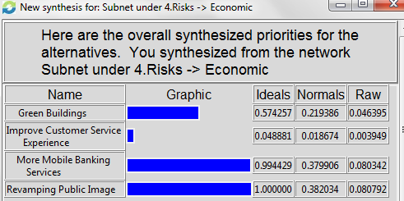
Synthesized Priorities Under Economic Subsets

Slide 11
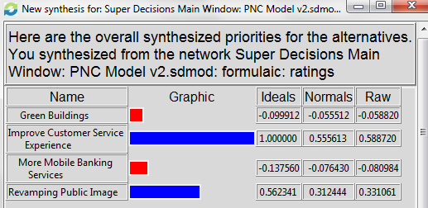
Overall Results
Using the additive negative formula (bB +oO – cC – rR) to determine the best option for the long term, we see the following:
In the long term, the best option is Improve Customer Service Experience.

Slide 12
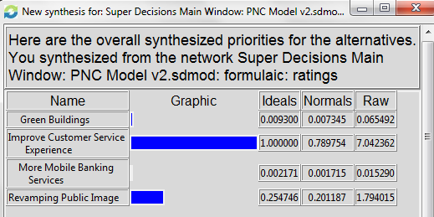
Conversely, using the multiplicative formula (BO/CR) to evaluate options for the short term, we find:
Again, the best option is to Improve Customer Service Experience.
Between these two tests, we see that regardless of time considerations, the preferred plan of action is to Improve Customer Service Experience in order to achieve the stated goals.

Slide 13
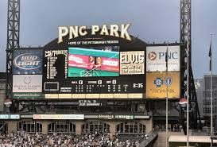
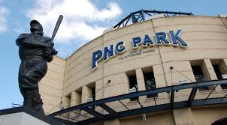
Questions?

