Slide 1
To Launch or Not To Launch…
Harry Beck & John Klune

Slide 2
Background
Product was developed for a Department of Defense solicitation that was subsequently cancelled, leaving product with significant research and development costs but no revenue plan
Approached by a business partner asking for exclusive rights to bring the product to market
Now company faces decision on whether or not to launch product and how best to proceed

Slide 3
The model’s alternatives
Offer exclusivity with contingency
Distributer interest
Offer product to all viable distributers
Could damage relationship(s)
Do not offer product
Product management did not plan to launch the product
Lean environment in the DoD caused the company to reconsider the original recommendation
Would reach the largest possible market
Could offer to another distributer
Could offer different terms

Slide 4
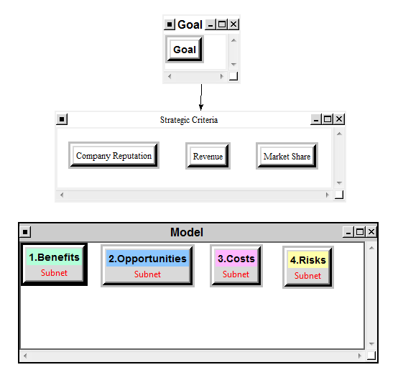
The top-level model

Slide 5
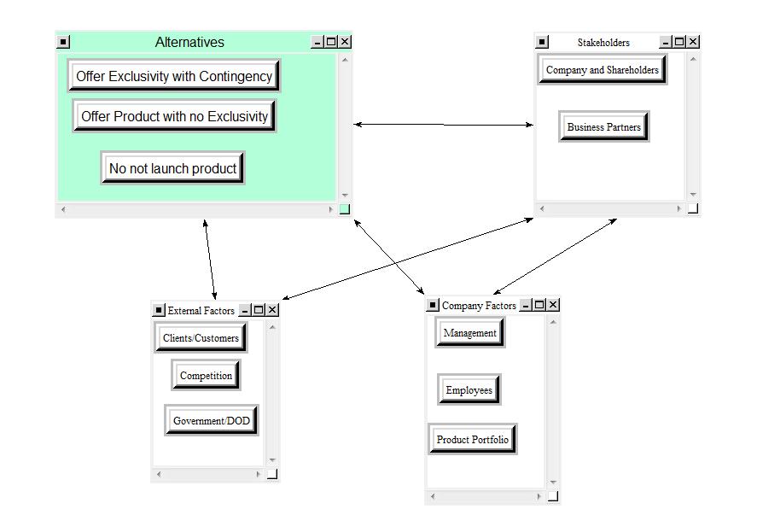
Sample subnet (Benefits -- Economic)

Slide 6
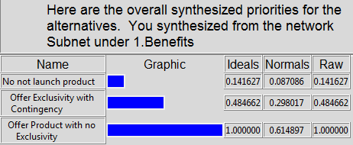
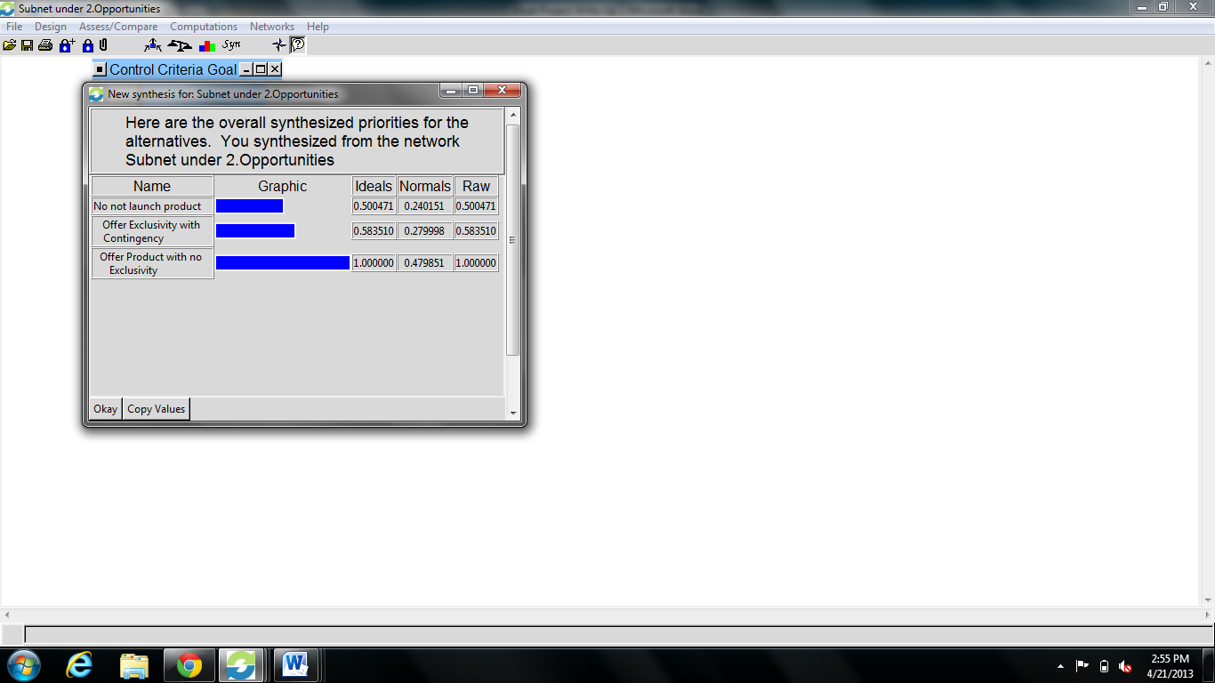
Subnet result – Benefits and Opportunities

Slide 7
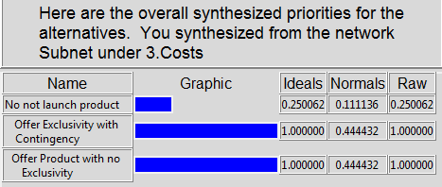
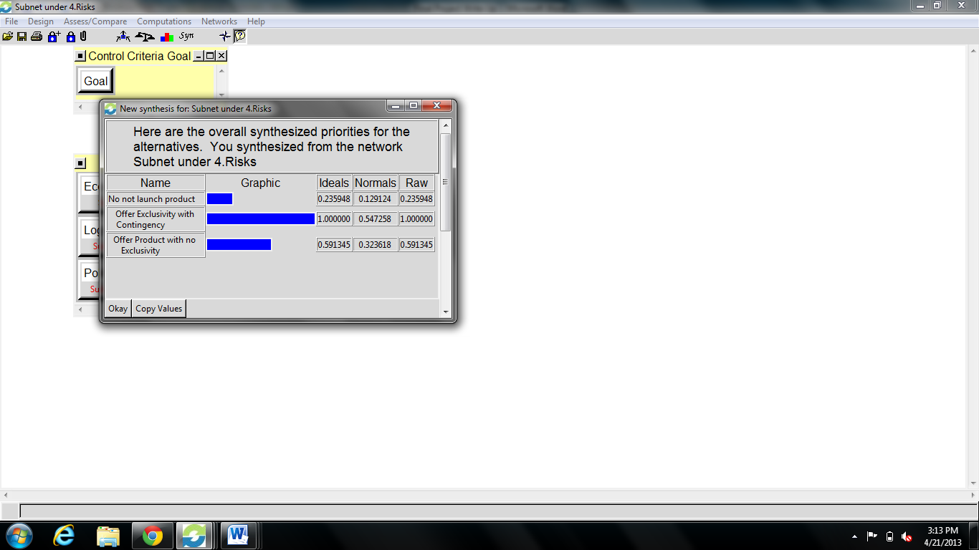
Subnet result – Costs and Risks

Slide 8
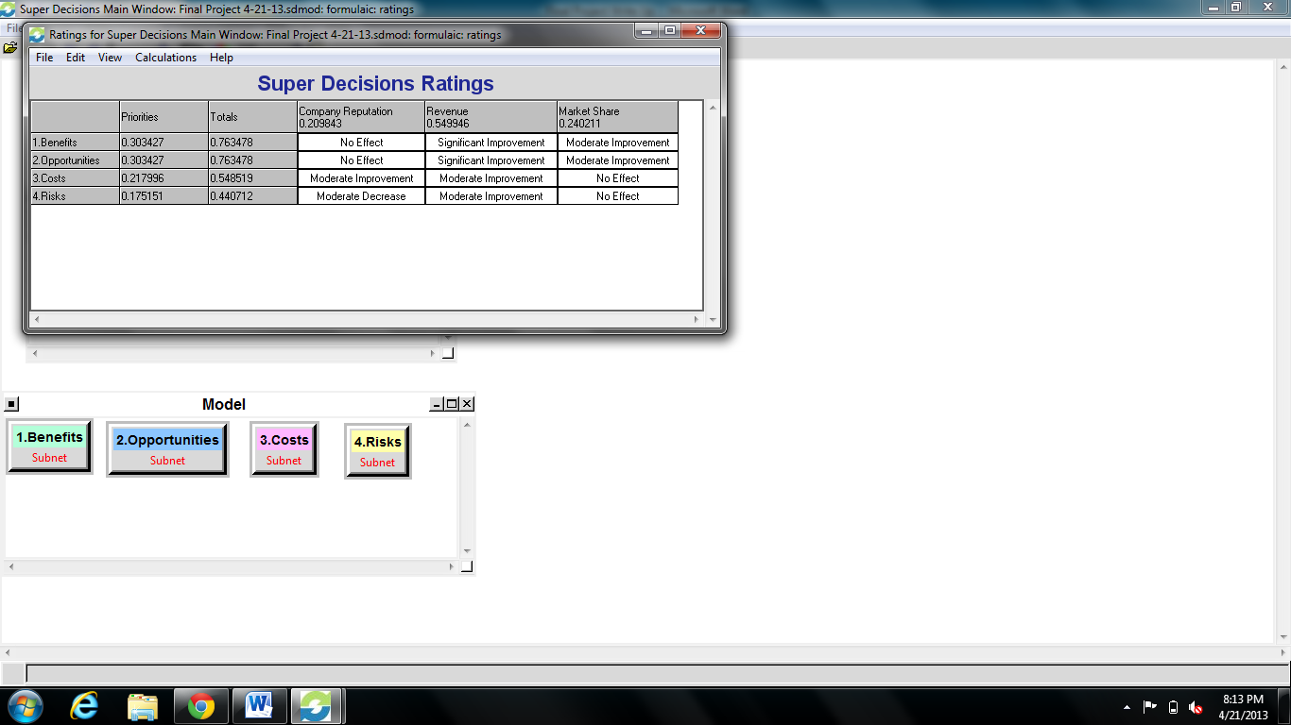
Strategic criteria

Slide 9
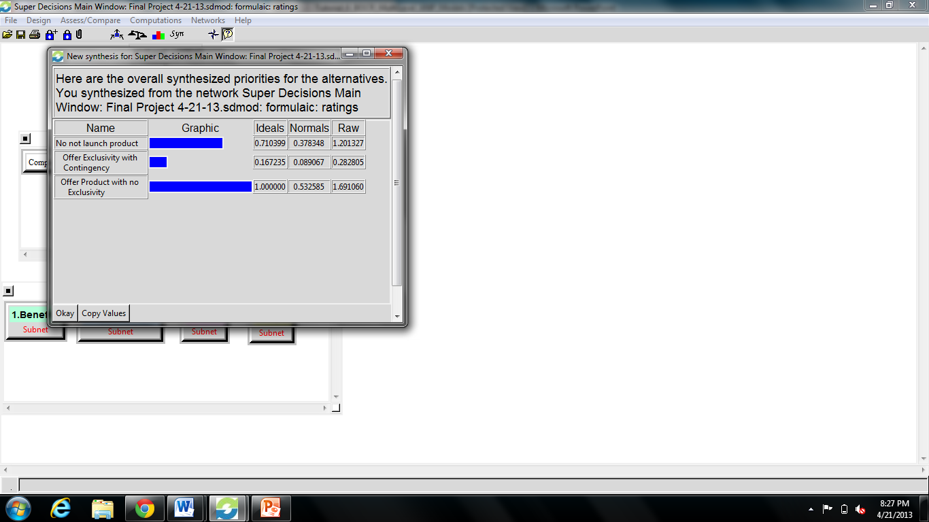
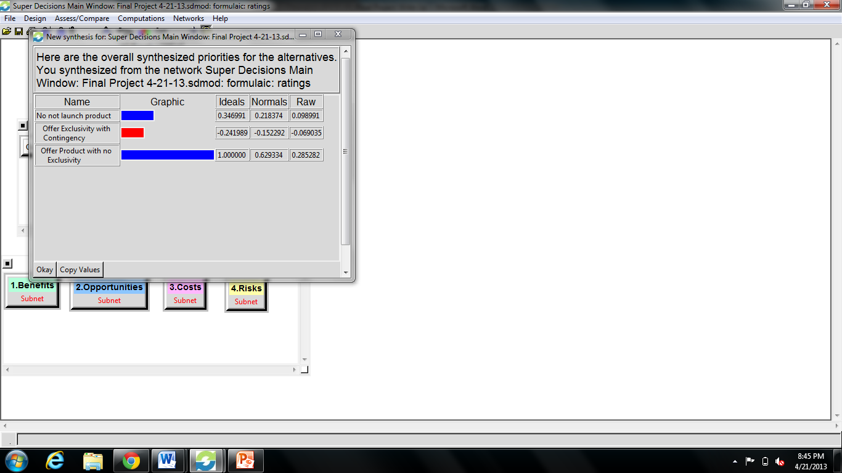
Results
Multiplicative
Additive

Slide 10
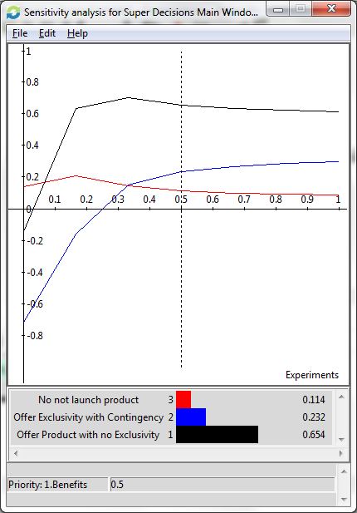
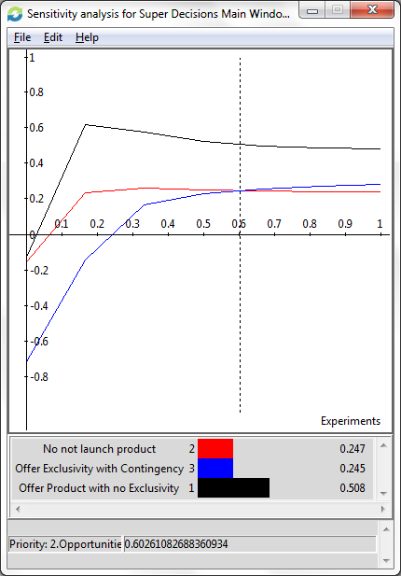
Sensitivity analysis
Benefits
Opportunities

Slide 11
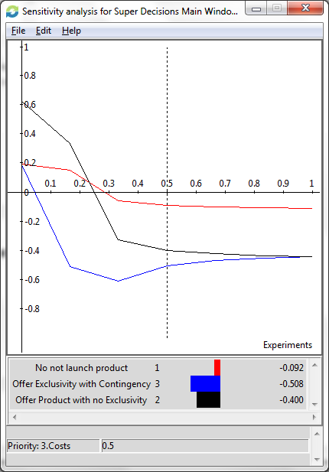
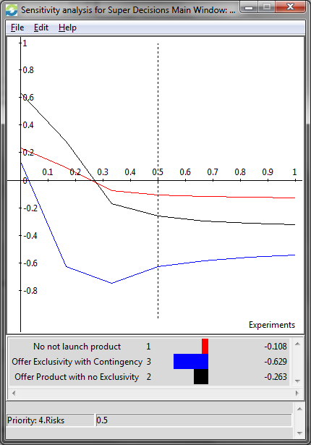
Sensitivity analysis
Costs
Risks

Slide 12
Recommendation
Offer product without exclusivity, the best option
Provides a the best potential to increased revenue
Provides more opportunities
Does not significantly change the cost
Reduces risk because this option relies less on a single distributers performance
Do not offer product, the second best option with the information presented
It reduces risk and cost
The market conditions may be such that fewer products allow the company to be most competitive

Slide 13
Thank you!

