Slide 1
Which Product Development Track Should PPG Take?
Kelly Bauer
Matt Kopacko
2011

Slide 2

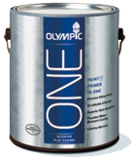
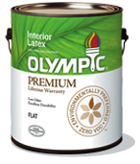


Background
PPG Industries is a global leader in the Architectural Coatings industry
Their Olympic brand of paints and stains is only sold through Lowe’s Home Improvement Stores
PPG is considered the #2 brand at Lowe’s – Valspar is the #1 brand
The #1 brand gets the most visibility and shelf space at Lowe’s
PPG needs a way to elevate their presence at Lowe’s and boost sales

Slide 3

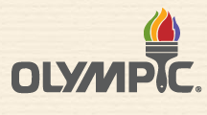
Alternatives
Launch a competitive offering to Behr All-in-One
Launch a revolutionary product not yet offered in the market
Re-engineer an existing product
Do nothing, keep product line as is
Notes:
1. Behr is the only paint + primer product on the market, it is only sold through Home Depot. Lowe’s does not have a product to compete with Home Depot in this segment. It would benefit PPG to launch an all-in-one product before Valspar

Slide 4
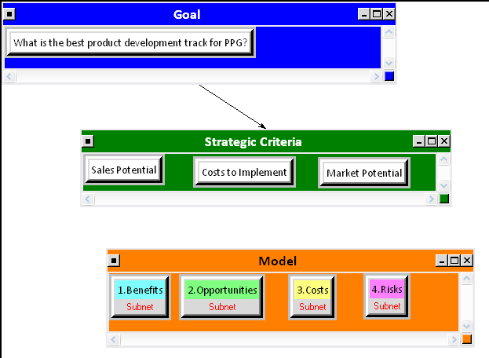
The Model
Notes:
Highlight strategic criteria: these are the 3 factors determined to be the most important to PPG in order to decide the best route for their products
Sales Potential- examples would be analysis of competition size and strength how hard/easy would it be to sell the product
Cost to implement- examples include R&D costs to develop the product and marketing/sales support to launch the product
Market Potential- market analysis, does a market exist for this new product? Is it a sizeable market worth pursuing?

Slide 5
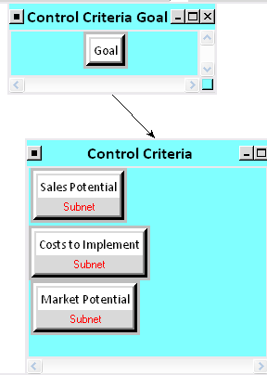
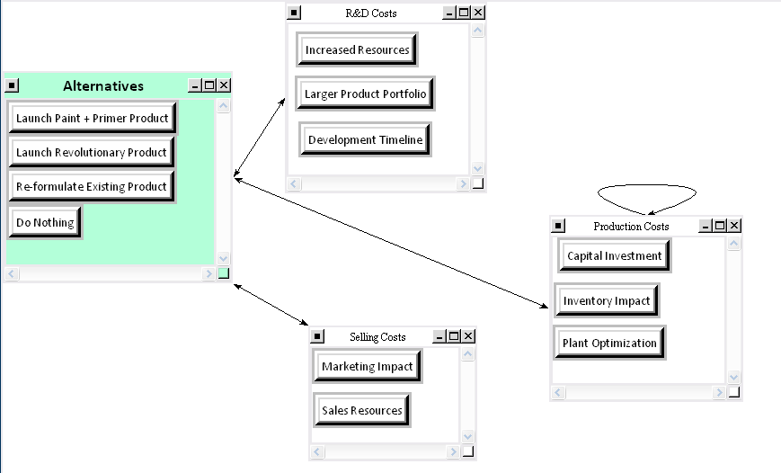
Benefits Sub-Criteria

Slide 6
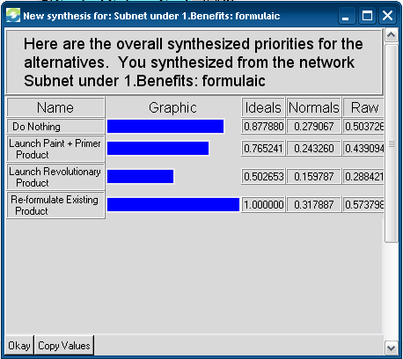
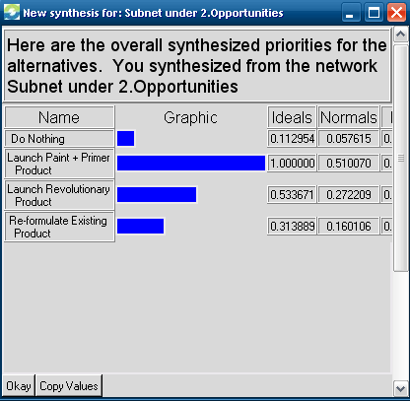
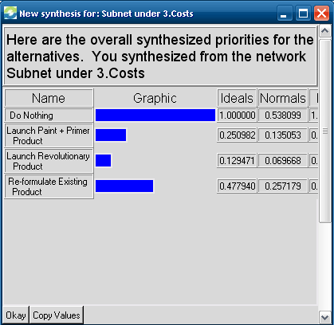
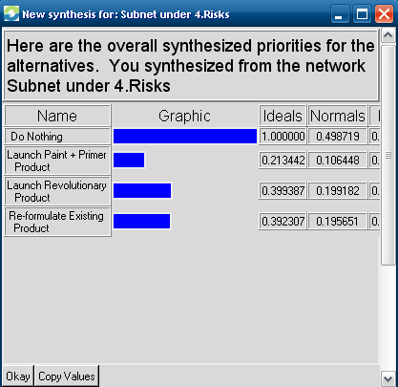
BOCR ANALYSIS

Slide 7
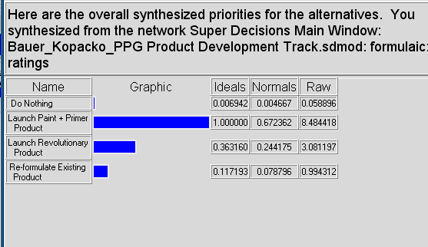
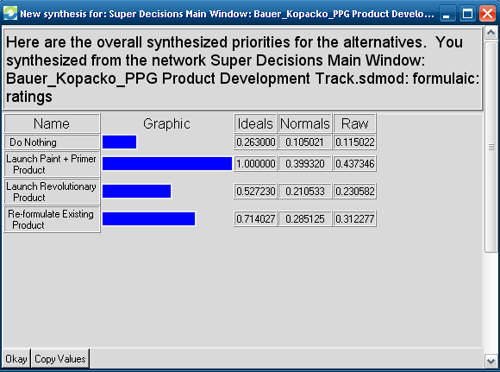
Results
Overall Synthesis Multiplicative
Overall Synthesis Additive Negative

Slide 8
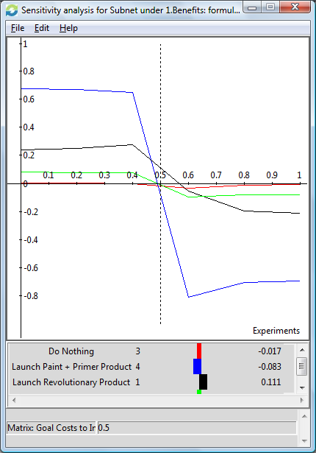
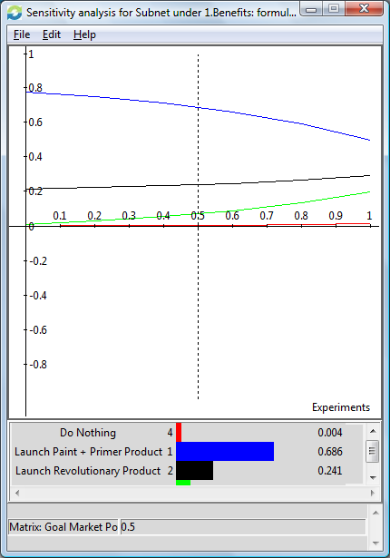
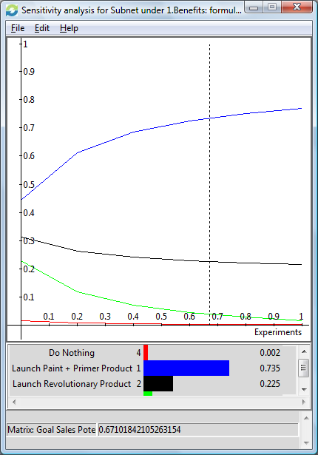
Sensitivity Example (Benefits)
Benefits wrt Cost to Implement
Benefits wrt Market Potential
Benefits wrt Sales Potential

Slide 9
Conclusions
The model shows that the Launch Paint-plus-Primer option is the best for PPG
The Benefits and Opportunities are highest with this option
The risks are slightly lower because a market for Paint-plus-Primer is already established
The costs are in the mid-range of all 4 options

Slide 10
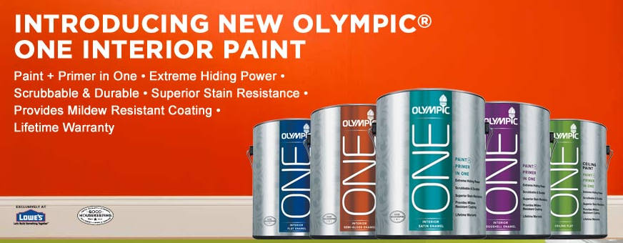
QUESTIONS ?

