Slide 1
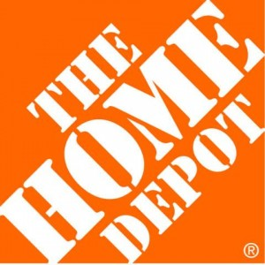
Home Depot Asian Development Strategy
Fangjian Shang
Xiaoying Geng

Slide 2


Agenda
Background
Alternatives
Modeling Process
Analysis
Results

Slide 3
Background
The Home Depot, Inc. is the world’s largest home improvement retailer
The Home Depot stores provide Do-It-Yourself ("D-I-Y") service.
During fiscal 2012, Home Depot closed all seven of its remaining big-box stores in China after years of losses
DIY service approach fails to grasp the local Chinese culture due to the cheap labor cost
Notes:
It sells a wide assortment of building materials, home improvement and lawn and garden products and provide a number of services such as helping DIY consumers to purchase products and complete their own projects and installations.
During fiscal 2012, Home Depot closed all seven of its stores in China after years of losses. Analysts attributed the failure to the difference in culture -- DIY service fails to grasp the local Chinese culture. Due to the cheap labor cost, Chinese consumers prefer do-it-for-me culture -- pay for people to do the work for them. Also, apartment-based living leads to scarce demand for products like lumber.
But Asian market is too big to ignore, so Home Depot is constantly searching for areas where it can expand into new markets to promote the profit in foreign market.

Slide 4


Goal
The next city in Asia Home Depot should march on
after failing to grasp China Mainland market
Alternatives
Alternative 1
Tokyo
Alternative 2
Seoul
Alternative 3
Hong Kong
Alternative 4
Don’t invest in Asia
Notes:
Learned from the lesson in China, we choose the areas with higher labor cost and higher average disposal income: Toyko Seoul Hong Kong

Slide 5
Differences
 | Tokyo | Seoul | Hong Kong
Income per year | 330,000 RMB | 240,000 RMB | 200,000 RMB
Rent | 36,7000 | 21,9000 | 30,000
Currency stability | medium | low | high
Interest Rate | 1.4% | 3% | 2%
Economic Growth in 2012 | downturn | 3.7% | 2%
Notes:
We analyze the differences among those cities, differences including per-capita income, Rent cost,
Currency stability and Interest rate

Slide 6
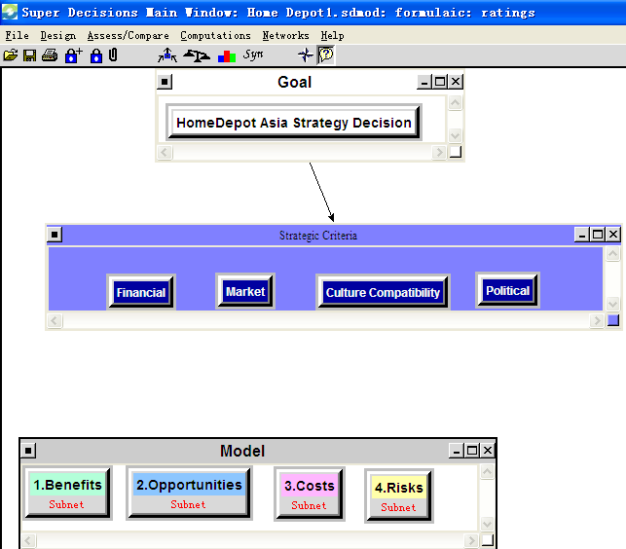
Model Overview
Notes:
This is the overview of our model,
We choose influential criteria and build the networks and sub-networks for each of the BOCR models
determine the best alternative for each subnet
rating the BOCR with respect to the strategic criteria.
Get the Overall Synthesized Results

Slide 7
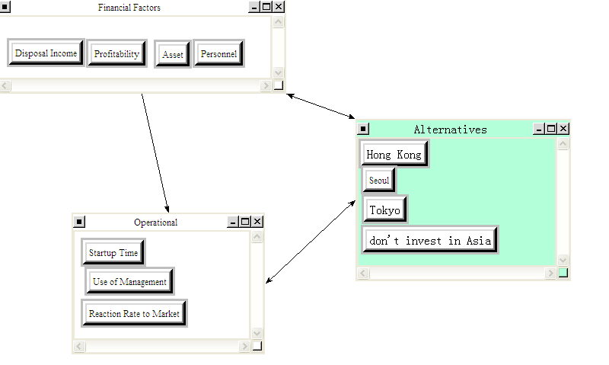
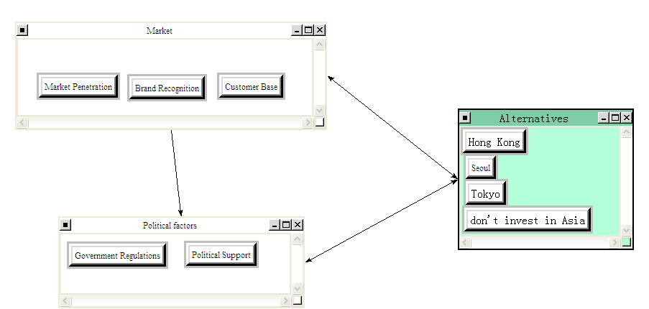
Benefit subnet
Notes:
This is the benefit subnet, we have the following nodes: Economical, Social
You can see that we focused on two control criteria Financial and operational,
Financial nodes include asset, disposal Income, profitability, personnel. Asset means the increase of the tangible or intangible asset that should be owned for new stores to make profit, such as financing lease, furniture, and laptops. Disposal income means the total personal income minus personal current taxes, which will influence the purchasing power. Personnel mean the increase of reserve of talents.
Operational nodes include startup time, use of management, and reaction rate to market.
Startup time means the time a new store need from the startup to function normally. the startup time will affect their timeline to occupy the market, the sooner they can start in a new country, the more opportunities they can obtain than other competitors.

Slide 8
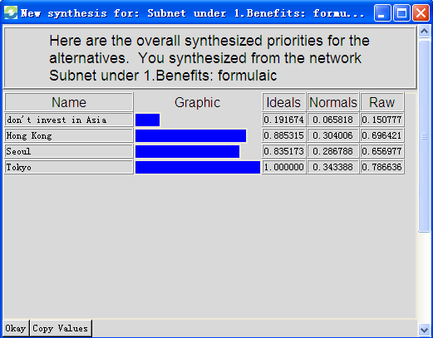
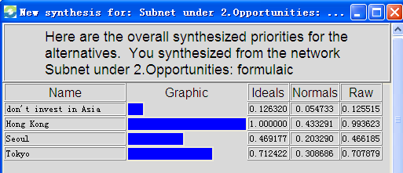
Synthesized Results: Benefits and opportunity Subnet
Notes:
We receive priorities through pair-wise comparisons
From the figure, The normalized values show that Tokyo offers the most benefits at 34%. For opportunity subnet, Hong kong ranks the top 1

Slide 9
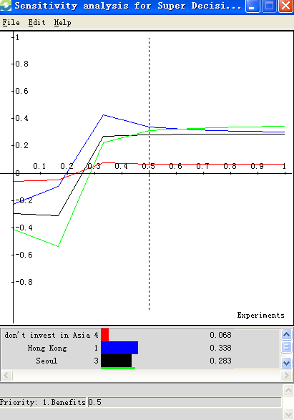
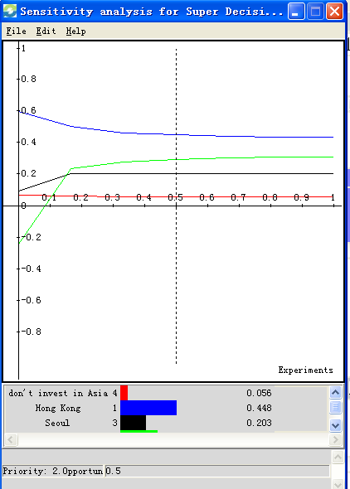
Benefits and opportunity Sensitivity Analysis
Notes:
Sensitivity analysis is shown in Figure. When the priority of Benefits is less than 60%, investing in Hong Kong is the best choice. above the percent the choice shifts to Tokyo. Because in Tokyo, average personal income is high, 50,000 dollars, so the purchasing power is strong, while the labor cost is also high, so consumers may prefer doing it myself and are willing to accept the market approach of home depot quickly, so the target market is broader, those factors will promote sales and profitability.
For the opportunity sensitivity, Hong kong ranks the top 1 all the time. Hong kong is the world financing center and is open to foreign investors, government provide preferential policies to attract investment, People are more open minded and accept the brand and foreign culture. so home depot has a good operating environment and great opportunities. And can expand the brand awareness and gain part of the competitors’ market share. In Tokyo and Seoul, people are more conservative, they still have a significant amount of local protectionism.

Slide 10
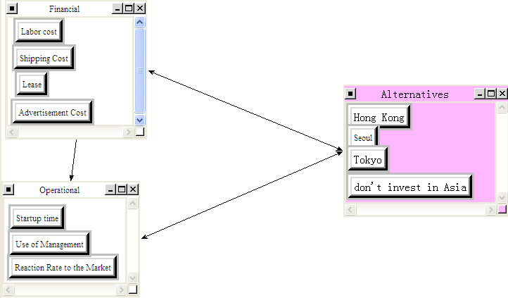
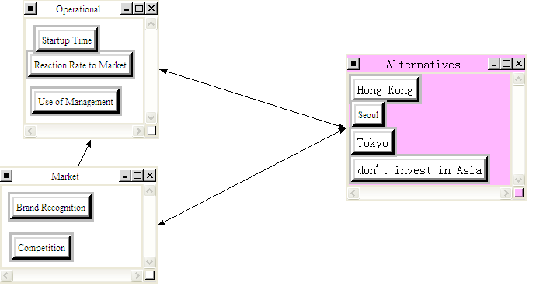
Subnet of Control Criteria: COST

Slide 11
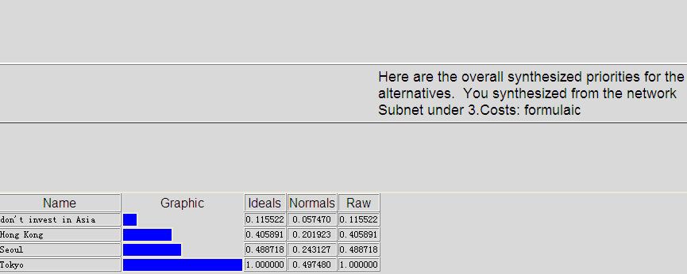
Synthesized Priorities--COST

Slide 12
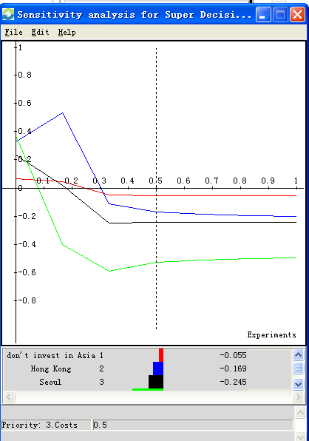
Sensitivity Graphs for cost

Slide 13
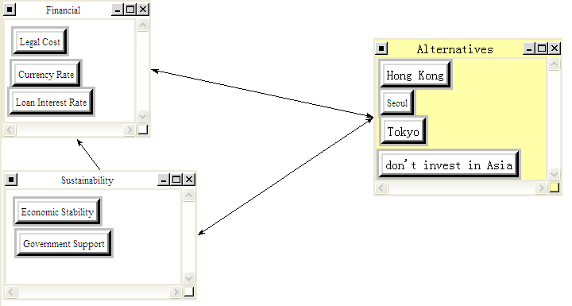
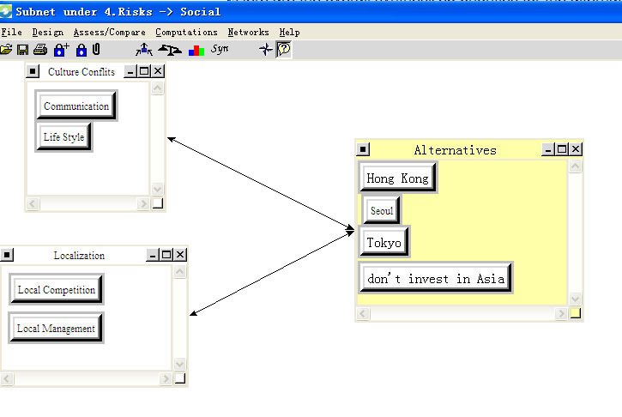
Subnet of Control Criteria: RISK

Slide 14
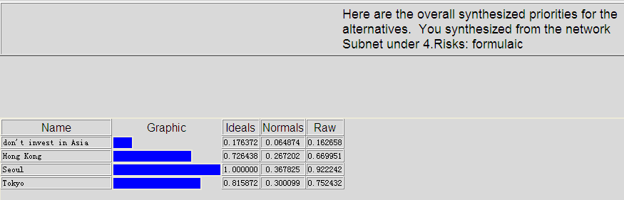
Synthesized Priorities--RISK

Slide 15
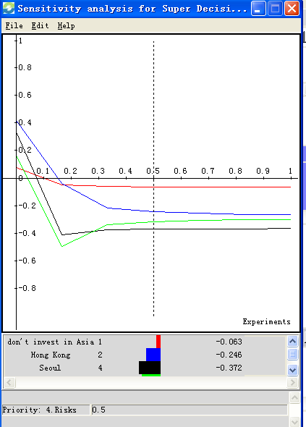
Sensitivity Graphs for RISK

Slide 16
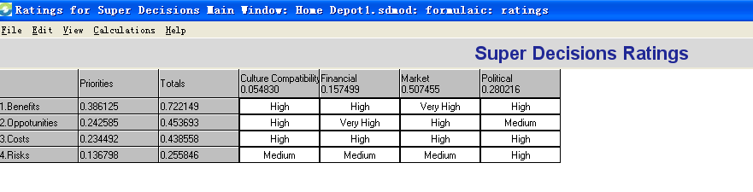
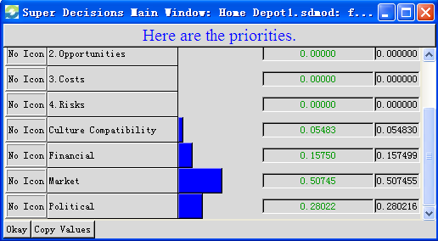
Rating Model
Market– highest priority at 50.74%

Slide 17
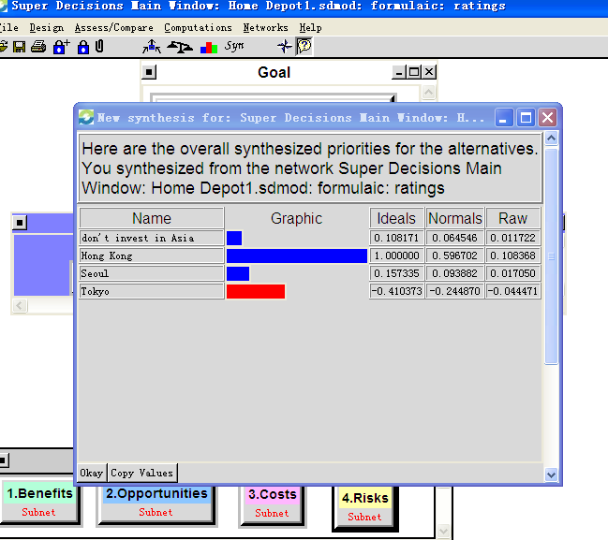
Conclusion
Background
Hong Kong is the first choice
Alternatives
Model
Analysis
Results

Slide 18
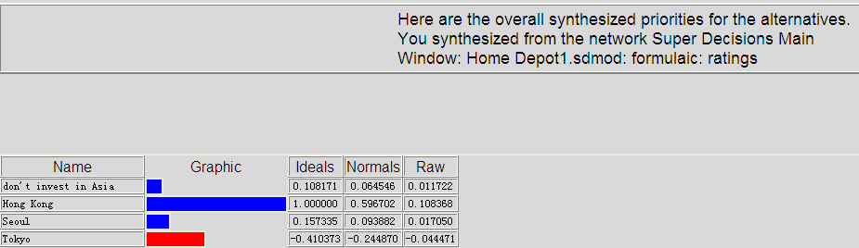
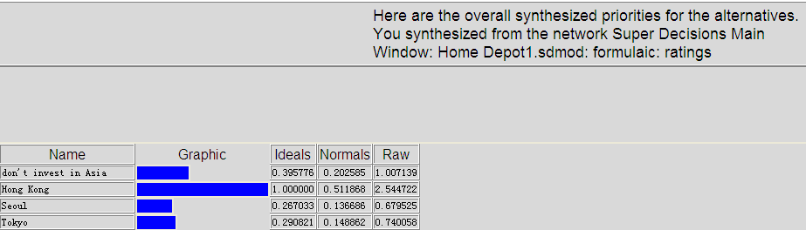
Analysis results from different formula
Additive(negative)
Multiplicative

Slide 19
Analysis results from different formula
From the short term formula-Multiplicative and the short term formula-Additive(negative),
Hong Kong is the first choice
for Home Depot in Asia

Slide 20
Thank You!

