Slide 1
Final Project BOCR Model Qoros Cars – A Market Entry Decision
Jan F. Klein
April 23, 2013

Slide 2
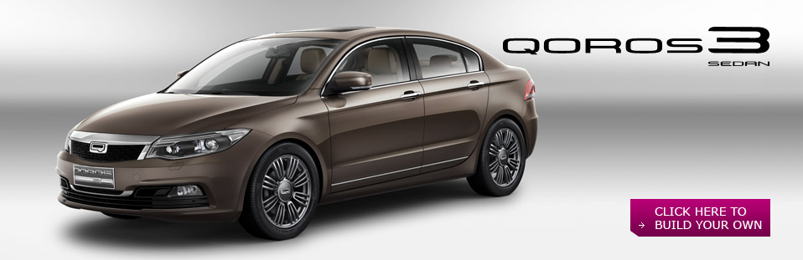
Should Qoros enter the European Car Market ?
focus on safety and quality for low cost
product and service quality
strong financial background
car model Qoros 3 Sedan

Slide 3
Three Alternatives for Qoros‘ Management
Market Enry?
No
Small Scale
Large Scale

Slide 4
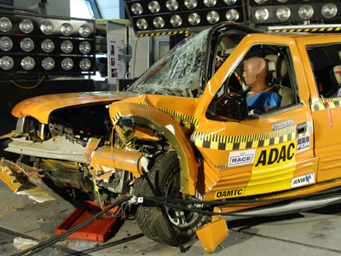
Chinese Car Manufacturer in Europe – A History of Failure

Slide 5
Chinese Car Manufacturer in Europe – A History of Failure
Bad reputation
Failure in the NCAP Crash Test
No Chinese manufacturer survived in the European car market
Declining market: “this is actually not the right time to attack in Europe“.
→the third Chinese manufacturer to enter, the third to fail?

Slide 6
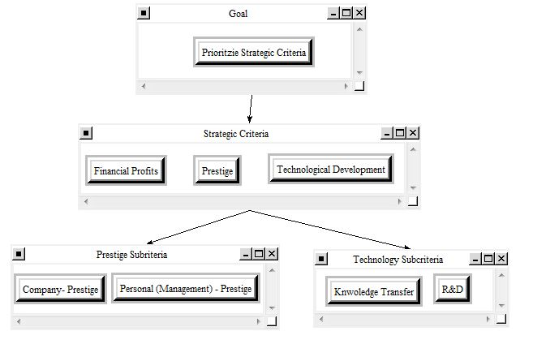
Strategic Criteria
Company Goal:
“To become the first automobile company from China to be widely-known and respected on the international stage”
Benefits | 0.21187
Opportunities | 0.26064
Costs | 0.29517
Risks | 0.23232

Slide 7
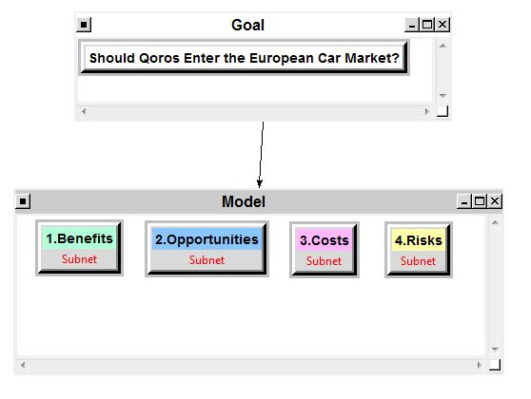
BOCR – Model

Slide 8
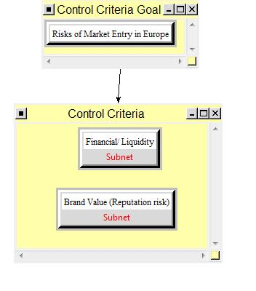
Control Criteria

Slide 9
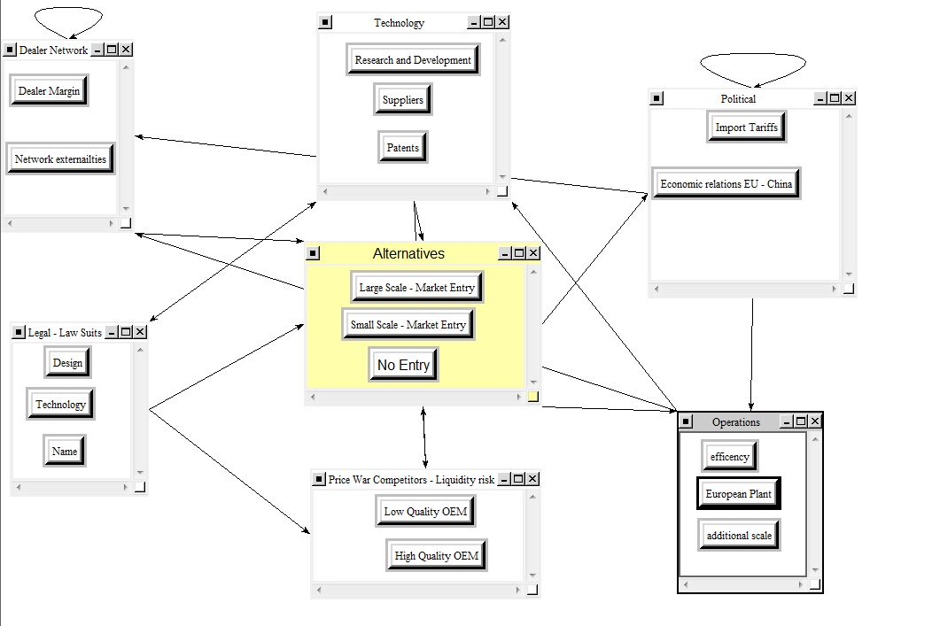
Subnet – Financial/Liquidity Risk

Slide 10

Copying Design and Technology → Legal Issues

Slide 11
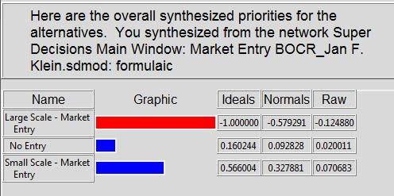
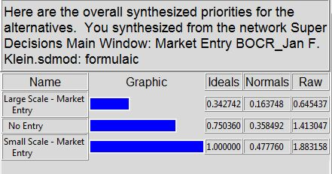
Synthesized Results
Opportunities
Costs & Risks
Benefits
Risks
“Small Scale Entry “

Slide 12
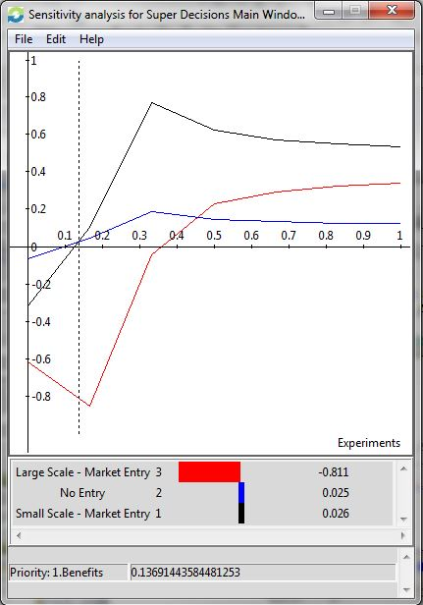
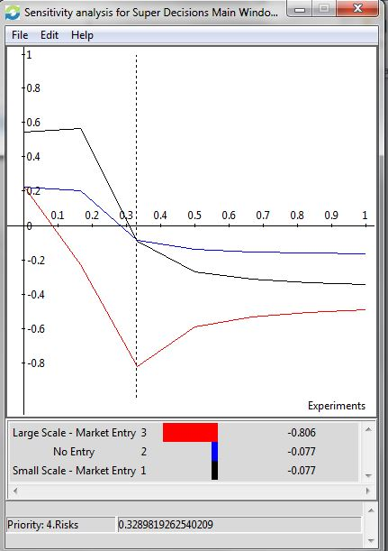
Sensitivity-Analysis
Benefits
Risks

Slide 13
Conclusion: The Best Alternative“ Small Scale“
Small Scale small scale entry is the best decision in the short and in the long run
Sensitivity small scale strictly dominates large scale for 3 out of 4 merits. Also preferred for sufficiently low priorities with respect to risks and costs over no entry.
Qorors‘ Decision enter European market with a low scale end of 2013

Slide 14
?

Slide 15
Thank you for your attention!

Slide 16
Appendix

Slide 17
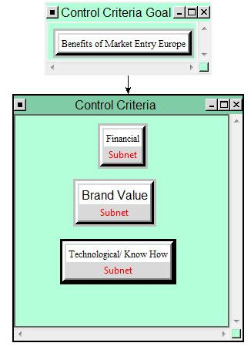
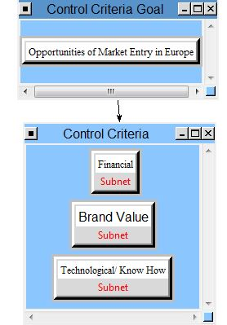
Control Criteria

Slide 18
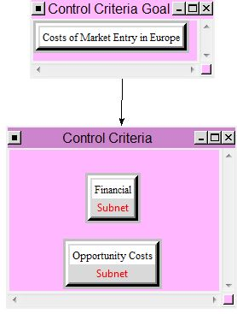
Control Criteria (cont‘d)

Slide 19
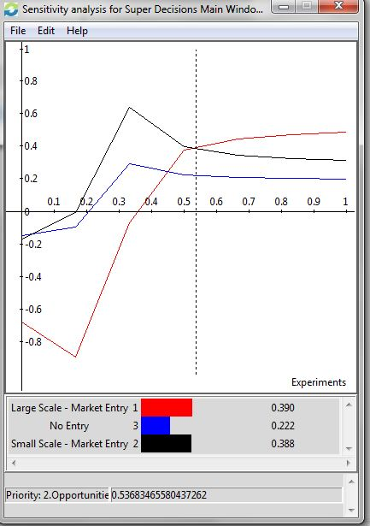
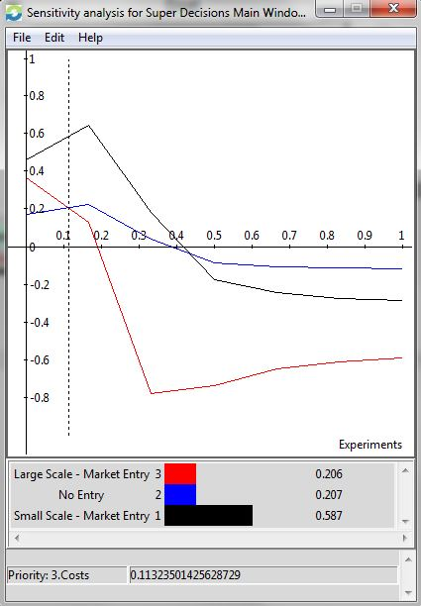
Sensitivity-Analysis
Opportunities
Costs

Slide 20
BOCR | Control Criteria | Cluster
Benefits | Financial | Sales and Services, Marketing, Employees, Market Positioning
 | Brand Value | Qorors China, Strategic, Europe
Opportunities | Financial | Financial Services, Sales, Customer Base, Car Service
 | Brand Value | Signaling, Expansion, Strategic
 | Technological/ Know How | Contract Relationships., Knowledge Transfer (“Copying”), Experience
Costs | Financial | Market Launch, Production, Market Development & Overhead, Employee Hiring, Car Development
 | Opportunity Costs | Expansion, Overhead Advancements, China
Riks | Financial/ Liquidity | Dealer Network, Legal – Law Suits, Technology, Price War Competitors – Liquidity risk, Operations, Political
 | Brand Value (Reputation risk) | Chinese Market, European, International

