Slide 1
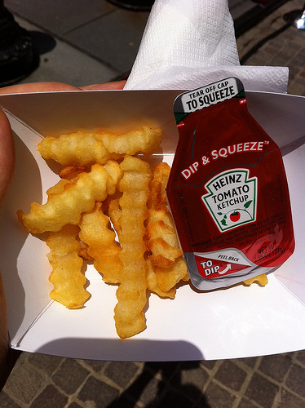
What will be the future of Heinz ‘dip and squeeze’: ± 5 years??? Decision Making in a Complex Environment Final Project Paul Pryblo and Tamanna Sultana
Oct. 17, 2011

Slide 2
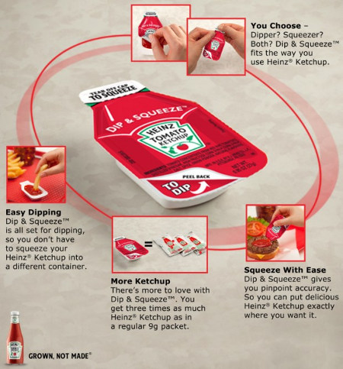
Background
Introduction of “Dip and Squeeze”
New innovative ketchup packet in response to consumer demand
Holds more ketchup per pack than the old version
Gives ketchup lovers two ways to enjoy Heinz Ketchup:
either peel back the lid for easy dipping, or
tear off the tip to squeeze onto favorite foods.

Slide 3
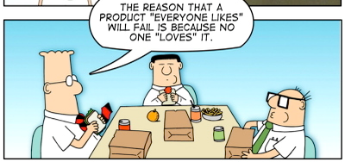
The alternatives (future of “dip & squeeze”???)
Will it last more than 5 years, or
Diminish before 5 years

Slide 4
Benefits of the decision
Our decision takes into account many more criteria than the traditional ROI / discounted cash flows assessment.
In using the ANP approach we utilized the BOCR model to predict the time frame of > or < five year.
Five years is a typical amount of time that corporations use in the project decision making process.
Decisions Made from the results > 5yr <5yr
Capital Investment Yes No
Process improvement Yes No
Sales & Marketing investment Yes No
International Expansion Yes No

Slide 5
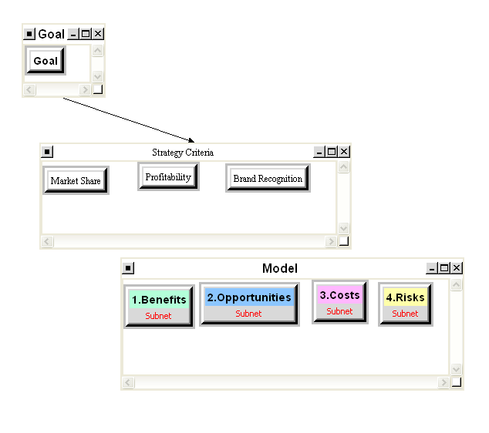
Strategic criteria
Market share
How will be the market share response
Profitability
How profit is going to be affected
Brand recognition
Will this product enhance the Heinz brand

Slide 6
BOCR model
Opportunities
Market share
Profitability
Global distribution network
Benefits
Acceptability
Profitability
Risks
Market share
Profitability
Global distribution network
Costs
logistics
Process
Sales & marketing

Slide 7
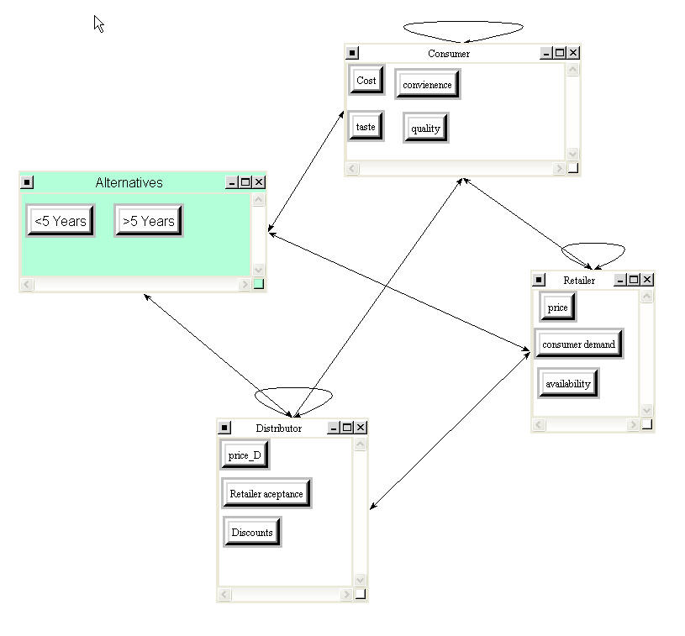
Acceptability benefits

Slide 8
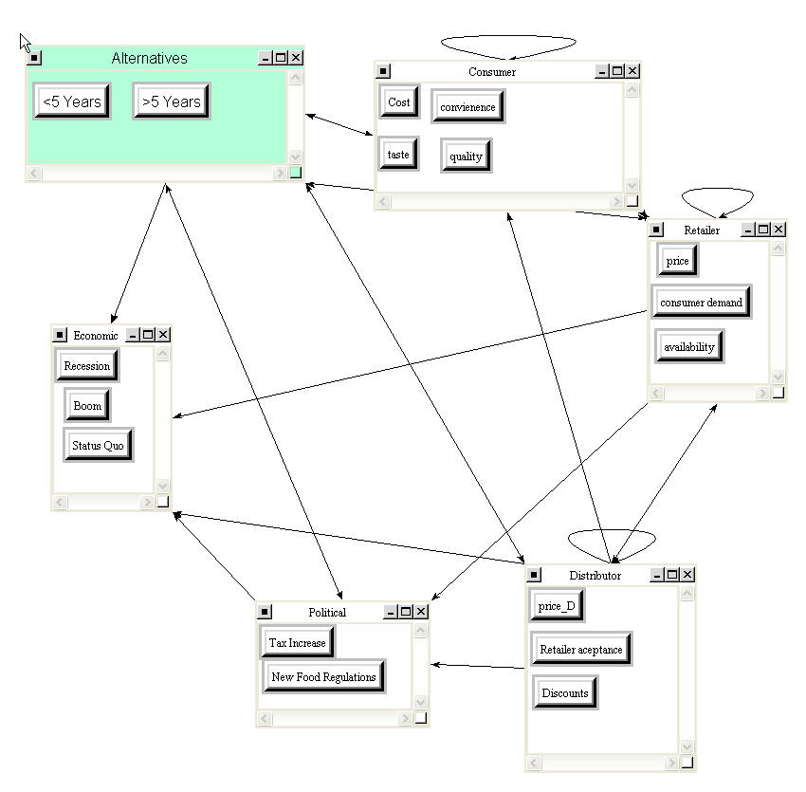
Profitability benefits

Slide 9
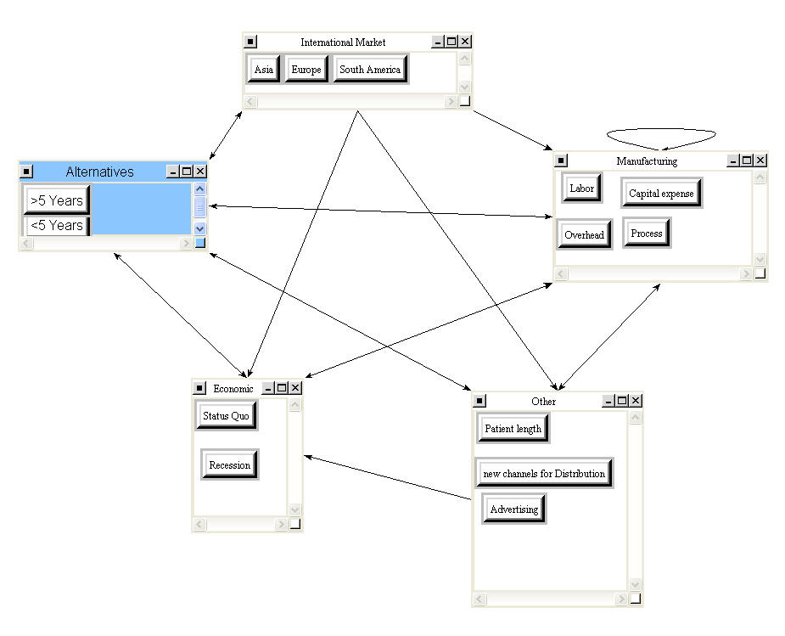
Market share opportunities

Slide 10
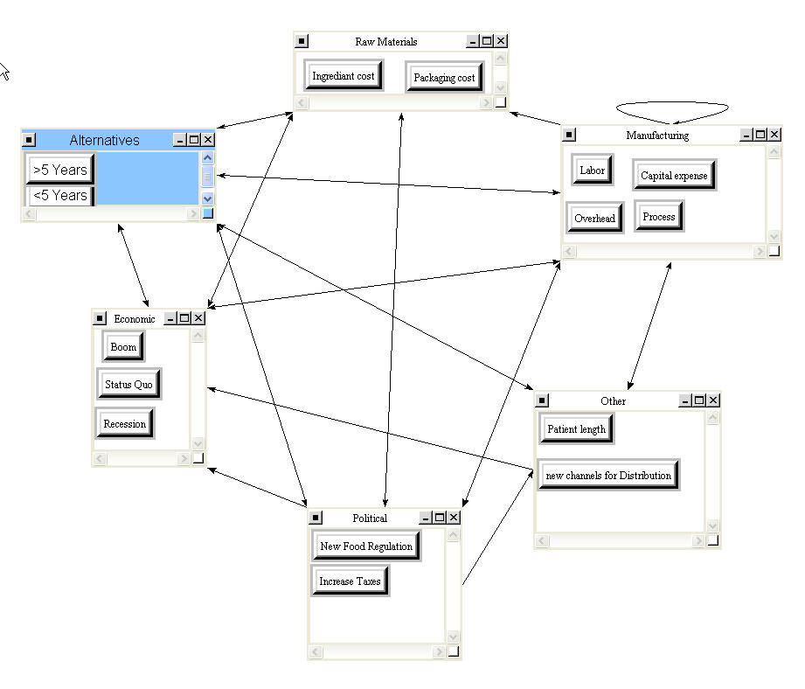
Profitability opportunities

Slide 11
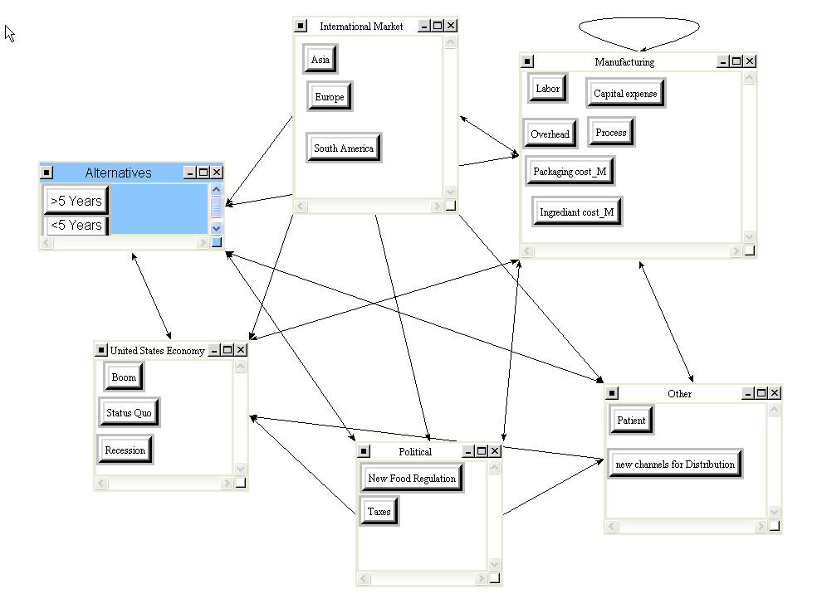
Global opportunities

Slide 12
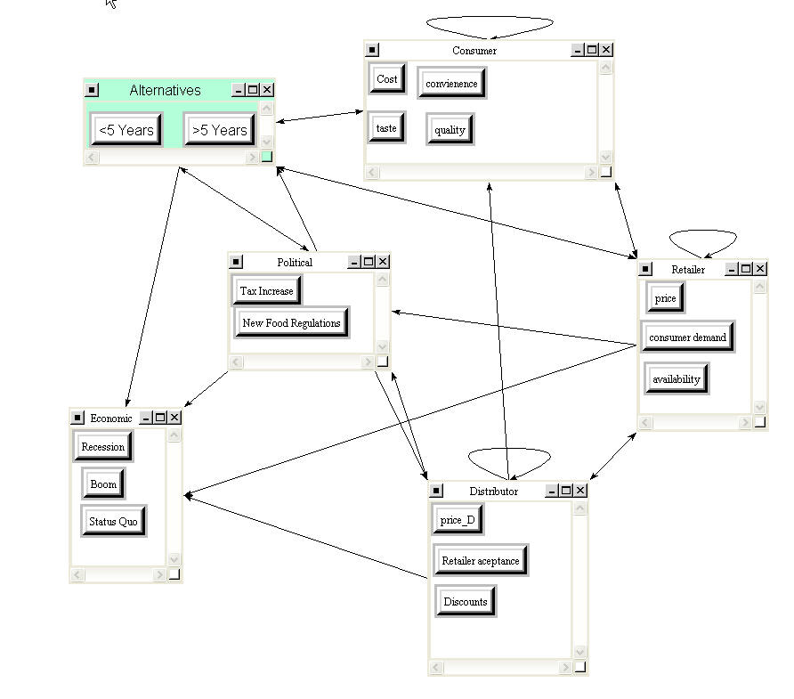
Logistics costs

Slide 13
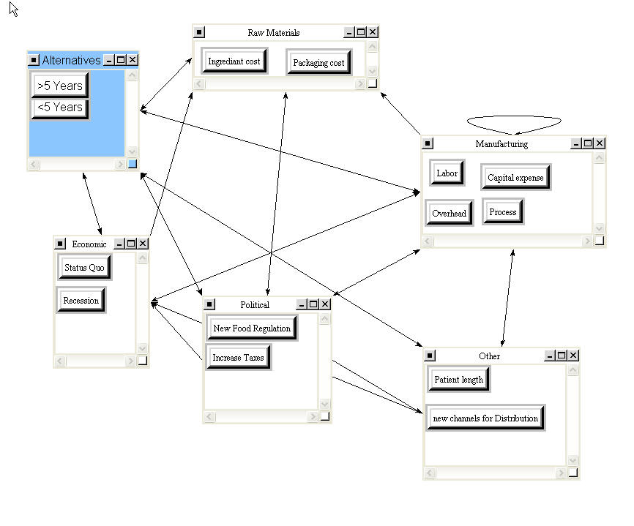
Process costs

Slide 14
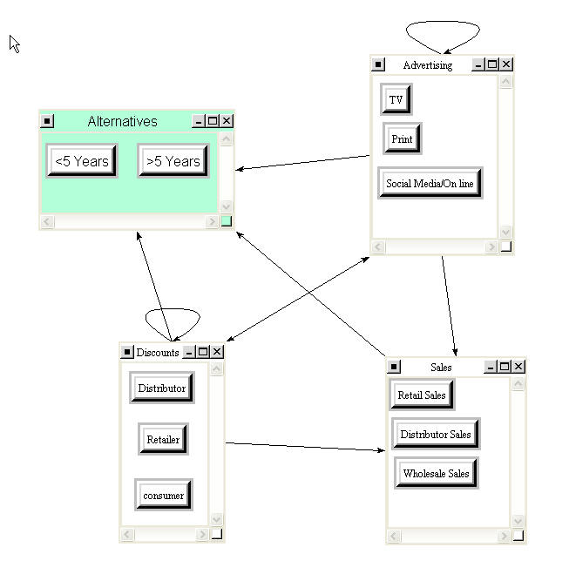
Sales and marketing costs

Slide 15
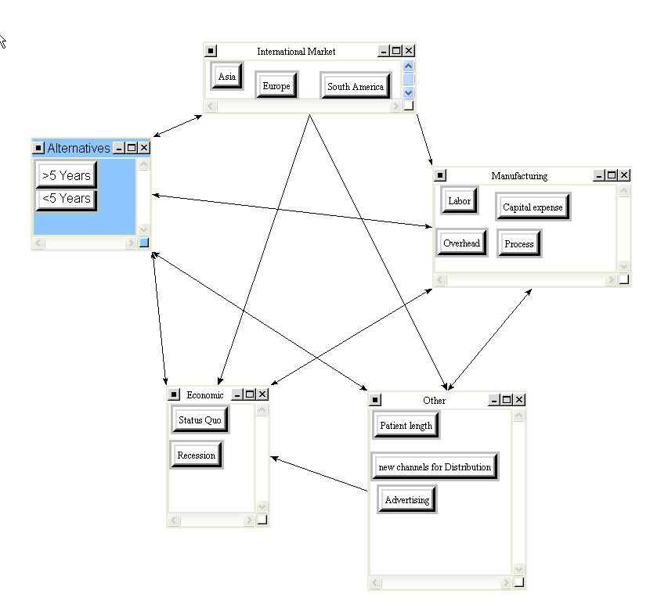
Market share risks

Slide 16
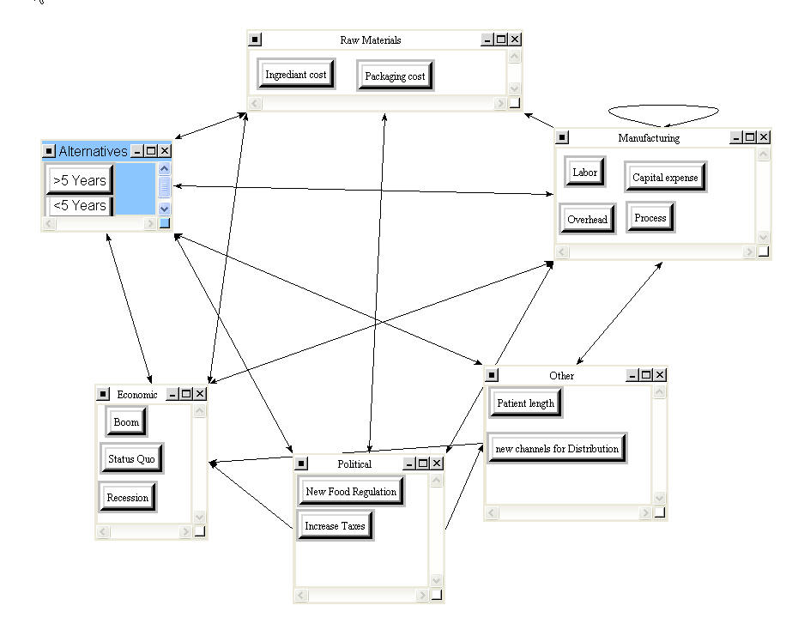
Profitability risks

Slide 17
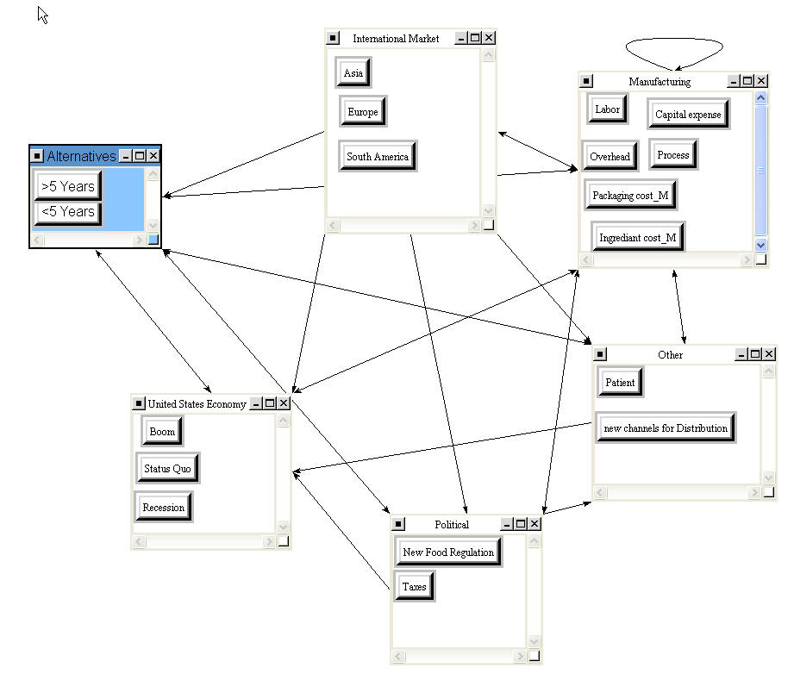
Global risks

Slide 18
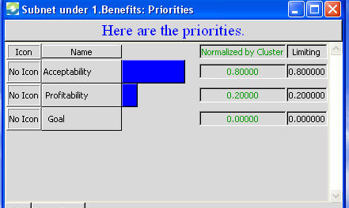
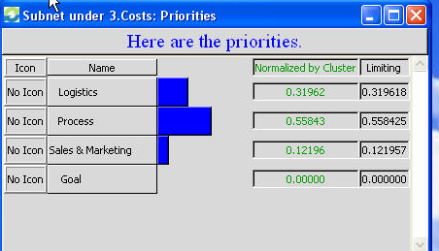
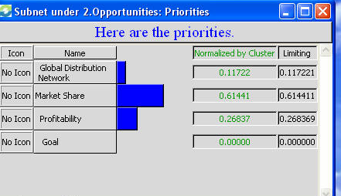
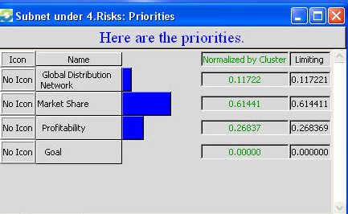
Priorities

Slide 19
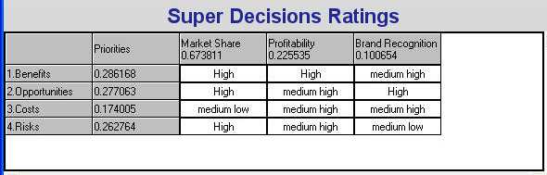
Ratings to set priority of BOCR
The priorities of the model rank as follows from most important to least important:
1.) Benefits (0.363)
2.) Opportunities (0.290)
3.) Risks (0.192)
4.) Costs (0.154)

Slide 20
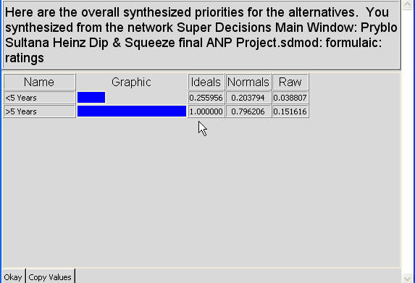
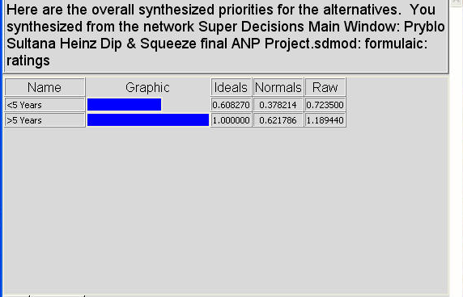
Results
Additive Negative
Multiplicative

Slide 21
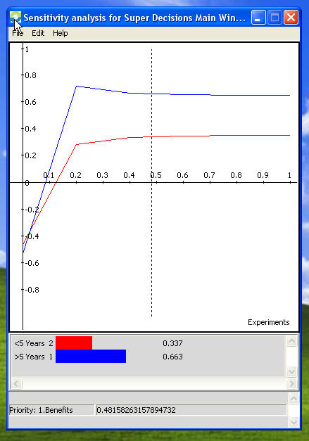
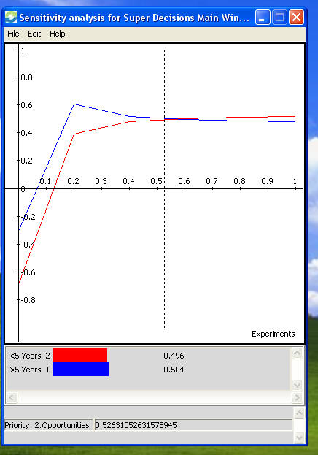
Sensitivity Analysis
Benefits
Opportunities
If the priority is more than about 3% for benefits and for up to 52% for opportunities, >5 years is the choice.
For opportunity priority from ~52%-65% the alternatives can not be differentiated and at >65%, the alternative <5 years becomes prominent.

Slide 22
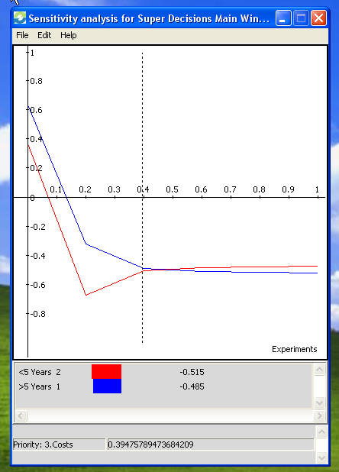
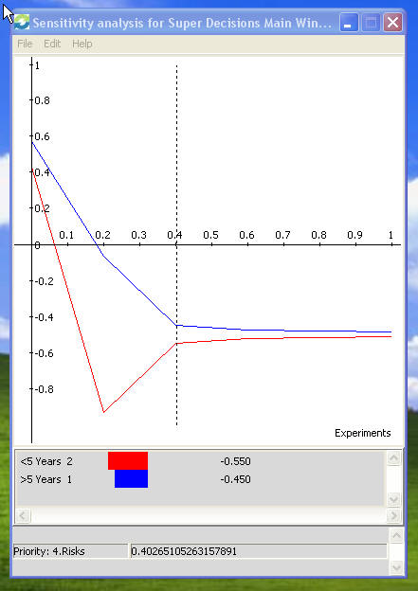
Sensitivity Analysis Continued
Costs
Risks
If the priority is less than about 43% for costs >5 years is the choice. Above 50%, <5 years is the choice
For any risk priority the alternative >5 years is prominent.

Slide 23
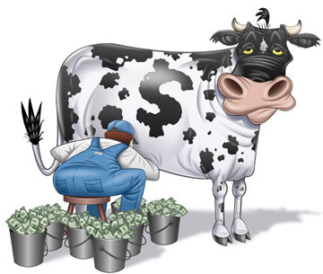
Conclusions
Dip & Squeeze might be a cash cow after all

Slide 24
Questions?
Thank you!

