Slide 1
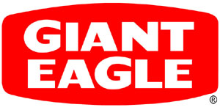
Giant Eagle’s Recommended Strategy to Win
Jessica Hollern (jjh65@pitt.edu)
Justin Petrulak (jep103@pitt.edu)

Slide 2
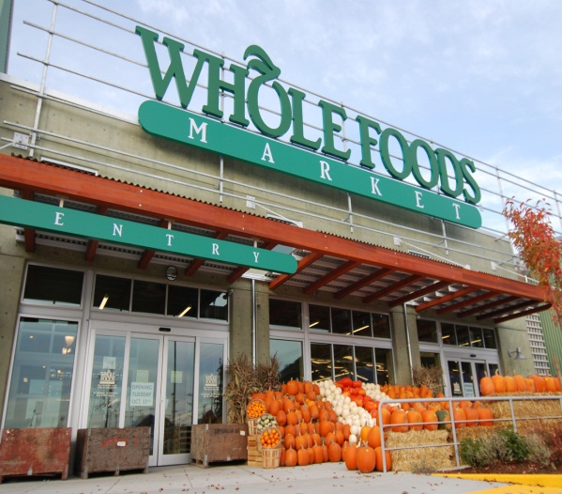
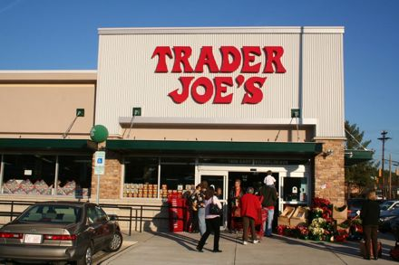
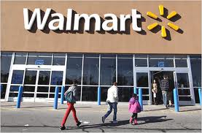
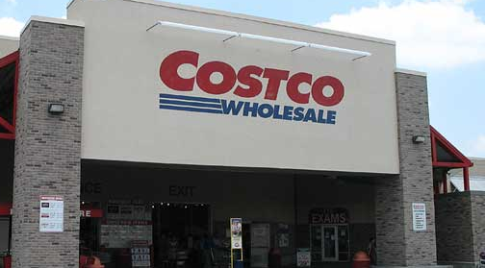

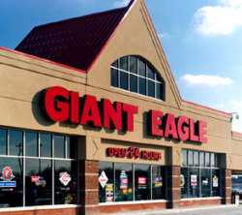
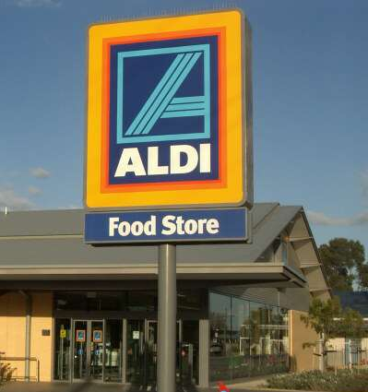
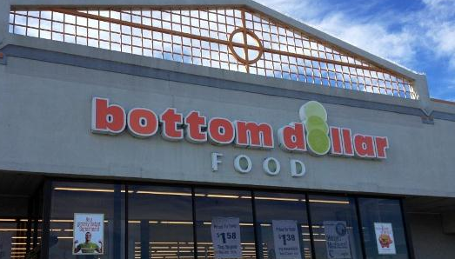
Where do you grocery shop? Are you loyal? What influences your decision?

Slide 3
Overview
Giant Eagle:
Supermarket chain with over 175 company-owned and 55 franchised stores in PA, OH, WV, and MD
Ranked #21 of the Top North American Food Retailers with annual sales of $10 billion¹
For long has had highest share of any supermarket chain in Pittsburgh area
Challenge:
Extremely competitive market where traditional grocers are being pushed out by value grocers (Walmart, Aldi, Bottom Dollar) and premium/specialty grocers (Whole Foods, Trader Joes)
Shrinking margins, less loyal consumer base, technology rapidly increasing
Current problem Giant Eagle is facing and working on through their Project 20/20 initiative to determine their strategy and goals for the coming years
¹ According to Supermarket News, 2012

Slide 4
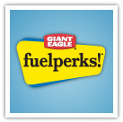
Alternative #1: Keep Hybrid Model
Giant Eagle’s core format, dominant in terms of the number of stores
Advantages: Very flexible format, appealing to a large customer base & not as specific to low-end or high-end shoppers, more recession proof as it caters to various levels of consumers, wide range of product offerings, fuel perks offered to consumers to drive loyalty
Disadvantages: Tradtional grocers are being squeezed by the growing value and premium grocers which this hybrid model struggles to compete with, lack of clear & defined strategy; rather it serves as a “catch all” type market

Slide 5
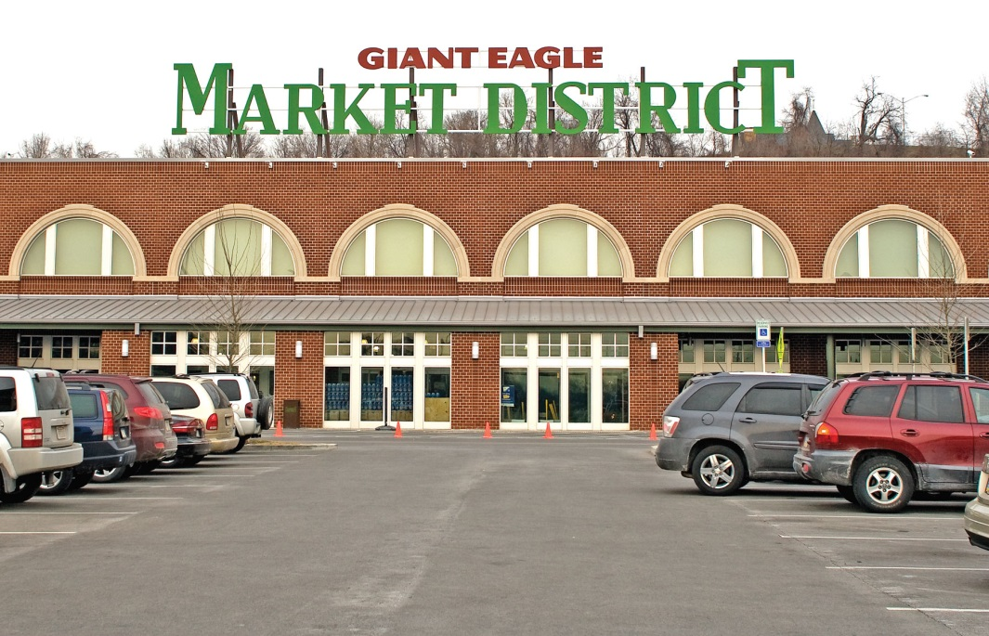
Alternative #2: Convert to Market District Format
Currently only 7 Market Districts, developed to appeal to food enthusiasts, feature wide array of freshly prepared foods, specialty items, and services (nutritionist, make up artist, cooking classes, etc.)
Advantages: High financial success and profitability, extremely loyal consumer base, creates a true shopping experience, limited competition in the Pittsburgh area and markets in which Giant Eagle competes, attractive promotions and fuel perks
Disadvantages: Higher prices – though warranted by premium and specialty products, the overall experience, and ambiance – don’t cater to value-shopping consumers, higher operating costs, could struggle in tough economy times as consumer disposable income declines

Slide 6
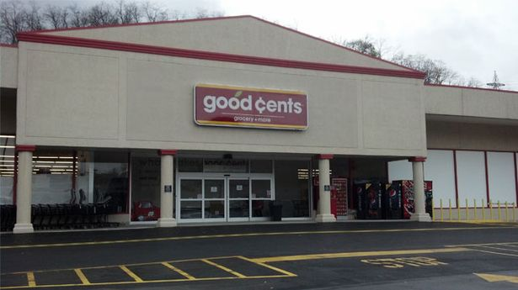
Alternative #3: Convert to Good Cents Format
Previously named Valu King, low-cost supermarket concept to compete with Aldi, Bottom Dollar, and Walmart
Advantages: Offers low prices and helps consumers save through a sluggish economy and rising food & commodity costs, respectable fresh produce, low costs to operate
Disadvantages: Highly competitive market where sales are shared across many grocers, households not loyal – they will shop wherever has the best price, less differentiation potential, profitability margins very low

Slide 7
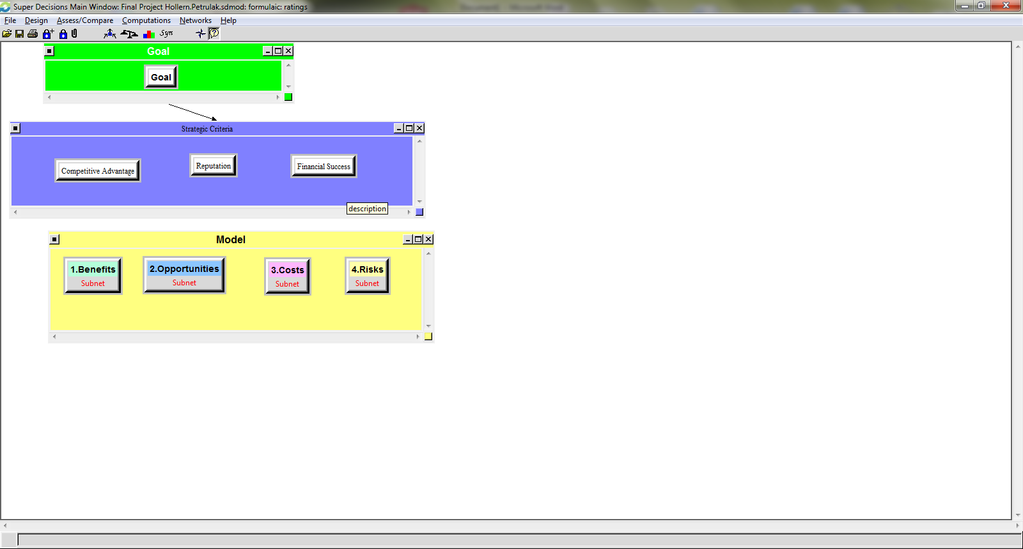
BOCR Model
Assumptions and data gathered through our professional experience being involved with Giant Eagle, other competing retailers, and one of the largest food manufacturers – in addition to other accredited sources¹
¹ Sources include Supermarket News, Progressive Grocer

Slide 8
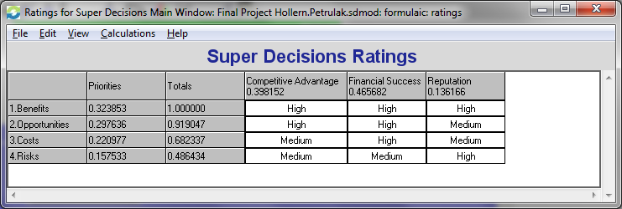
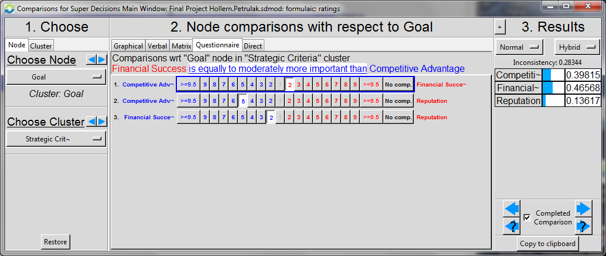
Strategic Criteria
Ratings
Pairwise Comparisons

Slide 9
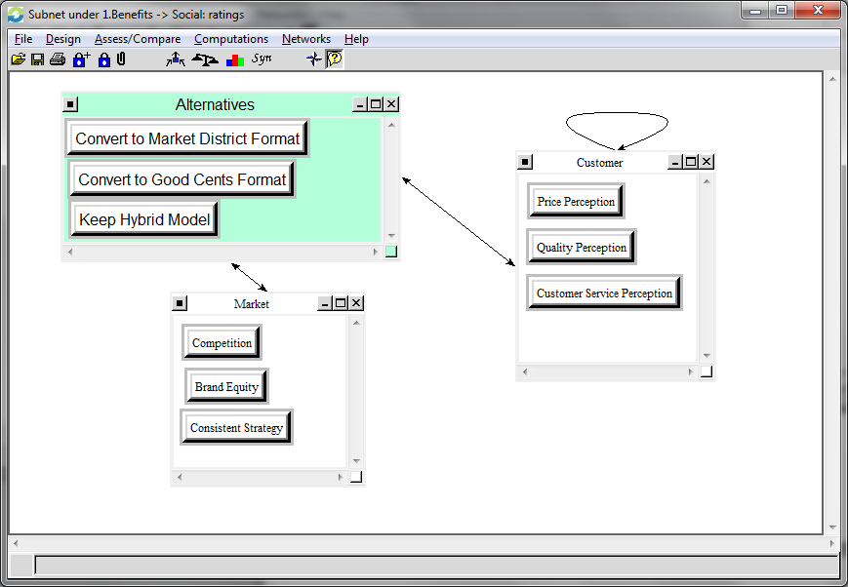
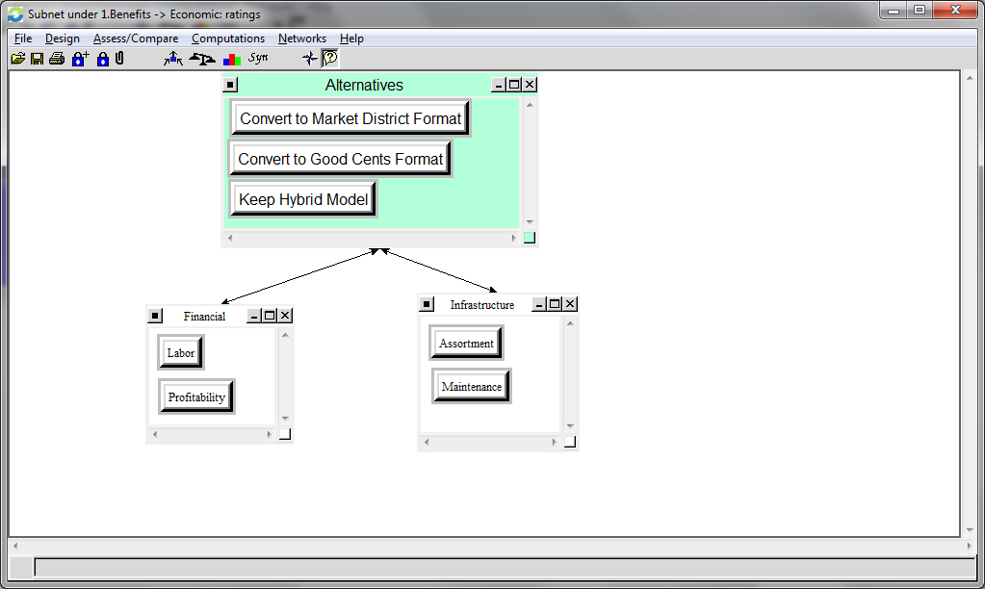
Benefits Weight: 0.324
Social
Economic
Convert to Market District (0.447),
Keep Hybrid Model (0.293), and Convert to Good Cents (0.258)

Slide 10
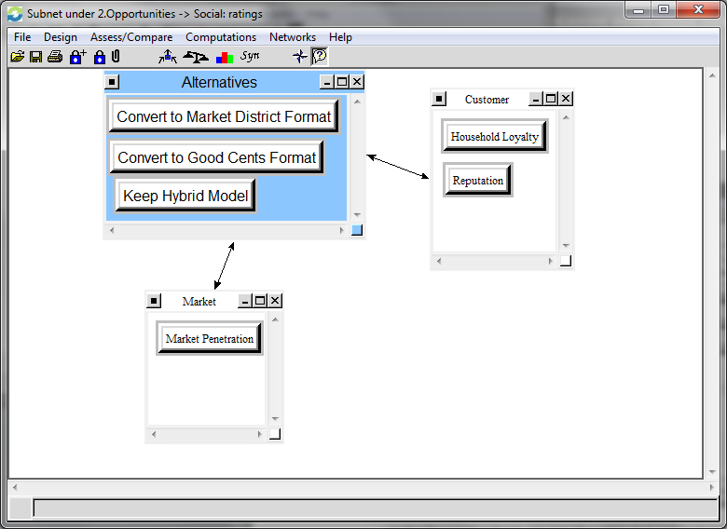
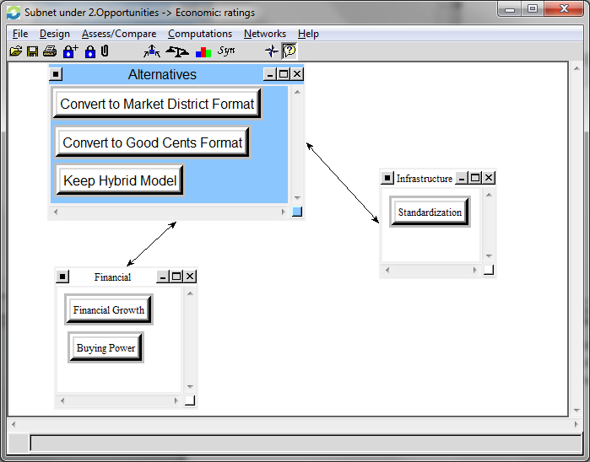
Opportunities Weight: 0.298
Social
Economic
Convert to Market District (0.453),
Convert to Good Cents (0.321), and Keep Hybrid Model (0.224)

Slide 11
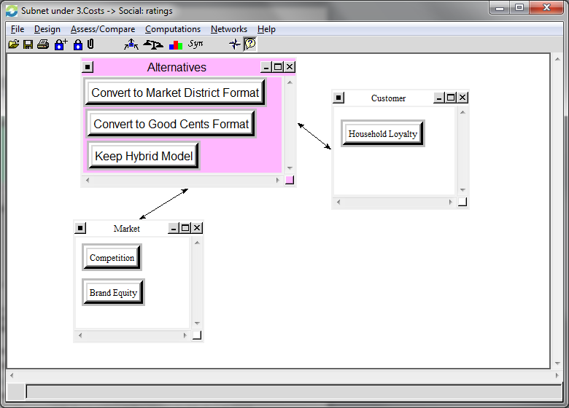
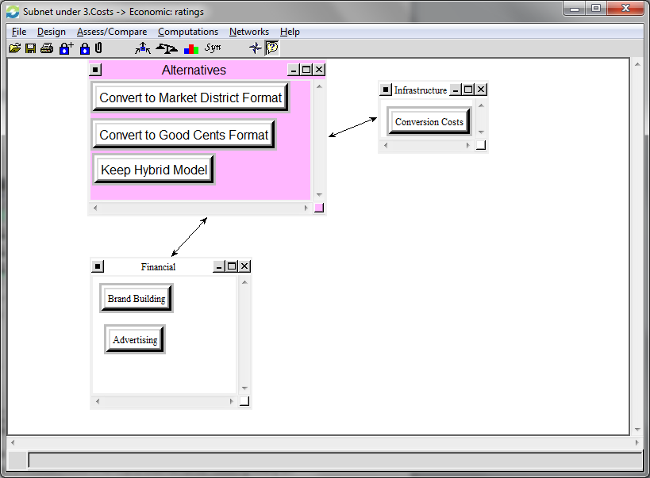
Costs Weight: 0.221
Social
Economic
Keep Hybrid Model (0.427),
Convert to Market District (0.366), and Convert to Good Cents (0.205)

Slide 12
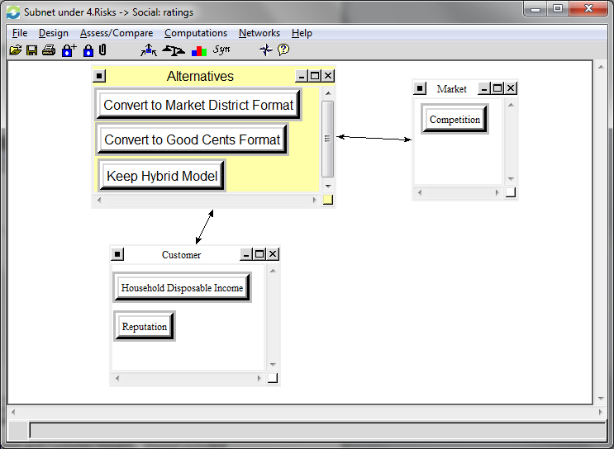
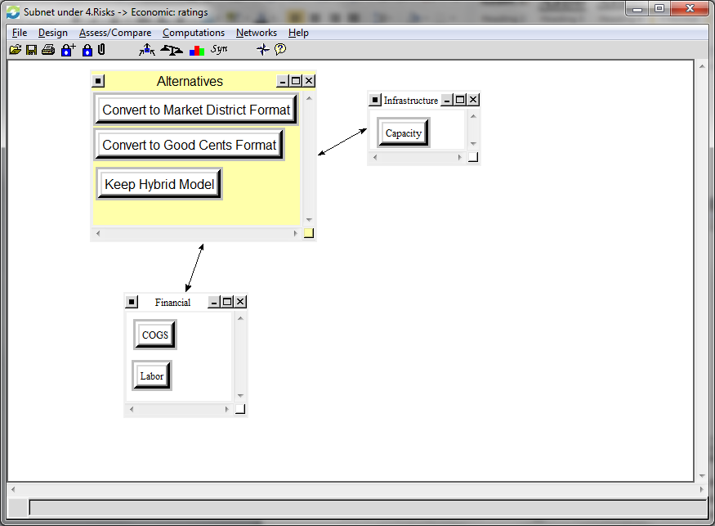
Risks Weight: 0.158
Social
Economic
Convert to Good Cents (0.472),
Keep Hybrid Model (0.310), and Convert to Market District (0.217)

Slide 13
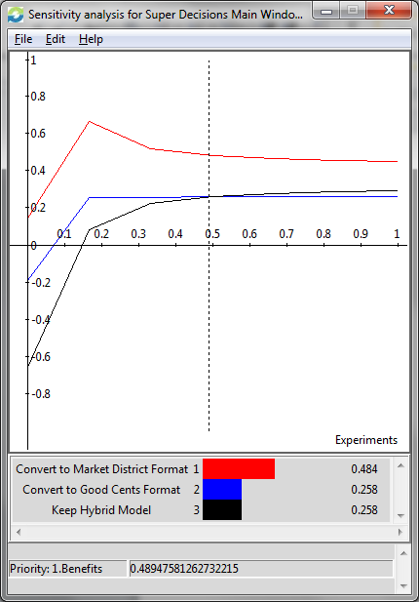
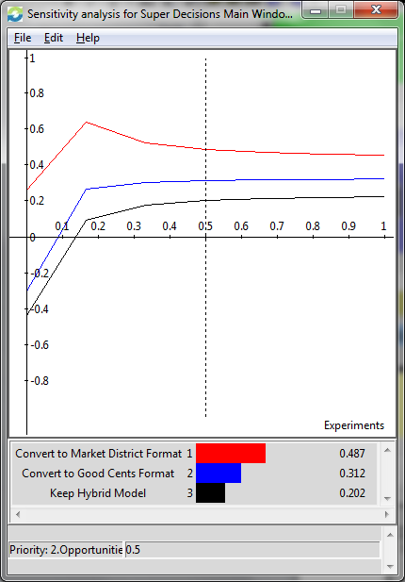
Sensitivity
Benefits
Opportunities
Converting to Market District at all priority levels is the best option.

Slide 14
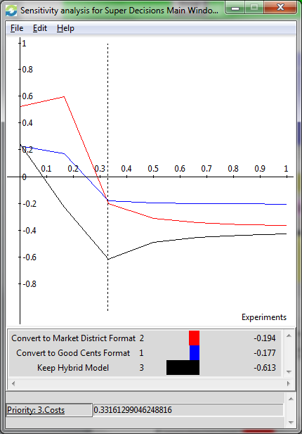
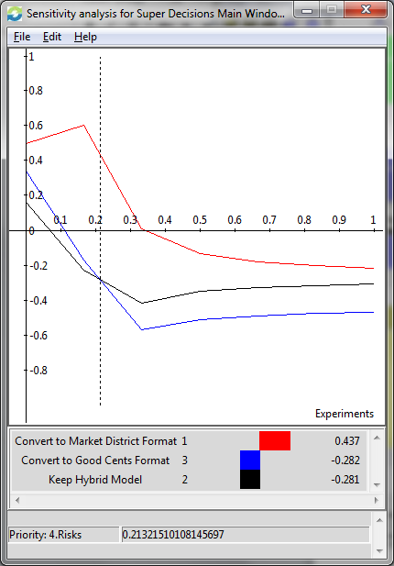
Sensitivity
Costs
Risks
With Costs as the independent variable,
Good Cents is the best alternative. Only when the priority is low (below 0.33) will Market District have an advantage over Good Cents.
With Risks as the independent variable, Market District is the best alternative.

Slide 15
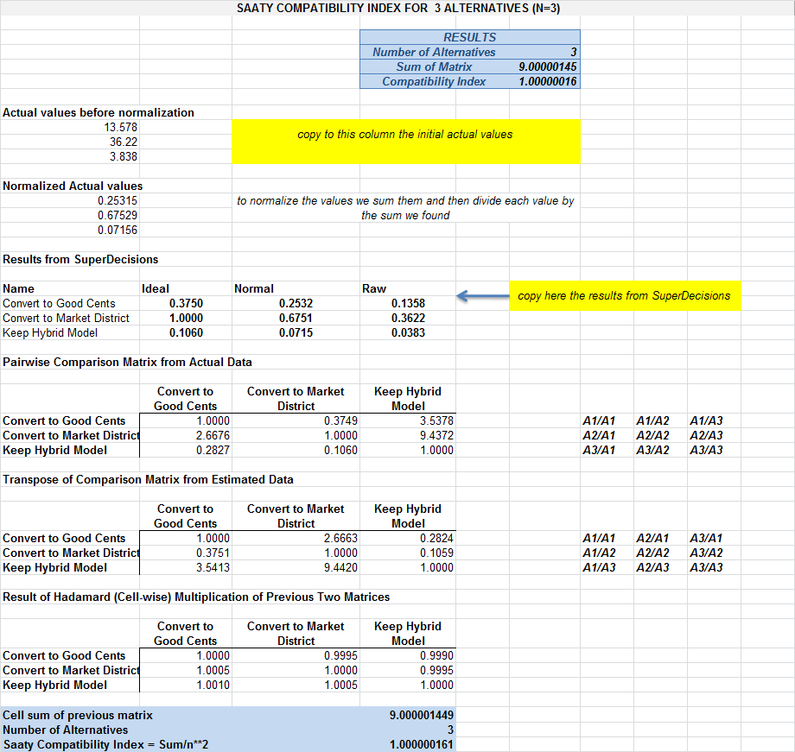
Compatability
Compatability Index for 3 Alternatives = 1.00000016101498

Slide 16
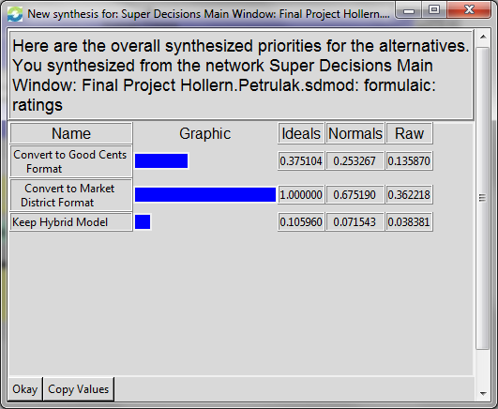
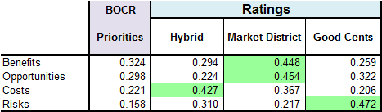
Final Results
Convert to Market District Format given the financial success, limited competitive threats, household loyalty, strong brand image, and the ability to drive a competitive advantage for Giant Eagle.

Slide 17
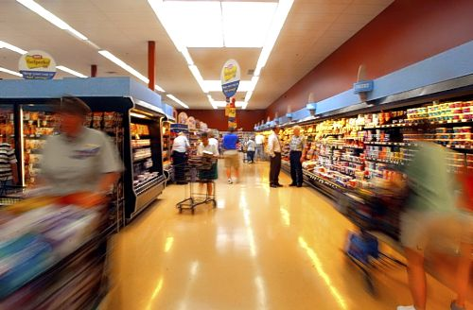
Questions?

