Slide 1
Mitsubishi Motors
Decision Making in a Complex Environment
Banu Tagal Chia-Chun Chen Wen-Jung Chen

Slide 2
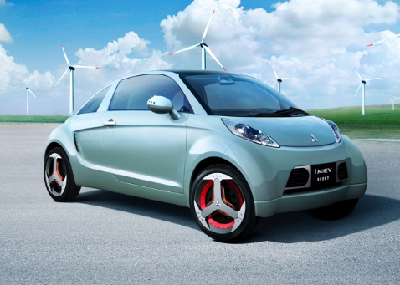
Background
Plan to expand its market share
Launch the electric-car, i-MiEV
Limitation of usage and expensive retail price
Unpredictable future demand

Slide 3
Alternatives
Invest more on electric-car
Remaining in the current strategy
Strategic Criteria
Existing Product Synergies
Manufacturing Impact
Market attractiveness

Slide 4
Benefits
Benefits | Economic | Market | Brand image
 |  |  | Industry competition status
 |  |  | Market share
 |  | Financial | After sales service cost
 |  |  | Tax incentives
 | Environmental | Pollution | Carbon emission
 |  |  | Noise
 |  | Resources | Electricity price
 |  |  | Fuel price
 | Operational | Engineering | Advanced technologies
 |  |  | Design simplicity
 |  | Manufacturing | Capacity utilization
 |  |  | Ease of manufacturing

Slide 5
Opportunities
Opportunities | Economic | Financial | Economics of scales
 |  |  | Stock price
 |  | Market | Market trend
 |  |  | New market
 | Environmental | Social | Corporate image
 |  |  | Increase in population
 |  | Eco-friendly | Increase in environmental consciousness
 |  |  | Increase in fuel price

Slide 6
Costs
Costs | Financial | Manufacturing | Component
 |  |  | Labor
 |  | Marketing | Advertisement
 |  |  | Promotion activities
 | Operational | Manufacturing | Manufacturing technology level
 |  |  | Production capacity
 |  |  | Quality control
 |  | Marketing | Customer service
 |  |  | Distribution channel

Slide 7
Risks
Risks | Corporation | External | Increase in tax
 |  |  | Restriction in regulations
 |  | Internal | Internal objection
 |  |  | Technical barriers
 | Industry | Economic | Fluctuation in interest rate
 |  |  | Fluctuation in material price
 |  | Market | Increase in competition
 |  |  | Overcapacity

Slide 8
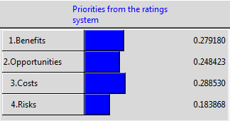
BOCR Model Priority
Costs – highest priority at 28.85%
Risks – lowest priority at 18.39%
Notes:
Based on the groups collective opinions and experiences, we worked through the priorities and it was determined that XXX had the highest priority. The lowest was Opportunity and Cost/Risk were roughly the same.

Slide 9
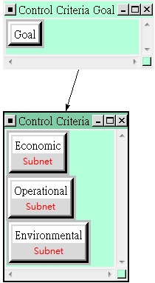
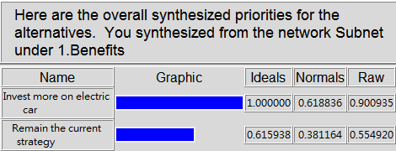
Synthesized Results-Benefits
Invest more on electric cars
61.9%
Remain the current strategy
38.1%

Slide 10
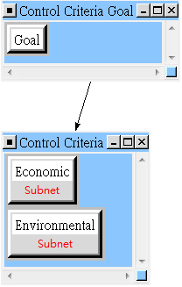
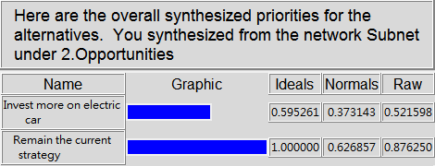
Synthesized Results-Opportunity
Remain the current strategy
62.7%
Invest more on electric cars
37.3%

Slide 11
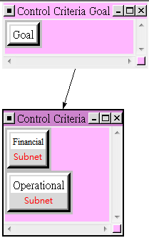
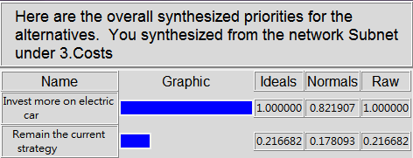
Synthesized Results-Cost
Invest more on electric cars
82.2%
Remain the current strategy
17.8%

Slide 12
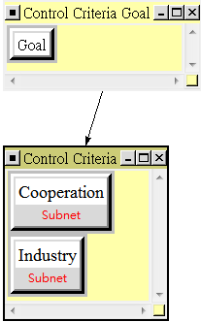
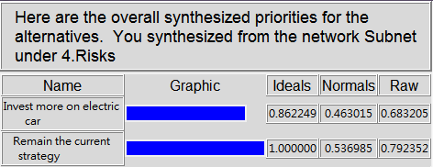
Synthesized Results-Risk
Remain the current strategy
53.7%
Invest more on electric cars
46.3%

Slide 13
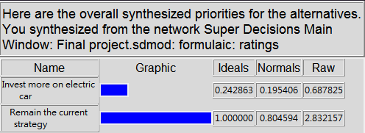
Overall Synthesized Result
Remain the current strategy is the best decision
Cost is the crucial factor of all

Slide 14
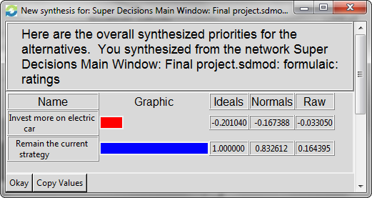
Overall Synthesized Result
Long term

Slide 15
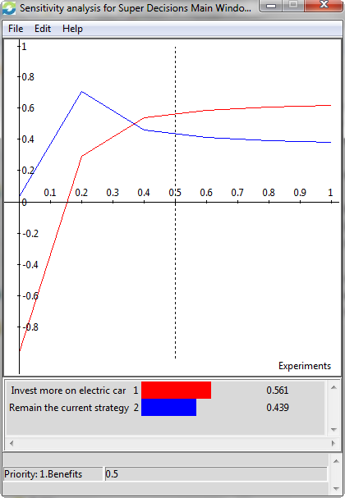
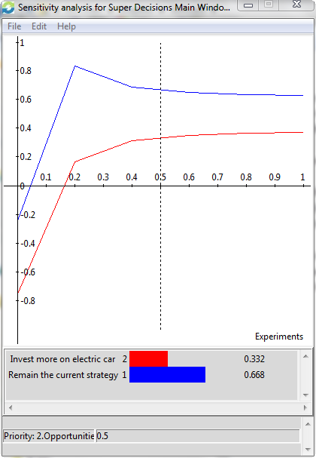
Sensitivity (Benefit & Opportunity)

Slide 16
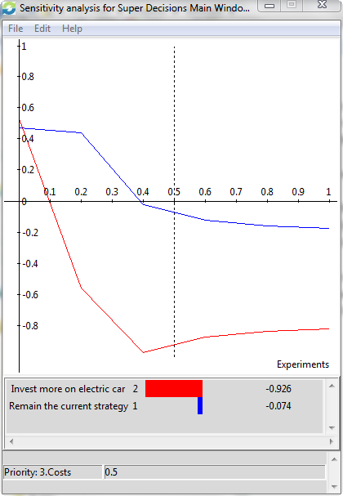
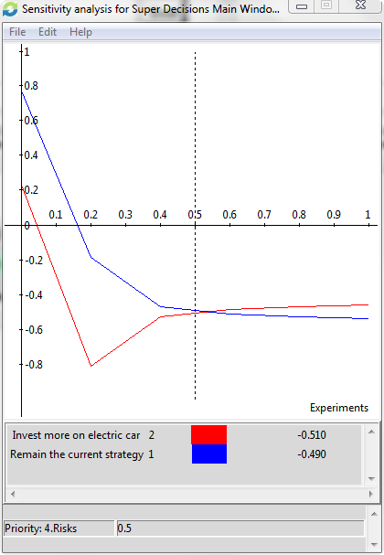
Sensitivity (Cost & Risk)

Slide 17
Questions?

