Slide 1
Selecting a Software System to Manage Clinical Trials
Andras Varadi
Katz Graduate School of Business
April 13, 05

Slide 2
Background
Organization:
Lupus Center of Excellence, University of Pittsburgh
My Position:
Systems Analyst:
Support Research Activities
Develop & Maintain IT infrastructure

Slide 3
Lupus - What is it?
Official Name: Systemic Lupus Erythematosus
Autoimmune Disease:
The immune systems turns against itself.
Immune response without any reason.
It can attack ANY organ system (lungs, heart, skin, blood, etc.)
It is incredibly difficult to diagnose.
It is caused by a combination of genetics, hormones, environmental triggers.

Slide 4
Lupus - Continued
Correction of Common Myths About Lupus:
Lupus is contagious (FALSE).
Lupus is a form of cancer (FALSE).
Dogs can get Lupus (TRUE).
Who gets lupus?
1.5 Million people in the US have Lupus.
10:1 Women
3:1 Minorities

Slide 5

About the Lupus Center
Part of the Department of Medicine, University of Pittsburgh
Two main divisions:
Clinical
Treat Patients
Clinical Research
Laboratory
Laboratory Research
Develop new tests, medications, vaccines, etc.
Funding:
University of Pittsburgh
NIH
Lupus Foundation, Inc.
Etc.

Slide 6
Clinical Trials - What are they?
Structured Experiments:
New Drugs
New Treatments
New Diagnostic Techniques
Sources:
Independent (internal) projects.
Projects commissioned by pharmaceutical companies, the government, etc.
Data:
Every project generates a large amount of data.
There are about 20 active projects at any given time
Need: System to manage all trials & data.

Slide 7
Alternatives

Slide 8
CTMA Software System
CTMA - Clinical Trials Management Application
Developed by UPMC Oncology Informatics.
Originally intended for use in Cancer Research.
Other Details:
Extensive IT infrastructure: servers, databases, etc.
Dedicated programming and database design staff.
They are willing to modify system to work in Lupus Research.
Free License of Software, only cost would be server and database services.

Slide 9
BILAG Software System
BILAG - British Isles Lupus Assessment Group
Standalone Microsoft Access Application
Expensive License fees - limited # of users.
Can only work on MS Windows computers.
Software was designed for Lupus Research.
Limited tech support services.

Slide 10
Internally Developed System
Develop clinical trials management software internally.
Lupus Center has limited IT staff and IT infrastructure.
Development can take a long time.
Software could be specific to the Center’s needs. (“Only we know exactly what we need”)
Center could establish standards for such systems.
There would be no licensing fees.
All systems and data would remain intellectual property of the Lupus Center

Slide 11
The Model

Slide 12
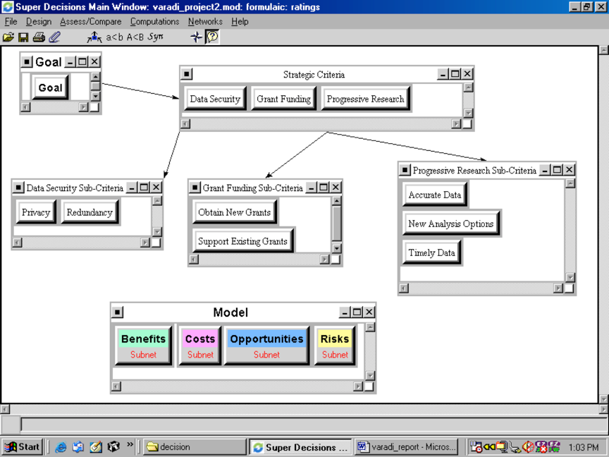

Slide 13
Benefits
Operational
Data Management:
Increase Speed
Measure Entry Pace
Reduce Errors
Research:
Always up to Date
Easy Access to Data
Improved Reliability
Human Resources:
Allow Task Specialization
Centralize Data Management
Reduce Stress on Study Coordinators
Technology:
Implementation:
Experience
Required Staff
Speed
Long-Term:
Interface with other Systems
Outside Support
Regular Updates

Slide 14
Costs
Economic:
Financial:
Infrastructure Costs
Licensing Fees
Recurring Costs
Transition:
Data Errors
Data Management Process Redesign
Down Time
HR Related:
Additional Employees
Resistance
Training

Slide 15
Opportunities - Economic
Financial:
Easier Licensing (of lupus diagnostic technology)
New Grants
Provide Data Management Services (to other labs)
Operational:
Research:
Collaboration
Cross Sectional Research
New Studies
Data Management:
Clinical Integration
National Standards Development

Slide 16
Opportunities - Economic (cont.)
Technology:
Implementation:
Data Clean-up
Database Infrastructure Expansion
Process Redesign
Long-term:
Scope Expansion
Spin-off System Development

Slide 17
Risks - Economic
Financial:
Budget Overruns
End of Grant Funding
Opportunistic Upgrading/Support Fees

Slide 18
Risks - Operational
HR Related:
Resistance from Employees
Turnover (employee)
User Mistakes
Research:
Data Misinterpretation
Inconsistency in Analysis
Data Management:
Data Loss/Corruption
Process Bottlenecks
Security Breach

Slide 19
Risks - Technology
Implementation:
Platform Conflicts
System Uptime/Downtime
Transition Process Errors
Long-term:
Scalability Issues
Software Bugs
Technical Support

Slide 20
The Result

Slide 21
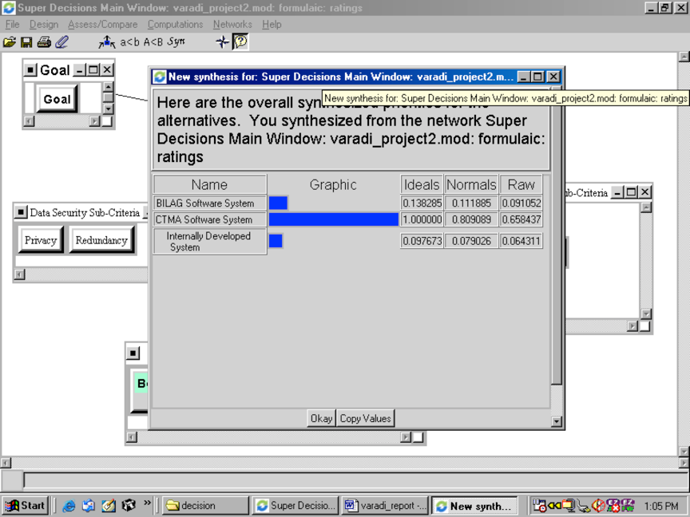

Slide 22
Why Such a Strong Result?
CTMA Software System is strongly preferred!
Result is not a surprise.
Reasons for large difference in preference:
Low cost due to lack of license fees.
Doesn’t require expansion of IT staff or infrastructure.
System created by experienced programmers.
Vendor can provide support services, also for free.
System is highly expandable.
System works on any platform (Windows, Mac, Other)
Etc.

Slide 23
Ways to Improve the Model
Inconsistency:
Reduce inconsistency in ratings.
Acceptable limit 0.1 or 1?
Sensitivity Analysis:
Find out why it doesn’t work.
Rating bias:
Do pair-wise comparisons with a group of people, based on consensus.
Include actual $ amounts for cost nodes instead of estimates.

Slide 24
Beneficial Outcomes of Project
Considered issue in a structured way.
Quantified actual benefits and drawbacks of all three systems.
Discovered (thought of) issues not considered previously.
I can present my bosses with a structured justification for my decisions.
Before, all I could was to state my opinion.

Slide 25
Questions?

