Slide 1
Relocation of Corporate Headquarters for LCC
Alternatives: Decide the location of the headquarters for the construction company
Alternative 1: Status Quo (Existing Plant in Lonavala)
Alternative 2: Mumbai
Alternative 3: Pune
Alternative 4: Headquarters in Lonavala and Satellite office in Pune

Slide 2
Background
Lonavala although a very lively city and in very close proximity to the twin cities of Mumbai and Pune, lacks the appropriate infrastructure required to sustain a growing organization. Lonavala is also unable to attract skilled labor and that poses a problem for the growth of LCC. Hence relocating the headquarters or opening satellite offices was an issue that was being debated for quite some time by the management. This model help us make that decision and quantitatively suggests where and how to relocate the business.

Slide 3
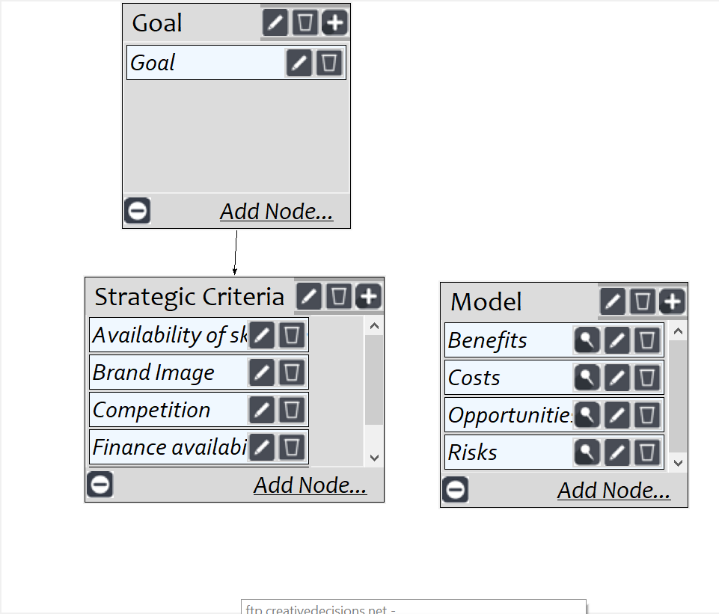
Model
Screenshot of SuperDecisions software Version 3.x

Slide 4
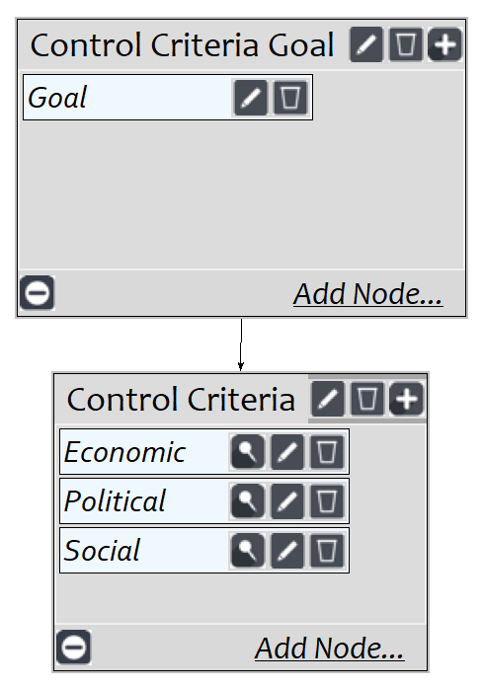
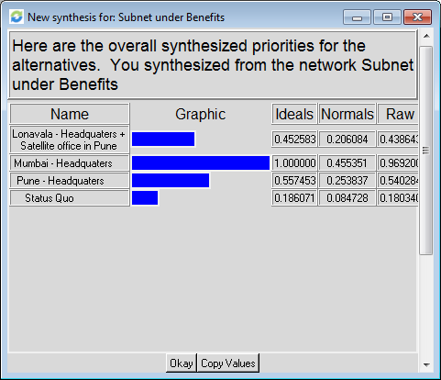
BOCR subnets - Benefits

Slide 5
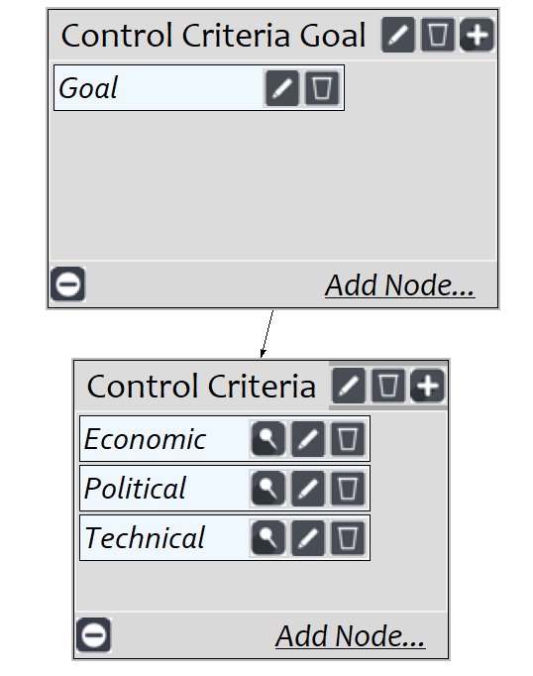
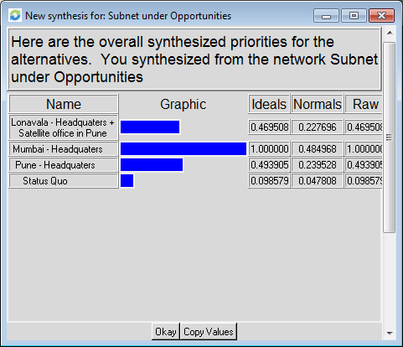
BOCR subnets - Opportunities

Slide 6
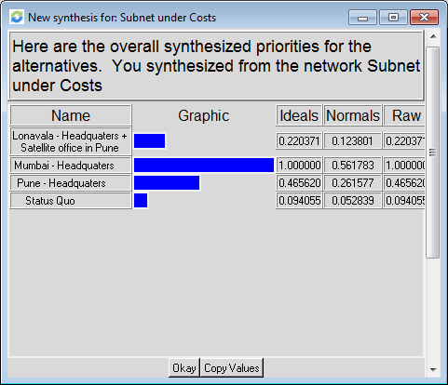
BOCR subnets - Costs

Slide 7
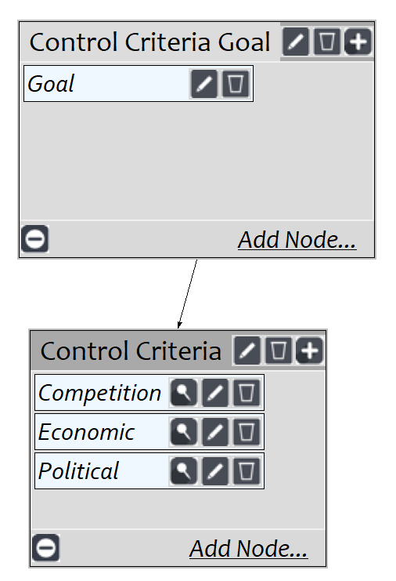

BOCR subnets - Risks

Slide 8
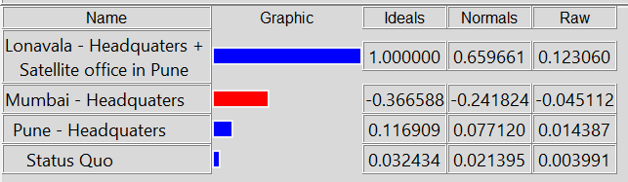
Overall Results

