Slide 1


Disney in Greater China
Decision Making Final Project
Ling-Hui Lin
Szu-Lun Peng

Slide 2

Agenda
Problem Statement
Alternatives
Model Overview
Subnet
Inner Subnet
Model Synthesis
Sensitivity Analysis

Slide 3

Problem Statement
Main Goal of Walt Disney
  Making a minimal equity investment in any operating entity and generate most of its returns through royalty, licensing, and fee income streams
Which Option is the Best to Disney in
Greater China.

Slide 4

Alternatives
Hong Kong
Shanghai
Taiwan
Do not Invest in Greater China
Notes:
From operation perspective, Disney can be benefited from FDI in 三點,所以我們會討論這三點based on china mkt potential

Slide 5
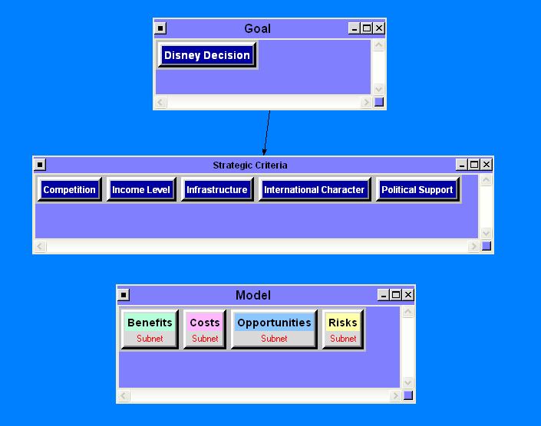
Model Overview
Strategic Criteria
  Competition
  International Characters
  Infrastructure
  Income Level
  Political Support
BOCR model utilizing Internal Rating System

Slide 6
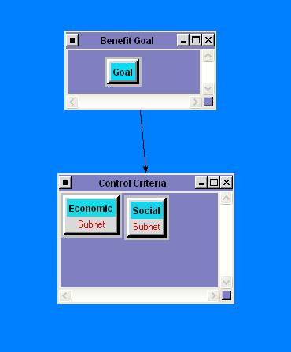
Subnet
Control Criteria
  Economic
  Social

Slide 7
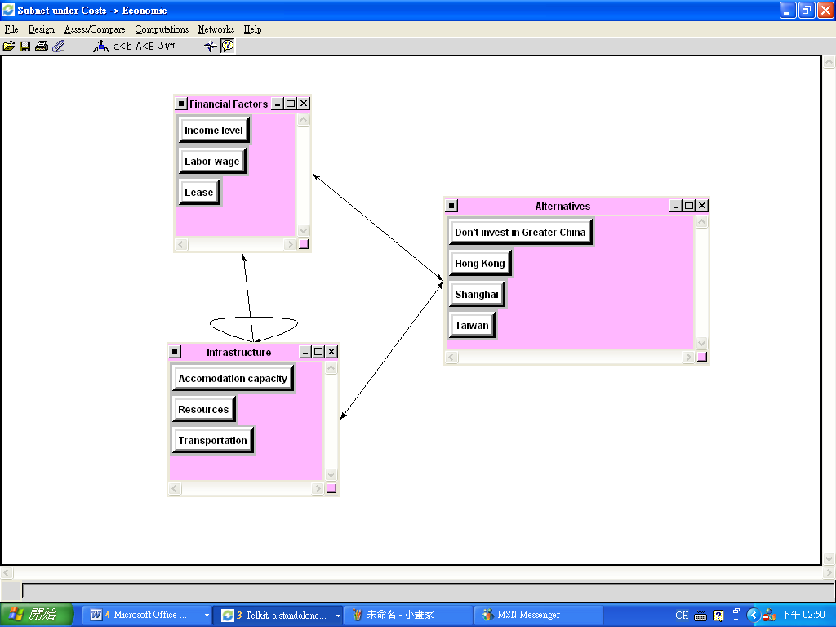
Inner Subnet (Example)
Cost-Economic

Slide 8
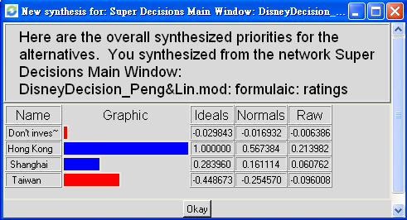
Model Synthesis

Slide 9
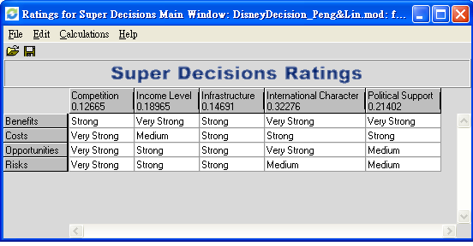
Rating Model

Slide 10
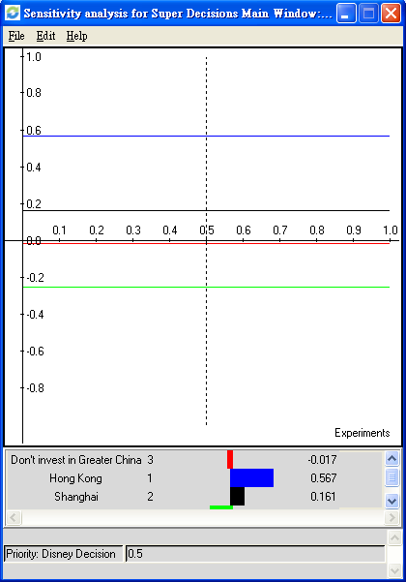
Sensitivity Analysis
(Disney Decision)

Slide 11

Conclusion
Hong Kong
Shanghai
Taiwan
Do not Invest in Greater China

Slide 12
Questions
Thank you!

