Slide 1
TERRITORY EXPANSION OF A WINE AND SPIRITS DISTRIBUTOR: A RESOURCE ALLOCATION MODEL
JOSHUA WATSON
BQOM 2521

Slide 2
WHAT IS A WINE AND SPIRITS DISTRIBUTOR: THREE-TIER SYSTEM
The three-tier system of alcohol distribution in the United States is the process of distributing alcohol and alcoholic beverages efficiently throughout the country.
Created as a result of the end of Prohibition, the three-tier system is designed to limit bootlegging, counterfeit bottling, and over-proofing by controlling four aspects of the industry:
Place: Ensuring that alcohol is purchased from a reputable and licensed store or restaurant
Product: Creating familiarity amongst established brands and a consistent architecture by which new brands and products can come to market.
Price: Creating consistent (or somewhat consistent) pricing across a market or groups of markets.
Packaging: Unifying packaging and pack requirements across all markets as a means of quality control.
Notes:
The United States employ

Slide 3
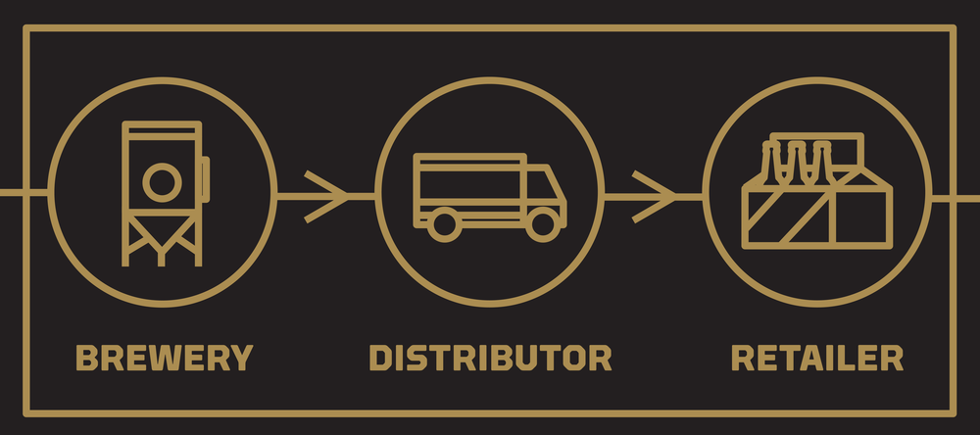
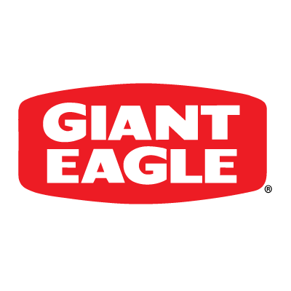

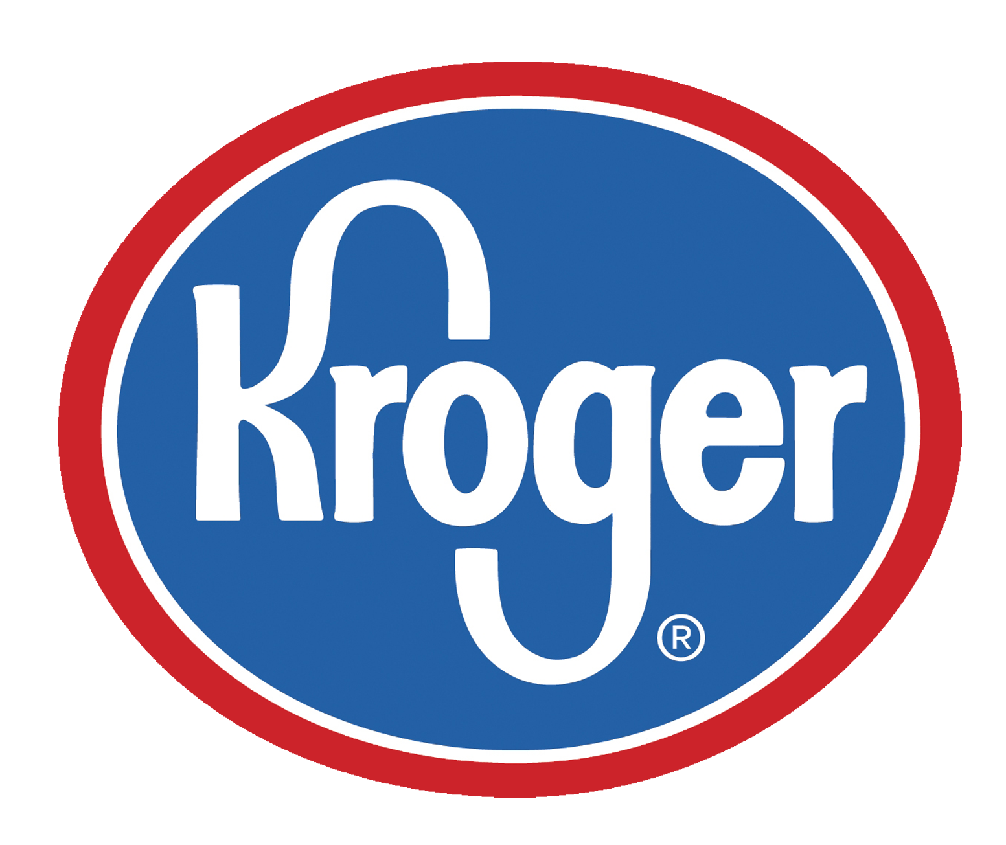
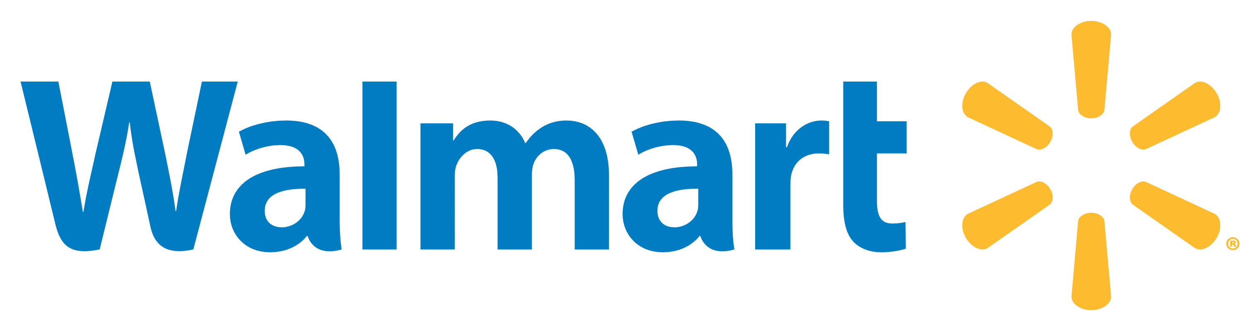
WHAT DOES A WINE AND SPIRITS DISTRIBUTOR DO?
A wine and spirits distributor, in traditional markets, purchases contractually-obligated quantities of cases of wines and/or spirits.
Contracts for purchase quantities and frequencies allow for suppliers to forecast their production, and can inform their ROI
The distributor, interchangeably known as a wholesaler, houses the product and distributes to retailers in a market.
A wine and spirits distributor will deliver to any and all of the different licensed entities in a statewide market, but typically do not deliver across state lines as each states’ laws regarding alcohol distribution, delivery, consumption, etc. can and will vary.
Typically, the wine and spirits distributors are responsible for the proper merchandising of product on retail shelving, mass displays, or any other marketable installation throughout a retail environment and delivery to bars and restaurants.

Slide 4

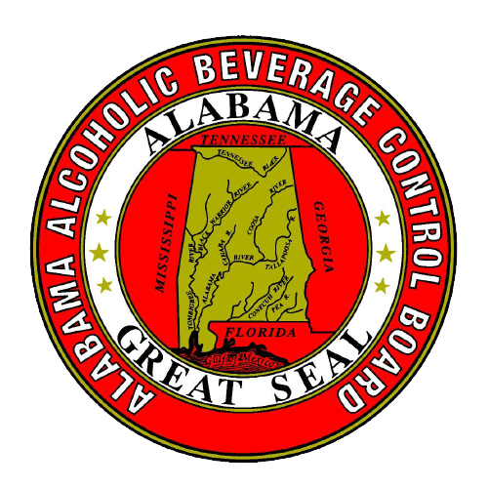

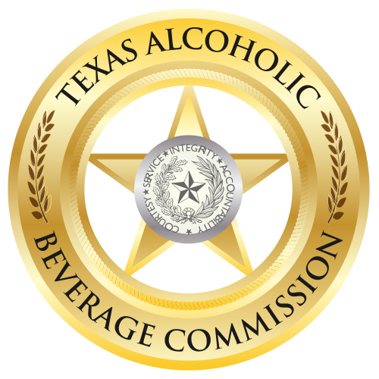
ARE ALL WINE AND SPIRITS MARKETS THE SAME?
Absolutely not.
Following the repeal of the 21st Amendment, the individual states were given authority over how alcohol was imported, distributed, sold, and consumed.
Most of the states opted for an “open” business model, which provides for lessened governmental intervention and maximized proliferation of alcohol sales in retail environments.
To date, there are seventeen states which employ a “control” business model, in which the state holds a monopoly over the wholesaling or retailing of some or all categories of alcoholic beverages such as beer, wine, and spirits.
Notes:
Example: Texas is an open market, where wine can be purchased at grocery stores throughout the state, but liquor must be purchased at private liquor stores. Illinois, on the other hand, is considered “more open” as liquor purchases can be made at grocers such as Target and Jewel-Osco.
Example: Pennsylvania is a control market, where liquor can only be purchased at state-run Fine Wine and Good Spirits stores. Recently, allowance was given to mass market grocers to sell wines wholesaled by the PLCB. This should be indicative of the weakening of the liquor laws in Pennsylvania.

Slide 5
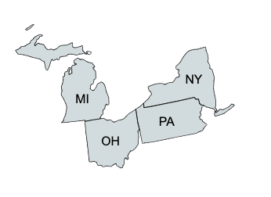
WHAT ARE WE DOING HERE?
We work for a nationwide wine and spirits distributor, and we are trying to assess which state(s) to enter for new business.
We have a budget of $100,000 at our disposal to use.
The costs of entry to each state varies:
Michigan: $45,000
New York: $65,000
Ohio: $35,000
Pennsylvania: $50,000
Our strategic objectives for consideration and eventual rating, each with sub-criteria, are costs, portfolio, government, market, ROI, premise, and promotion.

Slide 6
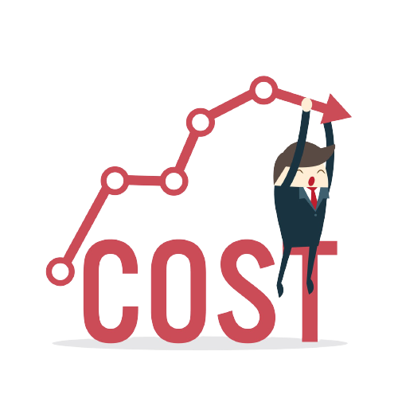
Breakdown of strategic objectives: cost
The strategic objective of cost consists of four sub-criteria:
Licensing:
What are the costs associated with securing a license to do business in the prospective state and how often does that license need to be renewed?
Office:
What are the upfront costs to rent office and warehouse space for operation? These costs will vary given the size of the prospective state.
Hiring:
How much will it cost to hire a sales and support staff in the prospective market and what are the projected increases in cost of living?
Development:
What is the projected cost to develop a sales team and bring them to a level consistent with sales professional in other markets?

Slide 7

Breakdown of strategic objectives: portfolio
The strategic objective of portfolio consists of three sub-criteria:
Nationwide Competition
If we were to enter the market, what would our portfolio of suppliers look like? What is the strength of competition in the market, and can we align our portfolio here to other states?
In-State Independents
What brands, if any, does the company represent in other markets that is represented by non-nationwide competition? Can we pull suppliers from independent distributors or cannibalize independent business?
Unique to Market Competition
What suppliers’ products, if any, that are unique to the prospective market of entry, are category leaders and could align well with our portfolio?
Innovation
How innovative and adept are our current suppliers regarding capitalizing or setting trends in the marketplace?

Slide 8

Breakdown of strategic objectives: government
The strategic objective of government consists of four sub-criteria:
Involvement
What is the expected overall involvement of the state government in the day-to-day operations?
Taxes
How much should the company expect to pay in taxes to operate in the prospective state? How and how often is the tax assessed?
Monopoly
Does the state have a monopoly on the sale of alcohol, meaning is the state an open or control market?
Outlook
What is the outlook of governmental involvement in the prospective state? For both open and control markets, is there pending or rumored legislation what might change their status and market construction?
Notes:
- For example: Michigan, Ohio, and Pennsylvania and considered Control Markets since the state government both runs and is responsible for the sale of alcohol in some capacity in their respective state. Yet, each state is not controlled the same way. Michigan and Ohio have state control over the sale of spirits, whereas Pennsylvania has state control over both wine and spirits.
- Michigan and Ohio are Control Markets like 10 other states, while the Pennsylvania market is exclusive to itself. No other state controls just wine and spirits.
- New York is considered an Open Market as the state government controls neither wine nor spirits.

Slide 9
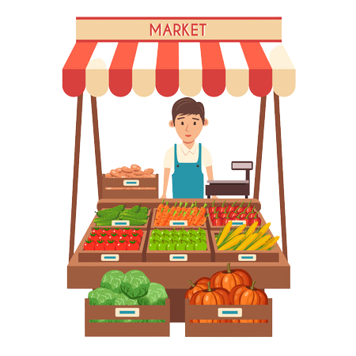
Breakdown of strategic objectives: MARKET
The strategic objective of market consists of four sub-criteria:
Supply Chain
What is the ease by which the consumer can purchase wine and spirits in the prospective market? How efficient is the route to market? How many retailers exist in the market and does the market allow for delivery options such as Drizzly?
Trends
What are the trends and can our ”Day One” portfolio capture incremental business? Also, is the market strong enough to legitimize entry currently?
Growth Potential
What are the unique factors that are driving business and how do these factors compare to the other states?
KPI Execution Feasibility
What is our expected ability to achieve and suffice our corporately-mandated key performance indicators such as sales volume, sales growth, and product distribution?

Slide 10
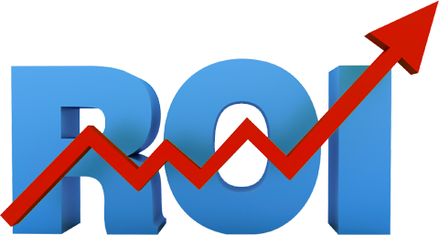
Breakdown of strategic objectives: ROI
The strategic objective of ROI consists of four sub-criteria:
30/60/90 Market Capture
Given our entry portfolio, what is our project capture of market share over the first 30, 60, and 90 days in the market?
Target Accounts
What is the strength of the target accounts in the market compared to the other prospective states, and what is our expectation of capture in these accounts?
Sponsorships
Do brands in our portfolio have established sponsorships in the prospective state and market?
Conversion Rate
What is the expected positive conversion rate of suppliers, products, and sponsorships as a result of our entry into the market?

Slide 11
Breakdown of strategic objectives: PREMISE
The strategic objective of premise consists of four sub-criteria:
On-Premise
What is the current strength and projected growth of on-premise accounts in the market?
On-Premise: bars and restaurants
Off-Premise
What is the current strength and projected growth of off-premise accounts in the market?
Off-Premise: Traditional exclusive retailers and package stores
Grocery
What is the current strength and projected growth of retail grocery accounts in the market?
Casino
What is the current strength and projected growth of casino accounts in the market?

Slide 12

Breakdown of strategic objectives: PROMOTION
The strategic objective of promotion consists of four sub-criteria:
Sampling
What ability will we have to sample consumers in both on- and off-premise environments in the prospective state?
IRC
Does the prospective market allow for IRCs (instant redemption couponing) in the market and what is the current level of utilization in the retail marketplace?
MIR
Does the prospective market allow for MIRs (mail-in redemption) in the market and what is the current level of utilization in the retail marketplace?
SPA Structure
What is the structure of SPAs (special price agreements) in the market? With what frequency and veracity will we be able to institute SPAs, how has our competition employed these sales and what was the overall exposure?

Slide 13
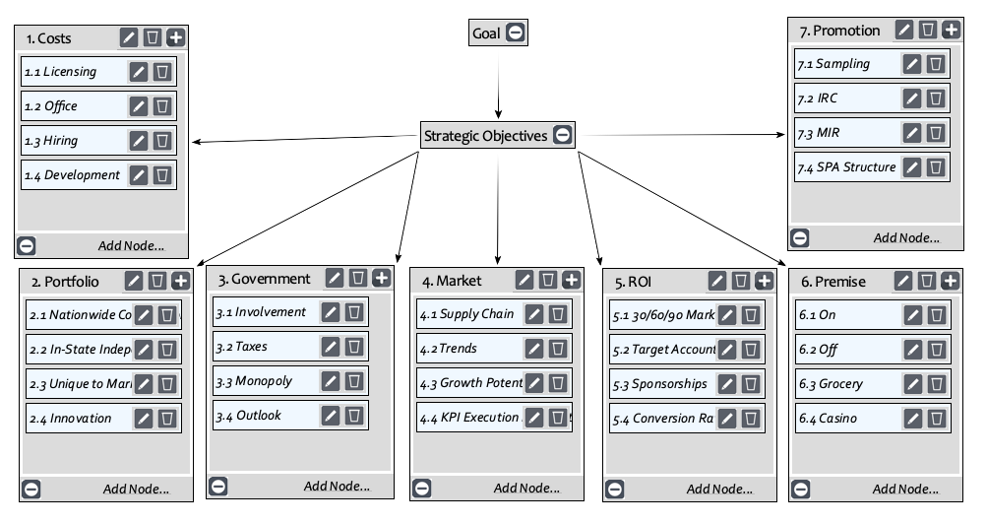
THE MODEL IN SUPER DECISIONS

Slide 14
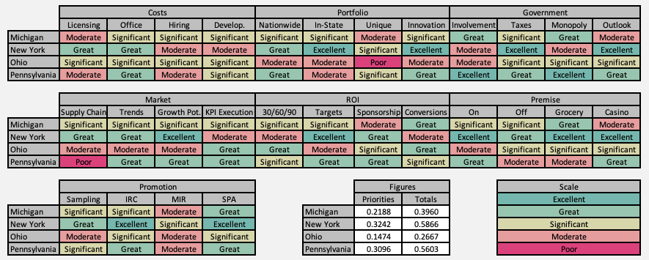
RATINGS FROM SUPERDECISIONS WITH PRIORITIES AND TOTALS

Slide 15
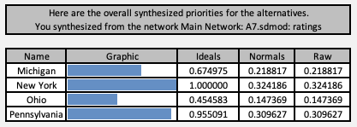
WHOLE MODEL SYNTHESIS FROM SUPERDECISIONS

Slide 16
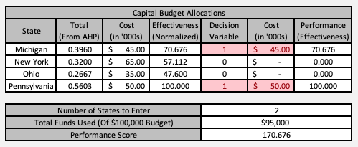
CAPITAL BUDGET ALLOCATIONS FROM MICROSOFT EXCEL

Slide 17
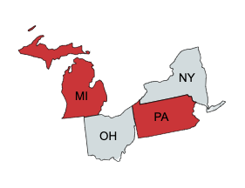
RESULTS
From our Budget Allocation, we have found that we should enter the markets of Michigan and Pennsylvania.
Entry stays under our $100,000 budget:
Michigan: $45,000
Pennsylvania: $50,000
Total Budget Allocation: $95,000
Both markets as control markets, meaning that they feature government control on the wholesaling and retailing of alcohol in some capacity.
While scoring less than New York on priority, the prospect of the dual Michigan and Pennsylvania markets seems to have outweighed the benefits of entering the single market of New York.

Slide 18
DISCUSSION: EXPECTATION VERSUS RESULTS
Were the results consistent with expectations?
No, the expectation was that, at minimum, the open market in New York would be selected, perhaps in concert with Ohio to maximize budgetary spend.
What could have influenced the ratings/priorities that could have contributed to the results?
Although New York is the most attractive state to enter given its open status, the combination of the higher cost of entry and the fierceness of competition could have proved prohibitive.
Are the results feasible and implementable?
Yes, of the control markets in the United States, Pennsylvania and Michigan are sales leaders, so it would be in our best interest to capitalize and enter.

