Slide 1
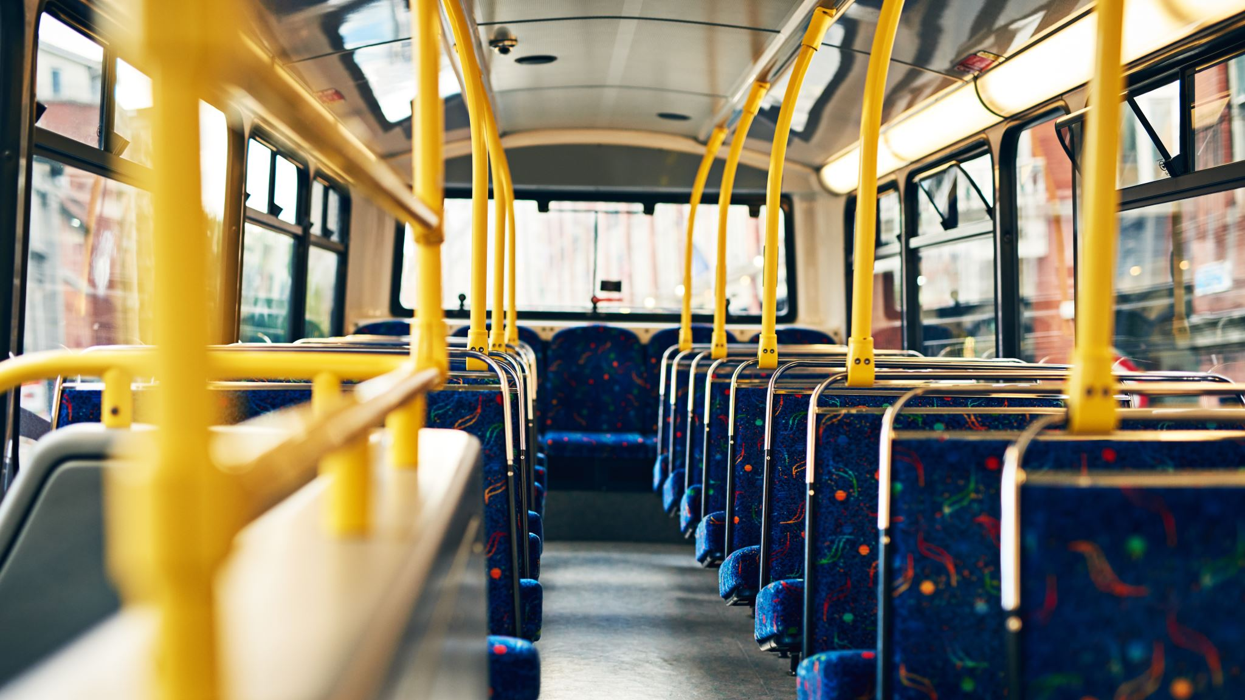
City of Pittsburgh Public Works Department
Decision Making In a Complex Environment- Final Project
Resource Allocation using a complex AHP/'Ratings model
Ron Dornin

Slide 2
Project Overview
The City of Pittsburgh’s Public Works Department has to decide which projects it would like to fund
The City has budgeted $75 Million for Improvements
The Staff of the Public Works department have the bandwidth to manage no more than 8 projects
Projects have been classified into four strategic Objectives:
Health
Recreation
Safety
Transportation

Slide 3
Strategic Objective 1- Health
Replace all remaining lead water pipes
Cost: $10,000,000
Effect: Greatly improves the quality of drinking water, and reduced lead content
Build 100 Smog Free Towers
Cost: $6,000,000
Effect: Reduces pollution and improves air quality
Stockpile PPE and ventilators for future pandemic
Cost: $4,000,000
Effect: Better prepares the city for its response to a pandemic
Install public use hand sanitizing stations across the city
Cost: $2,000,000
Effect: Improves the sanitation of population and reduce risks of transferring illnesses
Notes:
Project related to health were given some of the highest rankings in the model

Slide 4
Strategic Objective 2- Recreation
Build a dog park on the North Shore
Cost: $500,000
Effect: Provides an additional space for people to take their dogs
Build Swimming pools at all existing major city parks
Cost: $2,000,000
Effect: Increases citizen satisfaction
Repave Three Rivers Heritage trail Park
Cost: $4,000,000
Effect: Improves the quality of the trail for users
Notes:
The recreation projects were ranked with lower importance than all of the other categories

Slide 5
Strategic Objective 3- Safety
Install Smart Streetlights
Cost: $5,000,000
Effect: Brighter LED Lights and gunshot detection reduce crime rates
Install Automatic Crosswalks at all intersections
Cost: $2,000,000
Effect: Reduces the number of pedestrians struck by motor vehicles
Widen downtown sidewalks
Cost: $2,000,000
Effect: Reduces the number of pedestrians struck by motor vehicles
Add Designated Bike Lanes to all streets
Cost: $2,500,000
Effect: Decreases the number of cyclists involved in motor vehicle accidents
Notes:
Safety projects were similar to health in their prioritization

Slide 6
Strategic Objective 4- Transportation
Widen Squirrel Hill Tunnel
Cost: $35,000,000
Effect: Effect: Decreases congestion and risk of accidents
Widen Fort Pitt Tunnel
Cost: $50,000,000
Effect: Effect: Decreases congestion and risk of accidents
Convert to All Electric buses
Cost:$10,000,000
Effect: Provides cleaner transportation
Widen Route 28 at Highland Park Bridge
Cost: $20,000,000
Effect: Decreases congestion and risk of accidents
Notes:
These Project are the most expensive, but also some of the most impactful

Slide 7
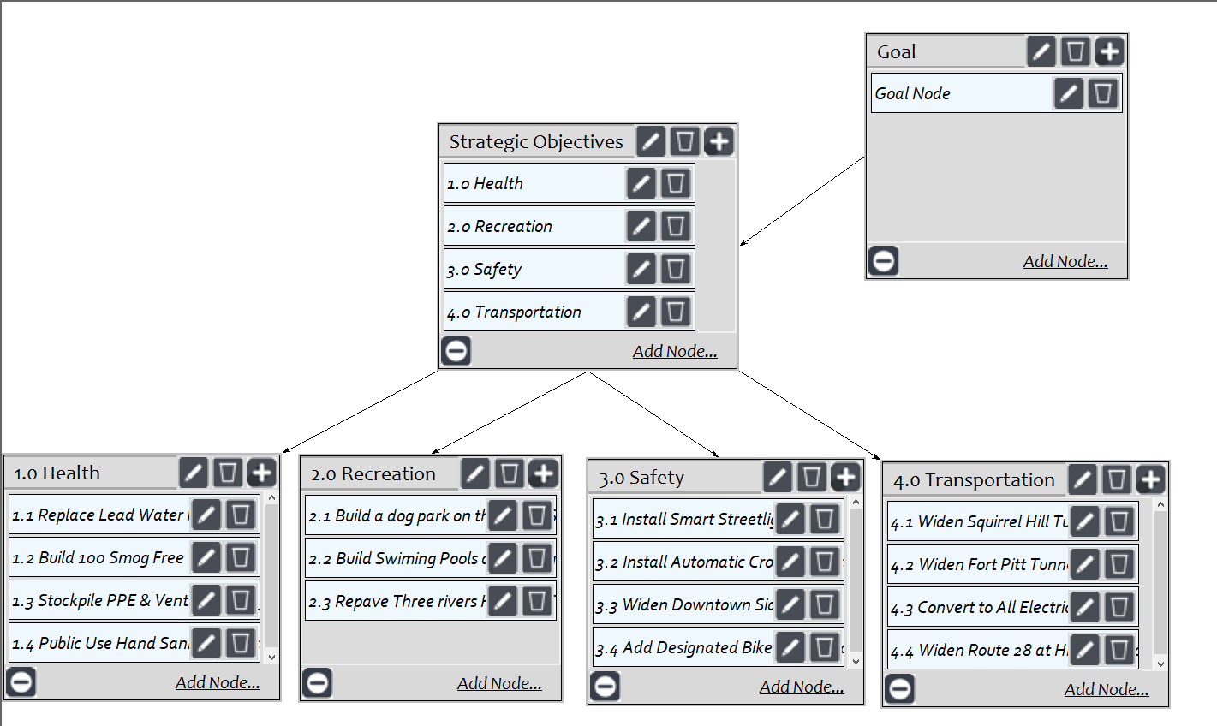
Super Decisions Model

Slide 8
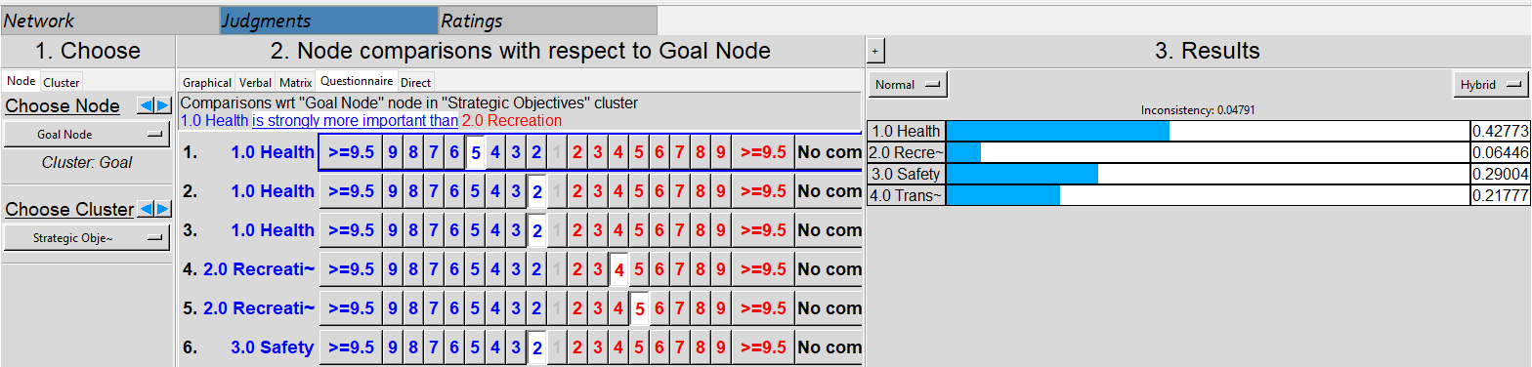
Pairwise Comparison Example

Slide 9
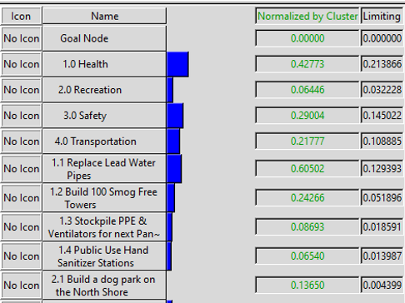
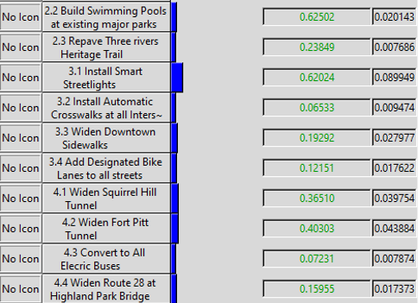
Calculated Priorities

Slide 10
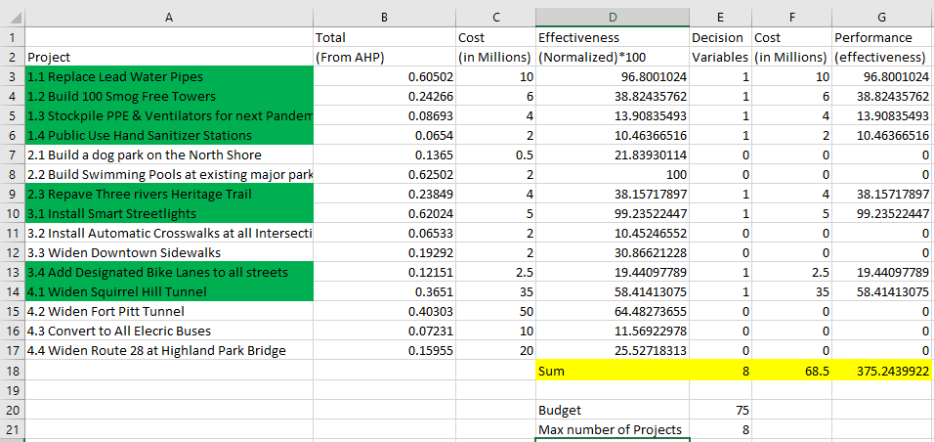
Excel Solver/ Performance Effectiveness
Notes:
Will have budgeted dollars leftover ~$6.5 million

Slide 11
Selected Projects
Replace Lead Water Pipes
Build 100 Smog Free Towers
Stockpile PPE & Ventilators for next Pandemic
Public Use hand Sanitizer Stations
Repave Three Rivers Heritage Trail
Install Smart Street Lights
Add Designated Bike Lanes to all streets
Widen Squirrel Hill Tunnel

Slide 12
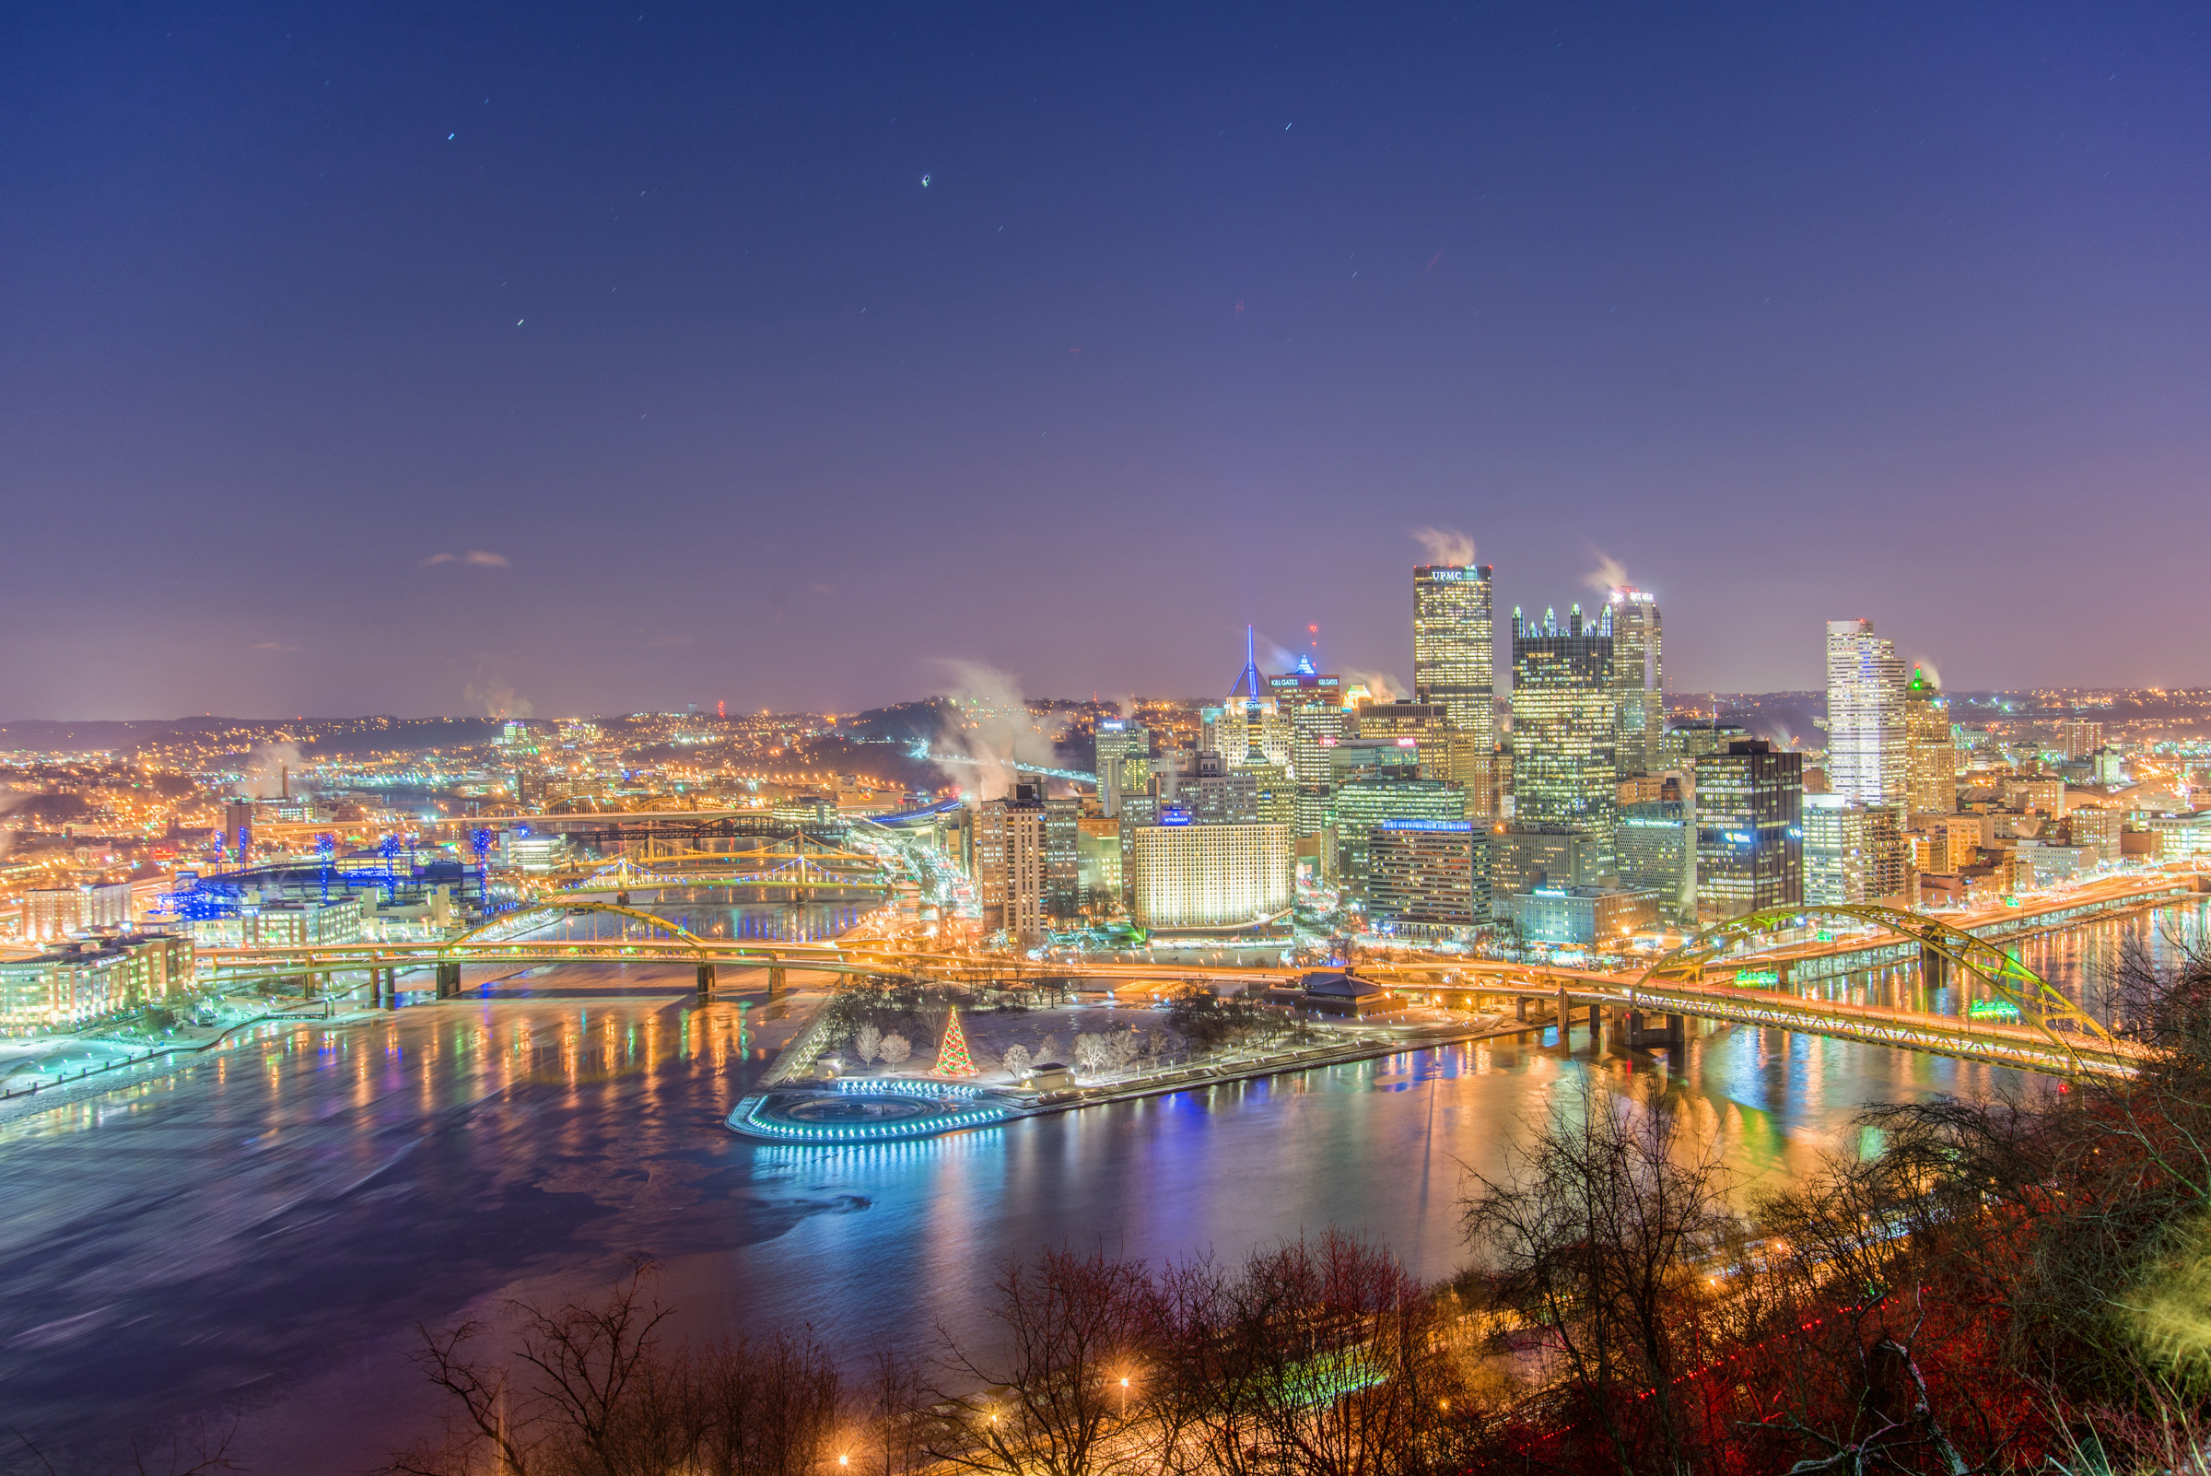
Thank You!

