Slide 1
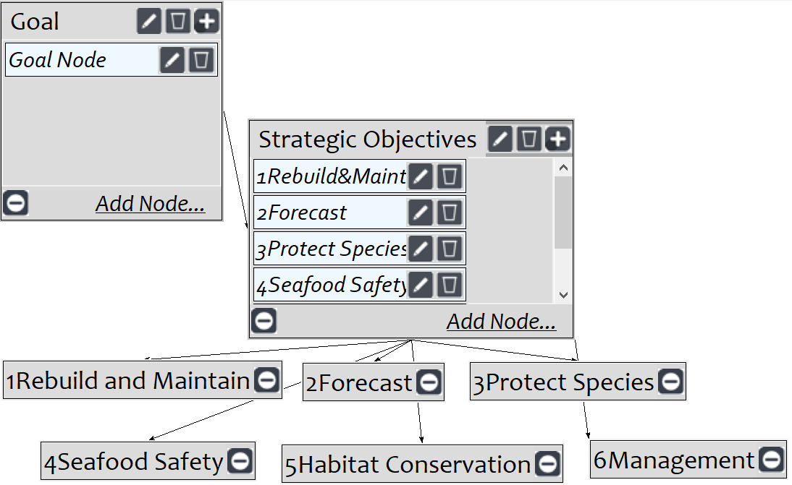
Fishery Resource Allocation
AHP model for fishery resource allocation
Screenshot of SuperDecisions software Version 3.x

