Slide 1

Hiring for the American Workforce A Foreign or Domestic issue?
Pei-Ying Hsu
Shih-Yi Chien
Caryn Burgh

Slide 2
Presentation agenda
Background
The Alternatives
Overview of the Model
Details of the Model
Results
Sensitivity Analysis
Conclusion

Slide 3
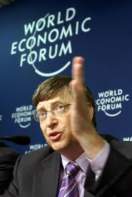
Background
More than 50% Ph.D.s at U.S. universities are foreigners.
U.S. workers protection
- employers attestation
- numerical cap for working visa
Employers pressure
Protect US workers
US competitiveness
Bill Gates "warning of dangers to the [U. S. economy] if employers can't import skilled workers to fill job gaps"

Slide 4
Alternatives What should u.s. government do?
Approve more foreigners to work in U.S.
Strengthen the restriction of foreigners working in U.S.
Keep the status quo

Slide 5
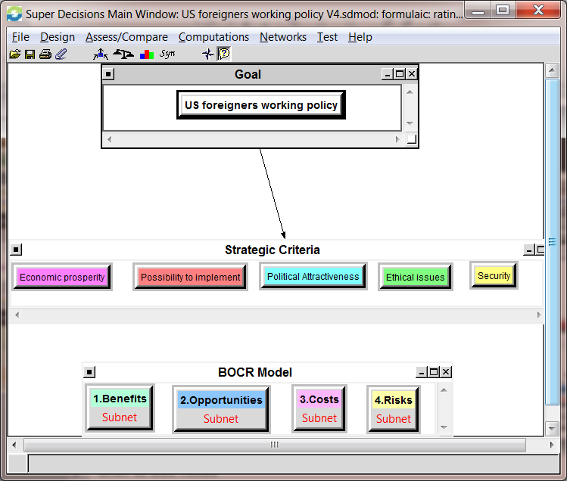
MODEL
Goal:
For U.S. Government to decide which policy to implement
Strategic Criteria
Economic Prosperity
Possibility to implement
Political Attractiveness
Ethical Issues
Security
BOCR Model

Slide 6
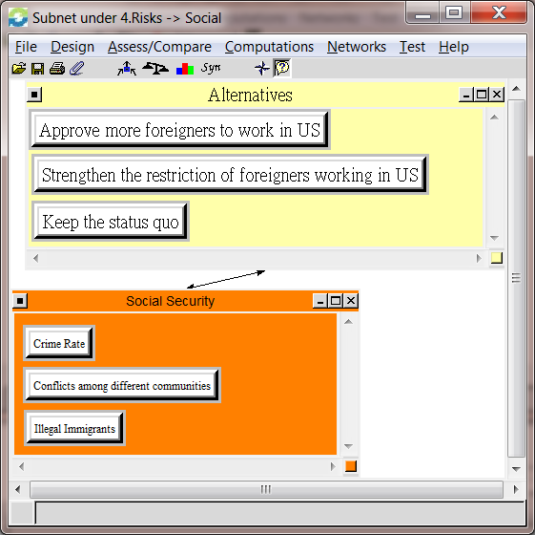
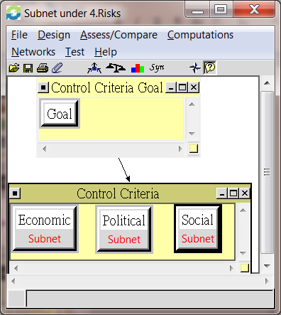
MODEL
Control Criteria
Economic
Political
Social
Clusters associated with alternatives

Slide 7
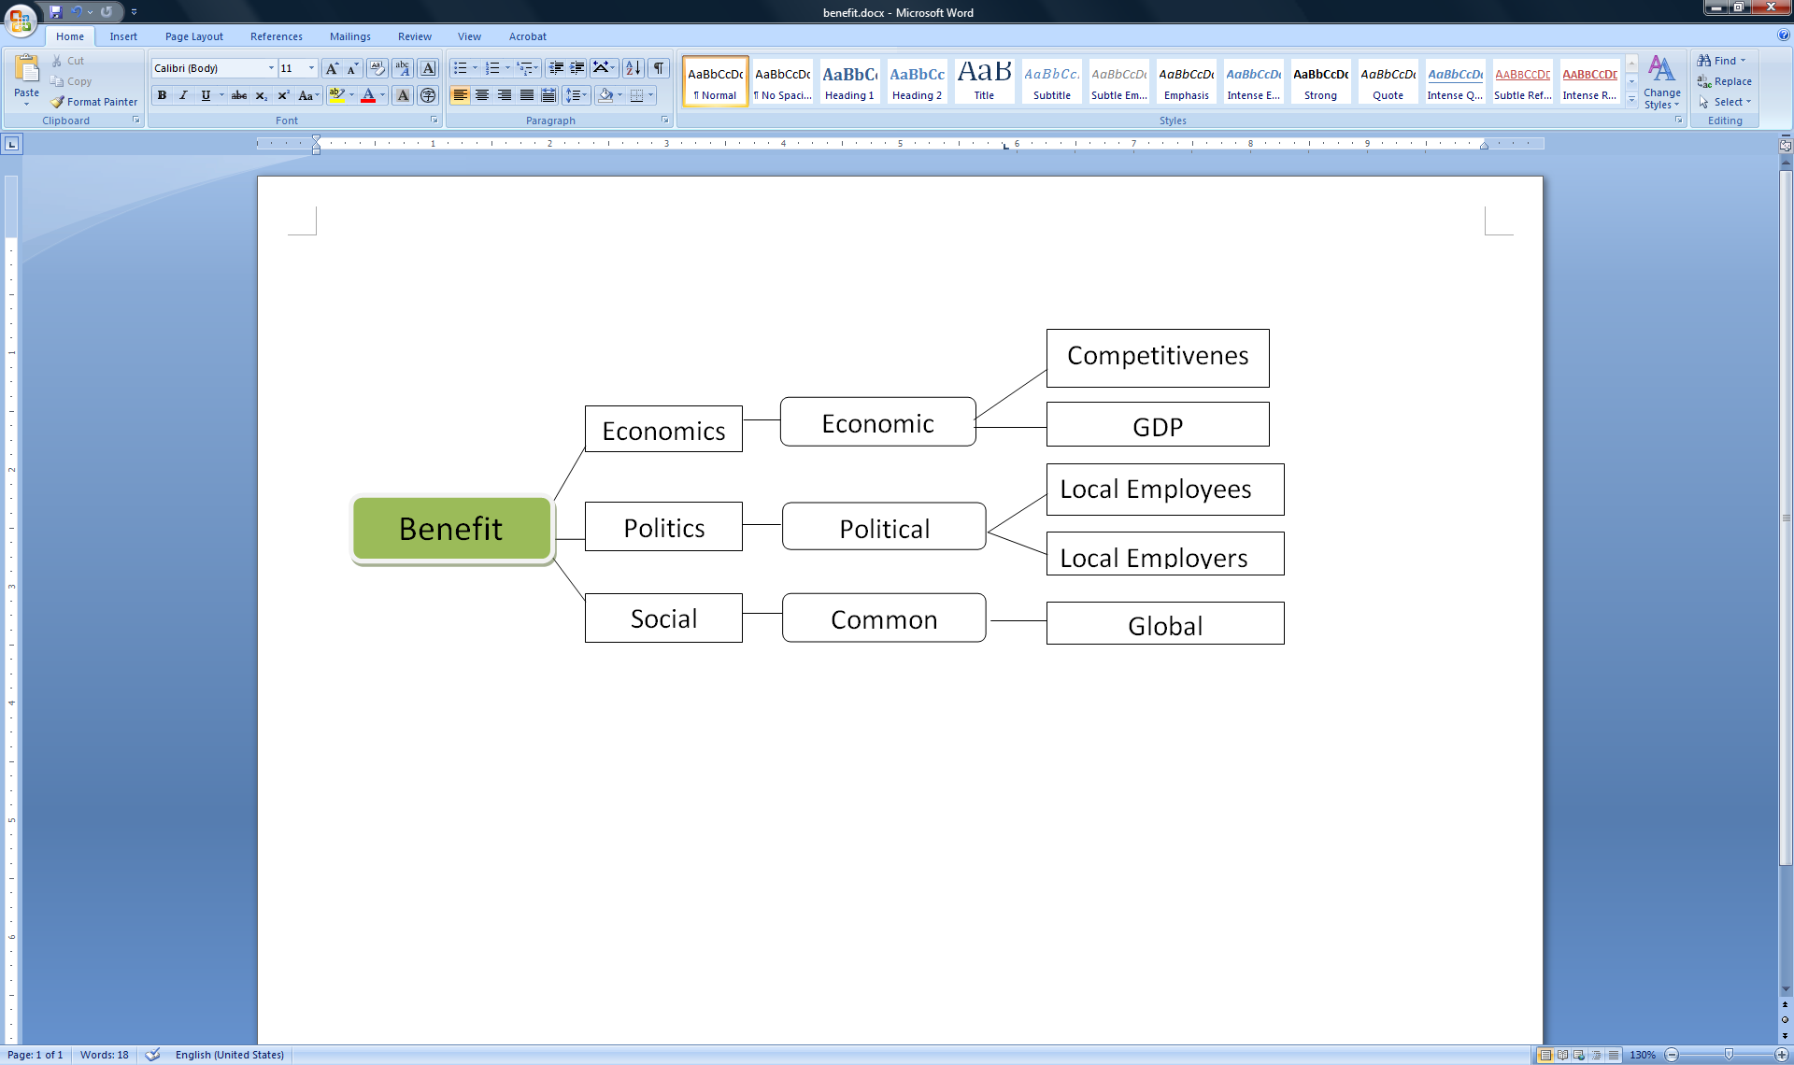
Benefit

Slide 8
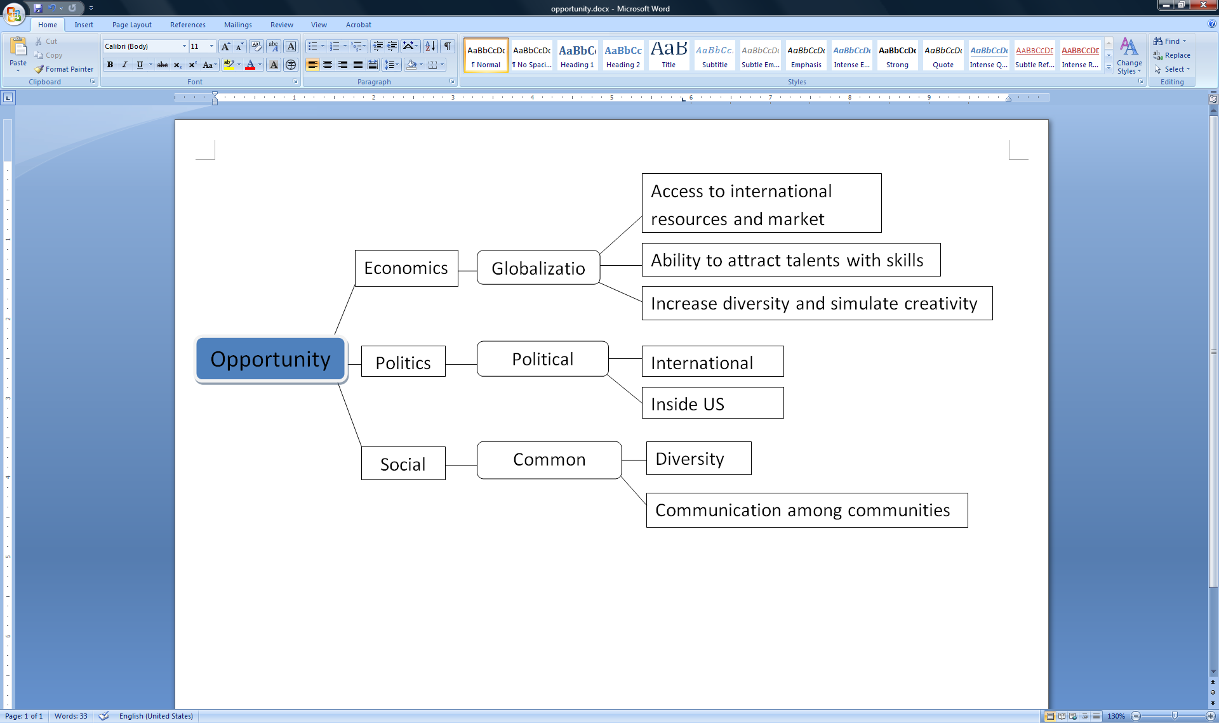
opportunity

Slide 9
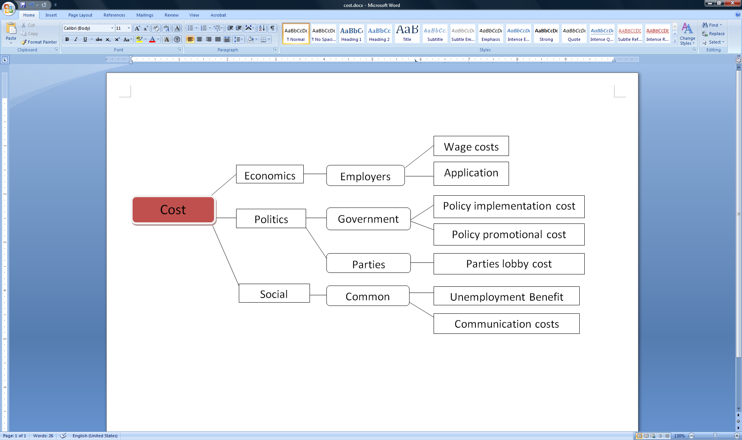
cost

Slide 10
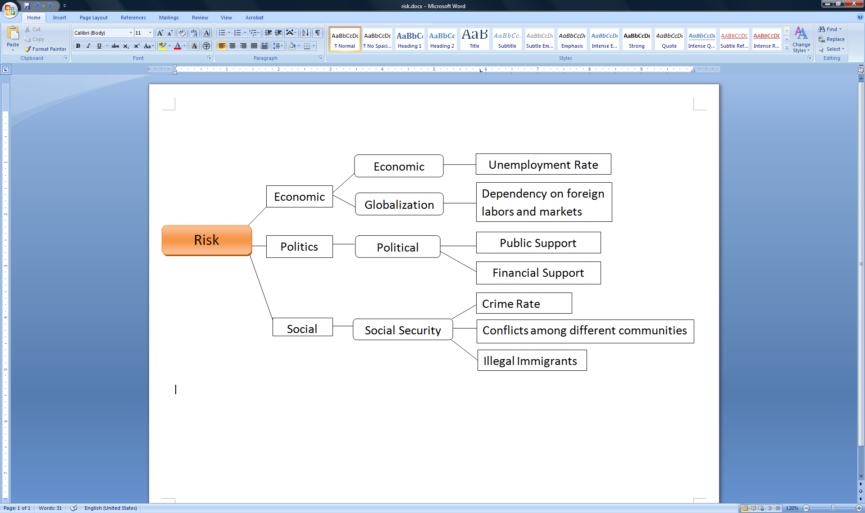
risk

Slide 11
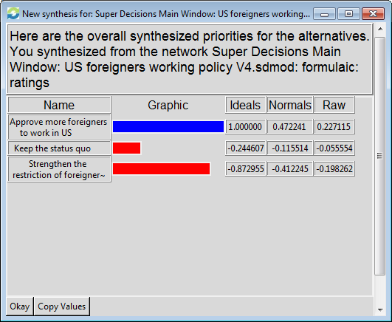
Results Additive Negative Formula

Slide 12
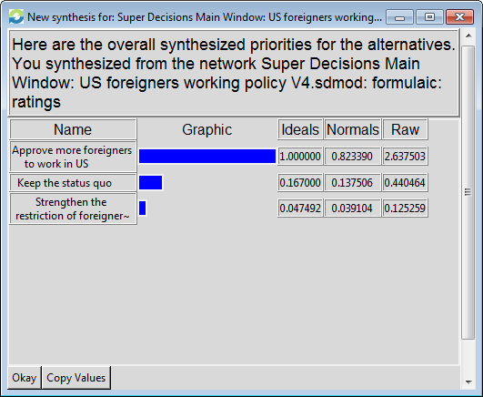
Results Multiplicative Formula

Slide 13
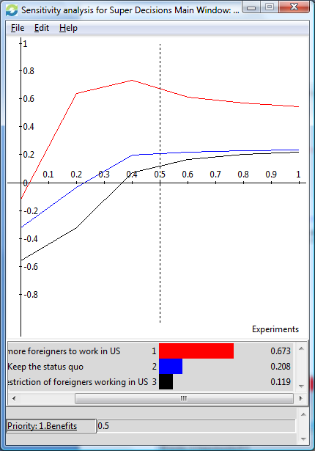
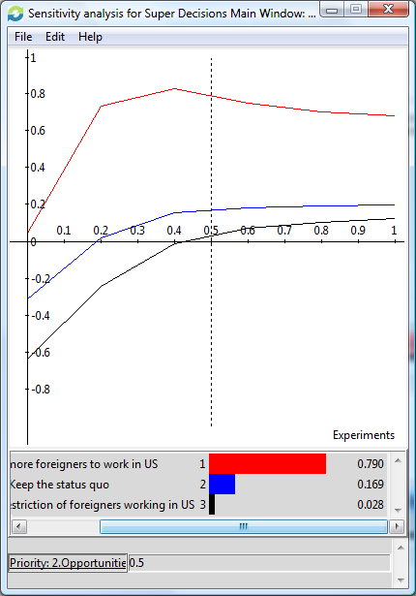
Sensitivity analysis
Benefit
Opportunity

Slide 14
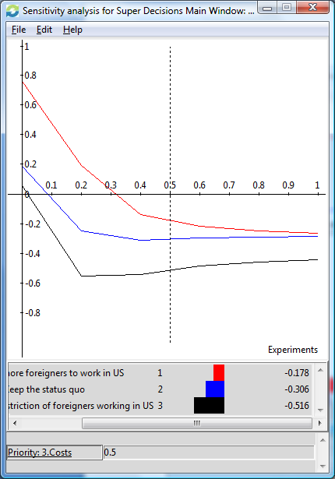
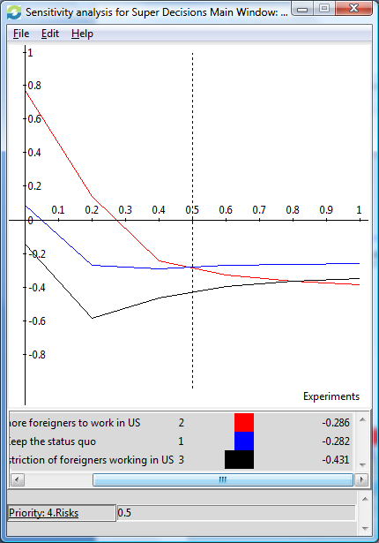
Sensitivity analysis
Cost
Risk

Slide 15

Conclusions
Approve more foreigners to work in U.S.

Slide 16
Thank you!

