Slide 1




University of Cassino - ITALY
University of Pittsburgh - USA
DECISION MAKING IN COMPLEX ENVIRONMENTS WITH THE ANALYTIC NETWORK PROCESS (ANP)
Green Supply Chain Design by
Integrating Life Cycle Assessment and BOCR Analysis
Orrin COOPER
University of Pittsburgh
Antonella PETRILLO
Engineering Faculty, University of Cassino, Italy
PITTSBURGH, PA - USA
October, 2011

Slide 2

GOAL
Goal: Develop a systematic approach that a firm can use to evaluate its supply chain environmental performance with the objective to develop a Green Supply Chain.
Result: An ANP model that provides effective information about the critical factors/areas in the whole supply chain in order to optimize the level of sustainability throughout the supply chain.
Orrin Cooper - Antonella Petrillo

Slide 3
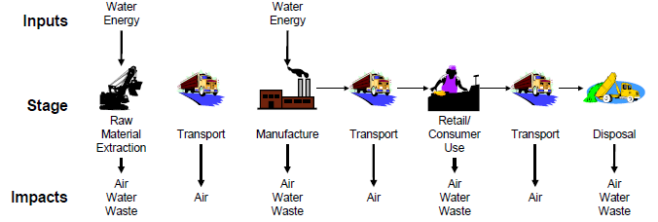
Supply Chain
Definition: A supply chain (SC) is the network of suppliers, manufacturing plants, warehouses and distribution channels organized to acquire raw materials, convert them to finished products, and distribute these products to customers.
Orrin Cooper - Antonella Petrillo

Slide 4
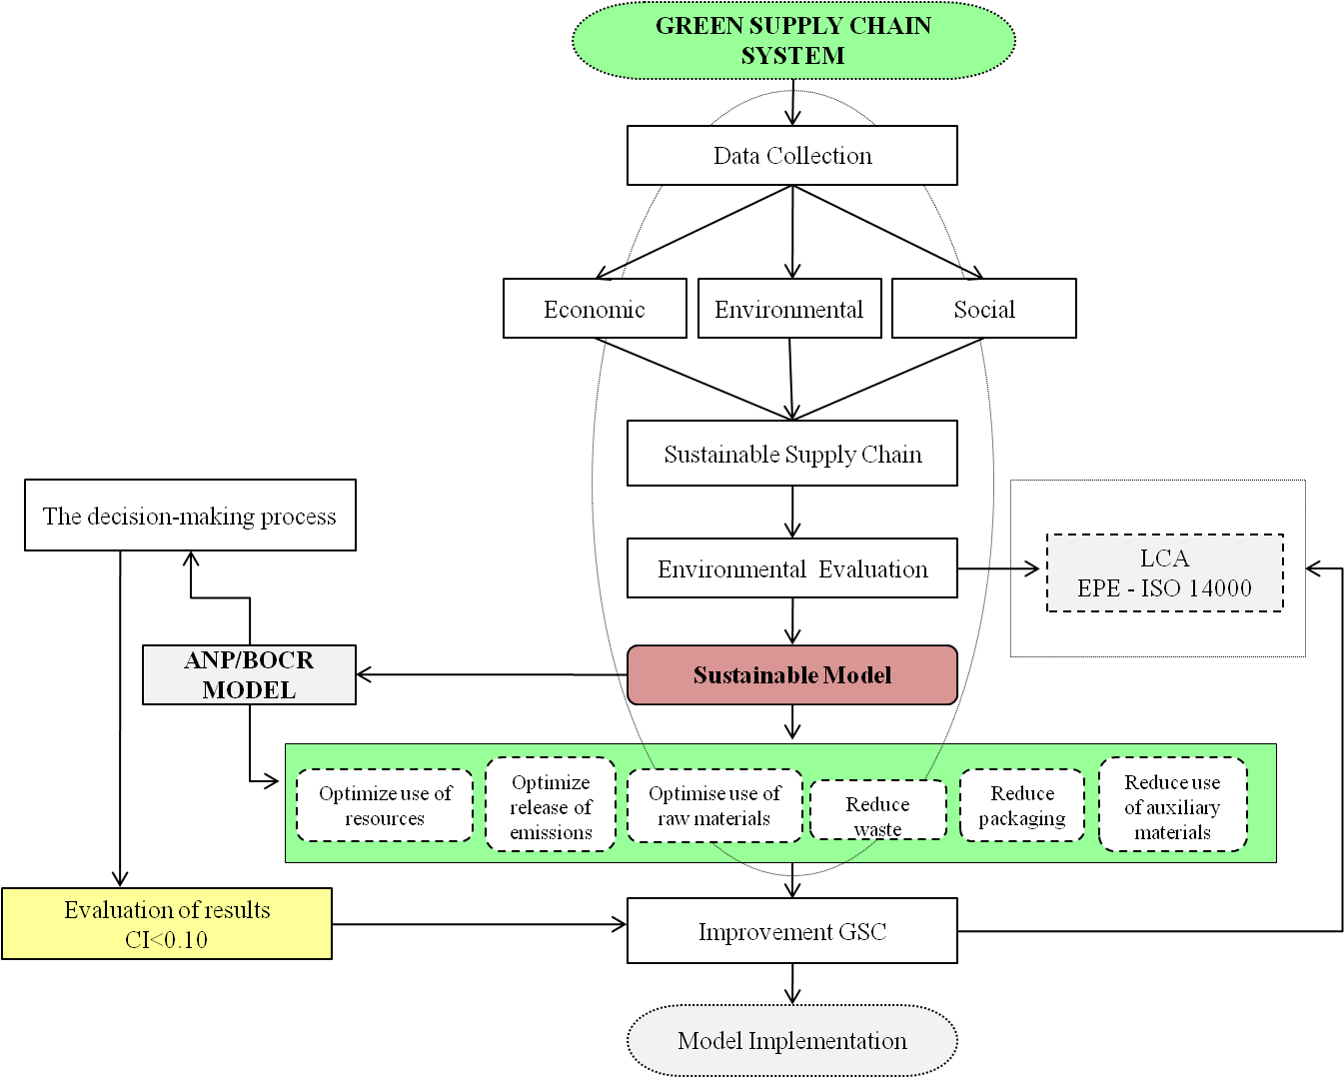
Methodological Approach
Conceptual Model
Orrin Cooper - Antonella Petrillo

Slide 5
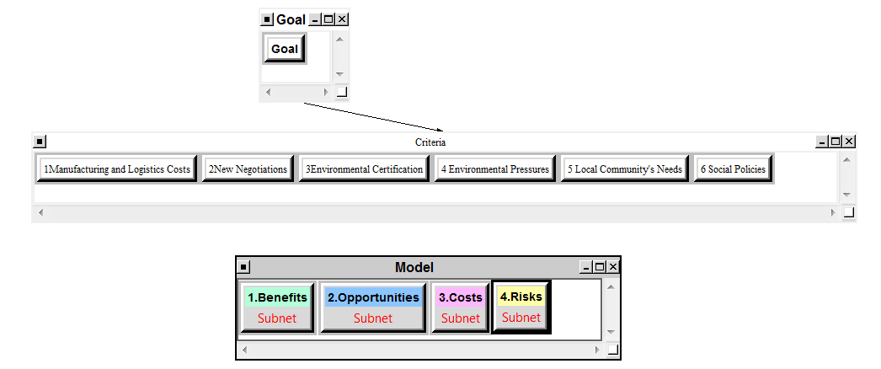
BOCR General Model
Orrin Cooper - Antonella Petrillo

Slide 6

BOCR Control Criteria
Manufacturing and Logistics Costs: These encompass the costs throughout the entire supply chain.
New Negotiations: Changes that come about because of negotiations from other members of the supply chain, e.g. Walmart demanding a 25% reduction in packaging.
Environmental Certification: The need to satisfy the requirements for ISO certification and of legislation, e.g. catalytic converters.
Environmental Pressures: Similar to environmental certification but for issues that have not been mandated, e.g. fracking chemicals.
Local Community Needs: Requests from the community that are not mandated by law, e.g. noise pollution.
Social Pressures: When a group or organization push for change within the supply chain. This is especially important for market share considerations, e.g. (coffee and deforestation).
Orrin Cooper - Antonella Petrillo

Slide 7
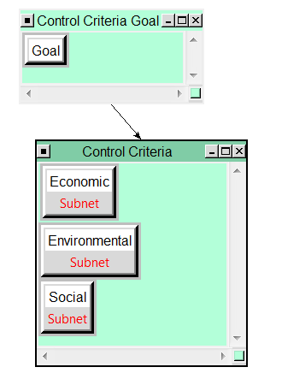
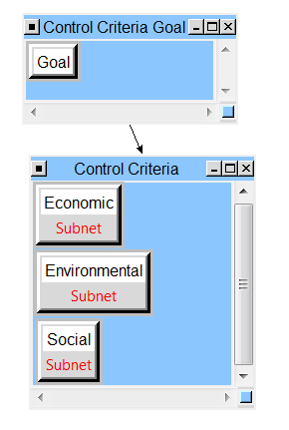
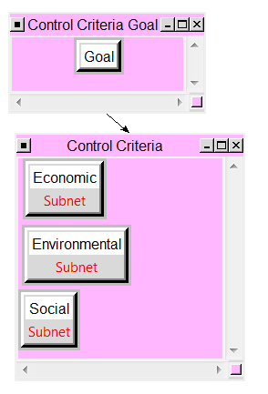
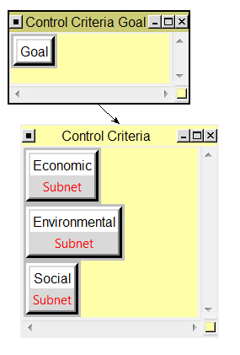
BOCR General Model
Benefits
Opportunities
Costs
Risks
Orrin Cooper - Antonella Petrillo

Slide 8
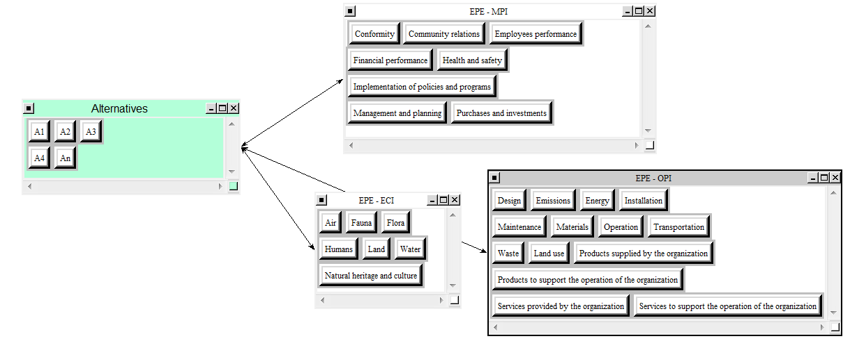
Benefits
Environmental
ISO 14000 Standards
MPI: Management Performance Indicators
ECI: Environmental Condition Indicators
OPI: Operational Performance Indicators
Orrin Cooper - Antonella Petrillo

Slide 9
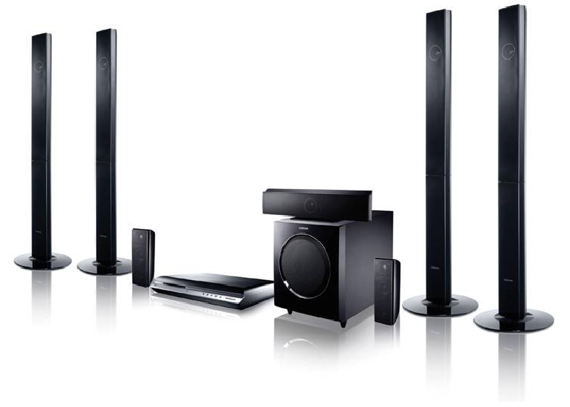
Case Study
Scenario: Green Supply Chain - directive 2002/95/EC and directive 2002/96/EC: RoHS & WEEE
Company: TV & AUDIO VIDEO
Goal: Develop a BOCR model that a TV and Audio/Video supply chain can use to evaluate the relative contribution of the proposed alternatives to develop a Green Supply Chain.
Result: A prioritized list of alternatives with respect to the critical factors/areas within the entire supply chain that will increase the level of sustainability. The result are then strengthened through sensitivity analysis.
Orrin Cooper - Antonella Petrillo
Notes:
The useful life of consumer electronic products is relatively short, and decreasing as a result of rapid changes in equipment features and capabilities (Kang and Schoenung, 2004). Again the growing importance of ICT to the world economy has brought about a surge in demand for electronic equipment (Macauley et al., 2001). Waste from electrical and electronic equipment, EEE (WEEE) is one of the priority streams in waste management because of its major challenges. It has in fact become an issue of concern to solid waste management professionals (Musson et al., 2000
In the last two decades, there has been an increase in the number of environmental policies and legislations focusing on the product development process with a view to reducing the environmental impacts resulting from the products; throughout their entire lifecycle-from product design, manufacture, through to consumption and eventual end-of-life (EoL) management.
These policies and legislations are almost all based on the principles of extended producer and whole supply chain responsibility. This concept has become an established principle of environmental policy in many countries. This approach integrates sustainable development principles into international trade based on an international environmental law principle known as the “Polluter Pays Principle” (Kibert, 2004).
In particular the EU sets up the green product regulations, where the most profound example is the establishment in 2002, of two environmental directives: directive 2002/95/EC on restriction of the use of certain hazardous sub- stances (RoHS) in electrical and electronic equipment (European Parliament, 2003b); and directive 2002/96/EC on waste electrical and electronic equipment (WEEE), respectively (European Parliament, 2003a). Directive WEEE introduces the producers’ responsibilities, such as increasing recycling and recovery rate of waste from electric and electronic equipment. Directive RoHS is a legal requirement that bans the use of Lead, Mercury, Cadmium, Hexavalent Chromium (Chromium VI), Polybrominated Biphenyl (PBB), and Polybrominated Diphenyl Ether (PBDE).
The aims of these two directives are not merely limiting the use of harmful substances, but also permeating into the recovery rate of at least 70–80% at the end of their useful life for electrical and electronic equipments in the EU market. This includes IT products such as PCs, laptops, printers, scanners and its related products.

Slide 10

Alternatives
Installation of emission abatement equipment
Installation of evaporative towers to recycle water
Installation of solar panels
Reuse packaging
Reuse of second hand materials
Orrin Cooper - Antonella Petrillo

Slide 11
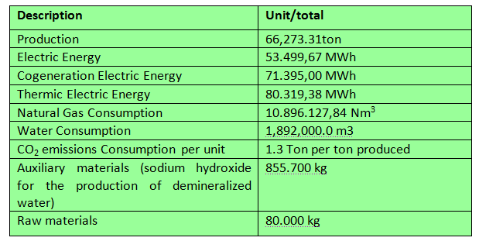
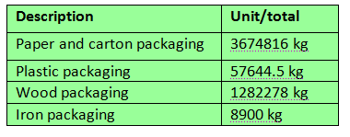
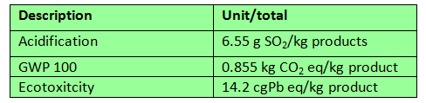
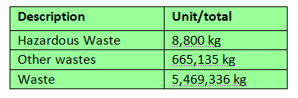
Methodological Approach
Data Collection
Packaging data
Consumption data
LCA data
Waste data
Orrin Cooper - Antonella Petrillo

Slide 12
BOCR – Case Study
Orrin Cooper - Antonella Petrillo

Slide 13
BOCR - Case Study
Benefits
Opportunities
Costs
Risks
Orrin Cooper - Antonella Petrillo

Slide 14
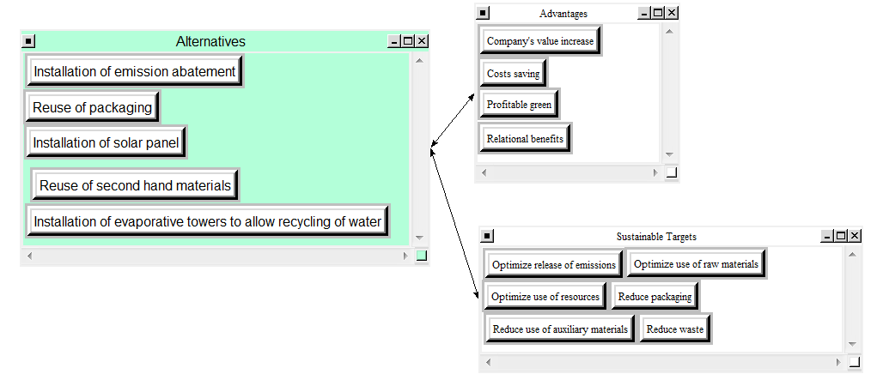
Benefits - Case Study
Economic
Orrin Cooper - Antonella Petrillo

Slide 15
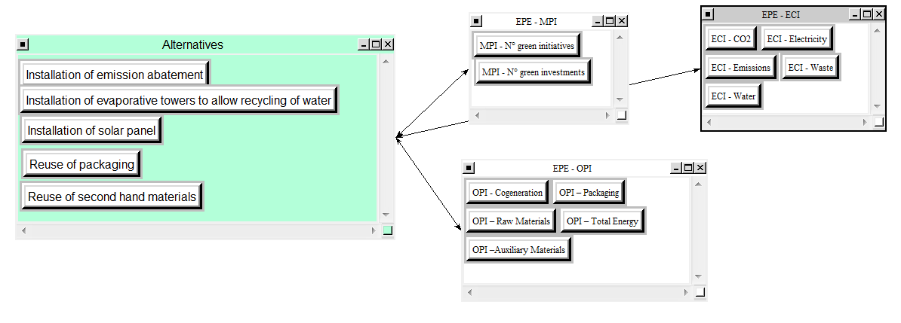
Benefits - Case Study
Environmental
ISO 14000 Standards
MPI: Management Performance Indicators
ECI: Environmental Condition Indicators
OPI: Operational Performance Indicators
Orrin Cooper - Antonella Petrillo

Slide 16
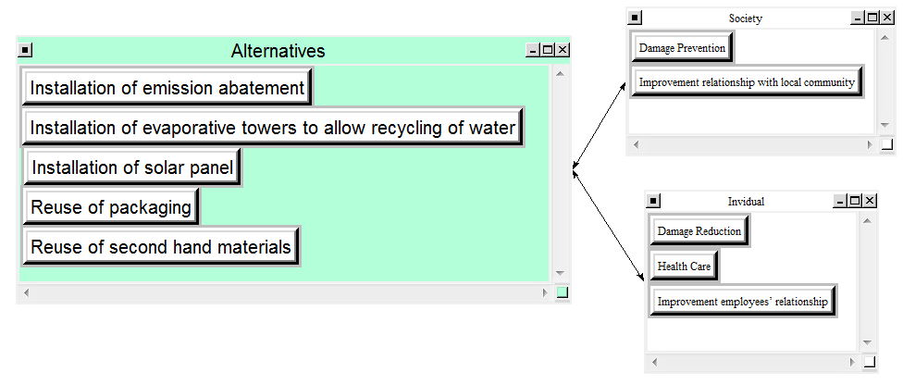
Benefits - Case Study
Social
Orrin Cooper - Antonella Petrillo

Slide 17
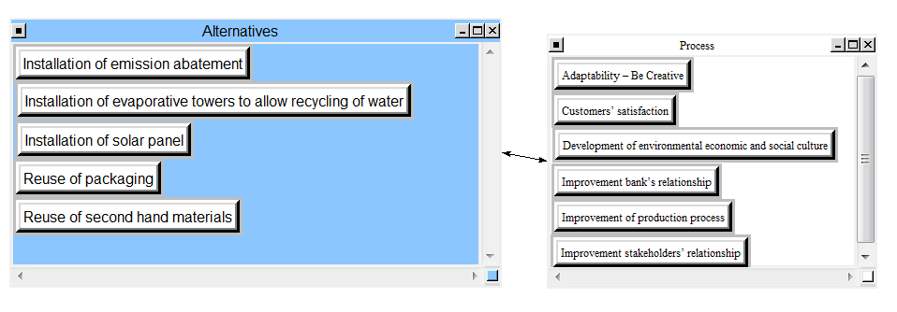
Opportunities - Case Study
Economic
Orrin Cooper - Antonella Petrillo

Slide 18
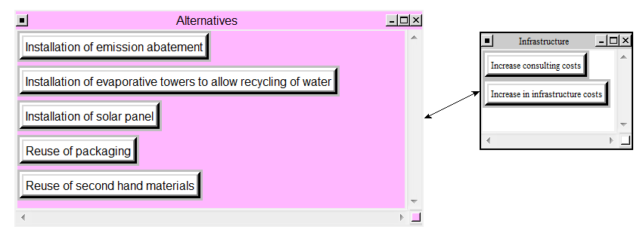
Costs - Case Study
Economic
Orrin Cooper - Antonella Petrillo

Slide 19
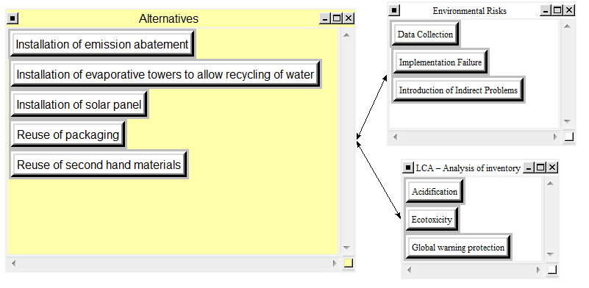
Risks - Case Study
Environmental
Orrin Cooper - Antonella Petrillo

Slide 20
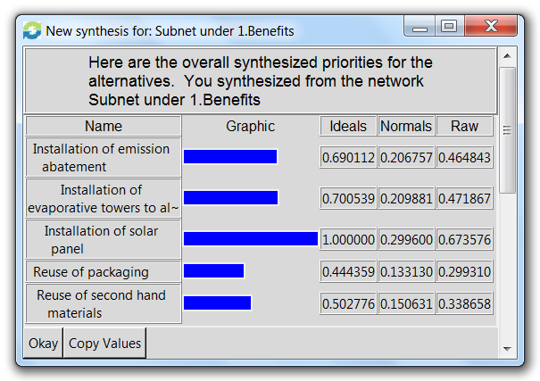
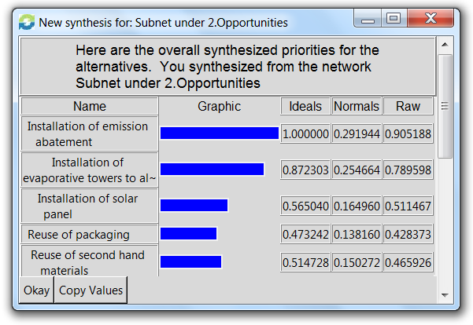
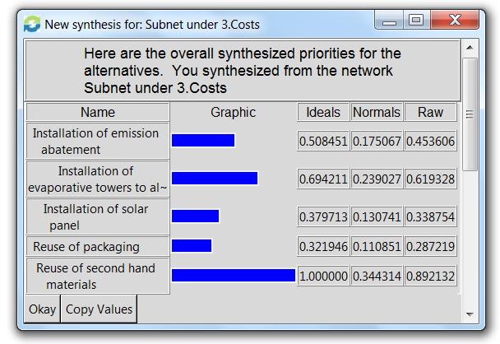
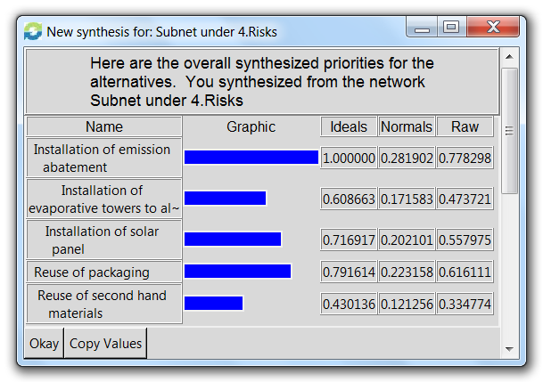
Local Priority
Orrin Cooper - Antonella Petrillo

Slide 21

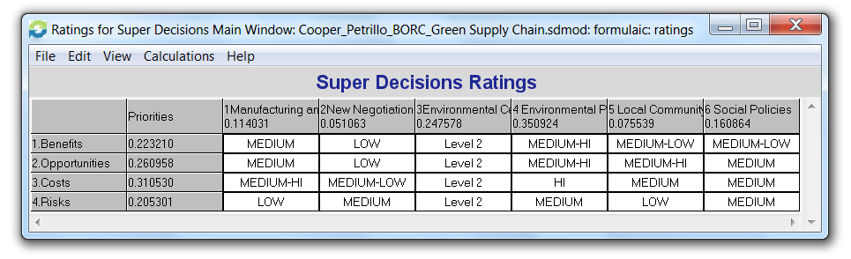
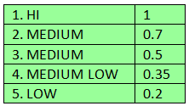
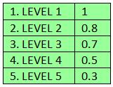
Rating Model
Orrin Cooper - Antonella Petrillo

Slide 22
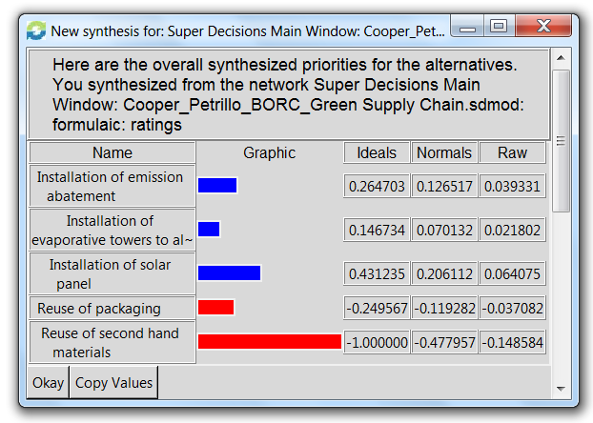

Priority
Additive Formula
Orrin Cooper - Antonella Petrillo

Slide 23
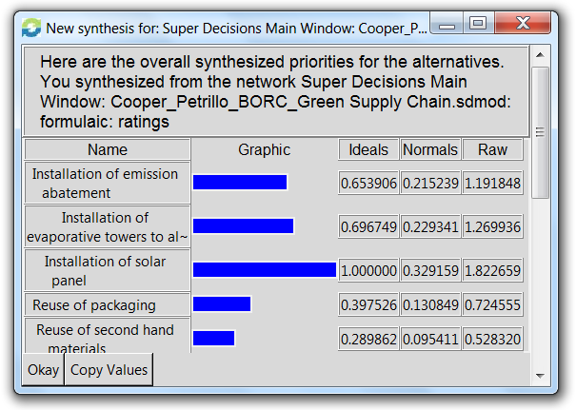
Priority
Multiplicative Formula
Orrin Cooper - Antonella Petrillo

Slide 24
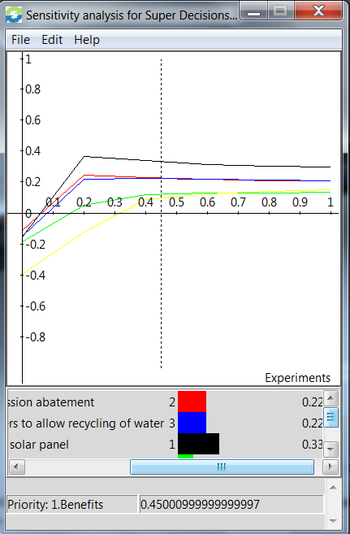


Sensitivity Analysis
Benefits
Opportunities
Solar Panel
Emission Abatement
Orrin Cooper - Antonella Petrillo

Slide 25
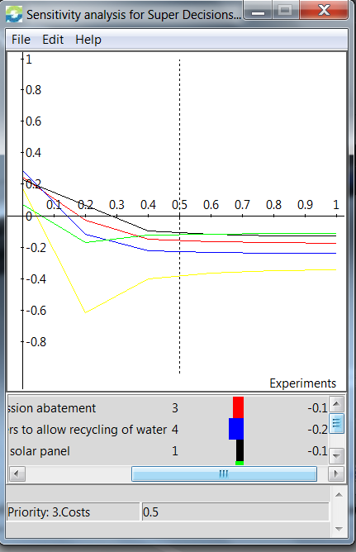
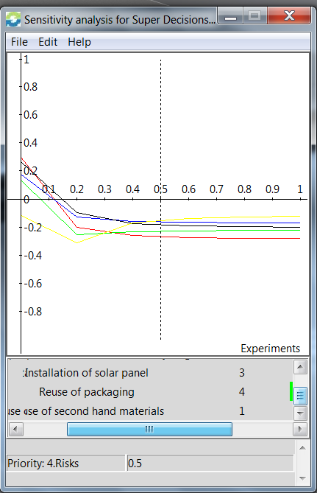
Sensitivity Analysis
Costs
Risks
Costs
Solar Panel and Packaging
Solar Panel
Water Recycling
Reuse of 2°- Hand
Orrin Cooper - Antonella Petrillo

Slide 26

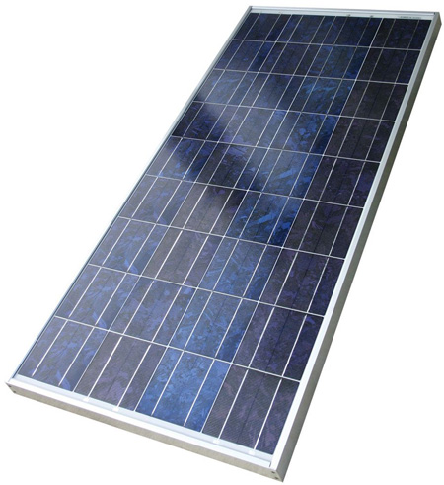

Conclusion
Orrin Cooper - Antonella Petrillo

