Slide 1
What should PPG do with its ERP system?
Justin Ritter
10/15/2012

Slide 2

Background
PPG Industries (NYSE: PPG) is a Fortune 200 company that manufactures coatings, specialty products and materials.
Today, PPG coatings division in North America runs on an old mainframe system for its ERP (Enterprise Resource Planning) that has been around for over 30 years.
This ERP system handles order placement, invoicing, inventory tracking, manufacturing, and many other aspects of the operation.

Slide 3
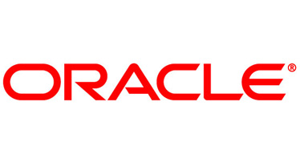
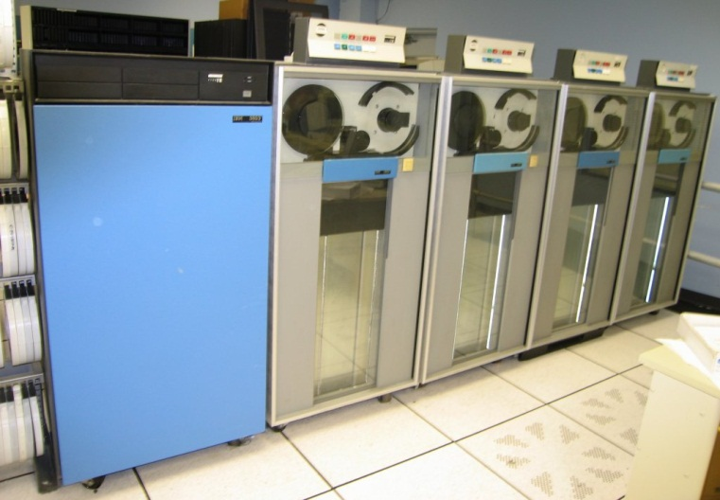

Decision Preface
Five years ago, the company took a look at its landscape to evaluate a business case for replacing its old ERP systems for coatings with a newer one.
So, what should PPG do with its ERP system?

Slide 4
Alternatives
Upgrade to a new ERP
  Expensive
  Multi-year project
  Takes away from other investments
Never upgrade to a new ERP
  Support costs
  Limitations
  Status Quo
Postpone upgrading for five years
  Save money now for later date

Slide 5
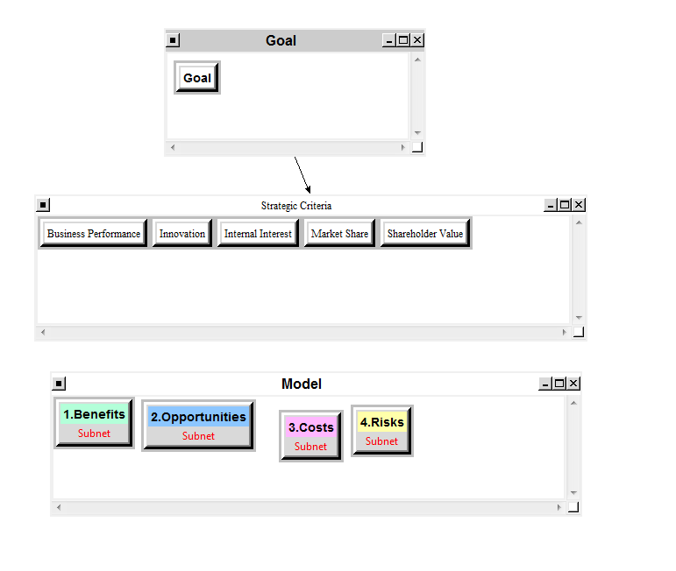
The Model

Slide 6
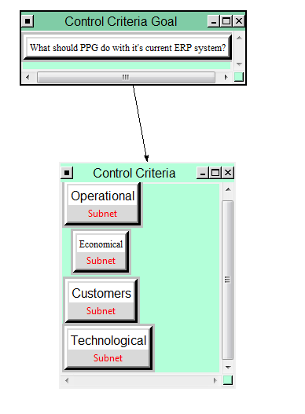
Benefits

Slide 7
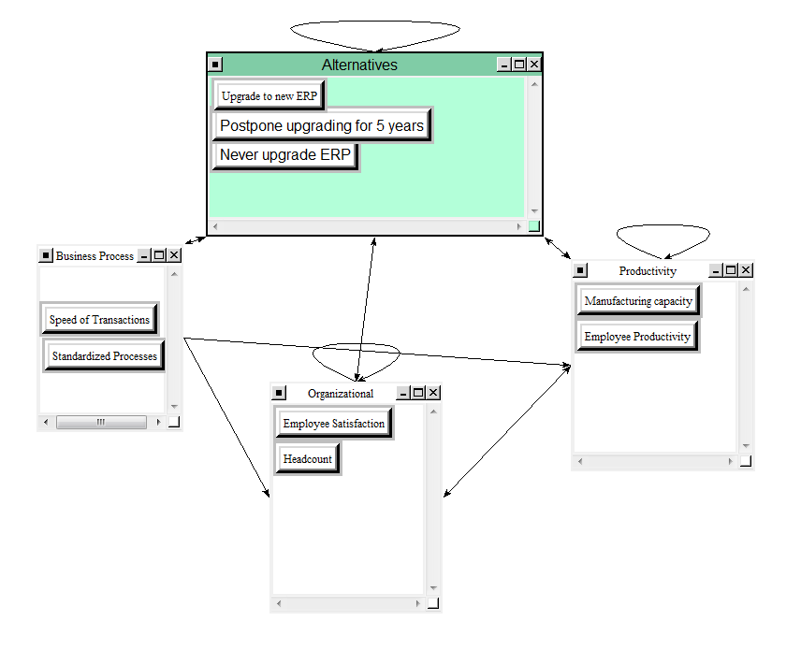
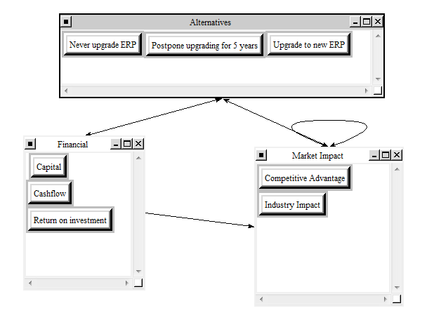
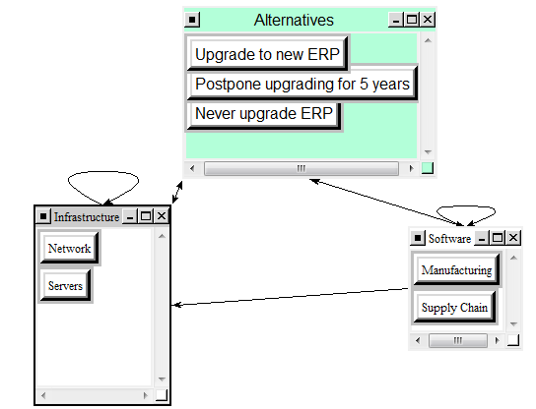
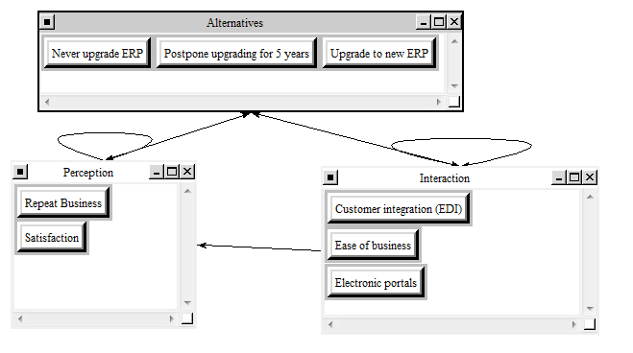
Benefits Subnets
Operational
Economical
Technological
Customers

Slide 8
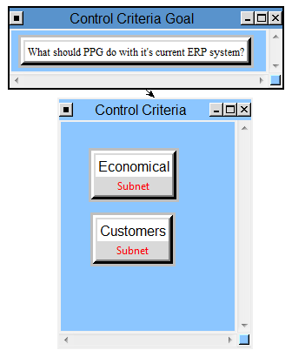
Opportunities

Slide 9
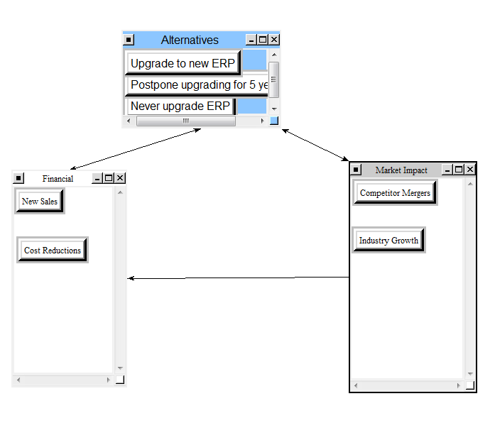
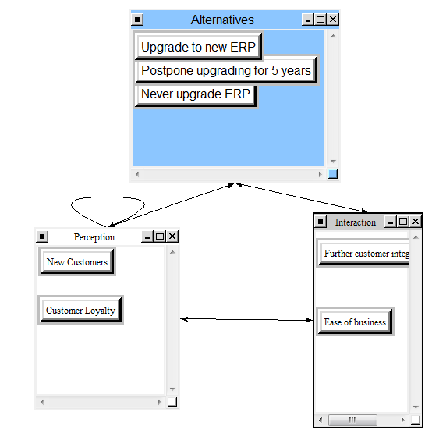
Opportunities Subnets
Economical
Customers

Slide 10
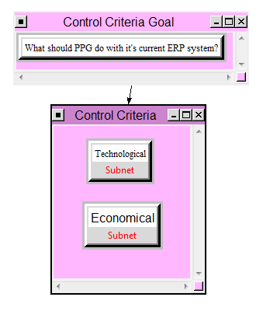
Costs

Slide 11
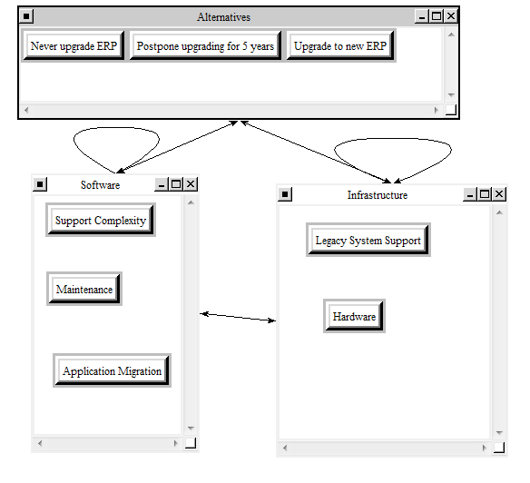
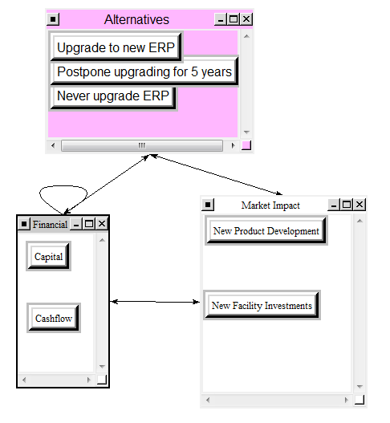
Costs Subnets
Technological
Economical

Slide 12
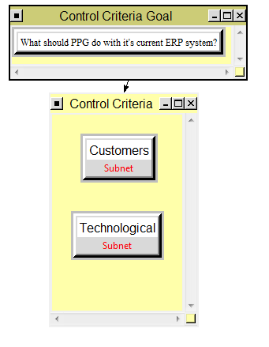
Risks

Slide 13
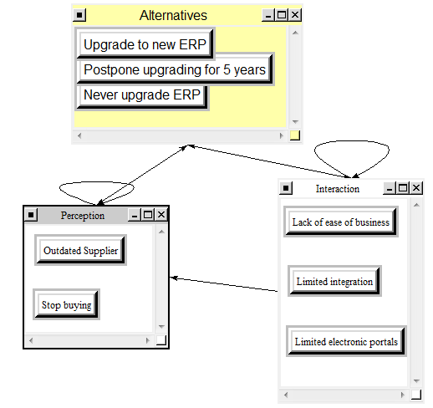
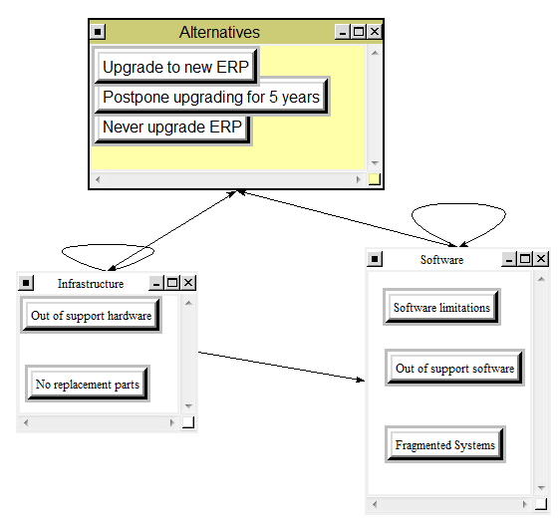
Risks Subnets
Customers
Technological

Slide 14
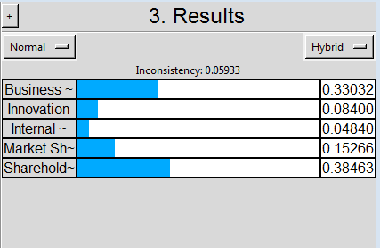
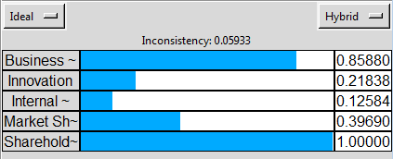
Strategic Criteria Priorities

Slide 15
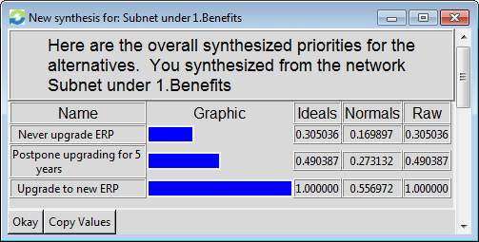
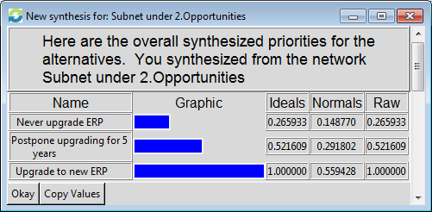
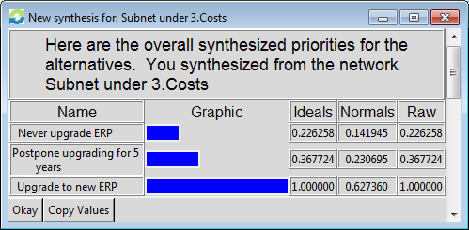
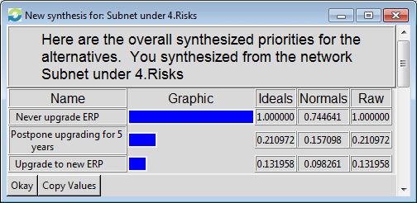
BOCR Priorities

Slide 16
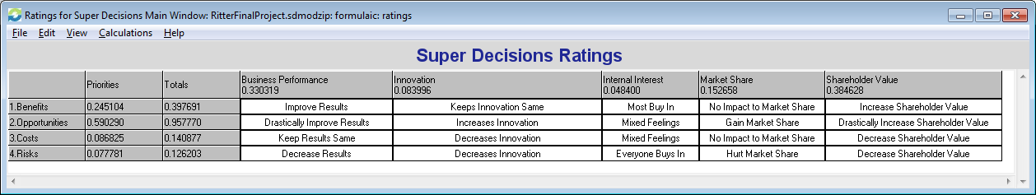
Super Decisions Ratings

Slide 17
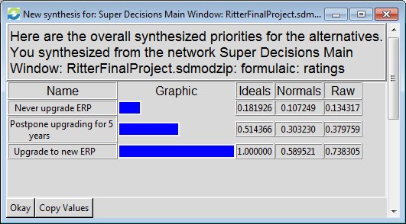
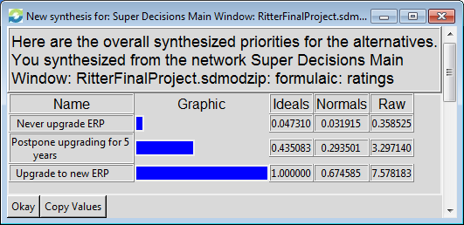
Model Results
Additive (Negative) Formula
Multiplicative Formula

Slide 18
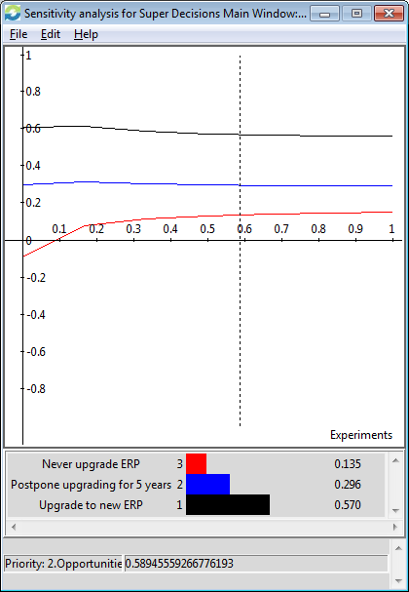
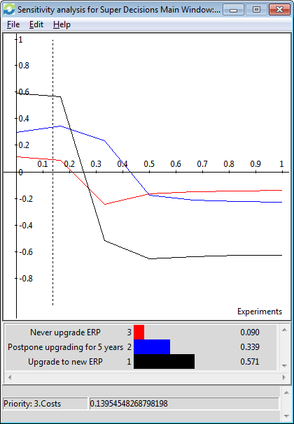
Sensitivity Analysis
Opportunities
Costs

Slide 19
Conclusion
Both long term and short term decisions are to make an upgrade of the ERP system with postponing coming in second.
While PPG can get away with not upgrading with no negatives, there are many benefits and opportunities to reap from this upgrade / capital transaction.

Slide 20
Further Improvements?
More complex subnets.
Real data behind benefits and costs of other businesses ERP implementations (high focus area)
Build in the effect on other business units within PPG.
Build in the effect on explicit competitors this could have.

