Slide 1
Improving Employee Morale Through Non-Financial Means
Ashley Rudy
Greg Spelar
April 23, 2013

Slide 2
Introduction
Companies are under growing pressure to improve employee morale while constrained on using resources for non-business purposes.
Higher levels of employee morale are tied to higher company performance
We examine three possible means of improving morale
Intrinsic Events
External Events
Profile-Raising Events

Slide 3
BOCR Model
Benefits
Operational
Product Development, Employee Retention, Profitability
Social
Employee Value, Reputation
Opportunities
Operational
Talent Pool, Process Improvement
Social
Communication, New Markets, Competitiveness, Knowledge Sharing

Slide 4
BOCR Model
Costs
Operational
Output, Time, & Financial Cost
Social
Industry Reputation & Shareholder Support
Risks
Economic
Legal Issues & Market Expansion
Social
Employee Value, Talent Pool, & Reputation

Slide 5
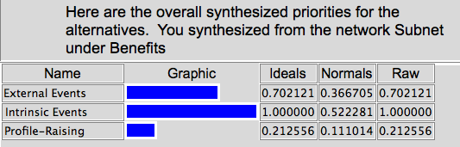
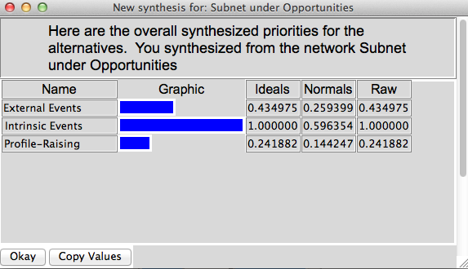
Benefits & Opportunities Results
Notes:
Benefits
Operational
Product Development, Employee Retention, Profitability
Social
Employee Relationship, Reputation
Management will see stronger benefits of raising employee morale by intrinsic events. These events include self-actualization and independence. For example, telecommuting and flex-time are usually more desirable than having employee of the year banquets or receiving a plaque for a job well done.
Opportunities
Operational
Talent Pool, Process Improvement
Social
Communication, New Markets, Competitiveness, Knowledge Sharing

Slide 6
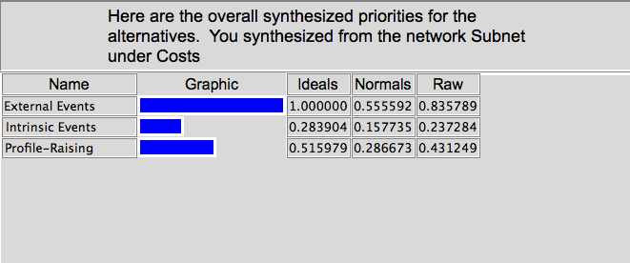
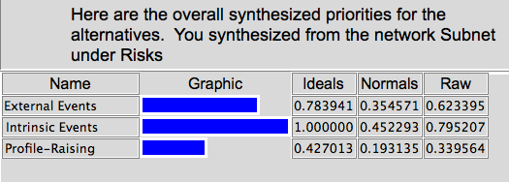
Costs & Risks Results
Notes:
Costs
Operational
Output, Time, & Financial Cost
Social
Industry Reputation & Shareholder Support
Risks
Economic
Legal Issues & Market Expansion
Social
Employee Value, Talent Pool, & Reputation

Slide 7
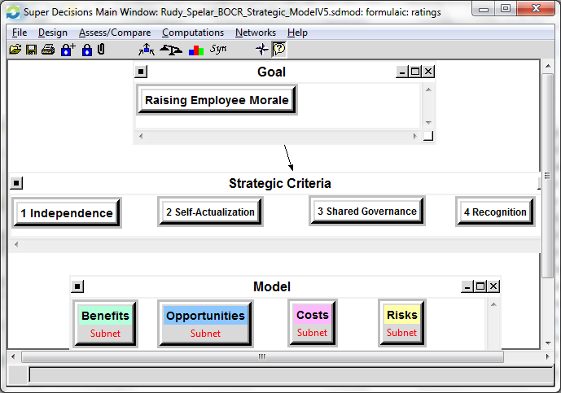
Strategic Criteria
Notes:
We evaluated our decision with the strategic criteria based on what motivates the employee, which may result in them becoming loyal to their company, and all around just happier in the working environment.
Based on our research, we concluded that independence, self-actualization, shared governance, and recognition were most important.
Flex-time and telecommuting are forms of independence
Self-actualization ( or basically fulfilling one’s potential) – provide challenges developed specifically for the employee.
For example: have rotational assignments in other areas of the workplace that the employee may be interested in
We assume that all the other needs have been met in Maslow’s hierarchy of needs
Physiological, Safety, Social, Esteem
Shared governance is having the employee contribute to making decisions, or to be listened to or heard from. Just seeing how they make a difference to the company with their work raises their motivation.
Recognition was defined as praise or acknowledgement of exceptional work. (could include receiving sporting event tickets or receiving donation from employer to their favorite charity)

Slide 8
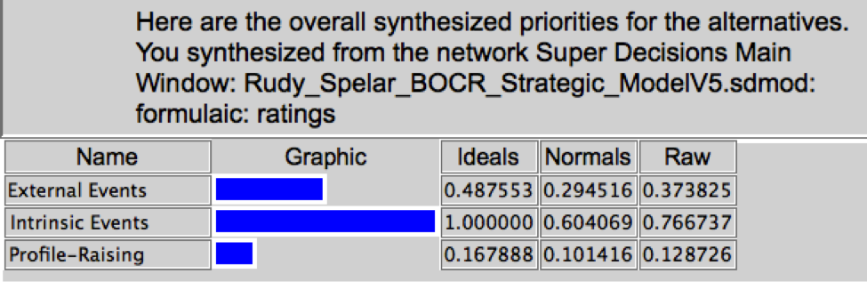
Results
Notes:
There are a few reasons why Intrinsic Events was the highest priority out of the three alternatives.
This alternative provided more opportunities to become more independent as an employee (which was done through flex time) and also increase self-actualization. Which as I mentioned in the previous slide are necessary for raising their morale in the workplace.
Also by having the opportunity to work in different departments, gave them a chance to challenge themselves in different areas. This could be fulfilling to some and continue to motivate them.

Slide 9
Possible Improvements & Further Research
Look further into Intrinsic Events
Break down into specific examples
Reward versus Recognition
Examine specific companies or industries
Conduct employee engagement surveys to gather feedback on interests of specific rewards or recognitions
Notes:
Employees like getting bonuses and promotions, but more are also increasingly satisfied with low-cost rewards such as tickets to sporting events and shows, free beverages and snacks, small plaques with their name and the date, gym discounts, holiday family parties or picnics.
Or even better yet… an extra vacation day earned by great performance.
We should have developed clearer alternatives.
The criteria should have been more defined before starting the pairwise decisions and making assumptions.

Slide 10
Questions?

