Slide 1
Will Biden win his Second Term ?
(Should he run again)
By Ash Wolowic

Slide 2
TABLE OF CONTENTS
01
02
03
04
05
06
The Main Network
The Sub-Networks
Initial Comparisons
Ratings Model
Final Results
Sensitivity Analysis & Final Thoughts

Slide 3
01
The Main Network

Slide 4
The Main Network
Goal: Will Biden get reelected if he runs for a second term
Strategic Objectives
1.The American People
2.International Community
3.Governmental employees
4.Lobbyist
Alternatives
Biden Wins
Biden Loses

Slide 5
Objective Criteria
Cost
Opportunities
Benefits
Risk
Economy
International Relations
Education
Social Equality

Slide 6

Sub-Networks
02

Slide 7
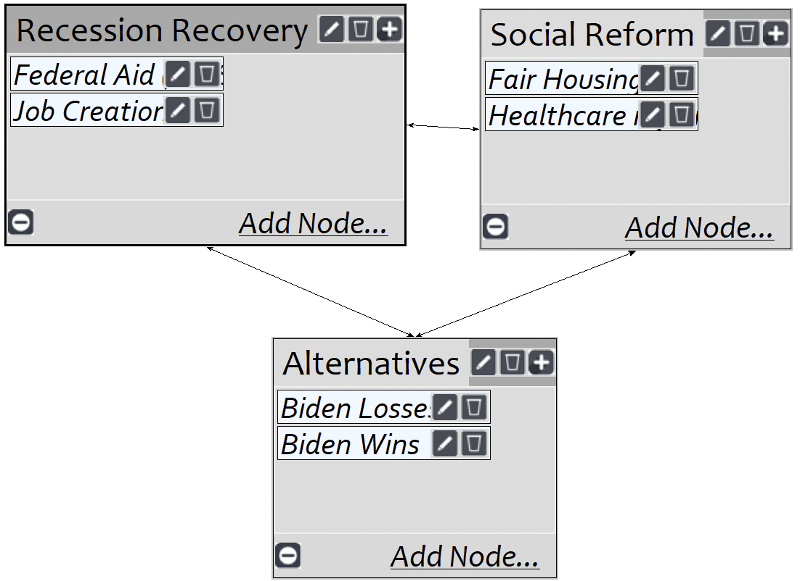
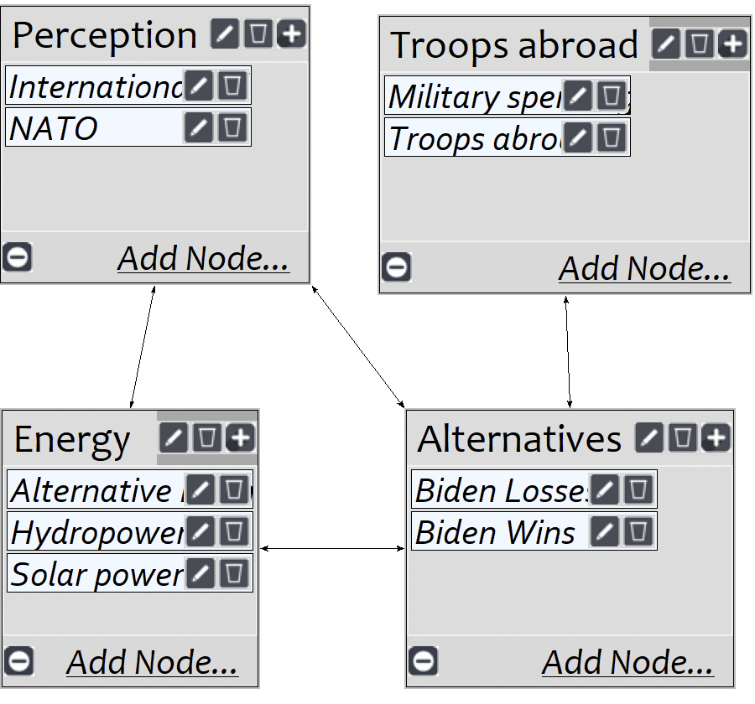
Benefit's Sub-Models
Economy
International Relations

Slide 8
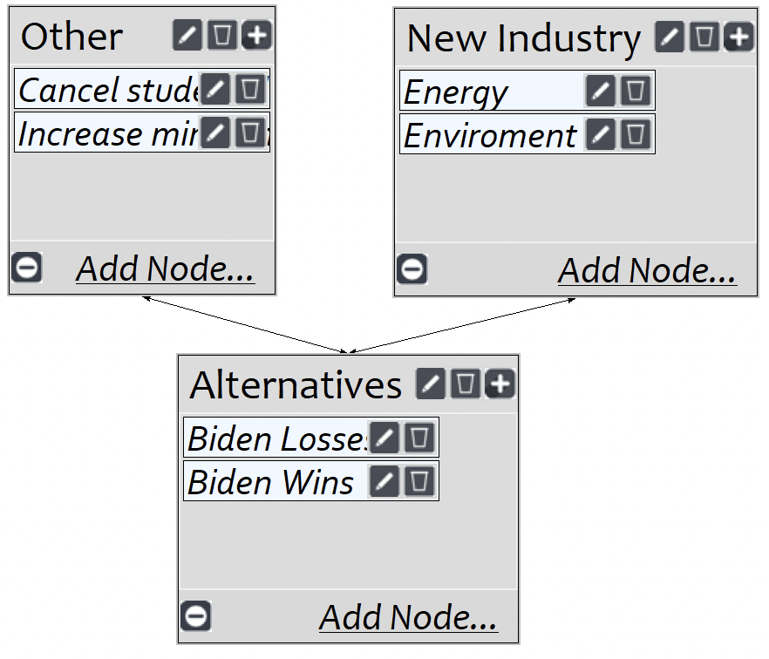
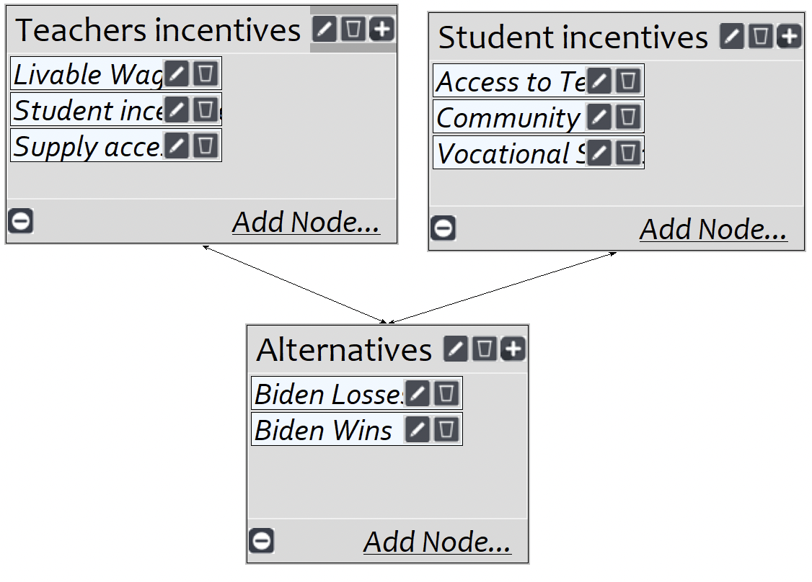
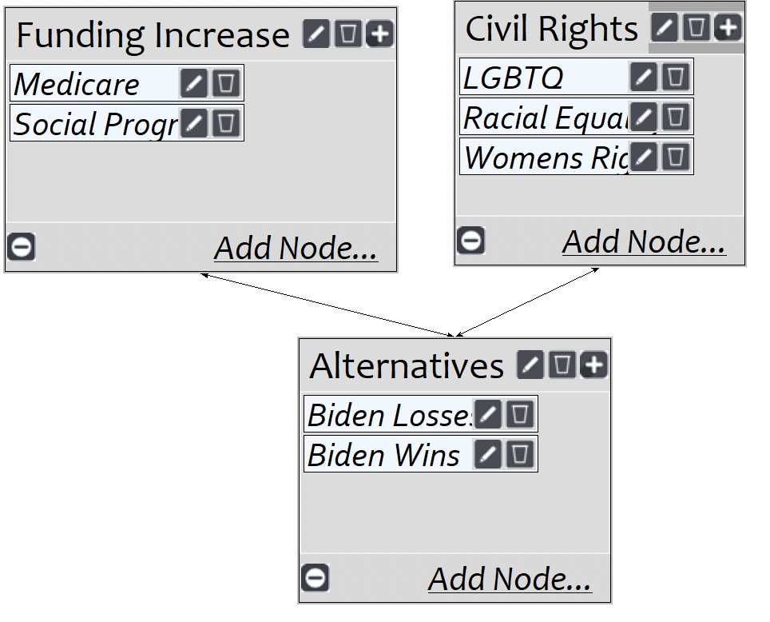
Opportunities Sub-Networks
Social Equality
Education
Economy

Slide 9
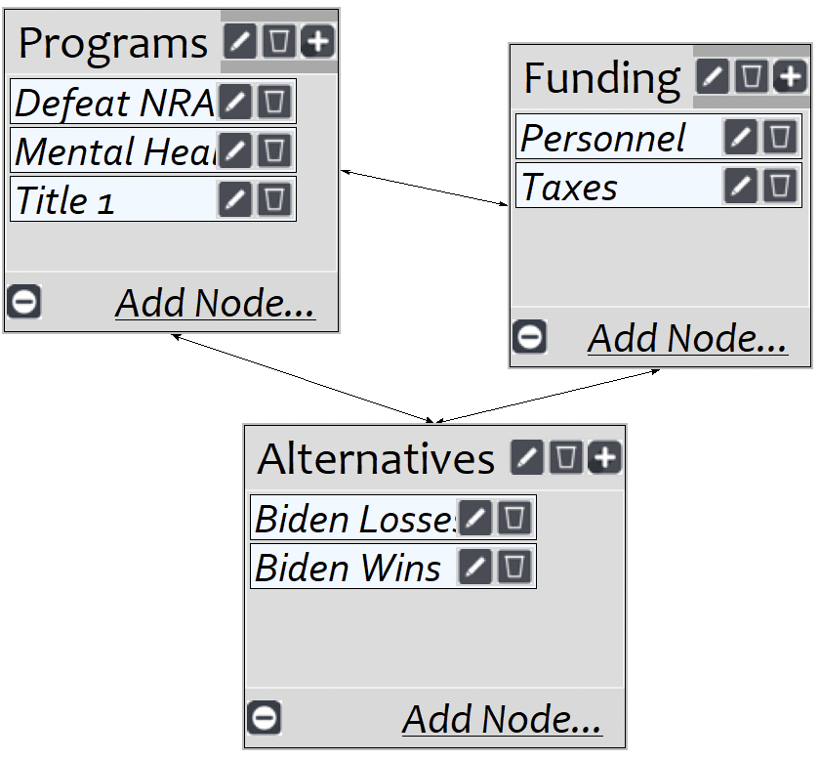
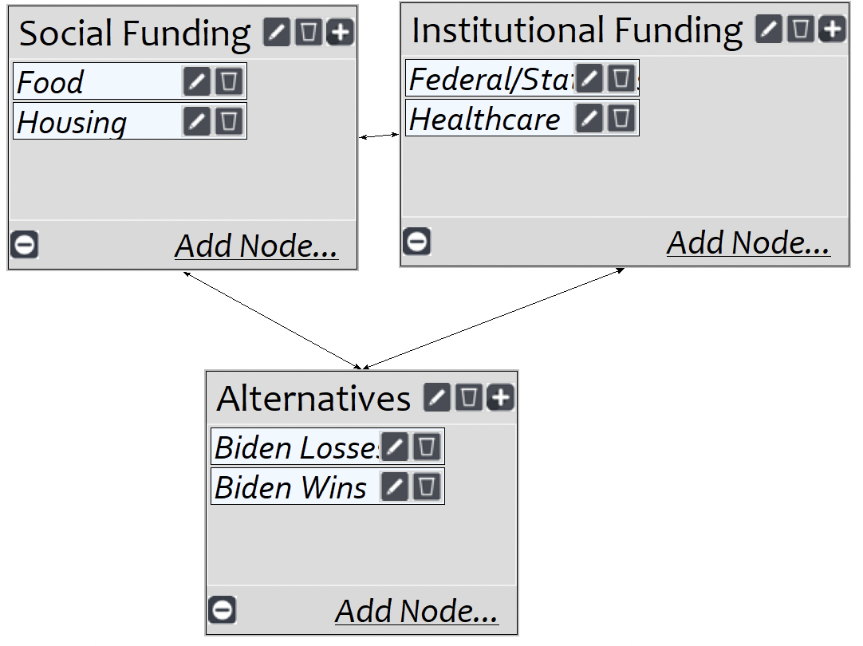
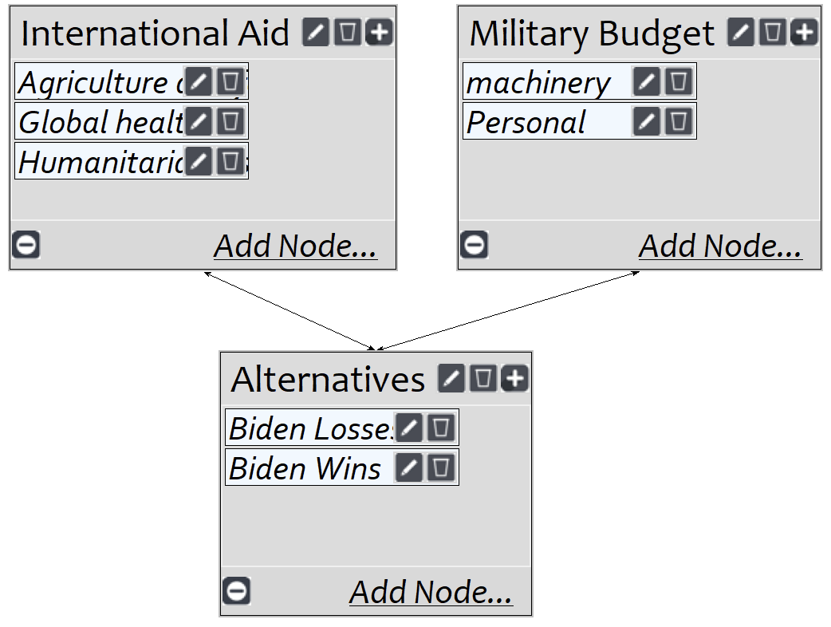
Cost Sub-Networks
International relations
Social Equality
Education

Slide 10
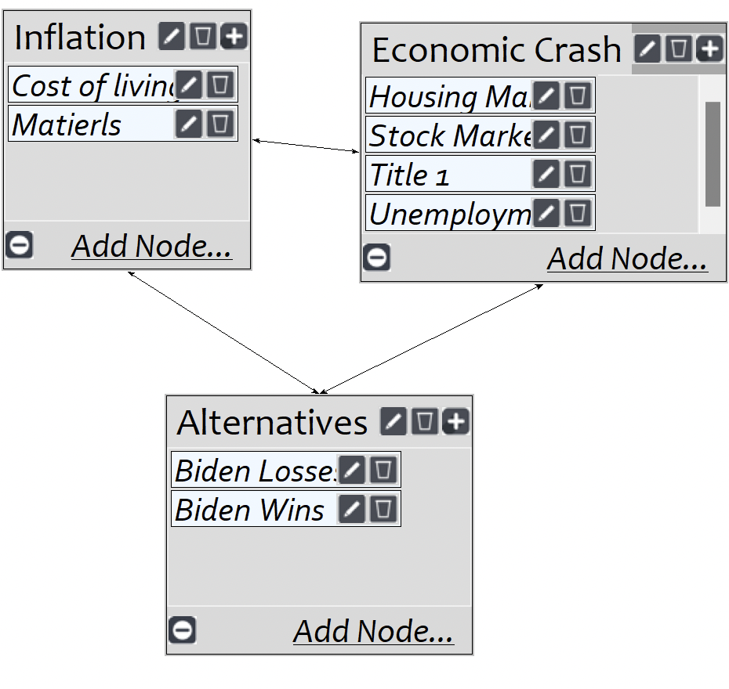
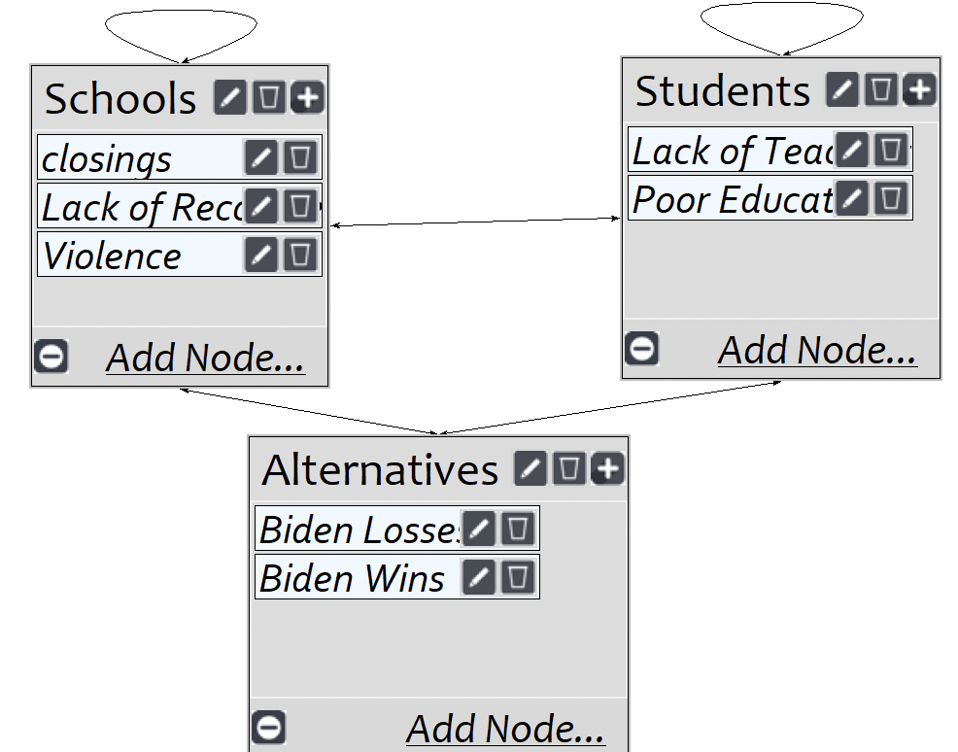
Risk Sub-Networks
Education
Economy

Slide 11
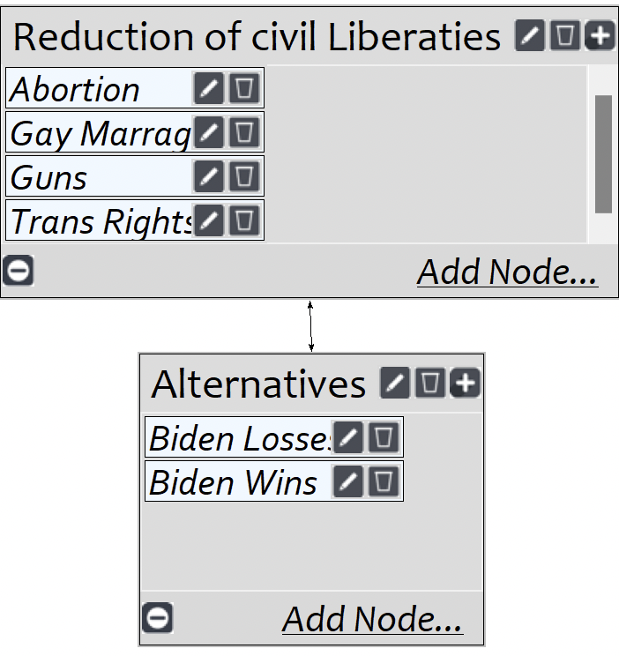
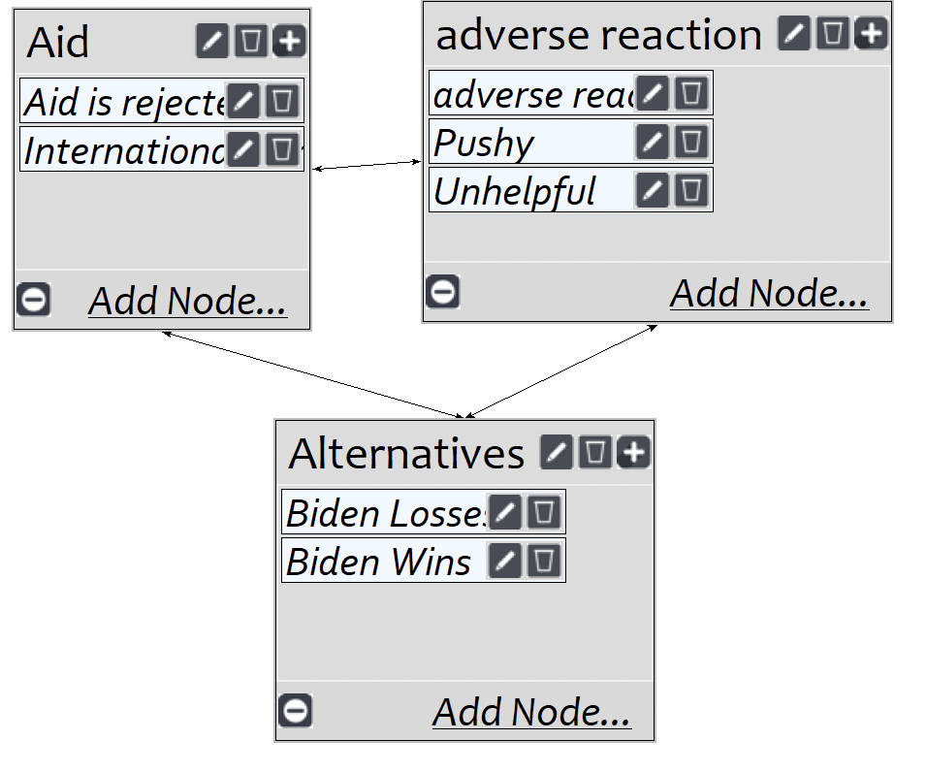
Risk Sub-Networks
International Relations
Social Equality

Slide 12
Initial Comparisons 03

Slide 13
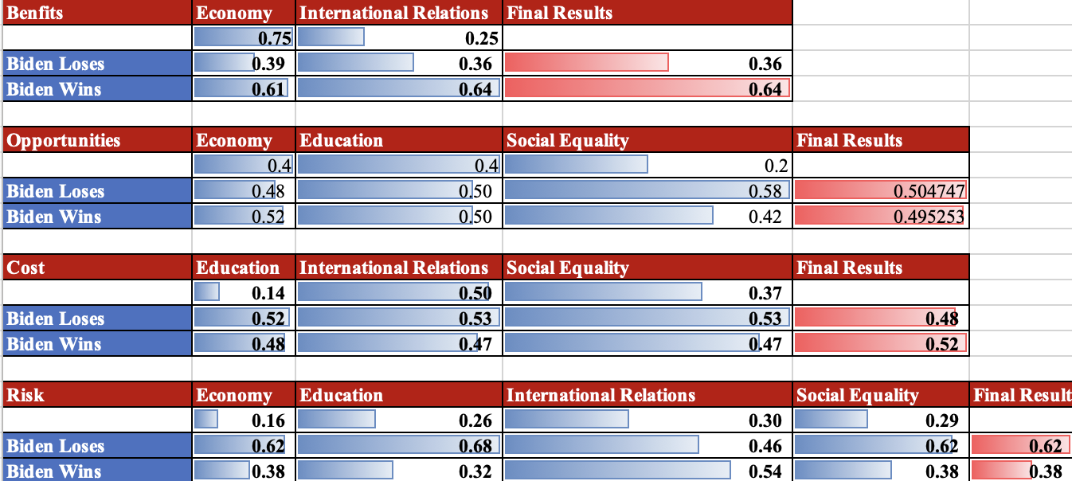
Risk Sub-Networks

Slide 14
04
Ratings Model

Slide 15
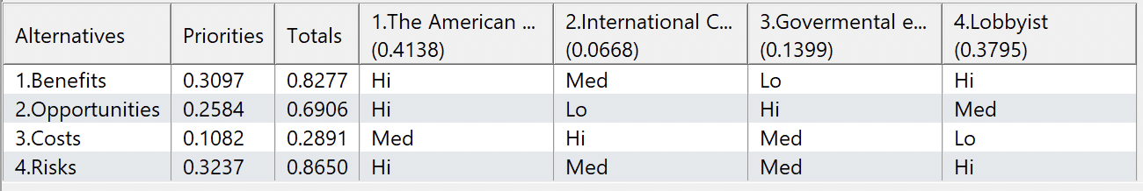
Ratings Model
DEMOCRATS

Slide 16
05
Final Results

Slide 17
Biden Wins!

Slide 18
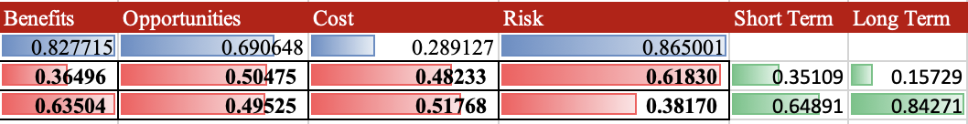

Slide 19
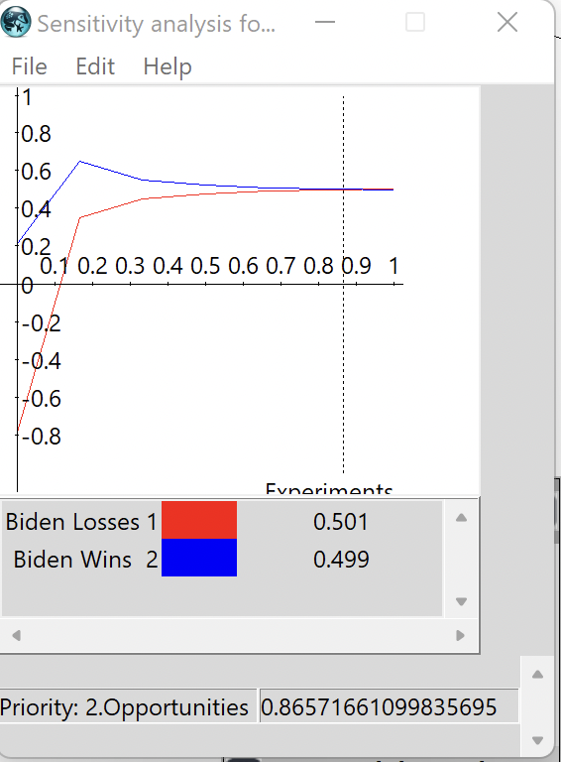
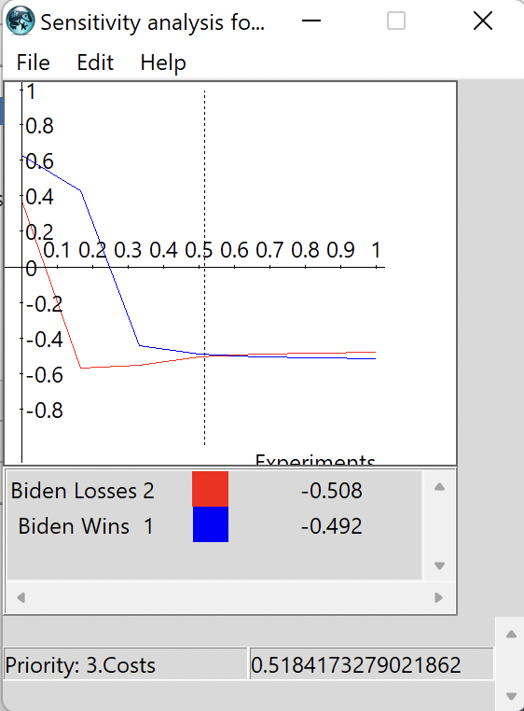
Sensitivity Analysis 06

Slide 20
Key Insights for the Biden Campaign
People care about the short-term economy, a lot, focusing on the ”now” benefits like recession recovery and social reform will greatly improve his chances of reelection.
Under opportunities, we see that Biden lost in that category because his long term-change does not reflect what enough constituents want, or it's too much change. Focus on long-term social change.
We see this again reflected in the cost
In this model, American people had the heaviest weight and gave most of that weight to benefits. This intuitively makes sense.

Slide 21
Limitations of the model
This model only accounts for the Populus vote within the USA, because of this the American and Lobbyist get rated higher than the International community and government workers.
No other candidates are factored in.
Ultimately, this model shows what Biden should focus on should he want to get reelected.
There is a lot of noise present in the model. Further research and Market studies would be needed to negate this.

Slide 22

Questions?

