Slide 1
FORECASTING THE RESURGENCE OF THE U.S. ECONOMY IN 2001:
AN EXPERT JUDGMENT APPROACH

Slide 2
Model
This is a forecast of the date for the resumption of the growth of the US economy in 2001. It uses an expert judgment approach within the framework of the decision theory, the Analytic Hierarchy Process, and its generalization to dependence and feedback, the Analytic Network Process.

Slide 3
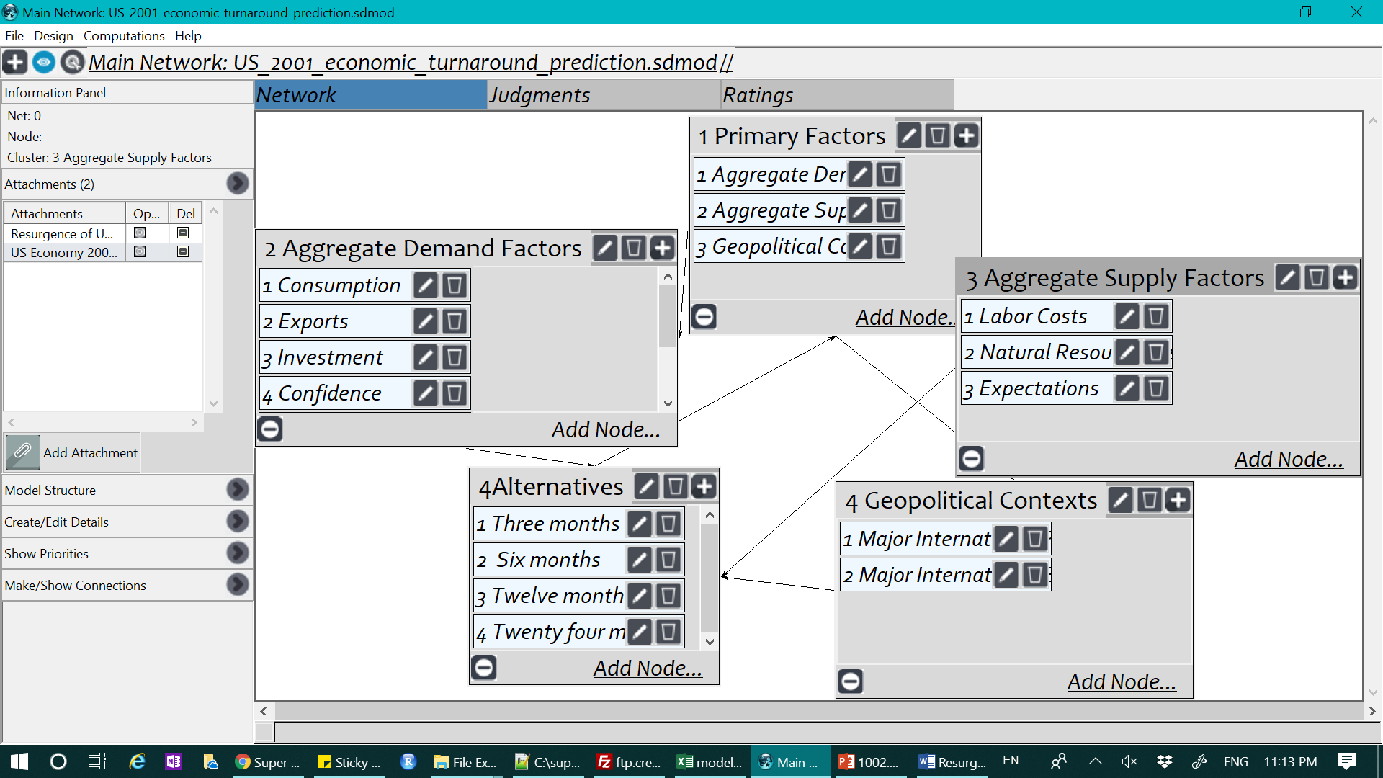
Model

Slide 4
Results
Time Period Midpoint of Time Period Priority of Time Period Midpoint x Priority
(in months from 0)
Three months 0 + (3 – 0 )/2 = 1.5 .30581 .45871
Six months 3 + (6 – 3)/2 = 4.5 .20583 .92623
Twelve months 6 + (12 – 6)/2 = 9.0 .18181 1.63629
Twenty-four 12 + (24 – 12)/2 = 18.0 .30656 5.51808
months TOTAL 8.53932

