Slide 1
Date and Strength of Recovery of U.S. Economy
Primary Factors
Conventional Economic
adjustment Restructuring
Consumption (C) Financial Sector (FS)
Exports (X) Defense Posture (DP)
Investment (I) Global Competition (GC)
Fiscal Policy (F)
Monetary Policy (M)
Confidence (K)
Subfactors
Adjustment Period
Required for
Turnaround
3 months 6 months 12 months 24 months
The U.S. Holarchy of Factors for Forecasting Turnaround in Economic Stagnation

Slide 2
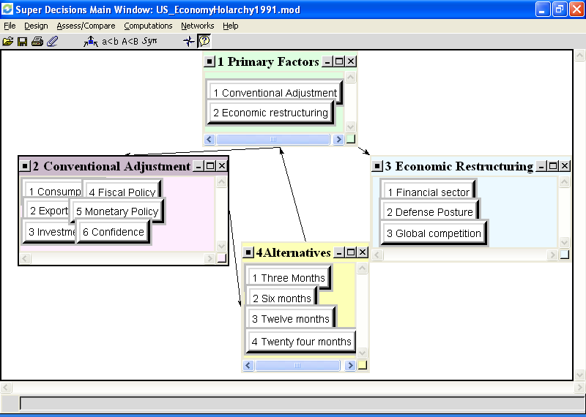
US Economy Recovery 1991

Slide 3
Synthesis/Results
When the judgments were made, the AHP framework was used to perform a synthesis that produced the following results. First a meaningful turnaround in the economy would likely require an additional ten to eleven months, occurring during the fourth quarter of 1992. This forecast is derived from weights generated in the first column of the limiting matrix in Table 6, coupled with the mid-points of the alternate time periods (so as to provide unbiased estimates:
.224 x 1.5 + .151 x 4.5 + .201 x 9 + .424 x 18 =
10.45 months from late December 1991/early January 1992

Slide 4
Table 1: Matrices for subfactor importance relative to primary factors influencing the Timing of Recovery
Panel A: Which subfactor has the greater potential to influence Conventional Adjustment and how strongly?
Vector
C E I K F M Weights
Consumption (C)
Exports (E)
Investment (I)
Confidence (K)
Fiscal Policy (F)
Monetary Policy (M)
1 7 5 1/5 1/2 1/5 0.118
1/7 1 1/5 1/5 1/5 1/7 0.029
1/5 5 1 1/5 1/3 1/5 0.058
5 5 5 1 5 1 0.334
2 5 3 1/5 1 1/5 0.118
5 7 5 1 5 1 0.343
Panel B: Which subfactor has the greater potential to influence Economic Restructuring and how strongly?
Vector
FS DP GC Weights
Financial
Sector (FS)
Defense
Posture (DS)
Global
Competition (GC)
1 3 3 0.584
1/3 1 3 0.281
1/3 1/3 1 0.135

Slide 5
Table 2: Matrices for relative influence of subfactors on periods of adjustment (months) (Conventional Adjustment)
For each panel below, which time period is more likely to indicate a turnaround if the relevant factor is the sole driving force?
Panel A: Relative importance of targeted time periods for consumption to drive a turnaround
Panel B: Relative importance of targeted time periods for exports to drive a turnaround
3 6 12 24 Vec. Wts. 3 6 12 24 Vec. Wts.
3 months 1 1/5 1/7 1/7 .043
6 months 5 1 1/5 1/5 .113
12 months 7 5 1 1/3 .310
24 months 7 5 3 1 .534
3 months 1 1 1/5 1/5 .083
6 months 1 1 1/5 1/5 .083
12 months 5 5 1 1 .417
24 months 5 5 1 1 .417
Panel C: Relative importance of targeted time periods for investment to drive a turnaround
Panel D: Relative importance of targeted time periods for fiscal policy to drive a turnaround
3 6 12 24 Vec. Wts. 3 6 12 24 Vec. Wts.
3 months 1 1 1/5 1/5 .078
6 months 1 1 1/5 1/5 .078
12 months 5 5 1 1/3 .305
24 months 5 5 3 1 .538
3 months 1 1 1/3 1/5 .099
6 months 1 1 1/5 1/5 .087
12 months 3 5 1 1 .382
24 months 5 5 1 1 .432
Panel E: Relative importance of targeted time periods for monetary policy to drive a turnaround
Panel F: Expected time for a change of confidence indicators of consumer and investor activity to support a turnaround in the economy
3 6 12 24 Vec. Wts. 3 6 12 24 Vec. Wts.
3 months 1 5 7 7 .605
6 months 1/5 1 5 7 .262
12 months 1/7 1/5 1 1/5 .042
24 months 1/7 1/7 5 1 .091
3 months 1 3 5 5 .517
6 months 1/3 1 5 5 .305
12 months 1/5 1/5 1 5 .124
24 months 1/5 1/5 1/5 1 .054

Slide 6
Table 3: Matrices for relative influence of subfactors on periods of adjustment (months) (Economic Restructuring)
For each panel below, which time period is more likely to indicate a turnaround if the relevant factor is the sole driving force?
Panel A: Financial system restructuring time
Panel B: Defense readjustment time
3 6 12 24 Vec. Wts. 3 6 12 24 Vec. Wts.
3 months 1 1/3 1/5 1/7 .049
6 months 3 1 1/5 1/7 .085
12 months 5 5 1 1/5 .236
24 months 7 7 5 1 .630
3 months 1 1/3 1/5 1/7 .049
6 months 3 1 1/5 1/7 .085
12 months 5 5 1 1/5 .236
24 months 7 7 5 1 .630
Panel C: Global competition adjustment time
3 6 12 24 Vec. Wts.
3 months 1 1 1/5 1/5 .078
6 months 1 1 1/5 1/5 .078
12 months 5 5 1 1/3 .305
24 months 5 5 3 1 .538
Table 4: Most likely factor to dominate during a specified time period
Which factor is more likely to produce a turnaround during the specified time period? Conventional Adjustment CA
Restructuring R
Panel A: 3 Months Panel B: 6 Months Panel C: 1 Year Panel D: 2 Years
CA R Vec. Wts. CA R Vec. Wts. CA R Vec. Wts. CA R Vec. Wts.
CA 1 5 .833 CA 1 5 .833 CA 1 1 CA 1 1/5 .167
R 1/5 1 .167 R 1/5 1 .167 R 1 1 R 5 1 .833
.500
.500

Slide 7
Table 5: The Completed Supermatrix

Slide 8
Table 6: The Limiting Supermatrix

Slide 9
Conclusion
The predicted time of turnaround was 10.45 months from late December 1991/early January 1992, which would have been about November 1992.
The consensus of financial experts is that the turnaround of the economy happened about that time.

